Slide 1
Cattle Dip Vats (CDVs) Update 2018
Update to presentation given by Zoe Kulakowski on February 10, 2016
February 14, 2018
Presented by:
Christi Whittington
Christi.Whittington@dep.state.fl.us
850.245.8880

Slide 2
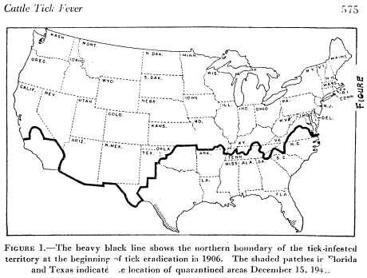
Talk Outline
1906 Extent of Cattle Tick Fever
Cattle Vat Dipping Program
Assessment
FDEP Regulatory Framework
Land Development Issues
Cleanup

Slide 3
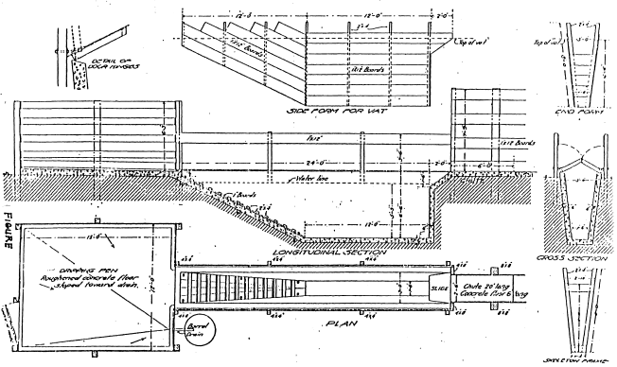
Vat Dipping Program
Run by Livestock Sanitary Board (LSB, now FDACS)
Federal requirement: 0.18% (1,800,000 μg/L) arsenic
LSB approved other chemicals in later years
Notes:
The vat capacity for this design would be 1470 gallons with a depth of 5’3”.
Looking at the bottom diagram, the entry side is on the right into the deep portion of the vat. The cow would use either grooves carved into the concrete ramp or boards nailed into the concrete to exit the vat onto the square drip pad shown here on the left side.

Slide 4
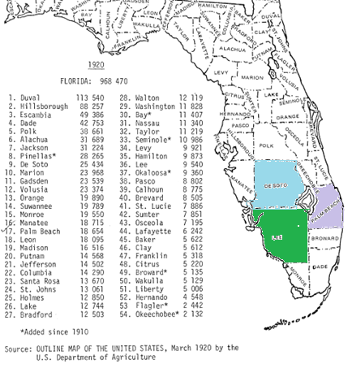
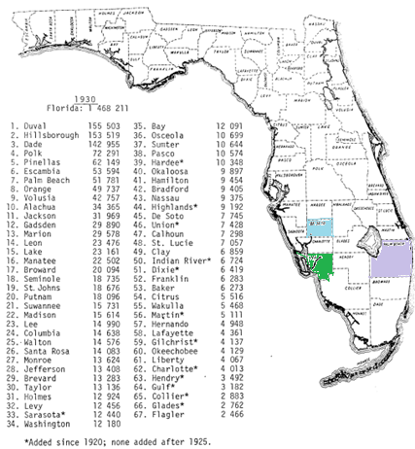
Location Issues
Vat locations not recorded
3200+ vats constructed at livestock markets, shipping ports, rail depots, state lines and private properties
Only 175+ known vat locations
Inconsistent naming
“Peach Orchard” or “Sink Hole” or “Log Camp”
“Alford” in Leon County owned more than 14,000 acres
Vats destroyed
buried, dynamited or removed (without the contaminated soil)
Revised County boundaries
1920 and 1930 County Lines
Notes:
There are 3200 vats on the vat list and we know that some large land owners elected to build and operate their vats independent of the State program.
The Livestock Sanitary Board list of other approved chemicals includes chemicals for which there is no approved EPA analytical method (there may be a university research method), no CTL, and possibly no surrogate compound that could be used for cleanup. Also, some of the compounds do not have the persistence of arsenic and the organochlorine compounds.
Look at the change in Desoto/Lee/ Palm Beach/St Lucie Counties, Lee County and Lafayette County.
This detail becomes important when using the FDEP web list of vats and you don’t find any former owners names from the title search. You may need to look under the historical County for your location.

Slide 5
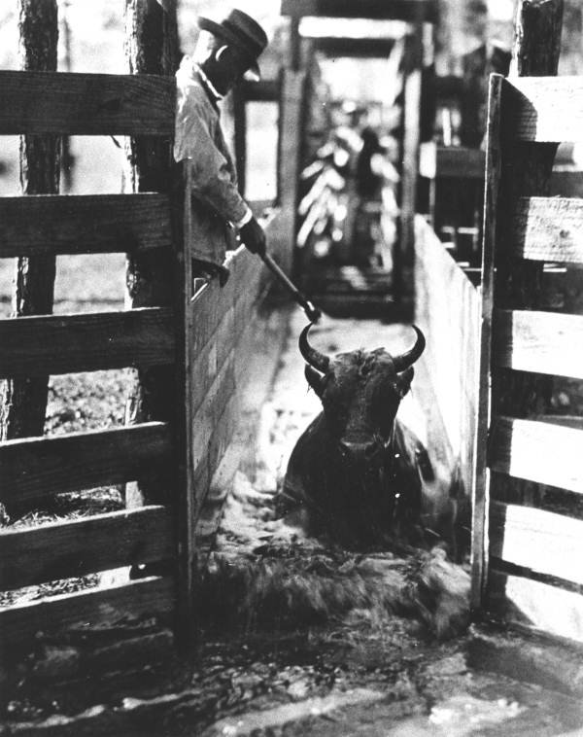
Contaminants of Concern
Historic analyses
EPA 8260/8270, EPA 8080, As, Pb, Cr, Cd, Fe and Cu
Cattle Dip Vat Report, Woodward-Clyde Consultants
Empirical results
As, organochlorine pesticides, Fe, aromatics and cPAHs
Present analyses
As and organochlorine pesticides
drive cleanup with regard to extent and CTLs
Chapter 62-777 CTLs apply
Notes:
Concentrations of toluene, xylene, and carcinogenic PAHs were above SCTLs but small in extent especially compared to the arsenic and/or organochlorine pesticides. Because the low CTLs for arsenic and organochlorine pesticides usually control the extent of removal, and these cleanups are voluntary, a decision was made to drop the aromatics and PAHs from required analyses. Minimizing analytical cost while still being protective.
The cattle ranchers often substituted other chemicals present on the farm, i.e. oils, diesel or kerosene in place of the pine tar.
This is a picture from the Photo Collection of the State of Florida Archives. Notice the wave of solution that proceeds this bull.

Slide 6
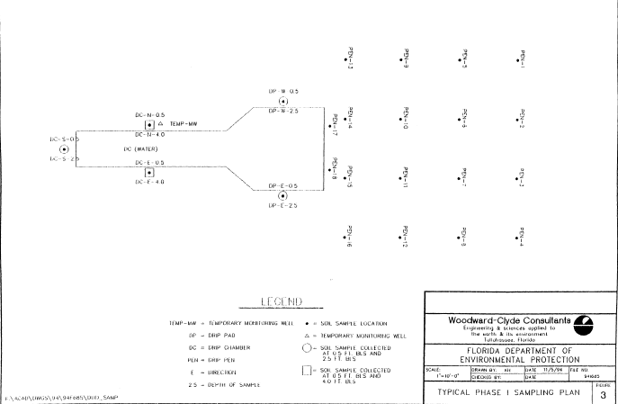
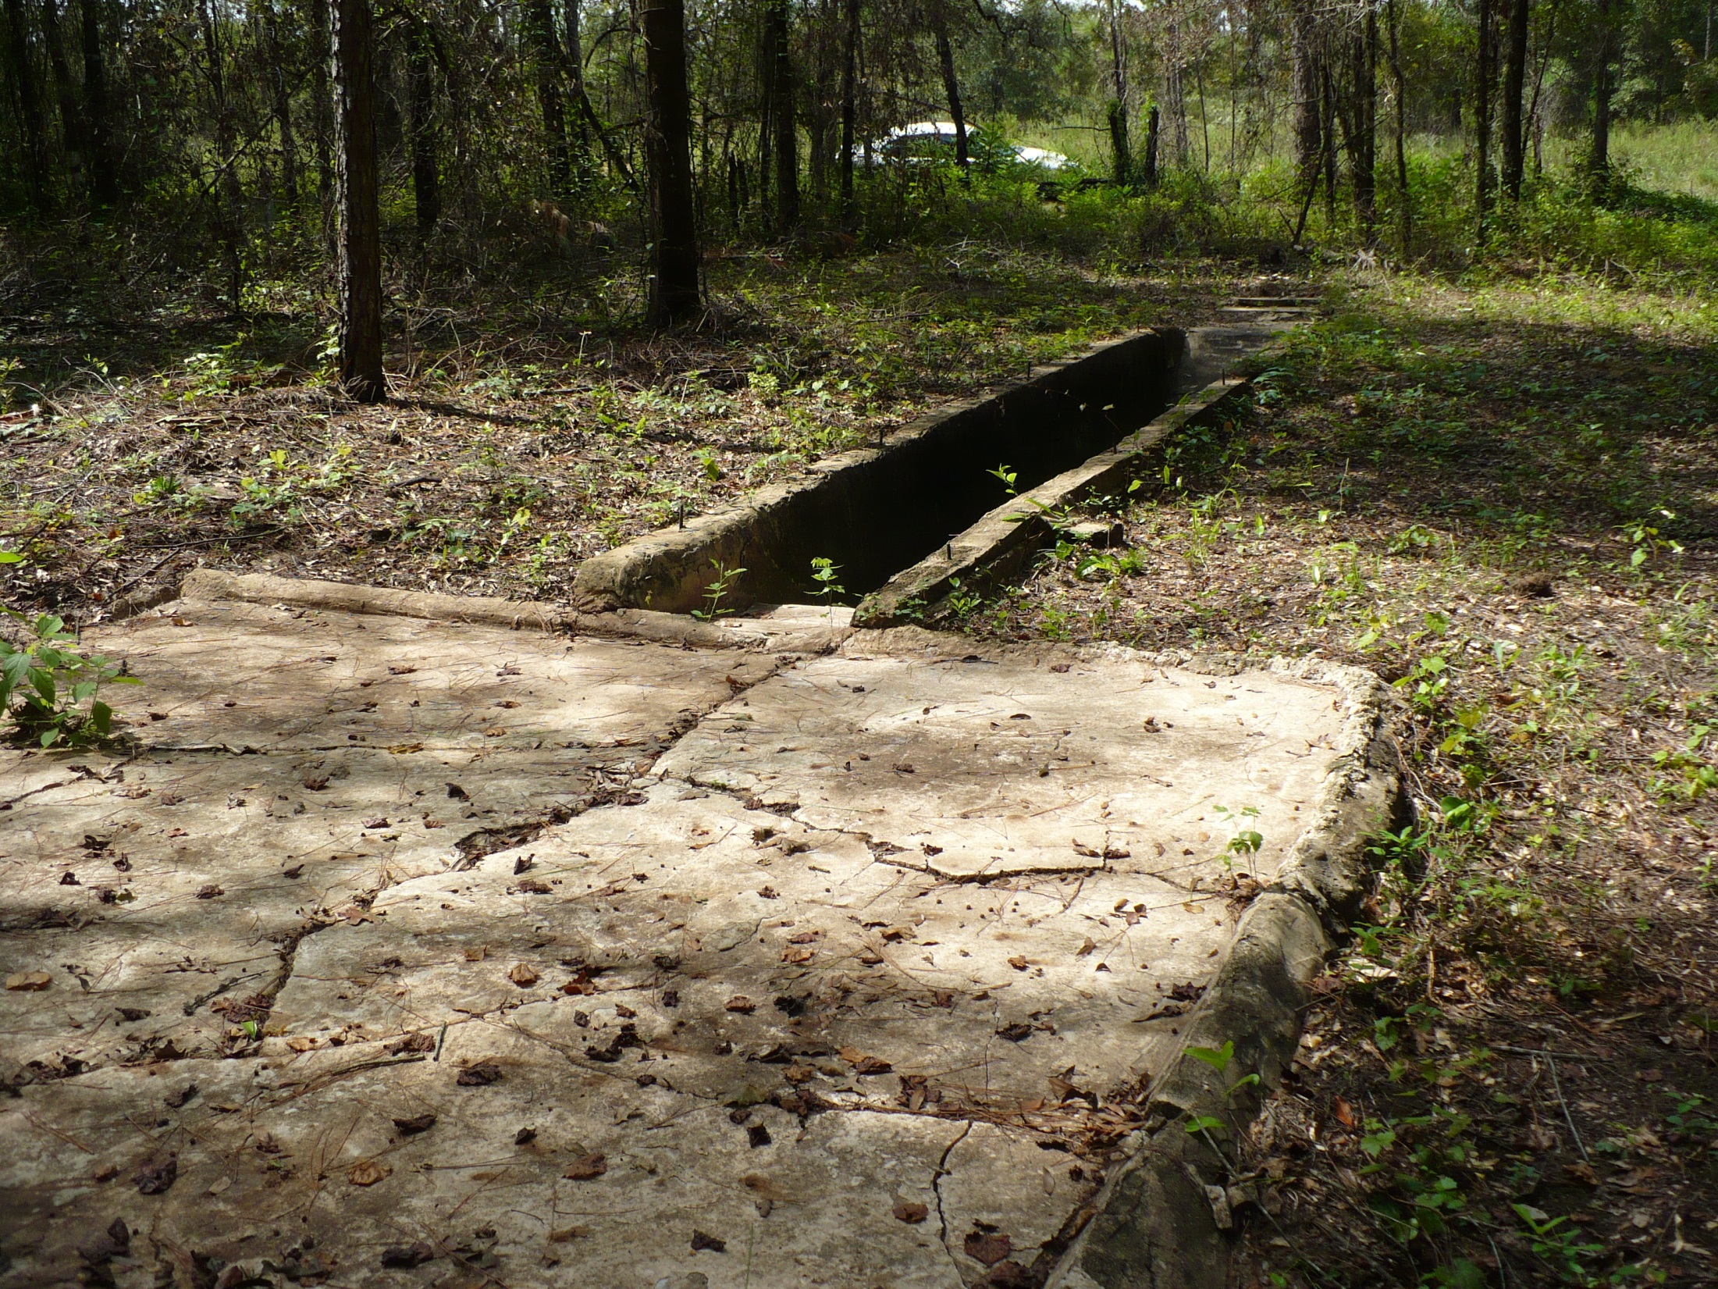
Initial Phase Sampling Plan
Sample water and sludge in the vat
Entry side
drip pad
Drip pen
10 feet
Notes:
Sample the water and sludge in the vat for arsenic and OC pesticides.
The original scale was 1” = 10’ so the drip pen samples are on a 10 foot spacing.
The final point I wanted to make is regarding the exit end of the vat at the beginning of the drip pad. No samples are proposed here, but it is likely contaminated as you will see from my next two slides.
Aenon Church Road vat and drip pad.

Slide 7
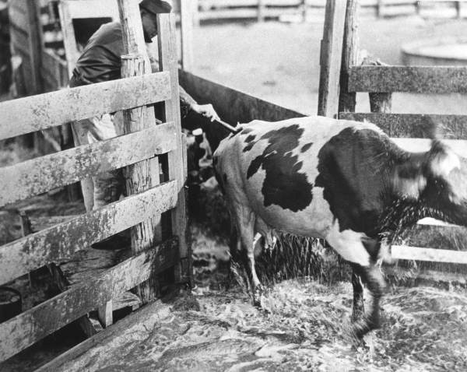
Assessment Findings
Vat soil/groundwater concentrations reflect steady state conditions
Official Vat Dipping Program ended in mid 1960’s
In many cases extent of groundwater impacts coincides with extent of contaminated soil
Sites with long plumes: Walker Ranch, Okeechobee
Some sediment impacts
Use SQAGs for delineation/removals
Sediment Quality Assessment Guidelines
Contact DOH to sample all private wells located near a vat
DEP-Drinking Water program provides alternate water supply if concentrations exceed GCTLs
Notes:
The recommendation was to change the solution at least every 4-6 weeks or when ever the solution became spent.
Notice the solution dripping off the cow onto the drip pad. Some vats have groves carved into the drip pad to gravity drain the solution back into the vat.

Slide 8
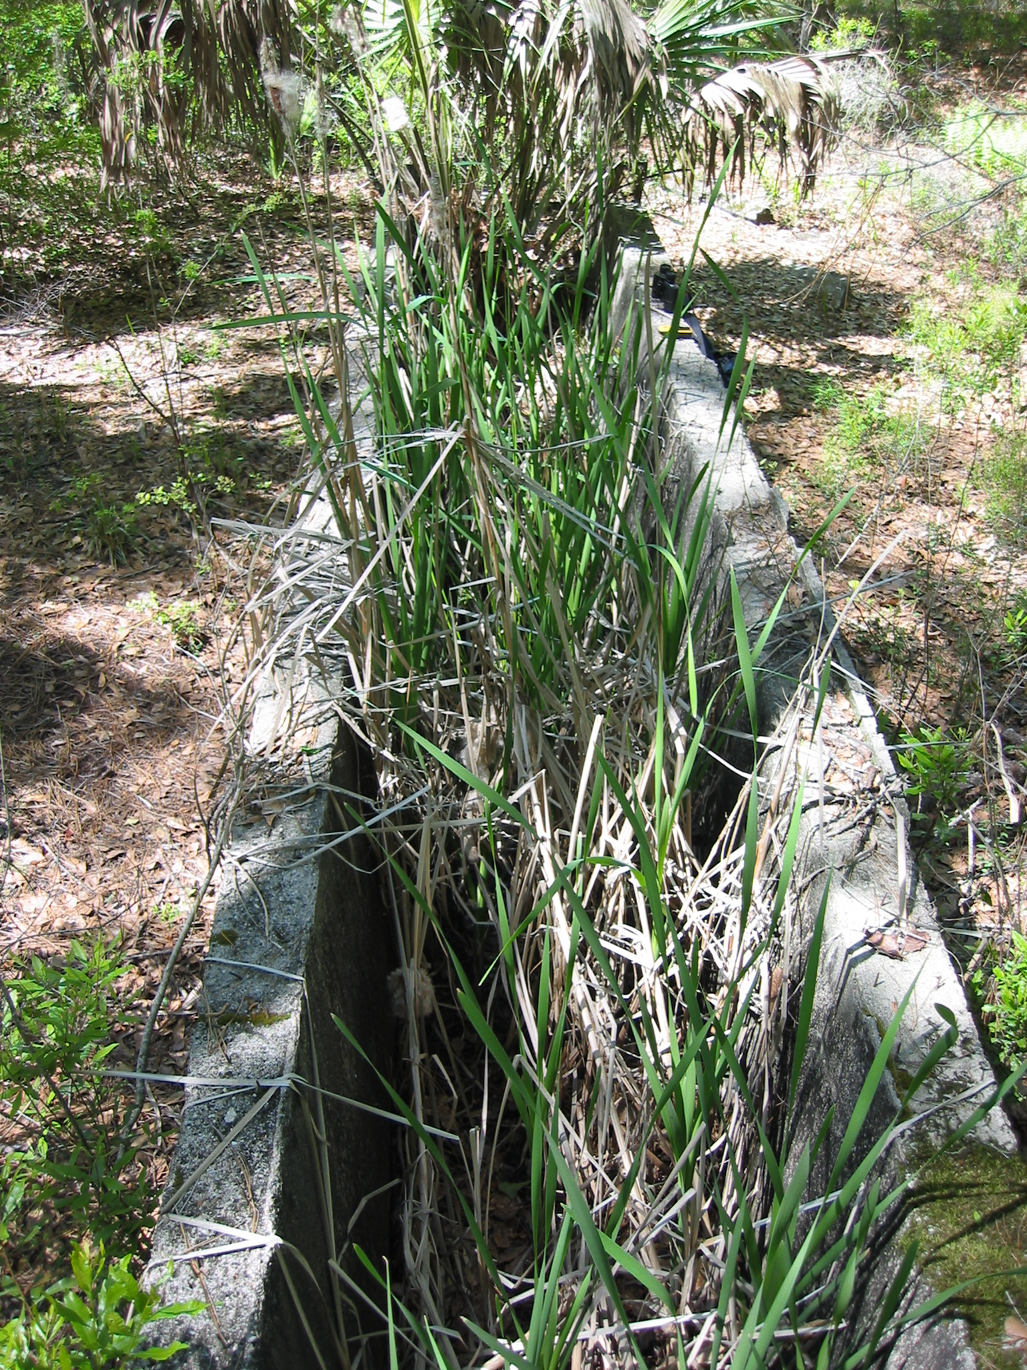
Examples of Vat Sites
Individual parcels to tracts of land proposed for development
Lake Weeks Subdivision
Citizens with a vat on or next to their property
Public ownership of land containing a vat
9 Vats Within the Kissimmee River Restoration Project
Vats on State Properties
Cleanup through State Owned Lands Cleanup Program (SOLCP)
Notes:
The Lake Weeks Subdivision is an example of the problems that arise when development occurs before vat remediation. Homeowners moved into their new homes and promptly discovered an intact vat a few doors down. Lawyers were hired and it was a public relations nightmare. Later partial soil removal occurred but surface soils (0-2’) may remain up to 235 mg/kg and subsurface soils (4-8’) up to 700 mg/kg. Arsenic concentrations in groundwater up to 900 ug/l. Private potable wells present in area. Access to the two impacted lots unrestricted with no IC.
Kissimmee - Area greater than 1 square mile to be used as a wildlife preserve and infrequent hunting visitors. Soil remediation occurred for infrequent human use and ecorisk 10 mg/kg for arsenic. IC for remaining soil and ground water contamination.
Photo: Rick Steel
Note the size of the binoculars – this vat has the width for dipping scrub cattle.

Slide 9
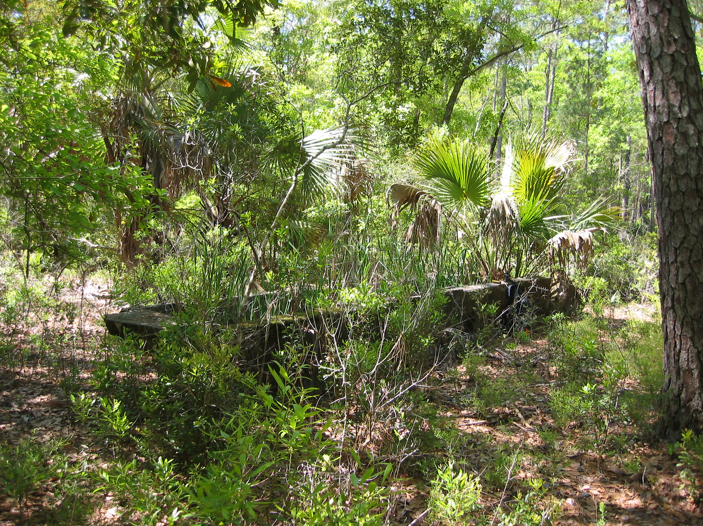
Regulatory Framework
State:
Enforcement stopped in 1993
Ch. 376.306, F.S.
CDV
Ch. 403.161, F.S.
Pollution Prevention
Ch. 1013.365, F.S
School Restriction
Federal:
EPA retains full CERCLA Liability
RCRA farmers exemption applies as long as no sludge/soils exceed TCLP
Notes:
Release of Liability passed 1996.
Education Statute- addressed risk to children at school property from contaminated sites.
If the sludge in the bottom of the vat and or the soils fail TCLP, the material is considered a characteristic hazardous waste and handling/disposal needs to comply with Federal Land Ban provisions.
Shepard’s Spring, FL – a vat may be more or less overgrown than this one. The left end of the vat is the entry end.

Slide 10
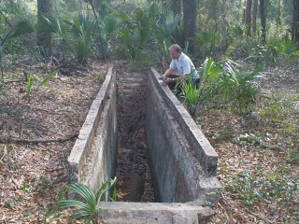
Chapter 376.306(2), F.S.
Any private owner of property in this state upon which cattle-dipping vats are located shall not be liable to the state under any state law, or to any other person seeking to enforce state law, for any costs, damages, or penalties associated with the discharge, evaluation, contamination, assessment, or remediation of any substances or derivatives thereof that were used in the vat for the eradication of the cattle fever tick. This provision shall be broadly construed to the benefit of said private owner.
Notes:
Vat picture found on a Department of Health web site. The raised concrete lip may be uncommon. Using the gentleman for size, this is a vat constructed to dip improved pasture cattle.

Slide 11
Highlights
DEP does not regulate land development
Local government land development regulations generally do not cover contaminated media
Lending institutions want their liability defined
Encourage voluntary cleanup before development
Seek cooperative solutions to eliminate human exposure and environmental impacts
Area of contaminated media cannot be enlarged
DEP and DOH concerned with acute and 1E-06 cancer risks
Notes:
Local governments have taken different approaches with regard to vats; some ignore the issue and some such as Hillsborough County EPC require assessment and cleanup prior to zoning changes/development.
Since development adds water lines. roads, telephone, buildings and other structures that complicate removal actions, cleanup can be completed quicker and cheaper before development.

Slide 12
62-780 Cleanup?
Property Owner | SRCO desired? | SRCO not desired?
Private | Voluntary | Exempt
Public | Non-exempt | Non-exempt

