Slide 1
ATC-PRP Teleconference Tallahassee, FL January 22, 2015
Division of Waste Management
PETROLEUM RESTORATION PROGRAM
ATC-PRP Teleconference
Tallahassee, Florida
January 22, 2015

Slide 2
Agenda
AGENDA:
Welcome – Diane Pickett
ATC Selection Process – John Coates
New Site Access Agreement – Stan Warden (procedure for having POs withdrawn for failure to obtain site access)
Importance of Due Dates – Diane Pickett and Chris Bayliss (LSA Reminder – Change Orders)
DEP Travel Form & Documentation for Invoices – Sharon Lee
ADaPT Update – Jamie Lopez (common mistakes and consequences of not submitting correctly)
Upcoming Master Contract Amendments – Martin Ehlen
Open Questions and Answers

Slide 3
WELCOME
DIANE PICKETT

Slide 4
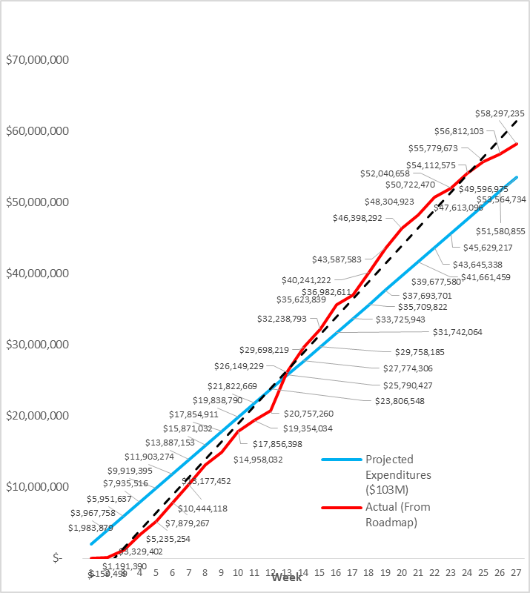
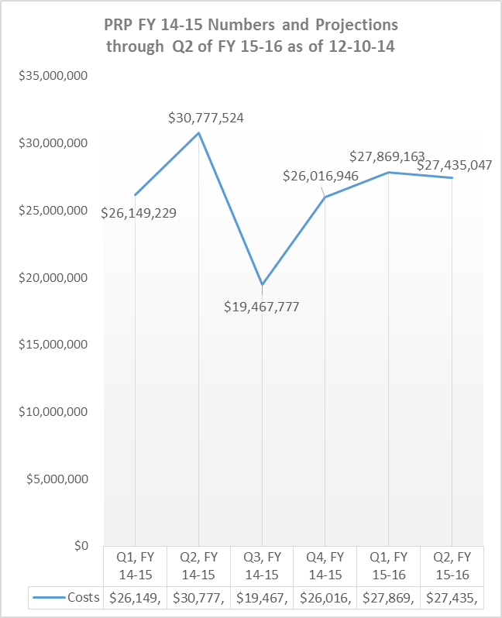
WELCOME

Slide 5
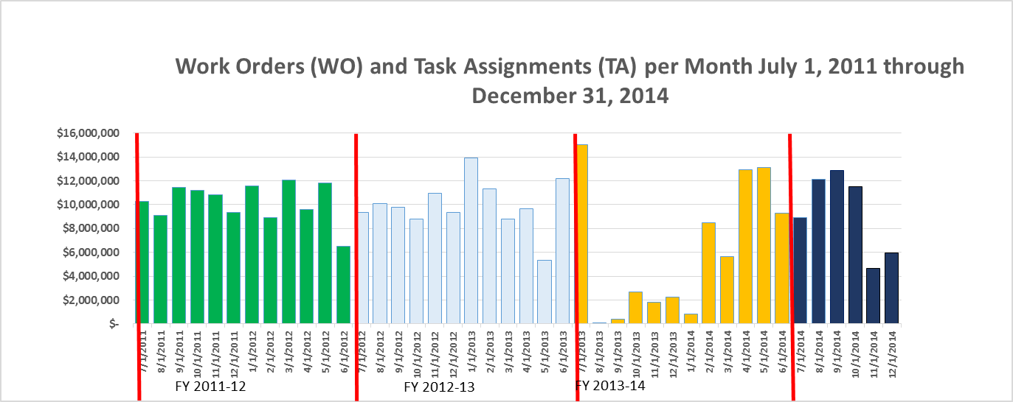
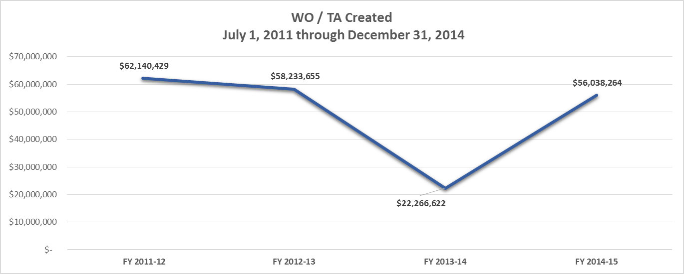
WELCOME

Slide 6
ATC SELECTION PROCESS
JOHN COATES

Slide 7
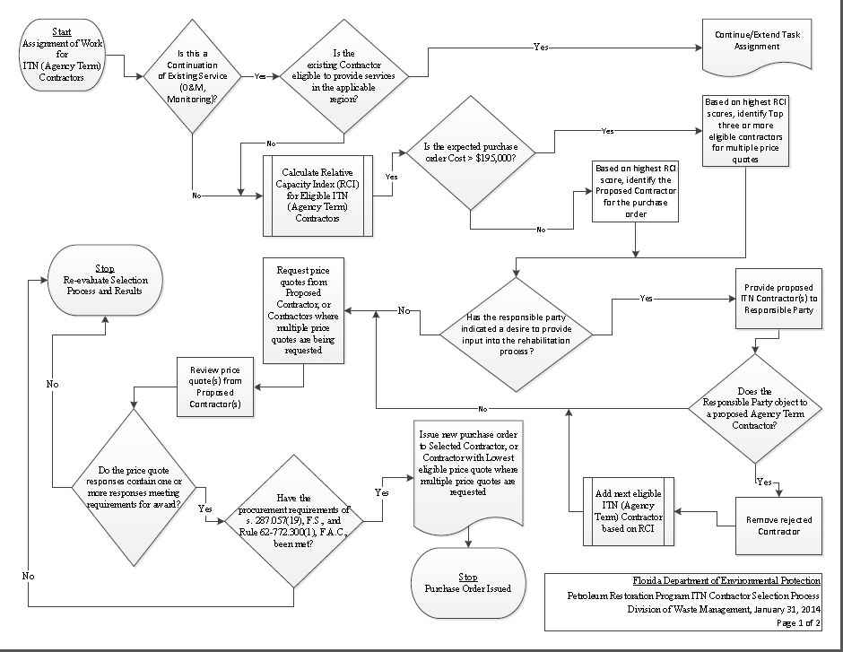
ATC SELECTION PROCESS

Slide 8
NEW SITE ASSESSMENT AGREEMENT
STAN WARDEN

Slide 9
Procedure for Having Purchase Orders Withdrawn for Failure to Obtain Site Access
Agency Term Contractors (ATC) that were unable to obtain site access and would like to have their Purchase Order (PO) withdrawn must:
WHERE MONEY IS DUE FROM PRP
ATC must submit a request for Change Order (CO) to remove the total cost of the PO, leaving any amount that is reimbursable from the PRP. The request for CO must include a detailed account as to the attempts to gain site access as well as any responses from the Owner/RP. Please note, the terms of the ATC Contract, in most cases, do not provide for reimbursement of costs where site access was not obtained. Generally, The PRP is authorized to reimburse site access efforts only where the ATC was able to obtain and submit fully executed Site Access Agreements to the PRP.
WHERE MONEY IS NOT DUE FROM PRP
ATC must request, in writing, that they would like for the PO to be cancelled. The written request must include a detailed account as to the attempts to gain site access as well as any responses from the Owner/RP. Please note, the terms of the ATC Contract, in most cases, do not provide for reimbursement of costs where site access was not obtained. Generally, The PRP is authorized to reimburse site access efforts only where the ATC was able to obtain and submit fully executed Site Access Agreements to the PRP.

Slide 10
New Site Access Agreement
For use by the Florida Department of Environmental Protection (Department) Agency Term Contractors (ATCs) when working as an ATC for Source and Non-Source Properties
Unless there are unique or extenuating circumstances, the new Site Access Agreement (Agreement) should not be altered
The new agreement is between the Owner/RP and Department
ATCs are no longer required to obtain the agreements from Owner/RPs
No work shall be conducted until the Department is in possession of a fully executed Agreement between the Department and Owner/RP
New Site Access Agreement Template:
http://www.floridadep.gov/waste/content/announcements-upcoming-events

Slide 11
INDEMNIFICATION (Paragraph 15 of New Site Access Agreement)
The Department does not indemnify the Owner but acknowledges and accepts its responsibility under applicable law (Section 768.28, Florida Statutes) for damages caused by the acts of its employees while on the property of owner (see paragraph 16 of the New Site Access Agreement)
The ATC has already indemnified the Department in it’s contract
The Contractor should not enter into any agreement that conflicts with its indemnification of the Department
Where no conflicts exist, any subsequent indemnification by the Contractor to any party associated with the Permissible Activities is subservient and subordinate to the Contractor’s indemnification of the Department

Slide 12
IMPORTANCE OF DUE DATES
DIANE PICKETT/ CHRIS BAYLISS

Slide 13
DEP DOCUMENTATION FORMS AND DOCUMENTATION FOR INVOICES
SHARON LEE

Slide 14
DEP Travel Form & Documentation for Invoices
Eligible for per diem when overnight travel is required
Invoicing for per diem is based on $20 per daily quarter
12:00 midnight
$20.00 Qtr 4
$20.00 Qtr 1
6:00 p.m.
6:00 a.m.
$20.00 Qtr 3
$20.00 Qtr 2
12:00 noon

Slide 15
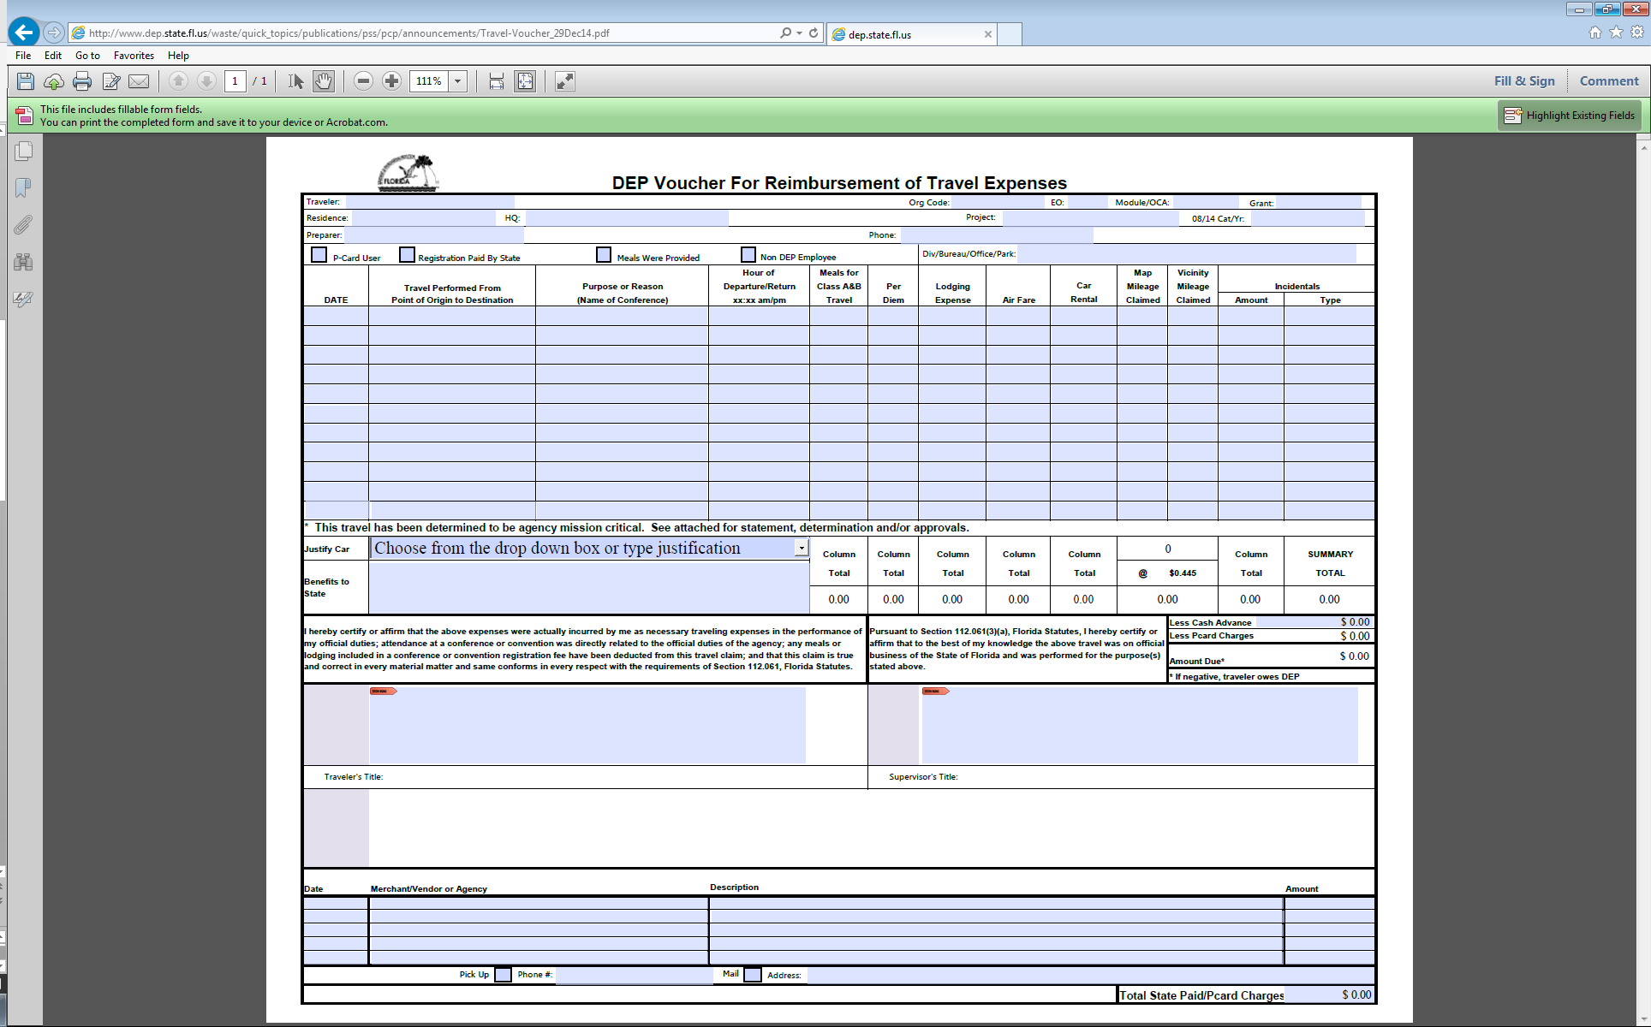
DEP Travel Voucher
The DEP Travel Voucher is found at this link:
http://www.floridadep.gov/waste/content/announcements-upcoming-events

Slide 16
DEP Travel Voucher
The DEP Travel Voucher is found at this link:
http://www.floridadep.gov/waste/content/announcements-upcoming-events
Must be completed and signed by the traveler
Accepts Adobe electronic signature
Can be printed and signed in ink
Must be included with deliverable to site manager
Must be included with invoice billing for per diem

Slide 17
Sample Travel Voucher

Slide 18
ADaPT
Automated Data Processing Tool
JAMIE LOPEZ
Notes:
Contact John Wright at ………………

Slide 19
Why do we need ADaPT?
The requirements for ADaPT Electronic Data Deliverable (EDD) submittals is mandated in our Division of Waste Management (DWM) Quality Assurance Plan.
The laboratory and field data that is received in the format of Electronic Data Deliverables (EDDs) will be validated by the Agency Term Contractor and DWM staff through ADaPT, then merged and uploaded to a database (REDD) in order for data analysis to be conducted.

Slide 20
What is ADaPT?
ADaPT checks for the following:
Critical or Non-Critical Errors in the EDD. Such as:
Facility numbers match the Facility name.
Each results and corresponding units are entered.
Date sample and times are matching from the Lab EDD and Field EDD.
Laboratory QC samples and holding times are included and then validated to ensure accuracy and precision.
If outliers exists ADaPT will add the necessary qualifier.

Slide 21
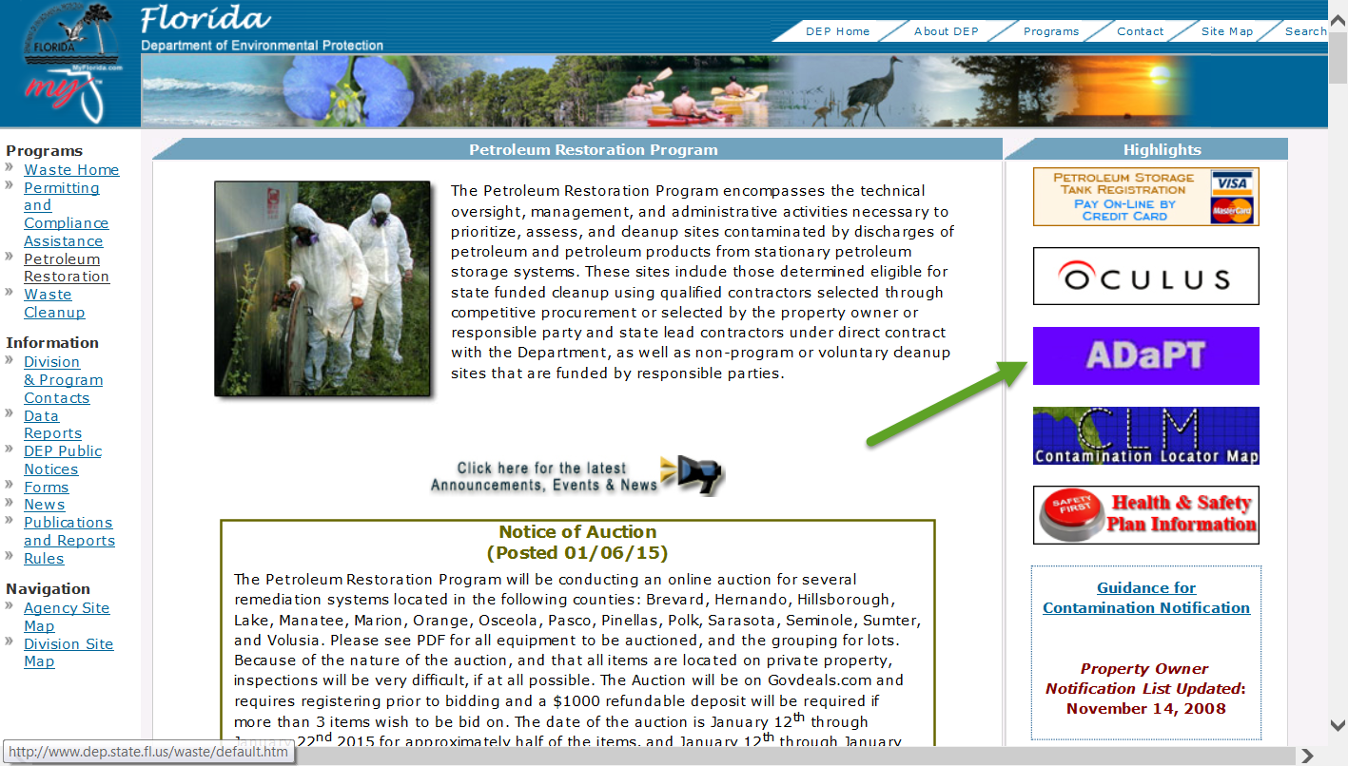
DWM Consolidated ADaPT User Guide
The ADaPT consolidated DWM User Guide can be located on our DEP website.
Notes:
Most of the consultants questions can be answered in the recently updated User Guide on PRP ADaPT webpage.

Slide 22
DWM Consolidated ADaPT User Guide
The ADaPT consolidated DWM User Guide is a working copy and subject to change.

Slide 23
Responsibilities
ADaPT EDDs are submitted to PRP via the FTP site.
Ensure that the electronic copy of the Zip file with the Lab EDDs, the Lab EDD Error Log, and Field EDD are named correctly.
The zip folder should be named:
8515075}{11-18-2014}{przdd.txt
And contain the following files:
8515075}{11-18-2014}{prldd.txt
8515075}{11-18-2014}{prldd_Errorlog.txt
8515075}{11-18-2014}{prfdd.txt or 8515075}{11-18-2014}{prfdd.csv

Slide 24
Corrected EDDs in Oculus
Once the zip file is received on the FTP site the file is pulled and reviewed (with in 24 hours) prior to upload.
If no errors are present it is uploaded to Oculus.
If the EDDs have Errors then the ADaPT Specialist will send an email to the site manager.
The site manager will contact you to correct the EDDs and request for you to resubmit the corrected EDD to the FTP site.
Notify the Site Manager via email when the corrected EDD is resubmitted.

Slide 25
Common File Naming Errors
Common Errors
File named wrong
Correct file naming convention
8517002}{01-14-2011}{przdd.zip
Incorrect file naming convention
8517002}{01-14-11}{przdd.zip
Incorrect file naming convention
8517002}{01-14-2014}{przdd.zip.zip
Incorrect file naming convention
85175002}{01-14-2014}{przdd.zip

Slide 26
ADaPT Errors
A total of 464 files were reviewed in December.
46% of them were returned with Errors.
Updating the following will assist in resolving some of these errors:
Update ADaPT Version 8.1.01
Update Valid Values Table
Update DWM Libraries

Slide 27
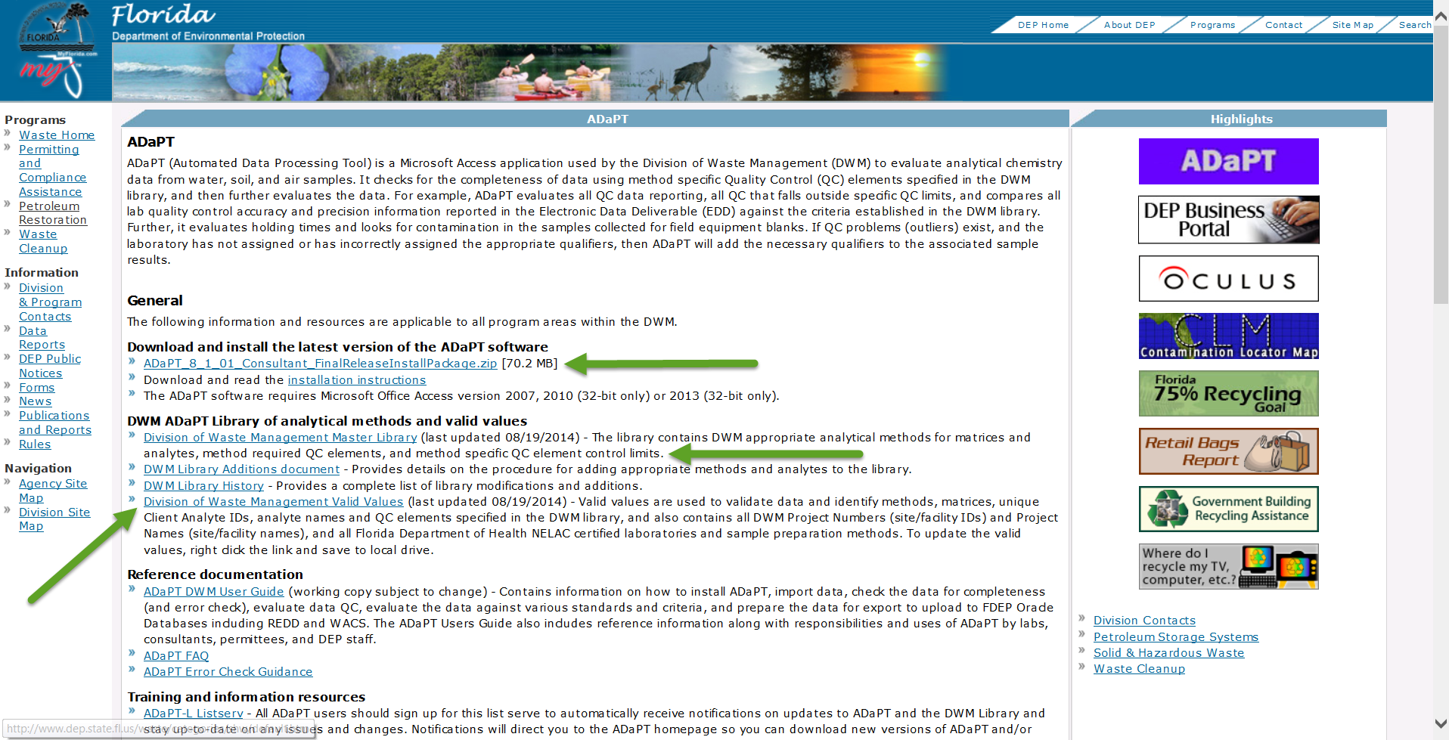
ADaPT 8.1.01
UPDATE your computer with the latest ADaPT Version 8.1.01, DWM library and DWM Valid Values.

Slide 28
ATC ADaPT Training Event
Date: Friday, January 30, 2015
Time: 9:00 am - 4:00 pm
Location:
BOB MARTINEZ CENTER ROOM 603
2600 BLAIR STONE ROAD TALLAHASSEE, FLORIDA 32399-2400
Email Jamie.l.lopez@dep.state.fl.us to register

Slide 29
Contact Information
PRP ADaPT Contacts
George Smith
(850) 245-7119
George.M.Smith@dep.state.fl.us
James Fletcher
(850) 245-7619
James.Fletcher@dep.state.fl.us
Tamara Blyden
(850) 245-8901
Tamara.Blyden@dep.state.fl.us
Jamie Lopez
(850) 245-8925
Jamie.L.Lopez@dep.state.fl.us

Slide 30
UPCOMING MASTER CONTRACT AMMENDMENTS
MARTIN EHLEN

Slide 31
OPEN QUESTIONS AND ANSWERS
OPEN QUESTIONS AND
ANSWERS

