Slide 1
Hazardous Waste Standards for CESQG and SQG
Compliance Assurance
Northeast District

Slide 2
Generator Status
Conditionally Exempt SQG (CESQG)
  Generates < 100 kg/mo (~1/2 drum) and < 1kg P waste
  May not accumulate more than 1,000 kg (~5 drums) at one time
Small Quantity Generator (SQG)
  Generates 100 kg/mo to 1,000 kg/mo (between ~1/2 drum and 5 drums)
  May not accumulate more than 6,000 kg (~30 drums)
Large Quantity Generator (LQG)
  Generates > 1,000 kg/mo (~5 drums) and/or > 1kg P waste

Slide 3
Conditionally Exempt Small Quantity Generators

Slide 4
CESQG Requirements
Conditionally Exempt Small Quantity Generator (CESQG)
  Generates < 100 kg/mo (~1/2 drum) and < 1kg P waste
  Performs a hazardous waste determination [40 Code of Federal Regulations (CFR) 262.11]
  May not accumulate more than 1,000 kg (~5 drums) at one time [40 CFR 261.5(g)(2)]
Notes:
If a CESQG accumulates >1000 kilograms, then it becomes a SQG

Slide 5
CESQG Requirements (a)
Conditionally Exempt Small Quantity Generator (CESQG)
  Ensure delivery of hazardous waste to a proper facility [40 CFR 261.5(g)(3)]
  Keep records documenting proper disposal [62-730.030(3) and (4), Florida Administrative Code (FAC)]
Notes:
If a CESQG accumulates >1000 kilograms, then it becomes a SQG

Slide 6
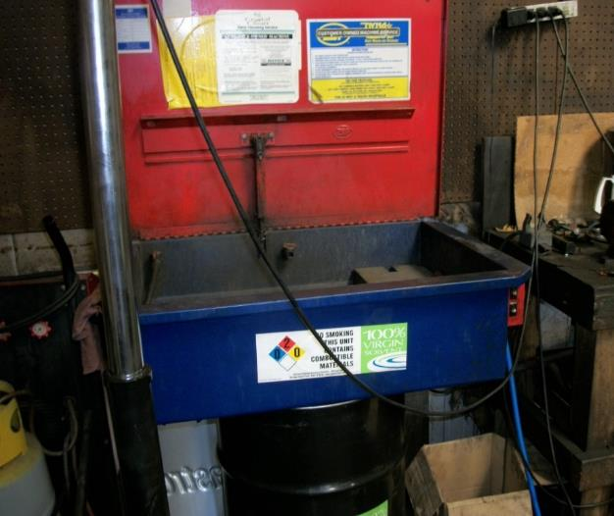
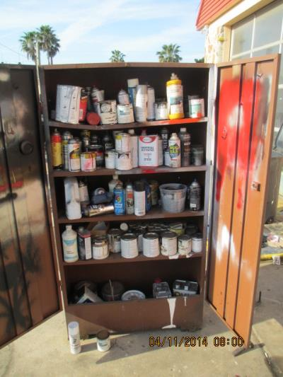
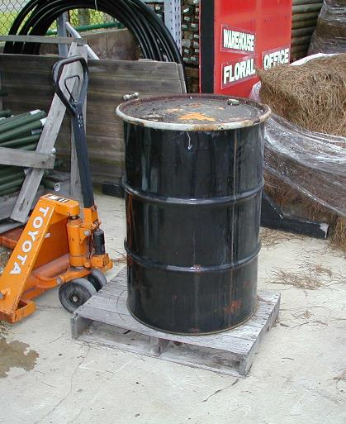
CESQGs Next Door
Notes:
There are thousands of CESQGs. Small auto shops, dry cleaners, collision shops, small manufacturing, etc.

Slide 7
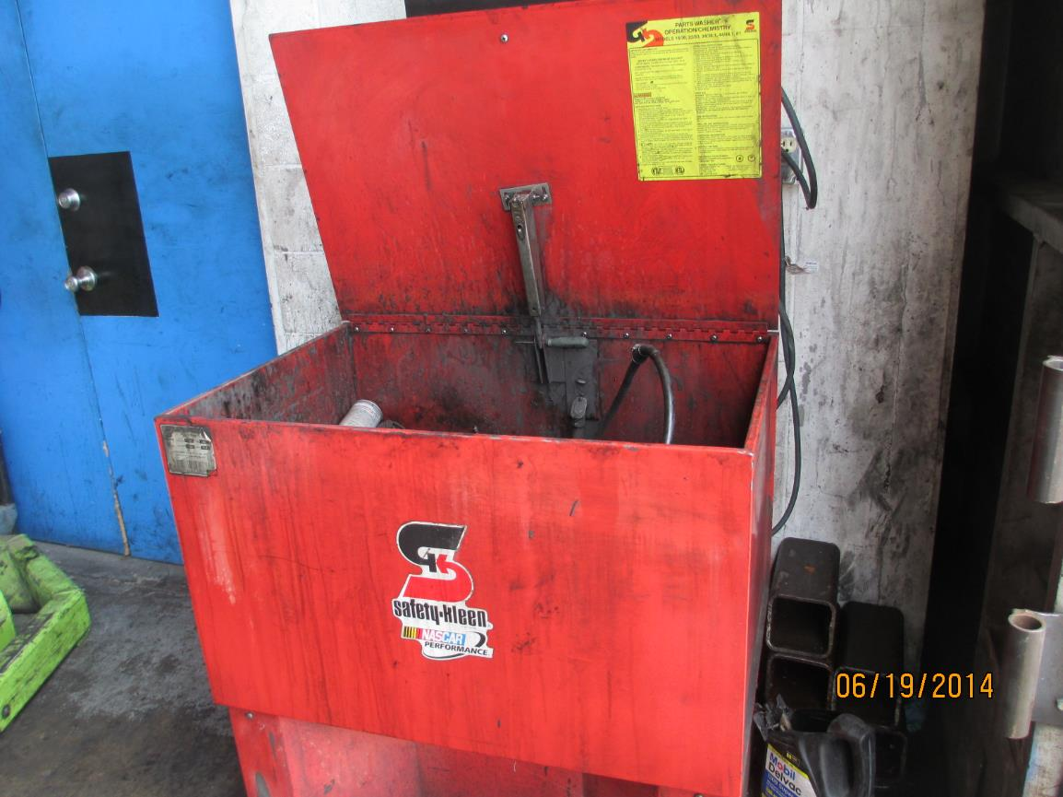
Solvent Parts Washer
Notes:
One parts washer may make a facility a CESQG.

Slide 8
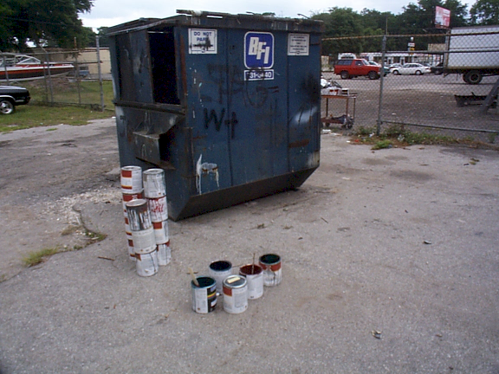
CESQG – Failing to Ensure Proper Disposal of D001 Paint
40 CFR 261.5(g)(3)
Notes:
One of the most common violation is failure to ensure proper disposal of hazardous waste. This facility threw D001 waste paint in to the dumpster.

Slide 9
Small Quantity Generators

Slide 10
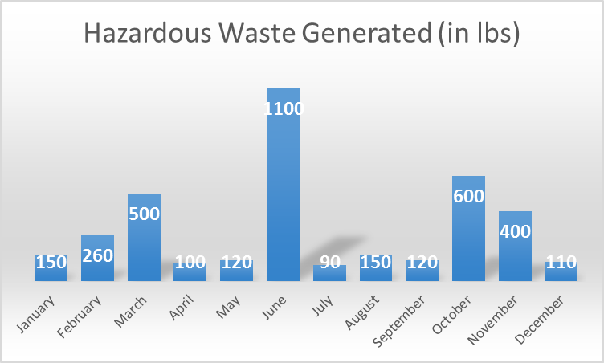
SQG Generator Status
  Generates 100 kg/mo to 1,000 kg/mo (~1/2 drum to 5 drums) [40 CFR 262.34(d)]
  May not accumulate more than 6,000 kg (~30 drums) [40 CFR 262.34(d)(1)]

Slide 11
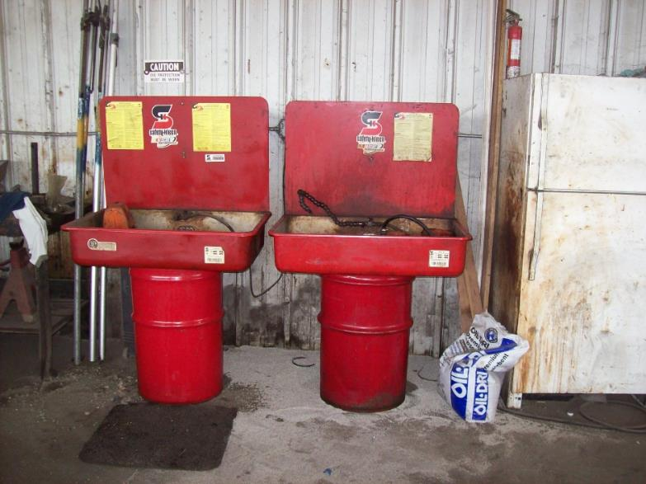
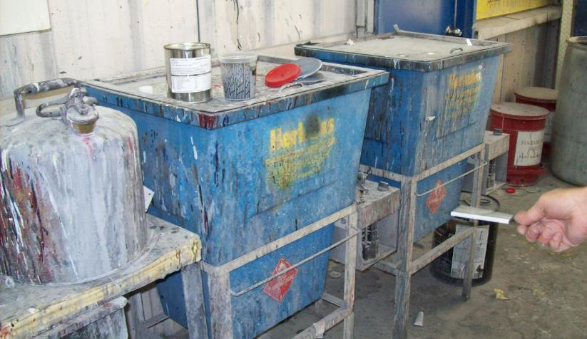
Solvent Parts Washer (a)
Notes:
One large parts washer may make a facility a SQG – it depends 1) is spent solvent hazardous waste; and 2) how many gallons of spent solvent the parts washer holds. Two or more parts washers may make a facility a SQG depending on when they are changed out.

Slide 12
40 CFR 262 Subpart A –
General Standards
Perform a hazardous waste determination [40 CFR 262.11]
Notify the DEP and obtain an EPA/DEP identification number [40 CFR 262.12] using form 8700-12FL
Notes:
Florida Handler Search: https://fldeploc.dep.state.fl.us/rcra_epa/CHAZreports/handler_sel.asp
Request notify closed/moved/change in status

Slide 13
40 CFR 262 Subpart B –
The Manifest
Use a Uniform Hazardous Waste Manifest [40 CFR 262.20(a)(1)]
May use tolling agreement instead of manifest
Notes:
Include generator EPA/DEP identification number
Example of tolling agreement = precious metals reclaimed for return to the facility and put back in process
- The uniform manifest will consist of six (6) pages:
o Page 1 (top copy): “Designated facility to destination State (if required)”
o Page 2: “Designated facility to generator State (if required)”
o Page 3: “Designated facility to generator”
o Page 4: “Designated facility’s copy”
o Page 5: “Transporter’s copy”
o Page 6 (bottom copy): “Generator’s initial copy”

Slide 14
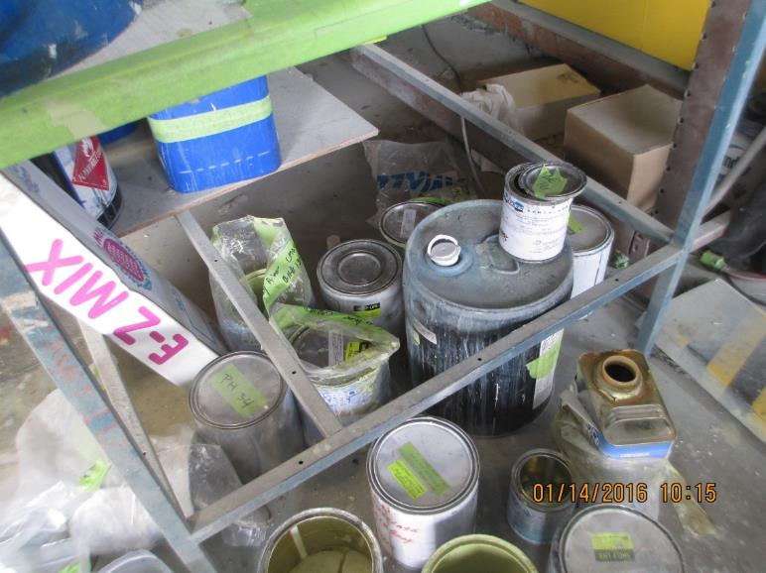
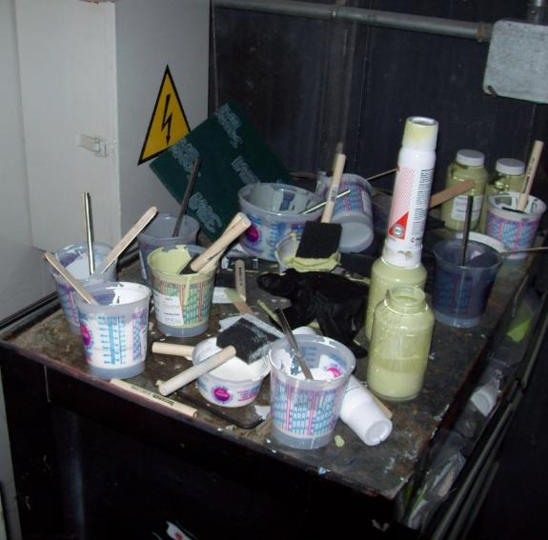
SQG Improperly Managing Waste
Notes:
Open containers evaporating waste is not ensuring proper disposal

Slide 15
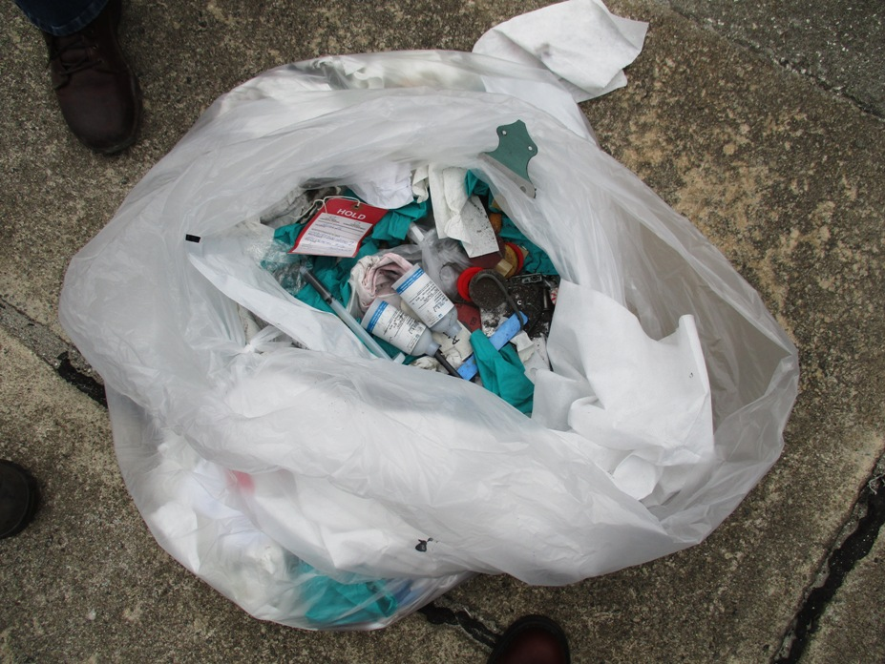
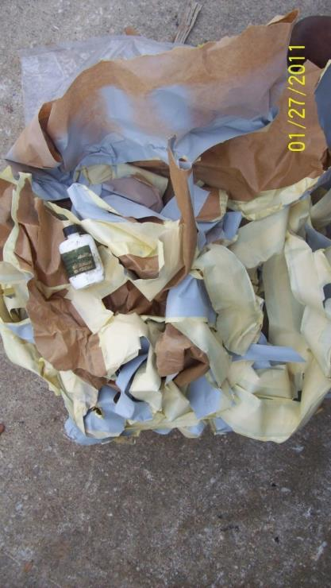
SQG – Disposal Without a Manifest
40 CFR 262.11 and/or 40 CFR 262.20
Notes:
Disposal of hazardous waste without a manifest
Dumpster diving!

Slide 16
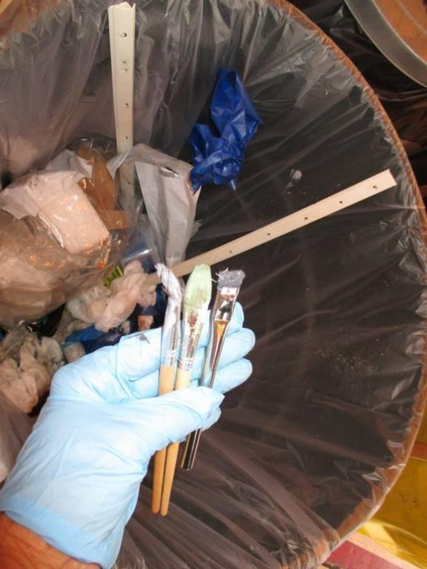
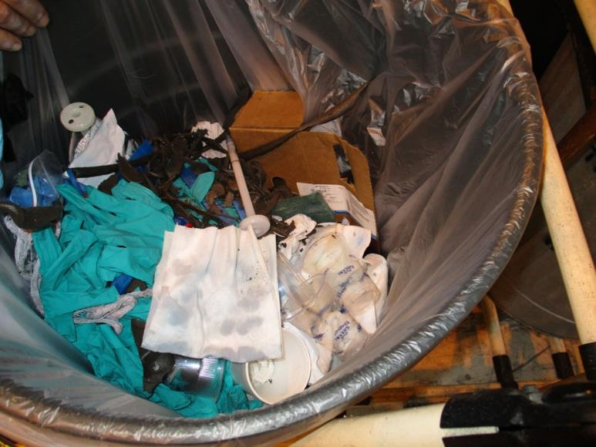
Hazardous Waste in Trash
Notes:
HW solvents and paint/alodine brushes are thrown away into the trash.

Slide 17
40 CFR 262 Subpart C – Accumulation Requirements
Hazardous waste should be accumulated in containers [40 CFR 262.34(a)(1)(i)]
Hazardous waste may be accumulated in tanks if the requirements of 40 CFR 265.201 are met

Slide 18
40 CFR 262 Subpart C – Accumulation Requirements (a)
SQGs may accumulate waste for 180 days [40 CFR 262.34(d)]
A one time 30-day extension may be granted by DEP under unusual circumstances [40 CFR 262.34(b)]
A SQG may accumulate up to 6,000 kgs of hazardous waste at one time [40 CFR 262.34(d)(1)]

Slide 19
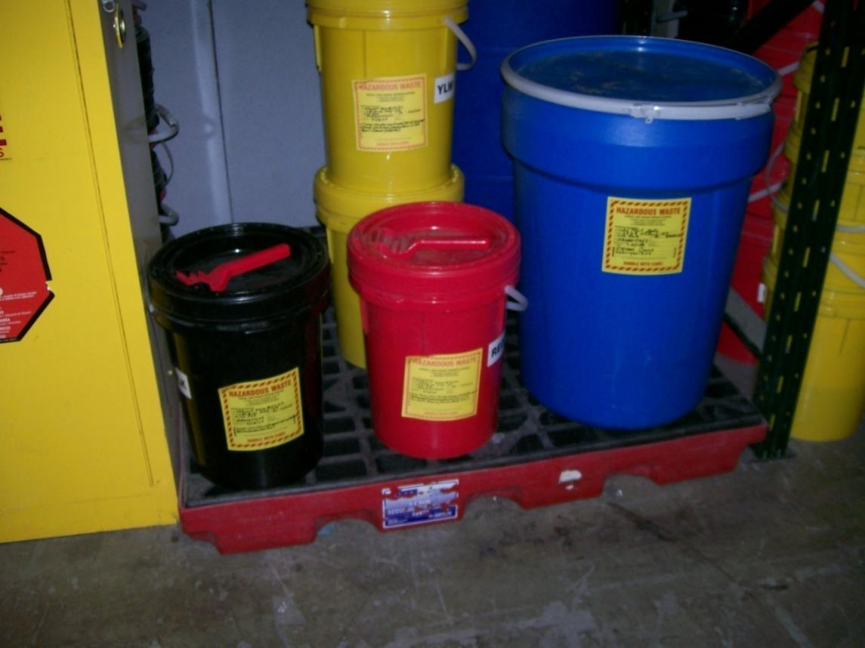
SQG Containers

Slide 20
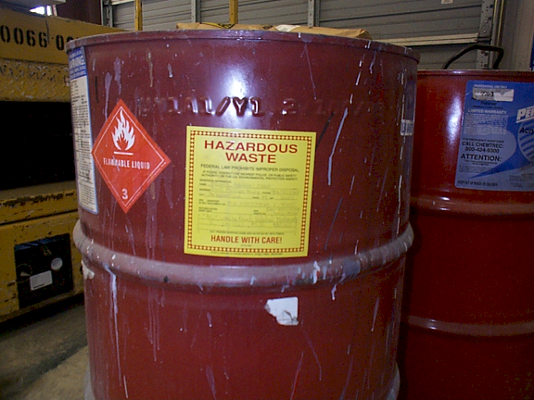
SQG Container Dates
Marked with date of accumulation

Slide 21
Container Labels
Labeled “Hazardous Waste”

Slide 22
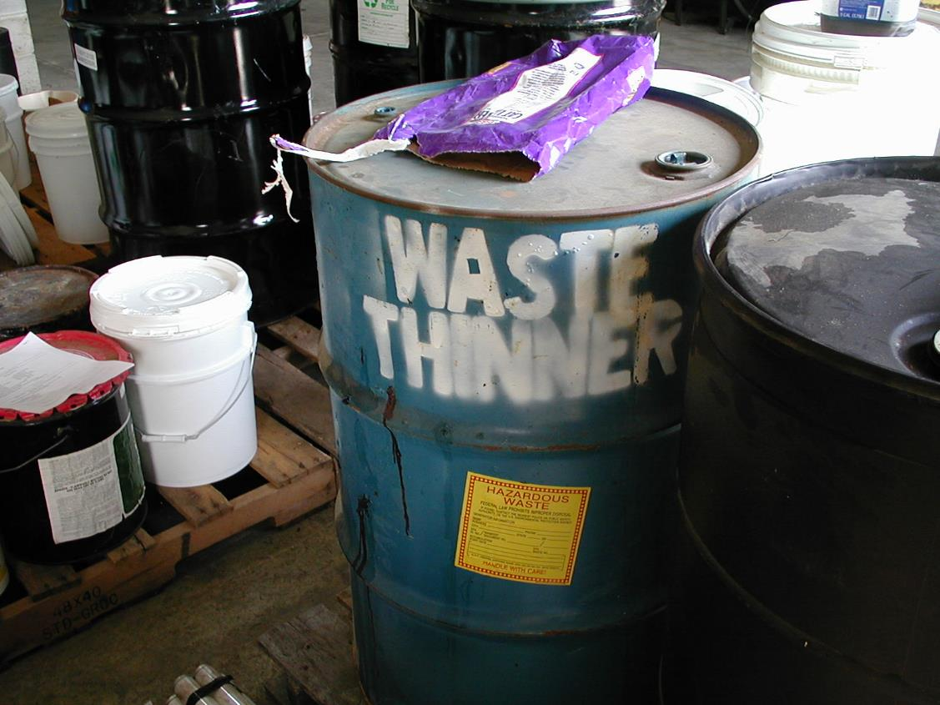
SQG – Satellite Container

Slide 23
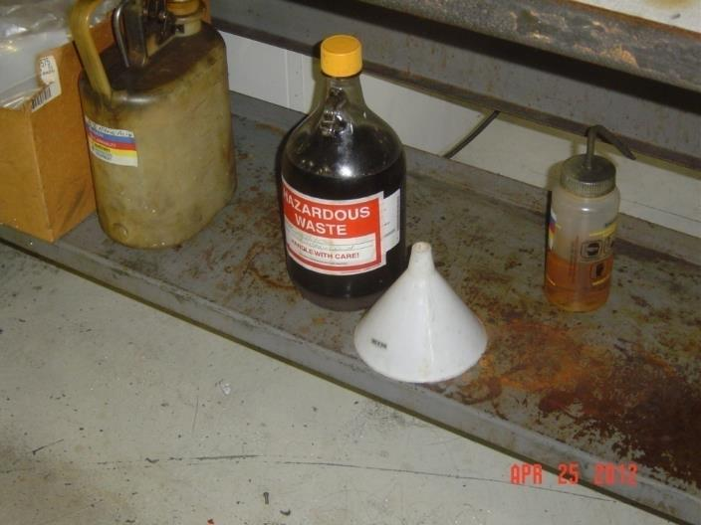
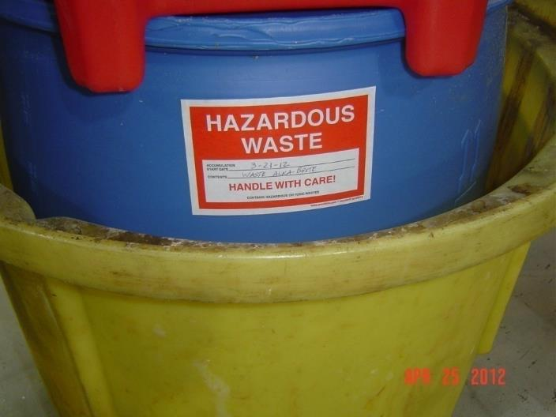
Satellite Container
Good – closed and labeled

Slide 24
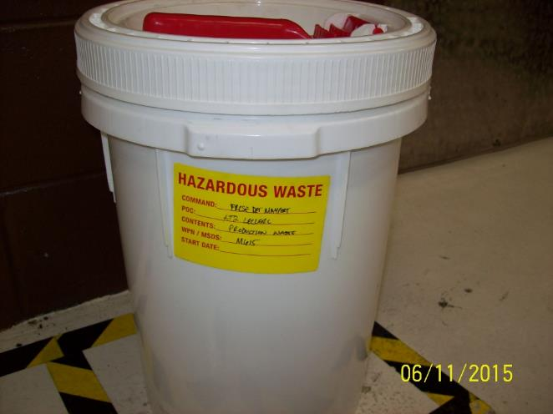
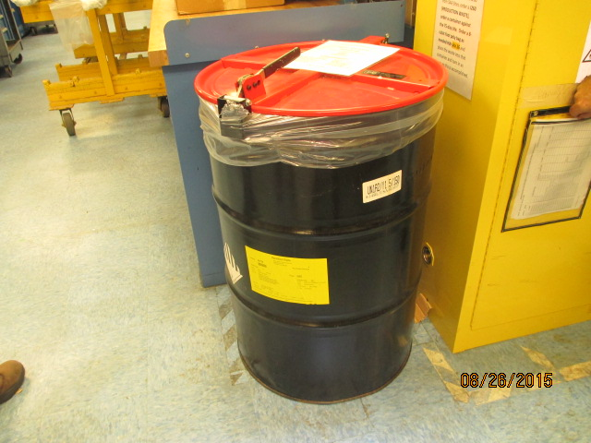
Satellite Container (a)
Good – closed and labeled

Slide 25
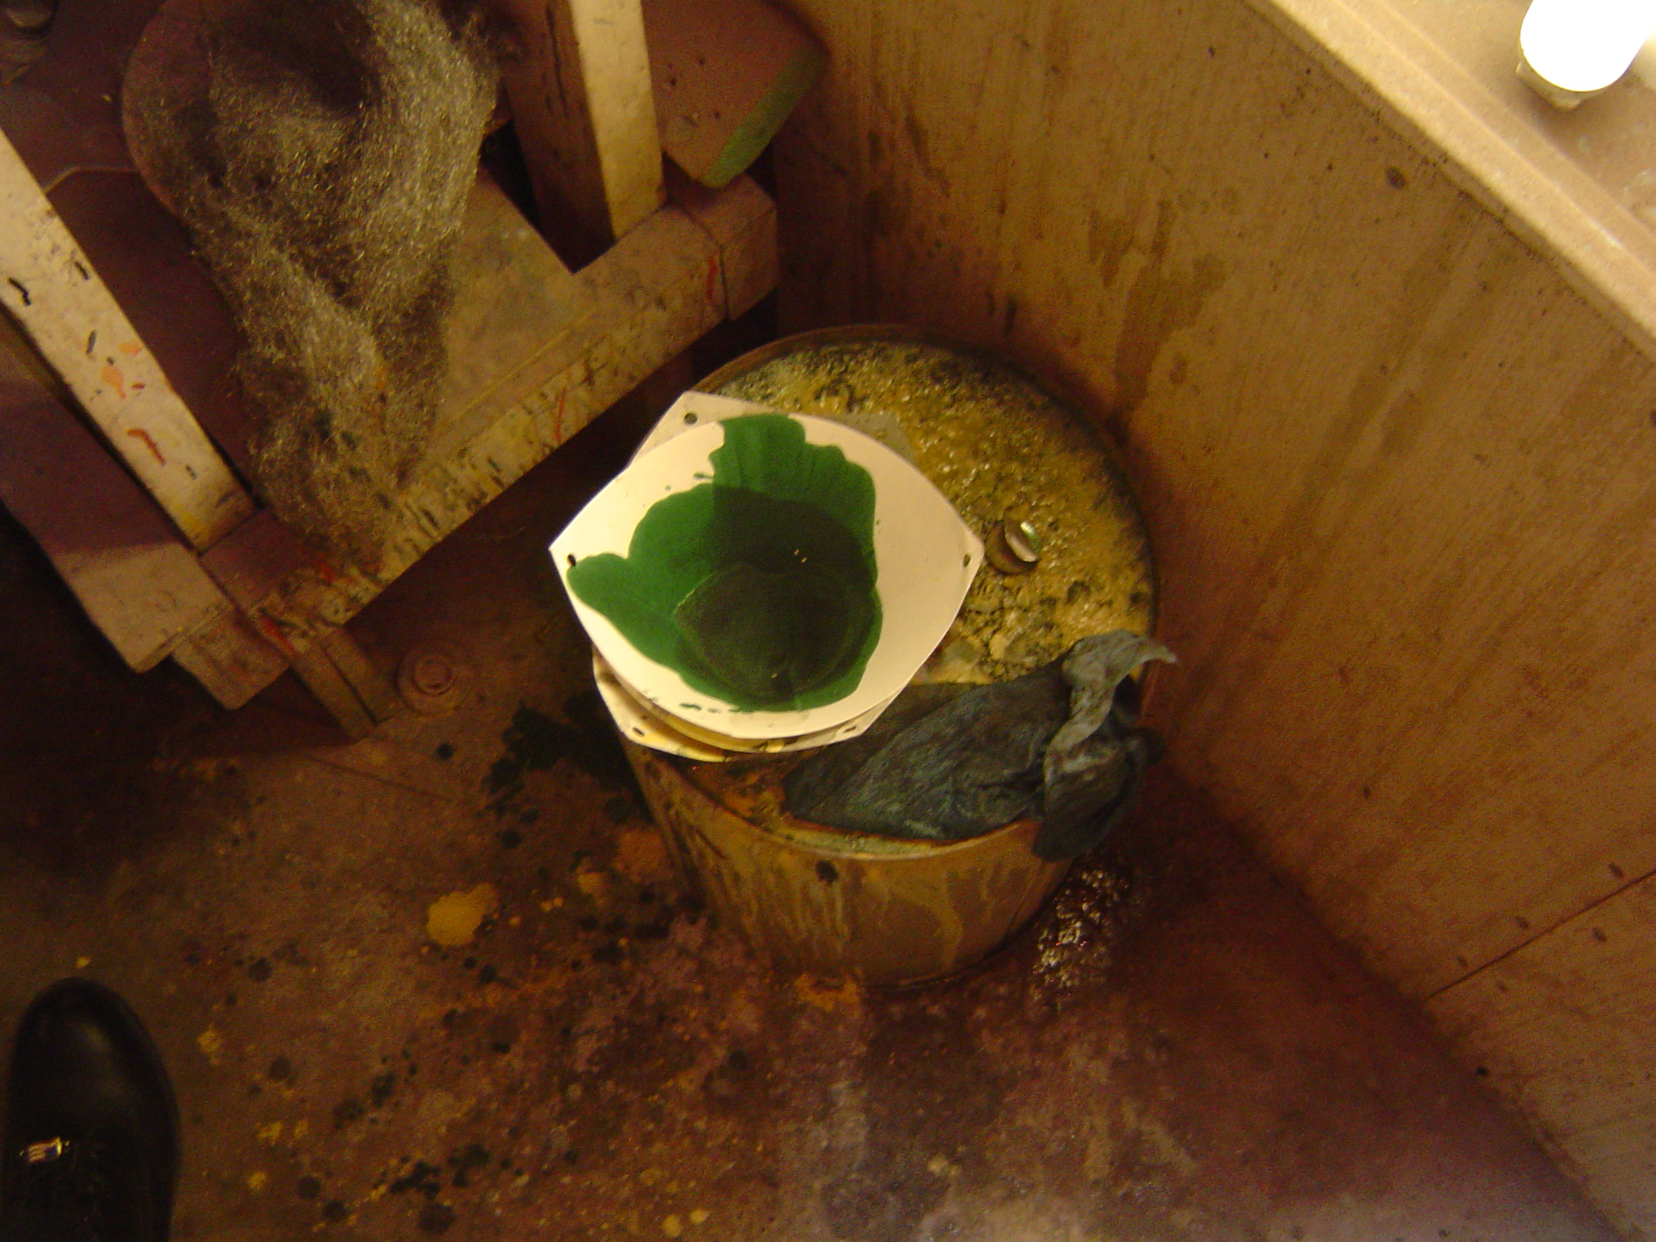
SQG – Satellite Container?
No label, open container, poor condition
40 CFR 262.34(c)(1)(ii); 40 CFR 262.34(c)(1)(i)

Slide 26
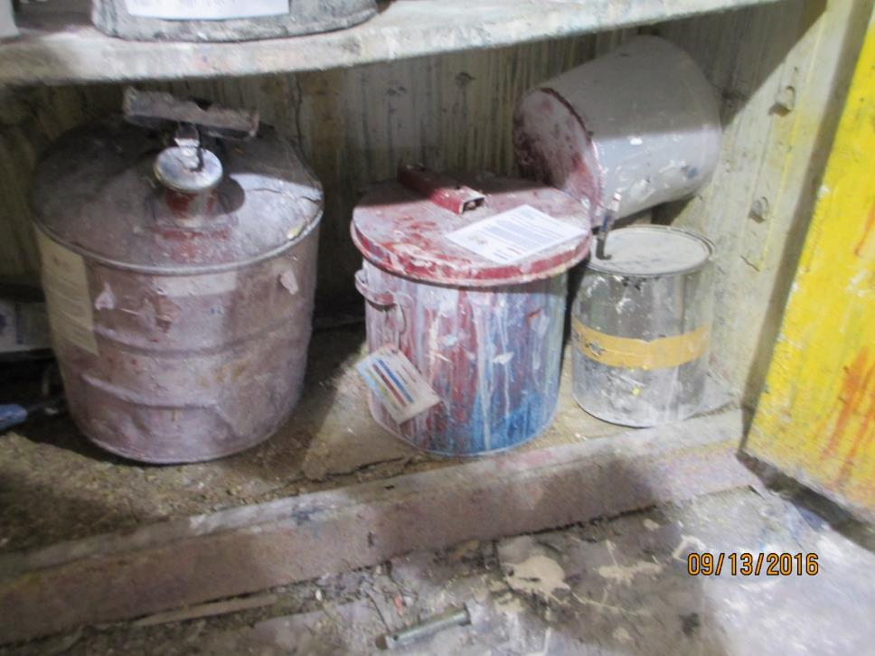
SQG – Satellite Container? (a)

Slide 27
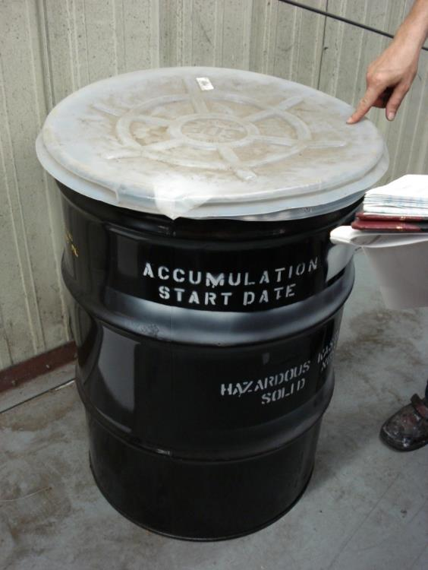
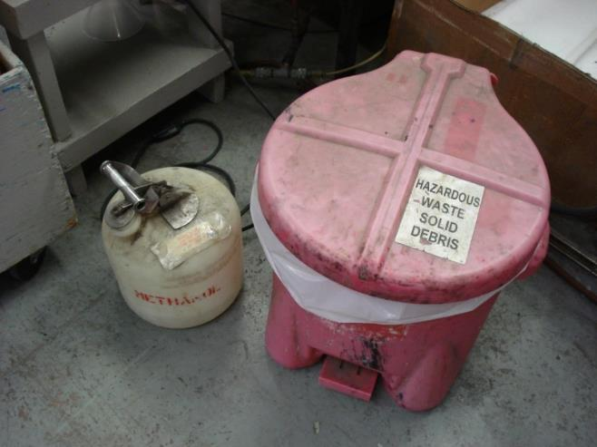
Satellite to Dated Accumulation Containers Only
Notes:
Can not place waste from satellite into another satellite. 2nd drum must be a dated drum.

Slide 28
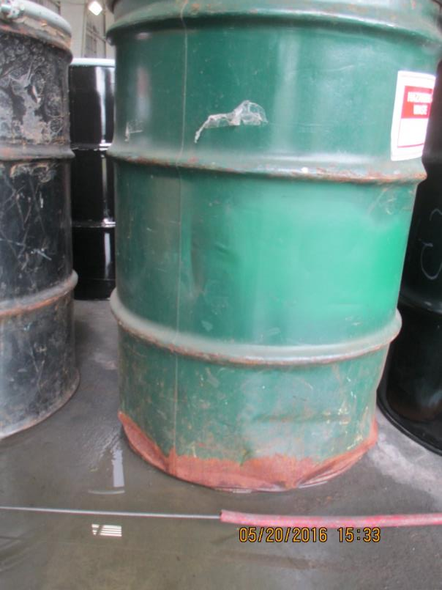
SQG – Container Condition
40 CFR 265.171

Slide 29
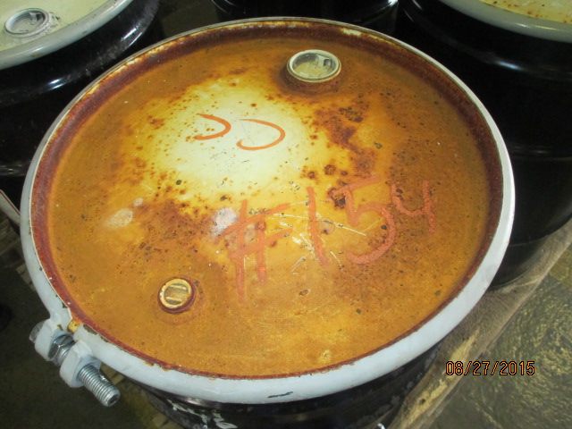
SQG – Container Condition
40 CFR 265.171

Slide 30
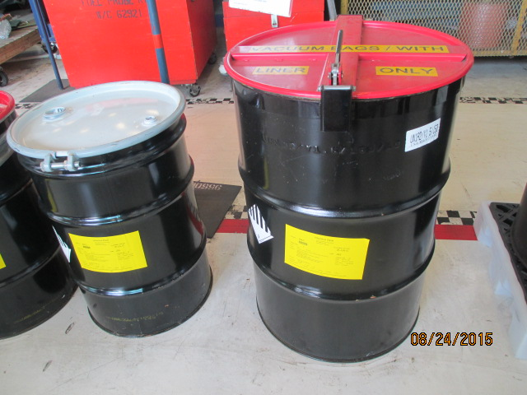
SQG Container Condition
Good condition - 40 CFR 265.171
Notes:
265.171
Good condition

Slide 31
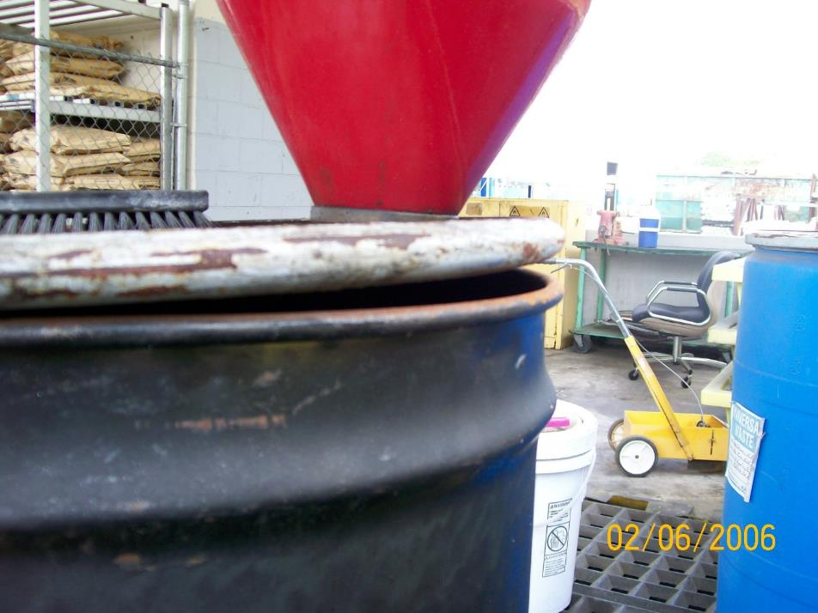
SQG Container Management
40 CFR 265.173(a)
Notes:
open

Slide 32
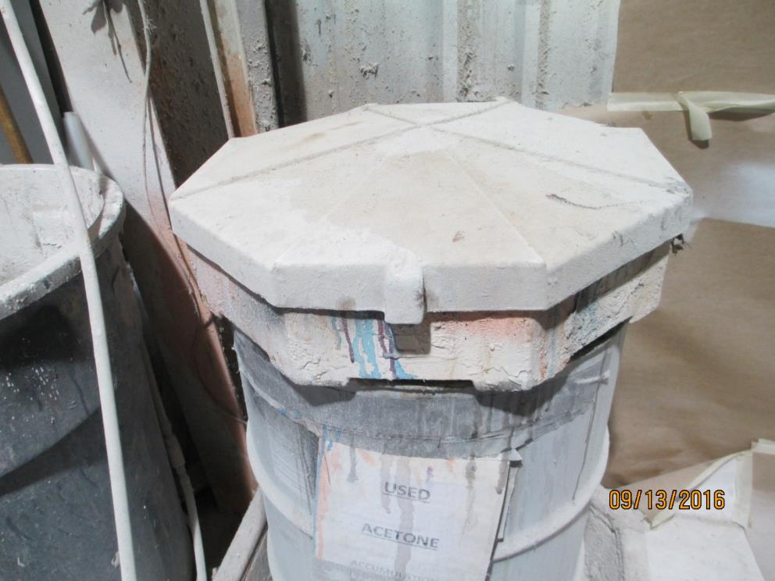
SQG – Closed Container?
40 CFR 265.173(a)
Notes:
Open because the funnel just slips into the bung. It does not screw in.

Slide 33
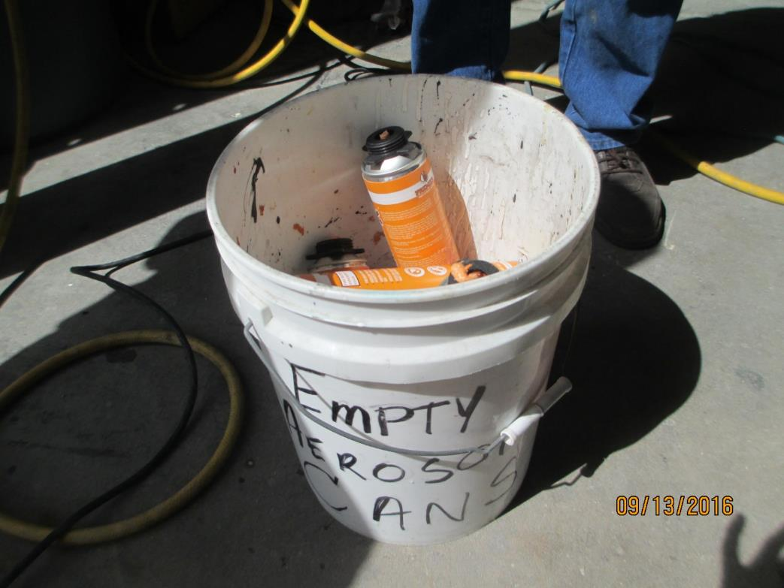
SQG – Closed Container? (a)
40 CFR 265.173(a)

Slide 34
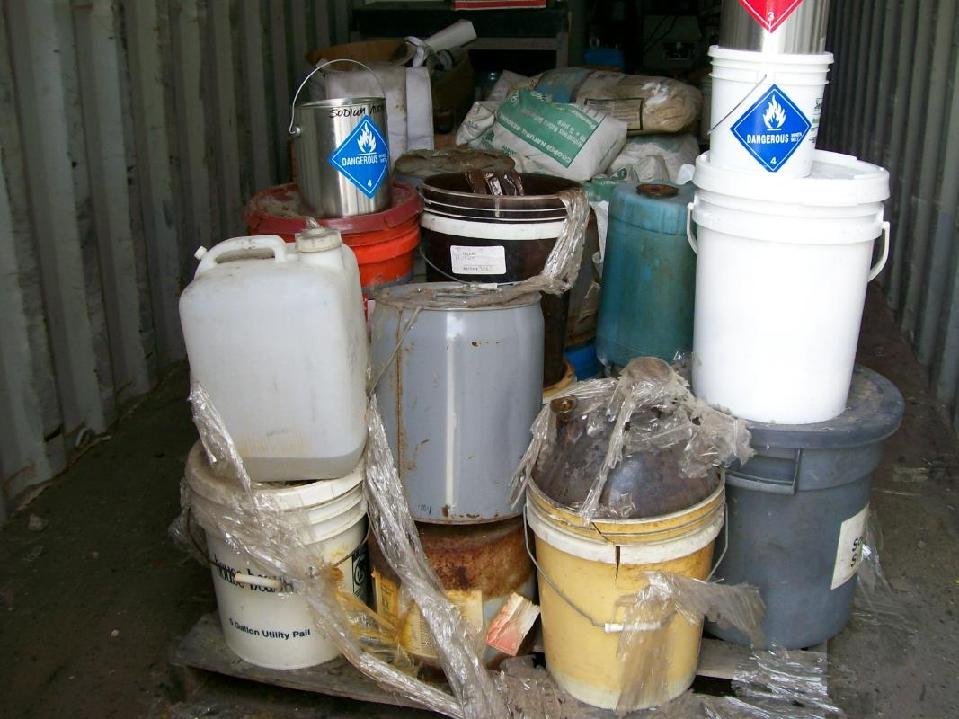
SQG – Container Management
40 CFR 265.173(b)

Slide 35
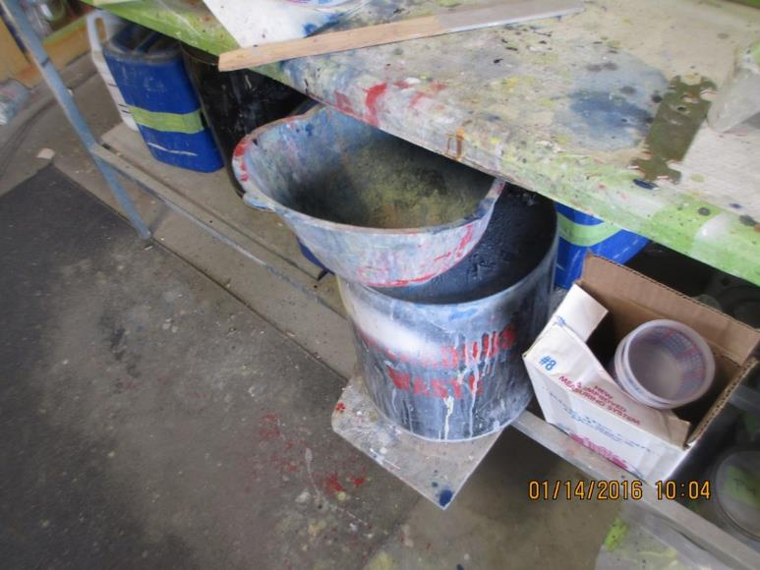
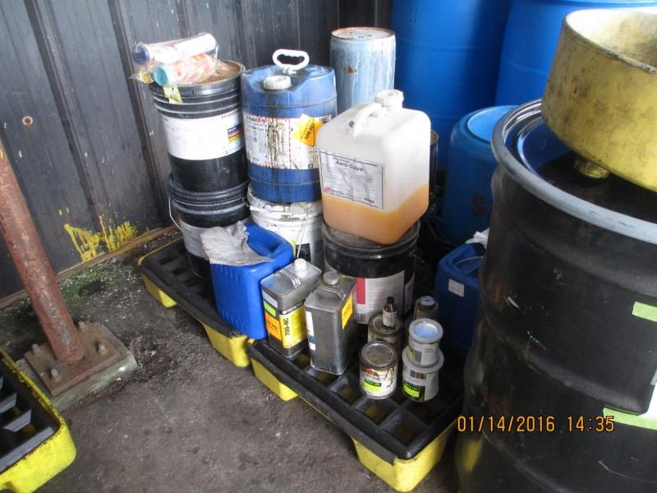
SQG Container Management (a)
40 CFR 265.173(b)

Slide 36
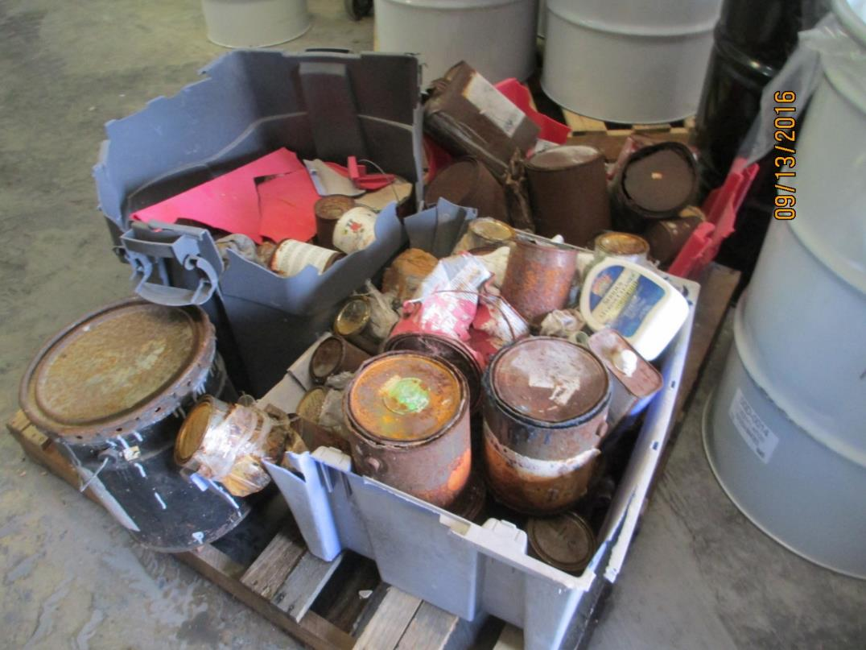
SQG – Container Management (b)
40 CFR 265.173(b)
Notes:
No telling what is in these containers – now “unknown” waste that requires costly sampling??

Slide 37
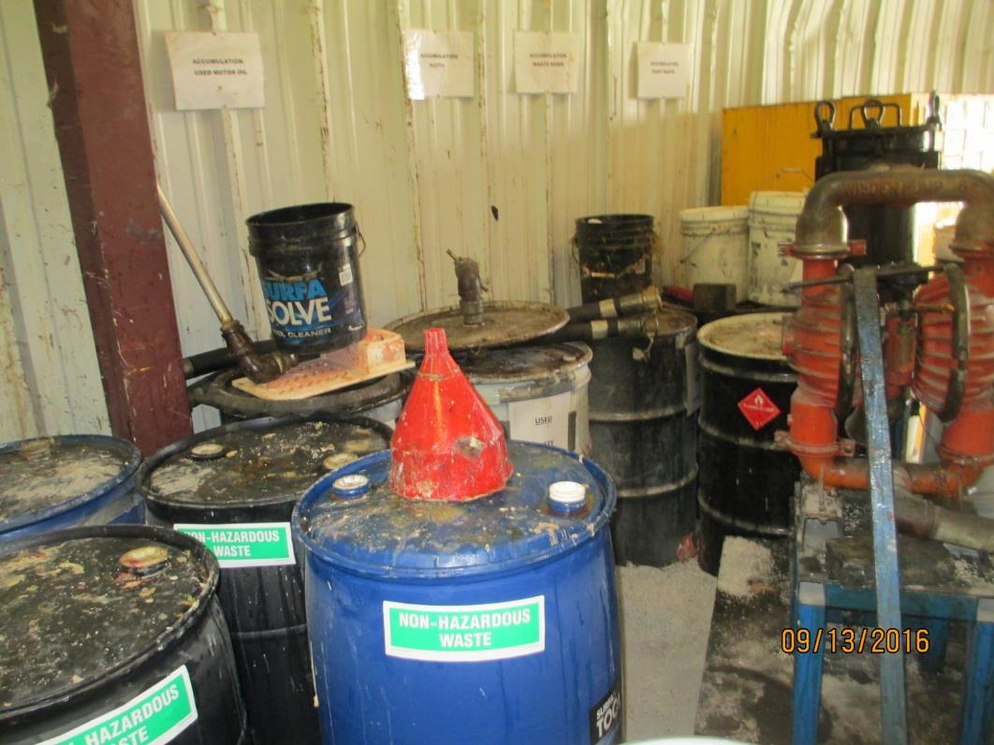
SQG – Container Aisle Space
40 CFR 265.35
and 62-730.160(7), FAC
Notes:
insufficient

Slide 38
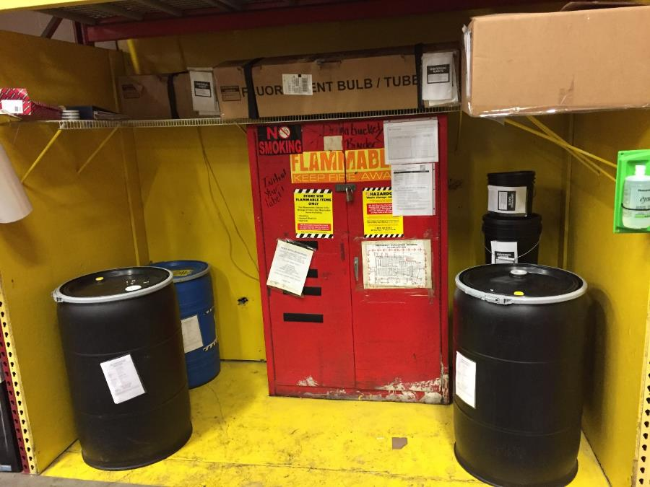
SQG - Container Aisle Space
40 CFR 265.35 and 62-730.160(7), FAC
Notes:
good

Slide 39
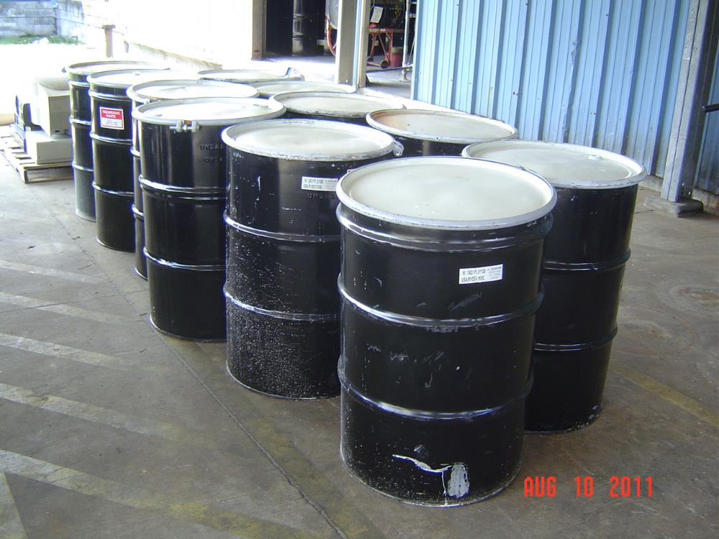
SQG Container Aisle Space
Good – adequate aisle space
40 CFR 265.35; 62-730.160(7), FAC
Notes:
Good aisle space

Slide 40
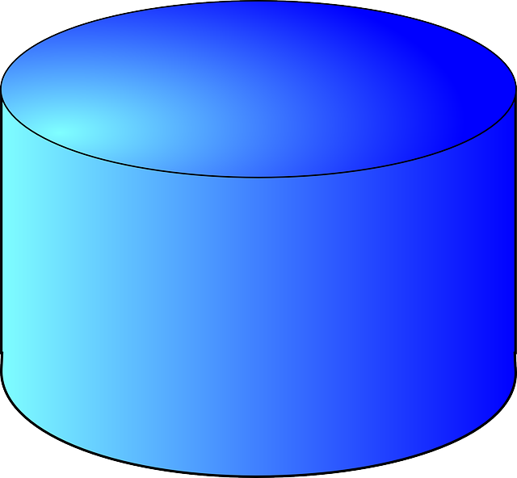
SQG - Tanks
Label “Hazardous Waste” [40 CFR 262.34(a)(3)]
Document 180 day storage limit compliance [40 CFR 262.34(d)]
Comply with 40 CFR 265.201 (SQG)
Notes:
IBC totes are not tanks.

Slide 41

40 CFR 262 Subpart C – Emergency Coordinator
40 CFR 262.34(d)(5)(i)
  Have at least one designated coordinator
  Coordinates all emergency response measures
  Either on premises or short distance away

Slide 42
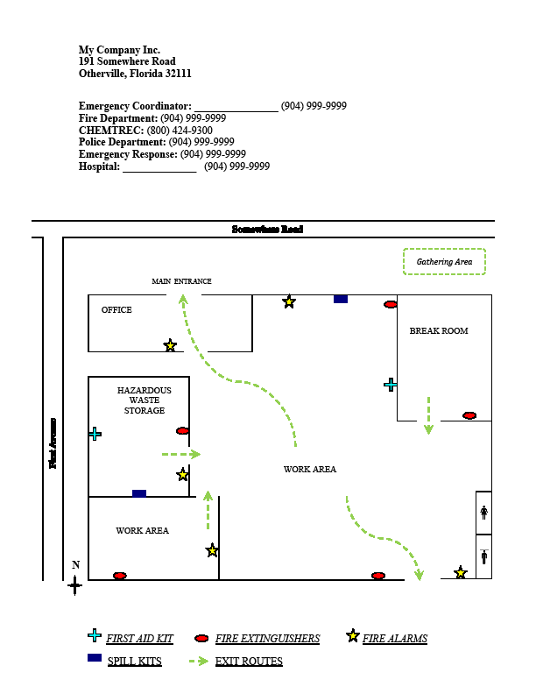
40 CFR 262 Subpart C –
Modified Contingency Plan
40 CFR 262.34(d)(5)(ii)

Slide 43
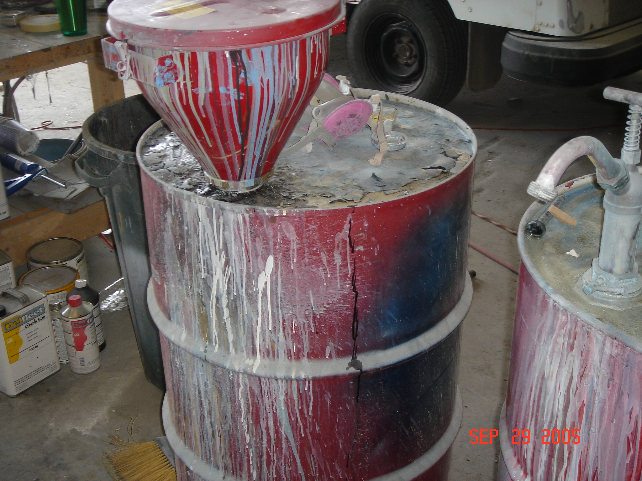
40 CFR 262 Subpart C –
Personnel Training
40 CFR 262.34(d)(5)(iii)

Slide 44
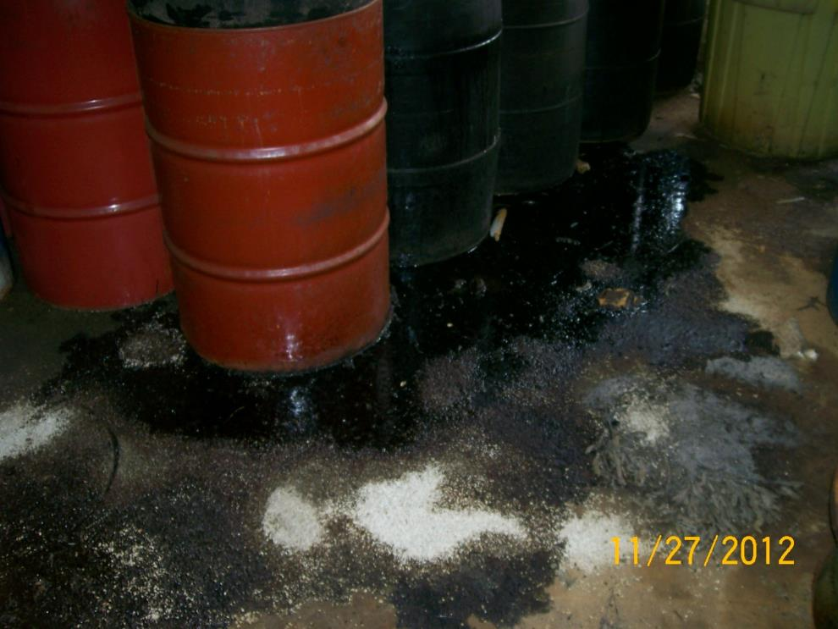
SQG – Personnel Training
40 CFR 262.34(d)(5)(iii)

Slide 45
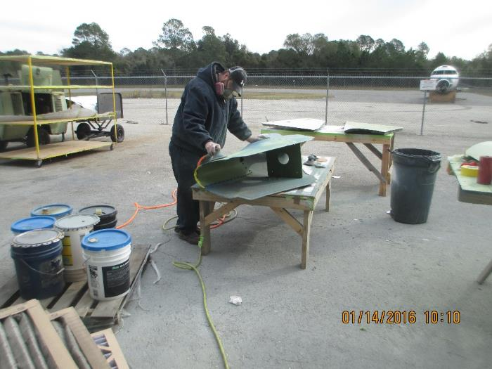
40 CFR 265 Subpart C – Preparedness and Prevention
Maintenance and Operation [40 CFR 265.31]
Minimize the possibility of fire, explosion, or release of hazardous waste or hazardous waste constituents to the air, soil, surface, or groundwater

Slide 46
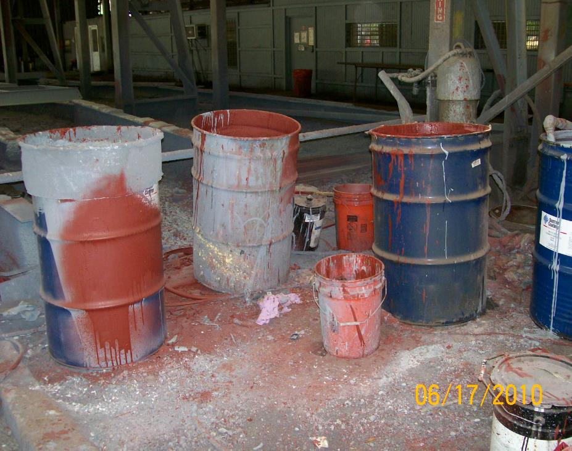
SQG – Maintenance and Operation
Facility must be properly maintained and operated [40 CFR 265.31]

Slide 47
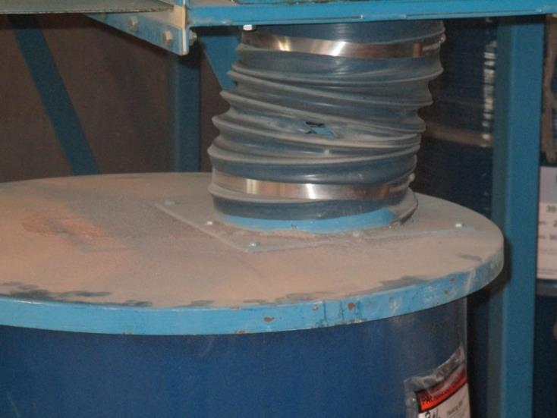
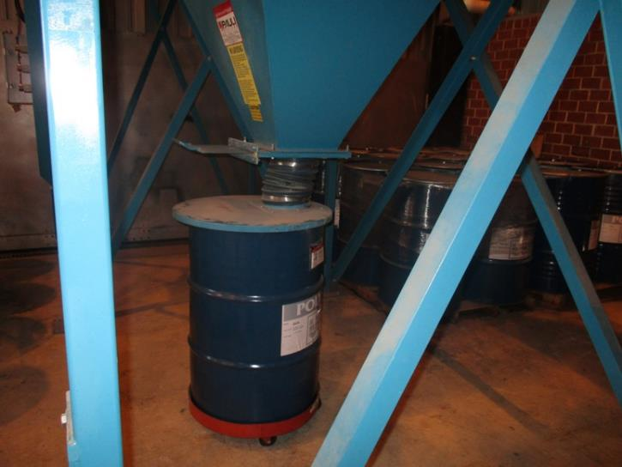
SQG – Maintenance and Operation (a)
Facility must be properly maintained and operated [40 CFR 265.31]

Slide 48
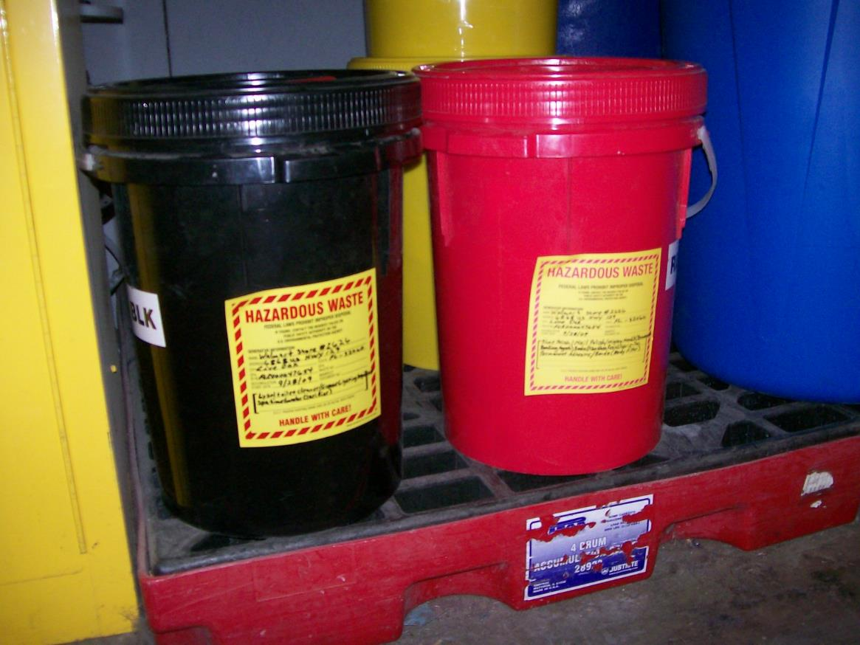
SQG – Maintenance and Operation (b)

Slide 49
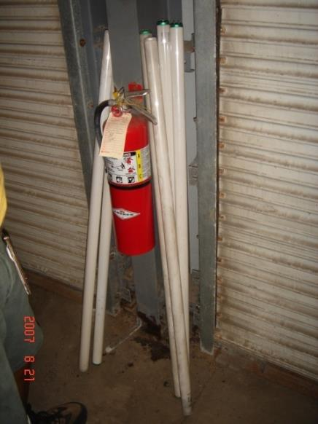
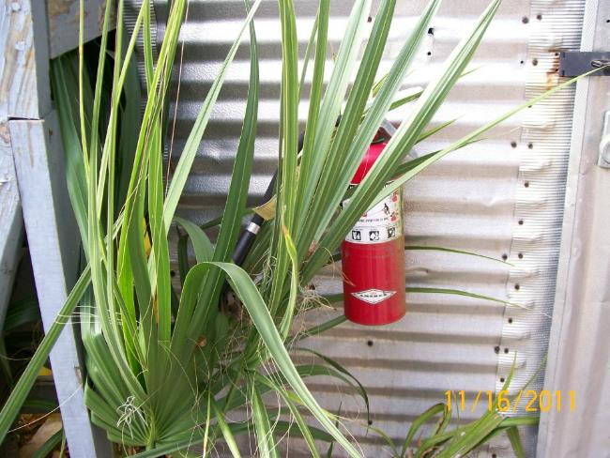
40 CFR 265 Subpart C –
Required Equipment
Internal communications or alarm equipment [40 CFR 265.32(a)]
Telephone or two-way radio [40 CFR 265.32(b)]
Fire equipment [40 CFR 265.32(c)]

Slide 50
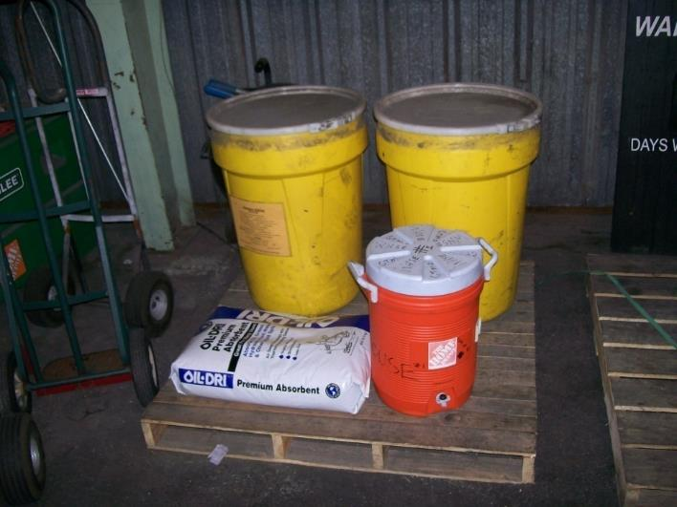

40 CFR 265 Subpart C –
Required Equipment (a)
Spill control/decontamination equipment [40 CFR 265.32(c)]
Water or foam available at adequate volume or pressure [40 CFR 265.32(d)]

Slide 51

40 CFR 265 Subpart C –
Required Equipment (b)
Notes:
Can you find the safety shower here?

Slide 52


40 CFR 265 Subpart C –
Required Equipment (c)

Slide 53

40 CFR 265 Subpart C –
Required Equipment (d)
[40 CFR 265.33]
Equipment Maintenance

Slide 54
40 CFR 265 Subpart C – Emergency Arrangements
Make arrangements with the local authorities
  [40 CFR 265.37]
Please document and keep copies
Notes:
We have a form letter that we give to facilities as an example.

Slide 55
40 CFR 262 Subpart D – Recordkeeping and Reporting
Exception reports required [40 CFR 262.42(b)] if a copy of the manifest is not received within 60 days
Test results – for example TCLP [40 CFR 262.11]

Slide 56



40 CFR 262 Subpart D – Recordkeeping and Reporting (a)
Weekly container inspections [40 CFR 265.174]
Container inspection records [Rule 62-730.160(6), F.A.C.]
    Date
    Time
    Legibly written name of the inspector
    Number of containers
    Condition of containers
    Notes of observations made, date and nature of repairs or corrective actions

Slide 57
40 CFR Part 268
Land Disposal Restrictions (LDR)
LDR waste analysis
LDR notification
LDR certification
LDR waste analysis plan
Retain documentation for three years

Slide 58
LDR Notice Contents
All applicable waste codes
Treatability group
Constituents subject to regulation, if not all regulated constituents
Manifest document number of shipment
Waste analysis data where available
One time notice pursuant to Phase IV LDR dated 5/12/97 (62 FR 25998-26040)

Slide 59
Questions?
Contact Compliance Assurance
Hazardous Waste Program
Northeast District
8800 Baymeadows Way West
Suite 100
Jacksonville, Florida 32256
(904) 256-1700 phone
(904) 256-1588 fax

