Slide 1
Background Soil Guidance
Division of Waste Management
August 14, 2018

Slide 2
Rationale for Updating the Guidance
The FDEP soil background guidance was written in 2012. Since this time:
ProUCL has updated/added statistical methods used in the program.
Lessons learned from use of the guidance at different sites has highlighted the need for updates to the recommended procedures.

Slide 3
Lessons Learned
Non-parametric tests can mask contamination due to the ranking procedure. ”Hot spots” are more easily identified than low levels of contamination.
Large numbers of non-detected data can also mask low levels of contamination, especially with multiple detection limits.
Notes:
Effectively, everything below the highest DL becomes censored. This reduces the power of the Wilcoxon Rank Sum and Wilcoxon-Mann-Whitney tests considerably, which may often lead to an incorrect conclusion.

Slide 4
Updates
Analyses were added from the USEPA Guidance for Comparing Background and Chemical Concentrations in Soil for CERCLA Sites (2002).
Added to help project managers get a better understanding of the dataset.
All additional analyses can be performed in ProUCL: https://www.epa.gov/land-research/proucl-software

Slide 5
1. Summary Statistics
Kaplan Meier method provides better estimates for mean and standard deviation than ½ detection limit for datasets with non-detects.
Summary Statistics for Censored Data Set (with Non-Detects (NDs)) using Kaplan Meier Method
Variable | NumObs | # Missing | NumDs | NumNDs | % NDs | Min ND | Max ND | KM Mean | KM Var | KM SD | MK CV
Cu (alluvial fan) | 65 | 3 | 48 | 17 | 26.15% | 1 | 20 | 3.608 | 13.08 | 3.616 | 1.002
Cu (alluvial fan) | 49 | 1 | 35 | 14 | 28.57% | 1 | 15 | 4.362 | 21.64 | 4.651 | 1.066
Summary Statistics for Raw Data Sets using Detected Data Only
Variable | NumObs | # Missing | Minimum | Maximum | Mean | Median | Var | SD | MAD/0.675 | Skewness | CV
Cu (alluvial fan) | 48 | 3 | 1 | 20 | 4.146 | 2 | 16.04 | 4.005 | 1.483 | 2.256 | 0.966
Cu (alluvial fan) | 35 | 1 | 1 | 23 | 5.229 | 3 | 27.18 | 5.214 | 2.965 | 1.878 | 0.997
Percentiles using all Detects (Ds) and NDs
Variable | NumObs | # Missing | 10%ile | 20%ile | 25%ile(Q1) | 50%ile(Q2) | 75%ile(Q3) | 80%ile | 90%ile | 95%ile | 99%ile
Cu (alluvial fan) | 65 | 3 | 1 | 2 | 2 | 3 | 5 | 7 | 10 | 15.2 | 20
Cu (alluvial fan) | 49 | 1 | 1 | 2 | 2 | 4 | 8 | 9.4 | 12.4 | 15 | 20.12
Notes:
Differences in mean suggest data sets are not equivalent. Differences in the standard deviation suggest one dataset is more skewed (has higher concentrations) than the other. A difference in standard deviation of the population is not always reflected in the mean, so both are important. The purpose of this analysis is to provide accurate summary statistics on censored datasets.

Slide 6
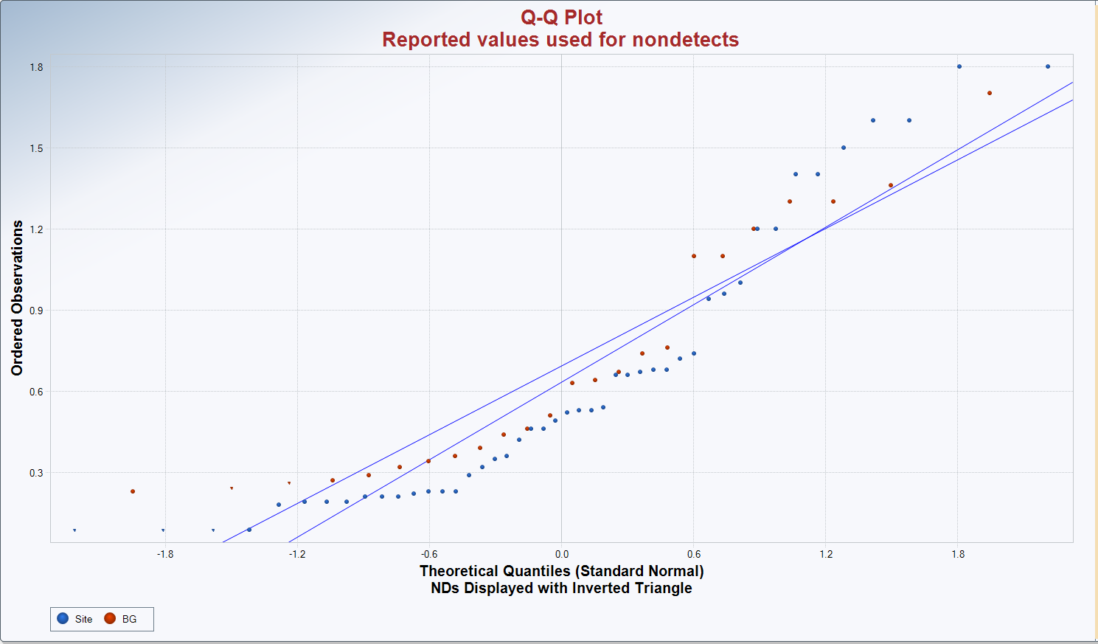
2. Quantile-Quantile Plots
Helps to visualize whether background and site concentrations are from the same population.
Unless sites are identical, the trendlines will be slightly different.
Deviations of data points from the trendline should be similar.
Notes:
This graphic plots the contaminant concentration for each quantile of the data. The mean of the dataset represents the 0.0 point on the y axis. Each quantile represents one standard deviation from the mean. Concentrations within that quantile are plotted on the graph.
It is important to not that Q-Q Plots assume a normal distribution. Most environmental datasets are lognormal. Therefore, there will likely be some deviation of the data points from the trendlines.

Slide 7
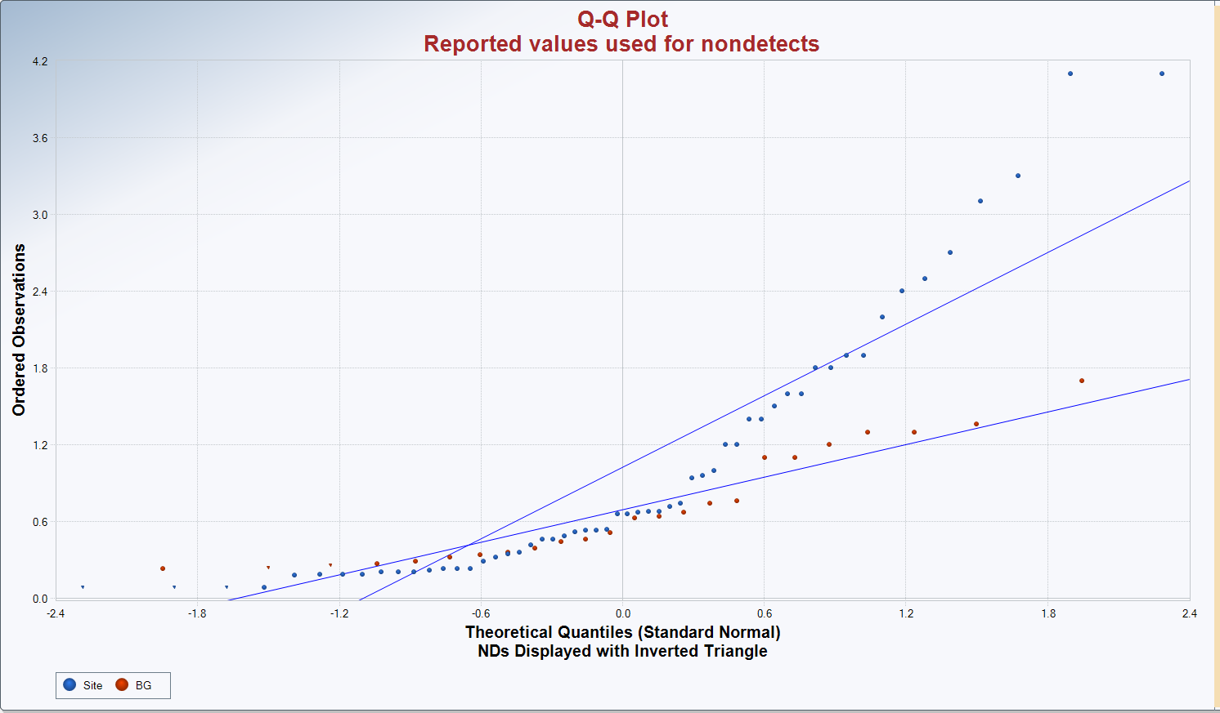
Quantile-Quantile Plots
When two populations are not equivalent, it helps in visualizing where the site concentrations deviate from background.
Q-Q plots are useful, but should not be used as a sole line of evidence for equivalence or non-equivalence of two populations.
Notes:
Q-Q plots work best when the site and background data sets are the same size. When there are more than twice the number of site samples as background samples, Q-Q plots may not reflect accurate distributions.

Slide 8
3. General outlier tests
Tests whether a sample is likely to be an outlier. Used to identify elevated concentrations in the dataset.
Presents statistical evidence the data point is not from the same population as the rest of the data.

Slide 9
3. Specific outlier tests
Rosner’s test is used for greater than or equal to 25 data points, Dixon’s test is used for less than 25 data points.
Outliers in background dataset suggests the sample was collected in an area that was not truly background.
Outliers in the site dataset suggests areas of low level contamination.
Outlier Tests for Selected Variables replacing Nondetects with 1/2 the Detection Limit
Options | User Selected
Date/Time of Computation | ProUCL 5.14/24/2018 8:28:34 AM
From File | WorkSheet.xls
Full Precision | OFF
Rosner's Outlier Test for 5 Outliers in Site 0-05
Total N | Number NDs | Number Detects | Mean with NDs=DL/2 | SD with NDs=DL/2 | Number of data | Number of suspected outliers | NDs replaced with half value.
56 | 0 | 56 | 0.902 | 0.821 | 56 | 5
# | Mean | SD | Potential outlier | Obs. Number | Test value | Critical value (5%) | Critical value (1%)
1 | 0.902 | 0.814 | 4.1 | 27 | 3.93 | 3.172 | 3.528
2 | 0.844 | 0.703 | 3.1 | 4 | 3.21 | 3.162 | 3.518
3 | 0.802 | 0.637 | 2.7 | 39 | 2.981 | 3.158 | 3.514
4 | 0.766 | 0.585 | 2.4 | 3 | 2.791 | 3.148 | 3.508
5 | 0.735 | 0.544 | 2.2 | 46 | 2.693 | 3.138 | 3.498
For 5% significance level, there are 2 Potential Outliers
4.1, 3.1
For 1% Significance Level, there is 1 Potential Outlier
4.1
Notes:
Outliers in background should be excluded from the background dataset since that point is suspect and will skew background statistics.
Outliers in the dataset are real outliers but may still be part of the background population (for example, a 99th percentile background value may be an outlier compared to other background data collected). If the dataset has a small coefficient of variation, larger values are likely to be identified as outliers.

Slide 10
4. UTL Approach
A 95% upper tolerance limit (UTL) on background – 95% of background concentrations will fall below this value with 95% confidence.
Site data are compared to the 95% UTL. If more than 5% of the data exceed the 95% UTL, it suggests a greater number of elevated concentrations on the site than background. In other words, the site may not be equivalent to background.
Background Statistics assuming Lognormal Distribution
95% UTL with 95% Coverage | 95% UPL (t) | 95% USL | 90% Percentile (z) | 95% Percentile (z) | 99% Percentile (z)
808.1 | 440.6 | 1162 | 265.4 | 393.5 | 823.5
Notes:
It is important to note that a UTL is not a background threshold value, but a method for comparing site and background populations.
If data are highly skewed, the 95% UTL will be closer to the 99th percentile than the 95th percentile. In this case, it may be more appropriate to use percentiles than the UTL.

Slide 11
5. Statistical tests
Outlier Tests for Selected Variables replacing Nondetects with 1/2 the Detection Limit
Wilcoxon Rank Sum (WRS) test is no longer on ProUCL. It was replaced with the similar Wilcoxon-Mann-Whitney (WMW) test, which can be used instead.
Gehan or Tarone-Ware test are used for datasets with greater than 40% non-detects or with multiple detection limits.
Options | User Selected
Date/Time of Computation | ProUCL 5.14/24/2018 8:49:57 AM
From File | WorkSheet.xls
Full Precision | OFF
Full Precision | OFF
Confidence Coefficient | 95%
Selected Null Hypothesis | Sample 1 Mean/Median >= Sample 2 Mean/Median (Form 2)
Alternative Hypothesis | Sample 1 Mean/Median < Sample 2 Mean/Median
Sample 1 Data: Site 1-2
Sample 2 Data: BG 05-2
Raw Statistics
Sample | Number of Valid Data | Number of Non-Detects | Number of Detect Data | Minimum Non-Detect | Maximum Non-Detect | Percent Non-detects
1 | 47 | 7 | 40 | 0.1 | 0.1 | 14.89%
2 | 12 | 2 | 10 | 0.715 | 0.735 | 16.67%
Sample | Minimum Detect | Maximum Detect | Mean of Detects | Median of Detects | SD of Detects | KM Mean | KM SD
1 | 0.1 | 4.1 | 0.773 | 0.5 | 0.882 | 0.672 | 0.838
2 | 0.745 | 2.175 | 1.211 | 1.065 | 0.505 | 1.128 | 0.475
Sample 1 vs Sample 2 Gehan Test
H0: Mean of Sample 1 >= Mean of background
Gehan z Test Value | Critical z (0.05) | P-Value
-2.553 | -1.645 | 0.00534
Conclusion with Alpha = 0.05
Reject H0, Conclude Sample 1 < Sample 2
P-Value < alpha (0.05)
Notes:
Test Form 2 is still recommended. Test Form 1 can be used for additional information.

Slide 12
Conclusion
The primary statistical approach is the ranking test (WMW, Gehan, Tarone-Ware).
Additional methods should be used as lines of evidence to support the determination of whether site concentrations are representative of background.

