Slide 1
A SIMULATION STUDY OF EXTRAPOLATION UNCERTAINTY IN EXPOSURE ASSESSMENT
USE OF PILOT STUDY RESULTS FOR SITE INVESTIGATION

Slide 2
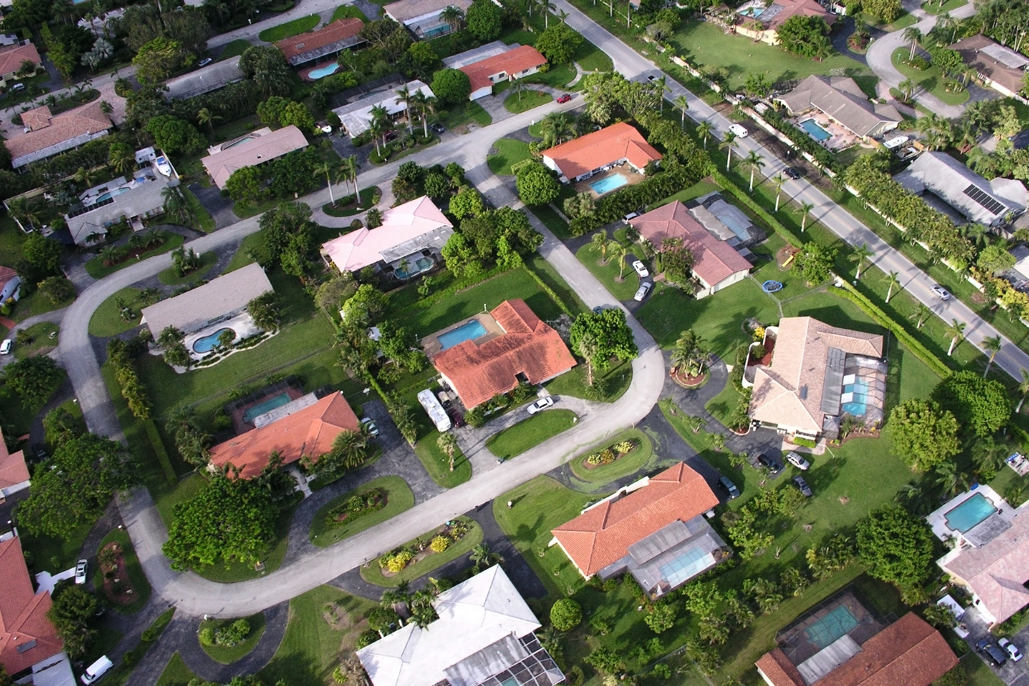
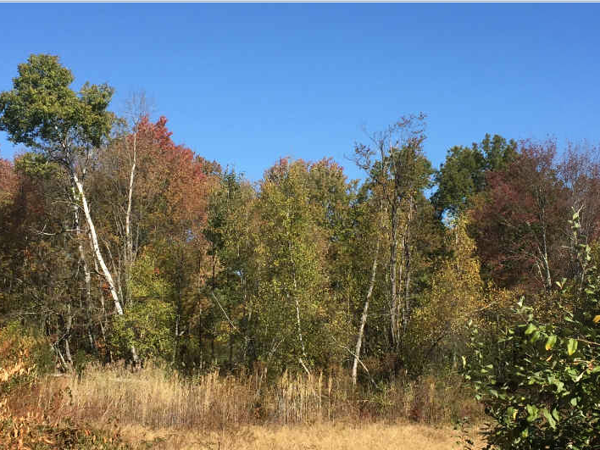
Characterizing sites with multiple decision units (DUs)
Exposure or remediation units (can be hundreds!)
Practical constraints of environmental sampling
Use of pilot studies to determine site compliance against threshold action level

Slide 3
Study Objective
Understand uncertainty in extrapolating from pilot study to site-wide compliance/non-compliance
  Simulation allows us to compare pilot findings to “true” site-wide conditions
  Quantify probability of making decision error (false compliance, false non-compliance)
  Characterize sample statistics from pilot study that can serve as reliable indicators of decision error rates
  Determine drivers in pilot study design and site conditions that impact decision error rates

Slide 4
Potential Pilot Study Outcomes
Public health concern
Costly but protective error (unnecessary action)

Slide 5
Defining Compliance
Pilot Study
Comparison of 95% Upper Confidence Level on the arithmetic mean (95UCL) for each DU to Action Level (AL)
Any exceedance triggers need for further sampling
True Conditions
Comparison of arithmetic mean for each DU to AL
Any exceedance is actionable
Notes:
A 95UCL is not needed to evaluate the Site condition because we are able to define the full
set of true arithmetic mean concentrations as part of the numerical simulation.
For these simulations, a high bar is set for Site‐wide compliance. True compliance occurs
only if the mean for every DU is less than the AL. Ideally, the Pilot Study would capture
the true compliance conditions each time, but in practice there is always a chance of
making the wrong decision. The performance of the Pilot Study is evaluated based on the
frequency with which the estimate of compliance matches the true Site conditions (i.e.,
a=b).
In a sense, the simulation study is partly an evaluation of the reliability of the “coverage
probability” of a 95UCL, meaning the likelihood that the one‐sided 95 percent confidence
limit exceeds the true mean.

Slide 6
Pilot Study Sampling Approaches
Define DU as having high or low Lognormal distributions
Incremental Sampling Methods (ISM)
Composite of increments in each DU (r = 1 or r=3)
Discrete Sampling
95UCL calculated following ProUCL decision tree (USEPA, 2013)
N=30 per replicate
95UCL calculated with Student’s t UCL and Chebyshev UCL
N=15 samples per DU
Key assumption: samples are independent and identically distributed

Slide 7
Scenarios Evaluated
Table 1. Scenarios evaluated in this simulation study.
Sampling Method | Lower Areas | Higher Areas | P(High)ª | AL^{b} | Pilot % of Site^{c} | ISM DU % r=3^{d}
Discrete^{e} | Log(100, 50) (CV=0.5) | Log(600, 300) (CV=0.5) | U(5%, 25%) | U(10, 6000) | U(10%, 90%) | NA
Discrete^{e} | Log(100, 150) (CV=1.5) | Log(600, 900) (CV=1.5) | U(5%, 25%) | U(10, 6000) | U(10%, 90%) | NA
Discrete^{e} | Log(100, 300) (CV=3.0) | Log(600, 1800) (CV=3.0) | U(5%, 25%) | U(10, 6000) | U(10%, 90%) | NA
ISM^{f} | Log(100, 50) (CV=0.5) | Log(600, 300) (CV=0.5) | U(5%, 25%) | U(10, 6000) | U(10%, 90%) | U(10%, 66%)
ISM^{f} | Log(100, 150) (CV=1.5) | Log(600, 900) (CV=1.5) | U(5%, 25%) | U(10, 6000) | U(10%, 90%) | U(10%, 66%)
ISM^{f} | Log(100, 300) (CV=3.0) | Log(600, 1800) (CV=3.0) | U(5%, 25%) | U(10, 6000) | U(10%, 90%) | U(10%, 66%)
Notes:
The AL is selected at random from a uniform distribution, with parameters that bracket the Low and High parent distributions by an order of magnitude. Specifically, the minimum AL = 100/10 = 10, and the maximum AL = 600 x 10 = 6,000.

Slide 8
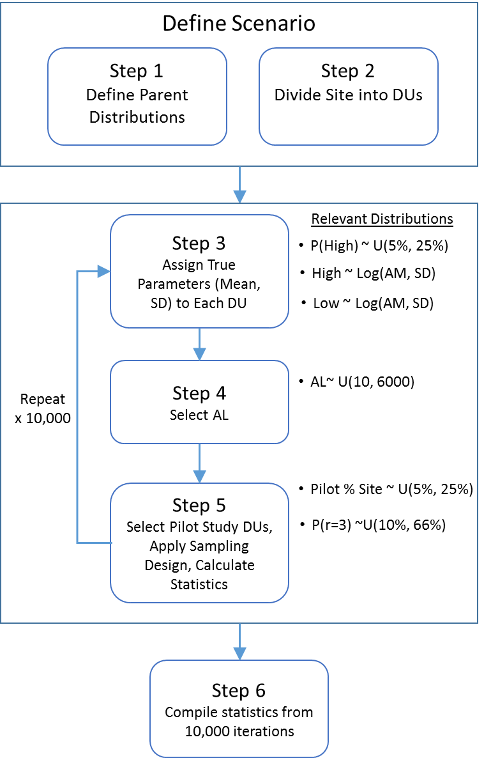
Simulation Approach: Overview
Key concepts:
Low, medium, and high variability scenarios
For ISM, some DU’s use r=1 instead of r=3. 95UCLs are calculated based on the arithmetic mean of the coefficient of variation (CV = SD/mean)
Each Pilot Study samples a subset of the Site area
Action Levels are variable – this allows us to examine a range of conditions of “near” exceedances

Slide 9
Simulation Approach: Define Scenario
Scenarios:
Define two parent distributions
  High and low concentrations differ by 10x (represents heterogeneity)
  Variability described by lognormal distributions
Divide site into DUs
  Site Area = 100 acres
  Average DU Size = 1 acre
Notes:
For all the scenarios, two parent distributions are defined, one that characterizes variability in contamination in Lower Concentration Areas and a second that characterizes Higher Concentration Areas. The purpose of defining two parent distributions is to introduce some heterogeneity, and to allow some of the DUs to be more influenced by subareas of elevated concentrations (formerly referred to as “hot spots” by some practitioners). Of course, every site is unique, and the challenge of any simulation study, and risk assessment guidance in general, is to capture a plausible range of conditions that represent cases that investigators will most often encounter. Results reported here may not apply to sites that exhibit more extreme conditions.
The Lower areas are characterized by a two-parameter lognormal distribution with a mean of 100 (units are intentionally excluded as they are not pertinent to the simulation study) and standard deviations (SDs) of 50, 150, and 300. The corresponding coefficient of variation (CV, equal to the ratio of SD divided by mean) values are 0.5, 1.5, and 3.0.
The Higher areas are characterized by a two-parameter lognormal distribution with a mean of 600 and SDs of 300, 900, and 18200 (again reflecting CVs of 0.5, 1.5, and 3.0). The Higher areas can be thought of as being more influenced by subareas of elevated concentrations than the Lower are 1800?

Slide 10
Simulation Approach: Simulation Parameters
10,000 iterations*:
Assign each DU true parameters (mean, SD) based on random sample of parent distribution (n=15). Probability of selecting a high concentration is uniform (5%, 25%).
Randomly select Action Level from uniform distribution (range is ~10x greater/less than high mean)
Randomly select DUs for pilot study
Apply sampling design (ISM or discrete)
  Random observations drawn from DU-specific true distribution
  95UCL calculated for each DU
*Analysis performed in Crystal Ball (ISM) and R (discrete)

Slide 11
Simulation Approach: Iteration Decisions
10,000 iterations:
Pilot study decision
  If there is any exceedance of AL, site is non-compliant
  If there is no exceedance of AL, site is compliant
Compare pilot study decision to true site-wide compliance to determine whether correct decision was made

Slide 12
Simulation Approach: Iteration Statistics
Compile match rates (correct or incorrect decision)
Tracking predictor variables from each iteration:
  Ratio of mean 95UCL from pilot study to AL
  Proportion of site in pilot study
  Probability DU has “high” concentration
  Proportion of pilot study DUs characterized by r=3 (ISM only)

Slide 13
Pilot Study Outcomes – Discrete Sampling
CV = 0.5
CV = 1.5
CV = 3.0

Slide 14
Pilot Study Outcomes – ISM Sampling
(Student’s t)
CV = 0.5
CV = 1.5
CV = 3.0
Notes:
Results are similar for chebyshev UCL method.

Slide 15
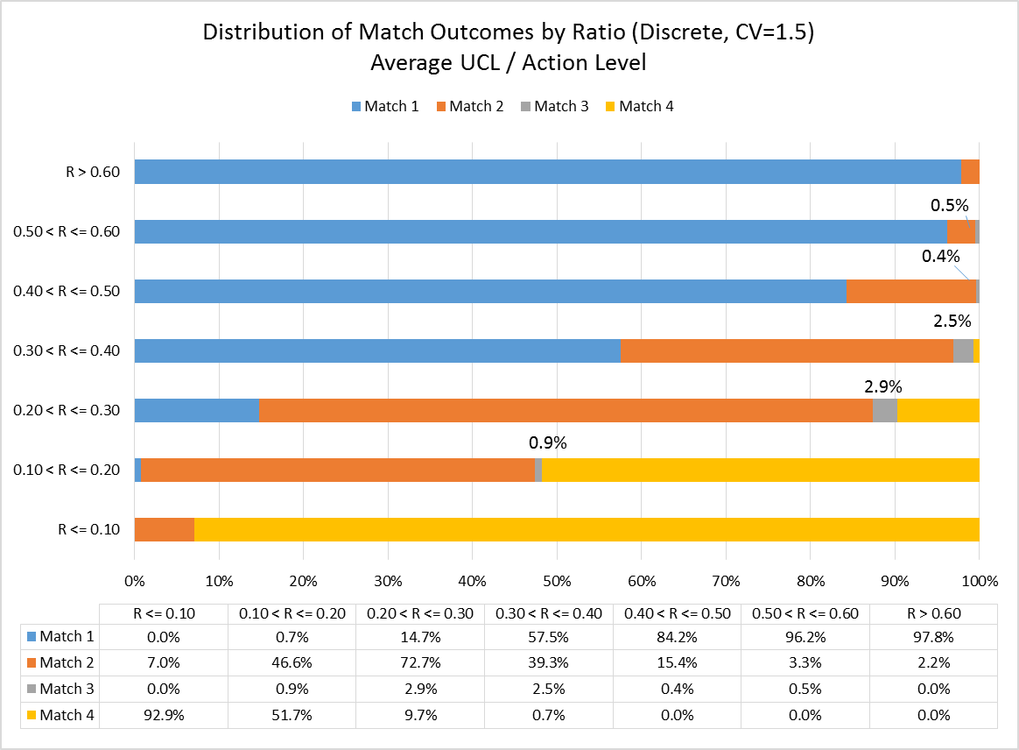
Outcomes by Ratio (Avg. 95UCL/AL) – Discrete
Ratio

Slide 16
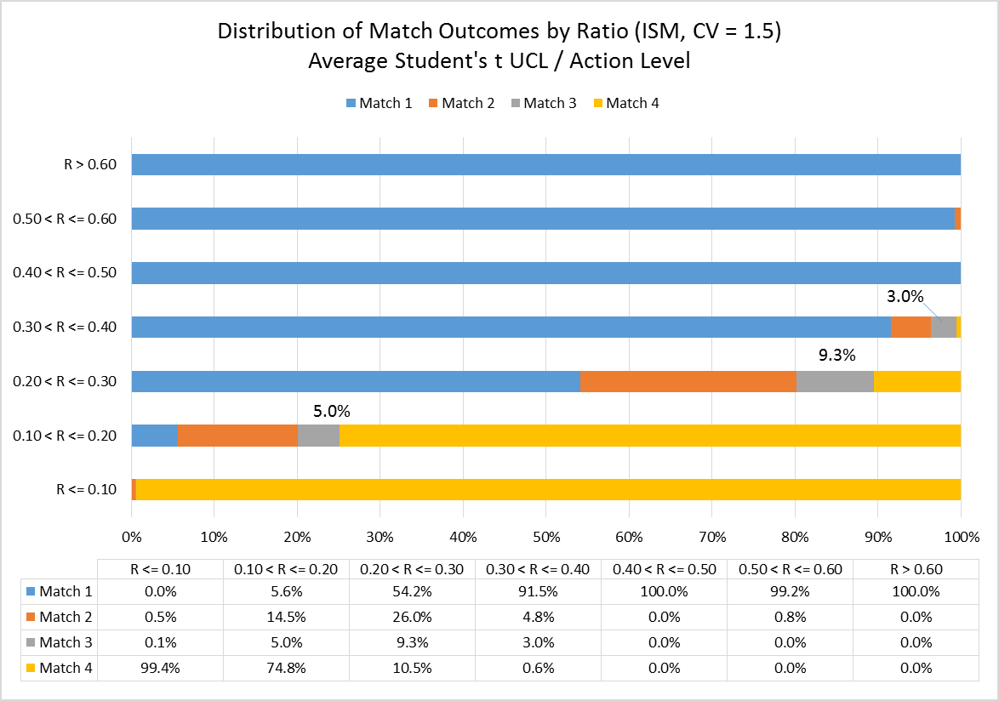
Outcomes by Ratio – ISM
Ratio

Slide 17
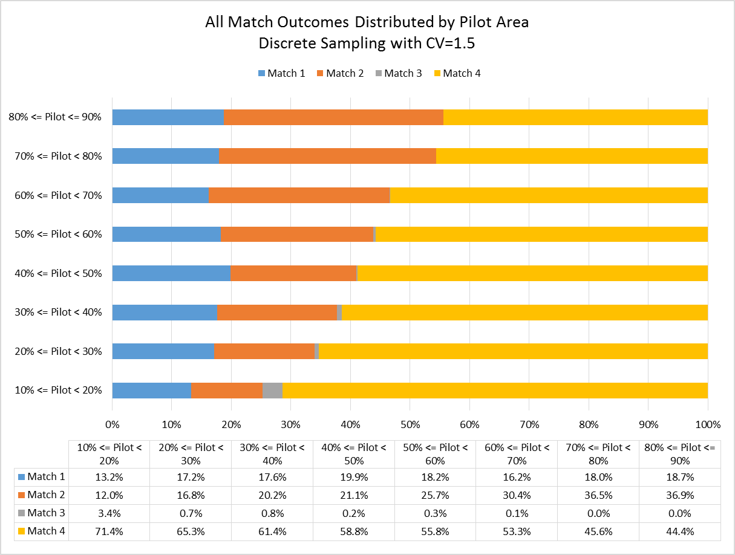
Outcomes by % Pilot Coverage - Discrete
Coverage
False Non-compliance is high (>10%) and increases by 3x
False Compliance is low (<5%) and decreases

Slide 18
Outcomes by % Pilot Coverage - ISM
Coverage

Slide 19
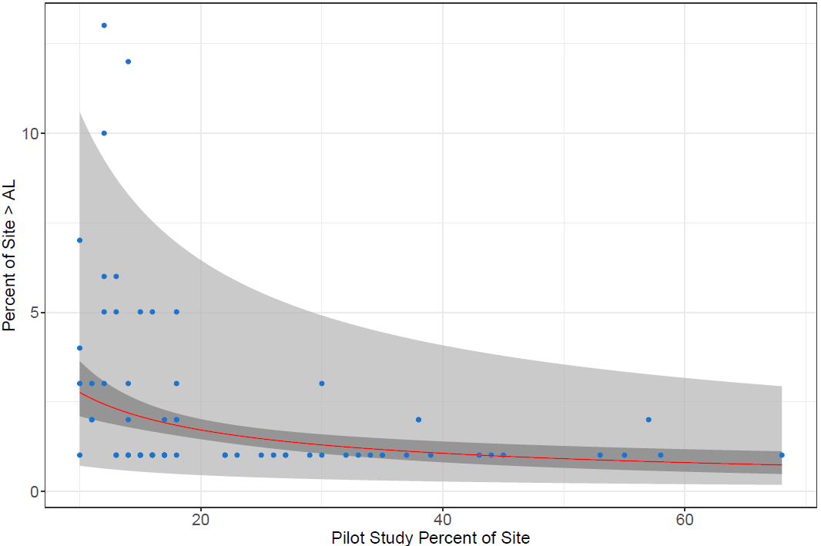
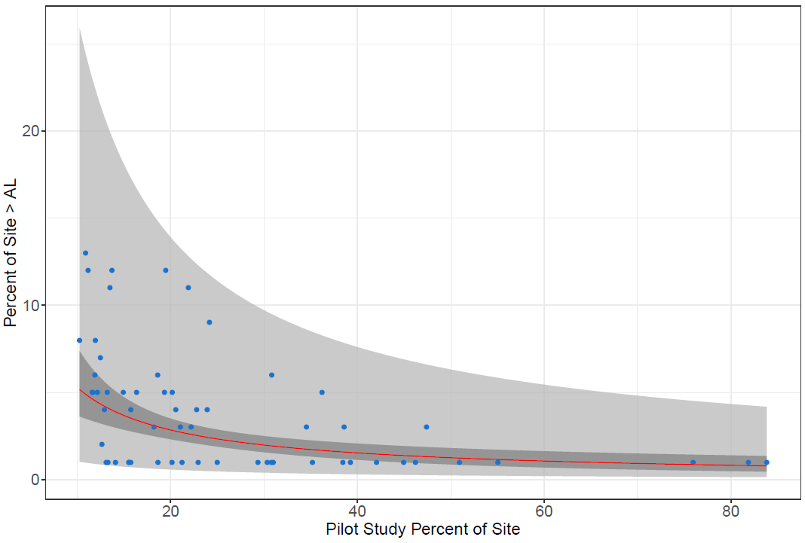
False Compliance Error by Percent Coverage: Pilot Study size independence
95% confidence interval shows < 5% of Site exceeds AL (on average), regardless of Pilot Study size
Discrete (CV=1.5)
ISM (CV=1.5)

Slide 20
False Compliance Error by Percent Coverage: Pilot Study Size dependence
When Pilot Study = 30% of Site, 95% prediction interval shows < 5% probability that area of exceedance is >5%
When Pilot Study = 30% of Site, 95% prediction interval shows < 5% probability that area of exceedance is >10%
Discrete (CV=1.5)
ISM (CV=1.5)

Slide 21
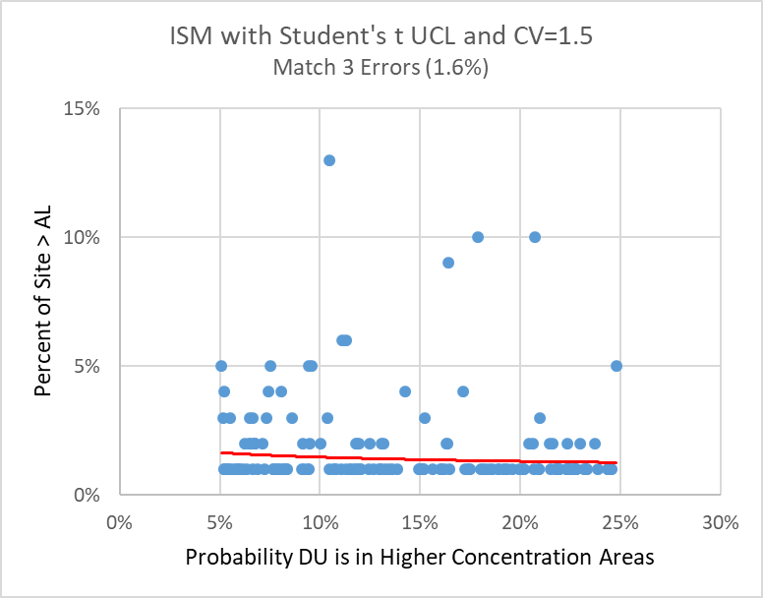
False Compliance Error by Probability of Higher Concentration Area
False Compliance error is not sensitive to the portion of the site that has higher concentrations. This means the findings from this simulation apply to Sites with heterogeneous concentrations.

Slide 22
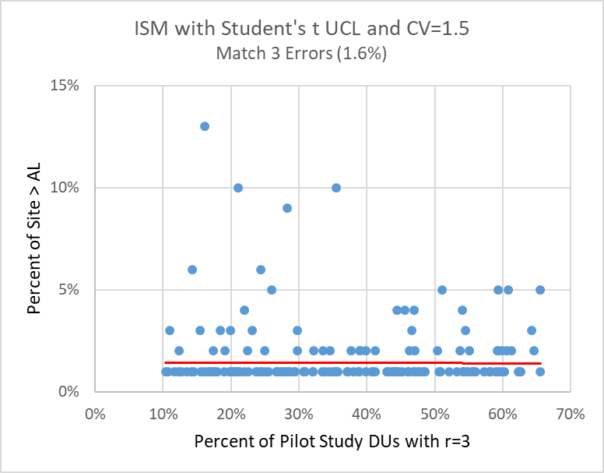
False Compliance Error by percent of Pilot Study DUs characterized by r=3 replicates
Site Area of Exceedance is not sensitive to the percent of DUs with r=3

Slide 23
Guidelines on Expected False Compliance Error Based on Calculated Ratio (Average 95UCL / AL)
If the average 95UCL is low (< 0.1 x AL) or moderate (> 0.4 x AL), there is a negligible probability of making a False Compliance error with either discrete sampling or ISM sampling (with both Student’s t and Chebyshev UCL methods).
If (0.1 x AL) > average 95UCL < (0.4 x AL), False Compliance errors vary with different CVs:
  If CV=0.5, then < 5% error for both discrete and ISM sampling
  If CV=3.0, then < 5% error for discrete sampling, ~ 8% error for ISM and Chebyshev UCL, and ~ 10% error for ISM and Student’s t UCL

Slide 24
Guidelines on Expected Magnitude of Site Error when False Compliance Occurs
By definition, some portion of the Site exceeds the AL when there is a false compliance error. Increasing the Pilot Study area decreases the probability and magnitude of the area of exceedance, while simultaneously increasing the chance of false non-compliance errors.
Occurring on average (based on a 95% confidence interval), < 5% of Site area exceeds the AL for both Discrete and ISM sampling for all Pilot Study sizes evaluated (e.g., as low as 10% of Site)
When the Pilot Study area equals at least 30% of the Site:
  Discrete sampling: 95% probability that < 5% of area exceeds AL
  ISM sampling: 95% probability that < 10% of area exceeds AL

Slide 25
Guidelines on Sampling Design Options
The likelihood of a False Non-compliance error is always greater than a False Compliance error. This is because we are relying on 95UCLs and random sampling.
ISM sampling reduces the False Non-compliance error rate by a factor of two compared with discrete sampling applied to the same Site conditions.
The False Compliance error rates using ISM sampling are insensitive to the fraction of the Pilot Study DUs that are characterized with r=3 replicates, so long as 95UCLs are calculated for the DUs with r=1 replicate using the average CV from the sample statistics for the r=3 replicate DUs. Use a Minimum of 3 DUs with r=3.
A Pilot Study Percent of Site of 10% to 20% achieves a False Compliance error rate of no greater than 5% to 10%, while also minimizing the False Non-compliance error rate.

