Slide 1
Florida Department of Environmental Protection Petroleum Cleanup Program Contamination Notification Training February 2009
Charles T. Williams
Environmental Administrator
Petroleum Cleanup Section One
Bureau of Petroleum Storage Systems

Slide 2
Contamination Notification Training
I. Types of Contamination Notification
Initial Notice of Contamination
Subsequent Notice for TPOC
Noticing for School Properties
II. Governing Statutes, Rules & Guidance
ss 376.3072, F.S.
Chapter 62-770, F.A.C
DWM Guidance & Procedures
III. Changes From Prior Noticing Guidance
IV. Specific Noticing Requirements

Slide 3
Types of Contamination Notification
Initial Notice of Contamination Beyond Property Boundaries
By Person Responsible for Site Rehabilitation (PRSR) to DEP/CHD/T&L of Source Property
By DEP to Record Property Owners (RPOs)
Subsequent Notice of Contamination Beyond Property Boundaries for TPOC
By PRSR to RPOs/CHD
Notice of Contamination at a School as Defined in Section 1003.01, F.S.
By DEP to School Board Chair (Superintendent)

Slide 4
Governing Statutes, Rules & Guidance
Section 376.30702, F.S. (2005)
Subsection 2): Initial Notice of Contamination
10 days - PRSR notice to DWM/Dist/CHD/Source T&L
Subsection 3): Department’s Noticing Responsibilities (Initial & School Board Notices)
30 days - DEP notice to RPOs & school board chair
30 days - School board chair notice to P/T/G’s
Repeat Every Year – School board notice to P/T/G’s

Slide 5
Governing Statutes, Rules & Guidance
Chapter 62-770, F.A.C. (12/27/07)
Section 220: Initial Notice of Contamination
Form 62-770.900 (3): Initial Notice Form
Section 690 & 700: TPOC Notice
Prior to NAMP/RAP approval - 30 day comment period
Repeat every 5 years unless notified that no longer affected
DWM Noticing Guidance & Procedures (11/14/08)
Statute & Rule Noticing
Expanded Noticing (State-funded & schools)
FAQ’s

Slide 6
Changes From Prior Noticing Guidance
11/14/08 DWM Guidance Supersedes Prior Version Dated 12/21/07
State-Funded Cleanup Sites Only
If no plume map, initial notice expanded to include properties within 250’ radius of confirmed samples *(GW & SW only, not Soil)
Initial notice for suspected properties (plume map & 250’ radius) expanded to residents, tenants & non-occupant RPOs
Initial notice update required if no TPOC notice or SRCO issued within 5 years of original

Slide 7
Changes From Prior Noticing Guidance
Non-Program Sites
If SM anticipates need in community with exceptional interest in contamination, may recommend that PRSR provide expanded notice
If PRSR does not comply, District Director may recommend by Department
School Sites (regardless of PRSR status)
Expanded to include private schools K-12
Recommend they notify P/T/G’s
Expanded to include schools with suspected contamination based on s&s plume map
Recommend they notify P/T/G’s

Slide 8
Initial Notice of Contamination
PRSR Notifies DEP-DWM Within 10 days of Initial Discovery of Contamination Beyond Boundaries - Form 62-770.900 (3), F.A.C.
PRSR Provides Copy of Same Notice to the DEP District, County Health Department (Environmental Health Director) & Lessees and Tenants of the Cleanup Site Property Concurrent w/Notice to DEP-DWM
Note copy to lessees & tenants excludes off-site property information (page two of Form)

Slide 9
Initial Notice of Contamination
Statute & Rule Require PRSR to Submit “Initial Notice” for Properties “Confirmed” above CTLs Based on Lab Analytical Results
Statute & Rule Require DEP to Send Copy of Initial Notice (or its equivalent) to RPOs of “Confirmed” Properties Within 30 Days
For Active State-Funded Cleanup Sites, the DEP Site Manager Fills the Role of the PRSR, But May Task Preapproval Contractor
Template B.5: Notice of Disc. of Cont. Package (Initial or TPOC) - $270.59

Slide 10
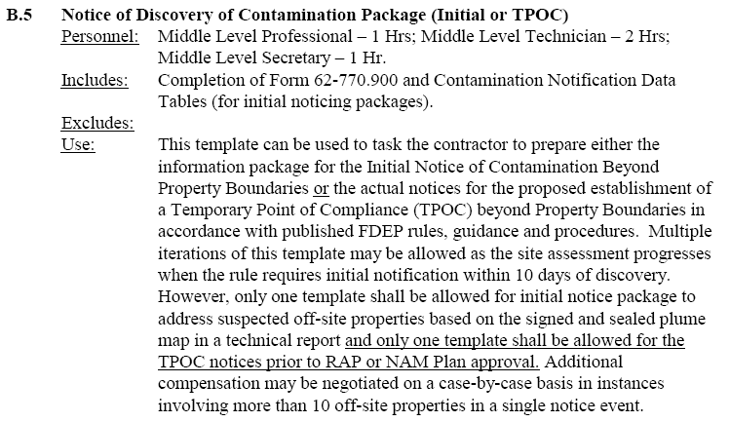
Notice of Discovery of Contamination Package (Initial of TPOC)

Slide 11
Initial Notice of Contamination
State-Funded Cleanup Sites are Subject to “Expanded Initial Notice” per DWM Guidance
Two Types of Expanded Notice
Properties “Suspected” to be contaminated above CTLs in any media based on a plume map signed and sealed by a Fla. licensed P.G. or P.E.
Site Managers are required to identify these properties
If plume map not yet available, properties within a “250-Foot Radius” of the location of each “Confirmed” off-site sample (GW or SW only)
York will identify these properties

Slide 12
Initial Notice of Contamination
Expanded Initial Notices Sent to:
Residents, Tenants & Non-Occupant RPOs
York will determine these entities
Other Expanded Initial Notice Provisions
If property has multiple or large buildings, only current residents, tenants and non-occupant RPOs of those buildings or units within large buildings that fall within 250 feet of confirmed sample location require expanded notice
If TPOC notice or SRCO have not been issued within 5 years, require updated initial notice

Slide 13
Initial Notice of Contamination Beyond Property Boundaries

Slide 14
Initial Notice Form – 62-770.900(3)
Attach “Contaminant Data Tables” for Each Contaminated Medium (groundwater, soil, surface water or sediment) Listing:
Sample locations & dates
Names of COCs detected above CTLs
The corresponding CTL
If multiple CTLs exceeded, list health based CTL
Toluene (40/1400), Ethylbenzene (30/700), Total Xylenes (20/1400), Acenaphthene (20/420)
The reason for the CTL
Health Based or Taste & Odor for groundwater
Leachability or Residential Direct Exposure for soil

Slide 15
Initial Notice Form – 62-770.900(3)
Attach Copies of Analytical Reports
Attach Vicinity Map Showing:
Locations, dates, types of samples collected
Analytical results for each sample
Property boundaries of cleanup site
Real properties at which contamination was discovered
Enter Information for Cleanup Site
Property address & DEP Facility #
Property owner name & contact information

Slide 16
Initial Notice Form – 62-770.900(3)
Enter Information Regarding Actions Taken in Response to Discovered Contamination
Cleanup actions
Offer/provide alternate water supply
Complete Separate Page Two for Each Parcel at Which Contamination was Discovered*:
Property address and parcel ID#
Names, address and phone # of record owner(s)
Date contamination discovered on that property
Site Manager Should Sign Form as PRSR

Slide 17
Contamination Notification Checklist for Active State Funded Cleanup Sites

Slide 18
Subsequent Notice for TPOC
Sections 62-770.690 & .700 Require DEP Approval to Establish a TPOC During:
Natural Attenuation Monitoring; or
Active Remediation
Prior to DEP Approval of NAMP or RAP, PRSR Must Provide Actual Notice to:
County Health Department; and
All RPOs of property into which TPOC is allowed to extend
Includes confirmed and suspected based on plume maps from reports signed & sealed by Fla. P.G. or PE.

Slide 19
Subsequent Notice for TPOC
TPOC Notices Must Include:
Proposed agency action
Location of cleanup site
Name & address of PRSR
Location of relevant technical documents
Name & address of DEP or LP Site Manager
Paragraph including statement “Persons receiving this notice shall have the opportunity to comment on the Department’s proposed action within 30 days of receipt of this notice”

Slide 20
Subsequent Notice for TPOC
PRSR Must Provide Copies of All TPOC Notices to DEP as Proof of Compliance
For Active State-Funded Cleanup Sites, the DEP Site Manager Fills the Role of the PRSR, But May Task Preapproval Contractor
Template B.5: Notice of Disc. Of Cont. Package (Initial or TPOC) - $270.59
TPOC notices are handled at Site Manager level and do not involve DWM or York

Slide 21
Subsequent Notice for TPOC
Additional TPOC Notice Must Be Provided
Once Every 5 Years Updating the Status of Site Rehabilitation to the Same Classes of Persons Who Received the First TPOC Notice, Unless They Have Been Informed That the Contamination No Longer Affects Their Property
TPOC Wells Do Not Need to be BDL
If clean enough to consider plume delineation complete (very low levels) OK to use for TPOC

Slide 22
Department’s Statutory Noticing Requirements For School Properties
If Contamination is Discovered at the Site of a School (originated or migrated) as Defined in Section 1003.10, F.S., Department Must Send Notice to the Chair of the School Board
K-12 public schools, charter schools and schools that include McKay Scholarship students
Notice directs the school board to provide actual notice to teachers and parents or guardians of students attending school
Notice shall include sources of additional information and phone number for inquiries

Slide 23
Department’s Statutory Noticing Requirements For School Properties
School Board Notices From DEP to the School Board
Must Include the Same Information Meet the Same Turnaround Time as the “Initial Notice of Discovery”
School Board Notices to P/T/G’s
Must Include the Same Information as the “Initial Notice of Discovery” and be Provided at Least Annually During Site Rehabilitation (updated as appropriate)

Slide 24
Department’s Statutory Noticing Requirements For School Properties
Site Managers Should Alert the BPSS BCO When Contamination is Discovered at the Site of a School (public or private)
This can be accomplished using the “Contamination Notification Checklist for Active State-Funded Cleanup Sites” if associated with an “Initial Notice” package.

Slide 25
DWM’s Expanded Noticing Requirements For School Properties
If the Site at Which Contamination is Discovered is a Private School K-12
The Department will send a notice to the governing board, principal or owner and recommend that they send a copy to P/T/G’s
If Contamination is Suspected but Not Confirmed at School Site (including private)
The Department will also send a notice recommending that they send a copy to P/T/G’s

