Slide 1
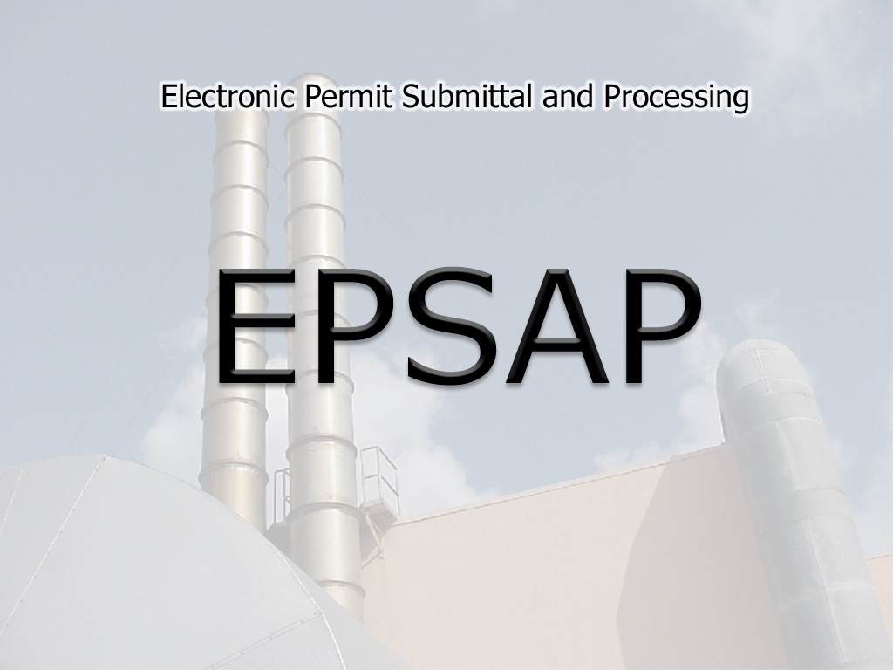
Electronic Products Workshop Division of Air Resource Management -DEP

Slide 2
The EPSAP Process
An applicant can login over the Internet
Each person has a secure account and password
DEP engineers can only review the application after it has been submitted
Existing information for a facility will be pre-filled, but can be modified
The Application can be edited for sufficiency prior to submission
Notes:
Highlights here are ease of access; security process; protection of your privacy; facilitation of completing the application; double-checking your entries.
Access: Access is universal for those with an internet connection; aside from a browser, nothing else is required.
Security: Security is controlled via the web; those using the EPSAP application must have an account and a password; submitting the application requires a PIN.
Privacy: As an applicant, you can work on an application with no concern about a premature review. Engineers are not permitted to review the application before its submittal.
Ease of completing the application: Much of the information needed for a complete application can be pre-filled saving the applicant from having to do so.
Double Checking: The application will check the validity of your entries and give you appropriate warnings.

Slide 3
EPSAP Design
EPSAP was designed with three modules: Applicant, Engineer Review, and Inventory Review
Flexibility in navigation was a major design concern. The user can easily move between different sections of the application
The EPSAP Applicant module was designed to reflect the hard copy permit application data
The Engineer and Inventory Review modules reflect the organizational needs of a reviewer. Using the tree view menu makes navigation quick and easy
Notes:
As you can see from the slide, the EPSAP application has 3 distinct modules: the application, the engineer’s review and the inventory review which is the final validation of data before it is uploaded into the ARMS database.
ARMS: Air Resource Management System
Each of these modules was designed with the needs of the primary users in mind. For instance, the applicant module was designed to look like a hard copy of the application.
More specifically...(See next slide)

Slide 4
Completing the Air Permit Application
Applicant module designed to use the structure of the hard-copy application sections
Application Information Section
Facility Information Section
Emissions Unit Information Section
Data stored securely prior to submittal
Prior to submittal, share application completion with multiple application owners
Notes:
More

Slide 5
Existing Facilities
Can fill out permit applications for permit renewals and modifications quickly and easily
The EPSAP software allows you to quickly download data from the Air Resource Management System (ARMS) database.
The data from ARMS pre-fills the fields in the permit application
Notes:
EPSAP is quite handy for renewing permits; all applicable data that has been uploaded to ARMS will be retrieved and used to pre-fill the application.

Slide 6
New Facilities
EPSAP also handles permit applications for new facilities
Advantage of submitting application data electronically to the department
Reduce data entry errors in the application with the use of the sufficiency check functionality
Reduce need for future data entry for Permit Reviewer and for future permit applications
Notes:
New permit applications can also be made with EPSAP
Having submitted the data electronically to the department, it will be there for retrieval the next time it’s needed, saving time for both the applicant and the permit reviewer.

Slide 7
Submitting an Application
Non-Title V Source application
Fill out application and submit fees and signature pages in Hard copy.
Submittal by PE with EPSAP account
Application is not considered received until these are received in the appropriate office.
Long Form Application
Submittal by PE and RO with Personal Identification Number (PIN)
PINS must be obtained by registered EPSAP Account holders.
A confirmation page will be displayed and confirmation emails sent to application owners.
Notes:
Both non-title V and long form permit applications can be made with EPSAP
The Non-title V application is completed online;
a hard copy of the signature pages and the fees are then sent by snail mail to the appropriate office
The application is submitted by a PE with an EPSAP account
NOTE: the application is considered “received” once the signature pages and fee are actually received
Long Form:
Application is completed online
Application is submitted by PE and/or RO who must have a PIN
NOTE: the process for securing a PIN is limited to those with a registered EPSAP account.
Application owners are notified when applications are submitted

Slide 8
EPSAP Engineer Review and EPSAP Inventory Review Process

Slide 9
After the Application Submittal
The appropriate office is notified via email that an application is ready for review
The reviewing engineer can access the application over the Intranet
Once all information is complete and satisfactory, the engineer will issue the permit and the data is submitted to an inventory specialist for review
The inventory specialist will ensure the data being uploaded to the ARMS (Air Resource Management System) database reflects the information in the permit. ARMS will be updated electronically
Notes:
Highlights:
Following submission, an electronic notification is made to indicate that an application is ready for review
Reviewing engineers with intranet access are now permitted to review the application
Engineer reviews and upon a satisfactory determination, the permit is issued
Data is submitted to the inventory review specialist to ensure data integrity and an accurate reflection of the information in the permit before uploading to ARMS
THIS IS NOT IN PRODUCTION YET

Slide 10
Recent Enhancements
Hard copy submission handling
- Process created to allow a reviewing engineer to
create an EPSAP application from a hard copy
Read Only Access
- Engineer and Inventory Review Modules accessible
to all those with an active account
Tracking Report
- Track application submissions, releases and
resubmits
Uploaded files/attachments Report
- View all files and attachments that were
uploaded with the application
Notes:
Some enhancements that have been made in the recent past which are either already in production or will be very shortly are:
Hard copy submittal, electronic version: Process to make the equivalent of an electronic application which will then lend itself to all other benefits afforded by the system
Read-only access: All reviewers with active accounts can view submitted applications. This is of particular use when a question needs to be answered and the assigned reviewer is not available
Tracking report: Means by which one can follow the application through the submittal process
Uploaded files/attachments: Soon to be available in both the applicant and the engineer modules, this is a report listing all the files and attachments that have been uploaded with the application.

Slide 11
Where is EPSAP Going?
Electronic signature capability will be part of DEP E2 Data Portal
Electronic Fee Submittal
Integration with ARMS PA application
Permit Generation
Enhanced Reporting and Application retrieval
Online tutorial
Notes:
Stayed tuned for these more involved enhancements….

Slide 12
EPSAP Support
Applicant:
User Manual/Walkthrough in Development
Online Help
Industry Workshops
Full Help Desk and Staff Support
Engineer Review:
Online Help
NetMeeting Training
Full Help Desk and Staff Support
Notes:
Support that is currently available includes:
user guides
online help; in mid-April an online tutorial
We offer workshops such as this one
Knowledgeable people who have been a part of this project since its beginning

Slide 13
Data Assistance Contact Information
Elizabeth Walker: 850-717-9008
Elizabeth.Walker@dep.state.fl.us
Kris Lanh: 850-717-9094 Kris.Lanh@dep.state.fl.us

Slide 14
Support Contact
DARM Help Desk
850-717-9012
Darm.Helpdesk@dep.state.fl.us
Notes:
Contact the DARM Help Desk for assistance with EPSAP and user accounts.

