Slide 1
New Emergency Generator Storage Tank Outreach Webinar
January 24, 2018

Slide 2
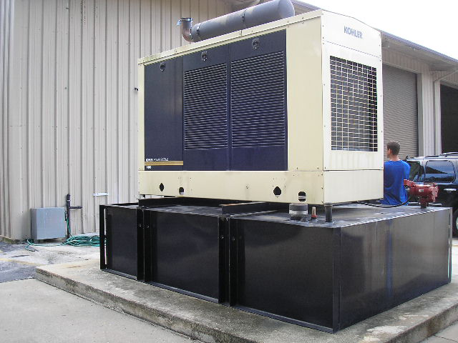
Why the Outreach?
Many businesses in Florida are installing emergency generators as backup for instances of power outages. A significant number of these generators are fueled by petroleum products stored in tanks that are regulated by the Department.
Division of Waste Management Website:
Division of Waste Management
Permitting and Compliance Assistance Program
Storage Tank Compliance

Slide 3
What Does the Department Regulate?
Underground Storage Tanks (USTs) > 110 gallons
Aboveground Storage Tanks (ASTs) > 550 gallons
Chapter 62-761, F.A.C.* - UST Rule
Chapter 62-762, F.A.C.* - AST Rule
*Florida Administrative Code

Slide 4
Installation Notification
The Department contracts its inspection program statewide to local governments. You may access contact information for these local governments at the following link: Storage Tank District and County Contacts
Timeframes to Notify Your Inspector:
Provide 30 to 45 day written (email) prior notice of the installation of the storage tank, and
48 to 72 hour email prior confirmation notification to the inspector.

Slide 5
Registration
Your storage tank is also required to be timely registered with the Department so that you may legally receive fuel from your supplier.
Storage tanks at new facilities (those without a current Facility #) must be registered through the Online Services Business Portal ESSA no later than 30 days prior to installation of your storage tank, or you may submit the Storage Tank Facility Registration Form in electronic or paper format to the Registration Section. To contact a Storage Tank Registration Representative call (850) 245-8839, or tankregistration@floridadep.gov.
Storage tanks at facilities with existing registered storage tanks must register the new storage tank(s) seven days prior to placing fuel into the storage tank.

Slide 6
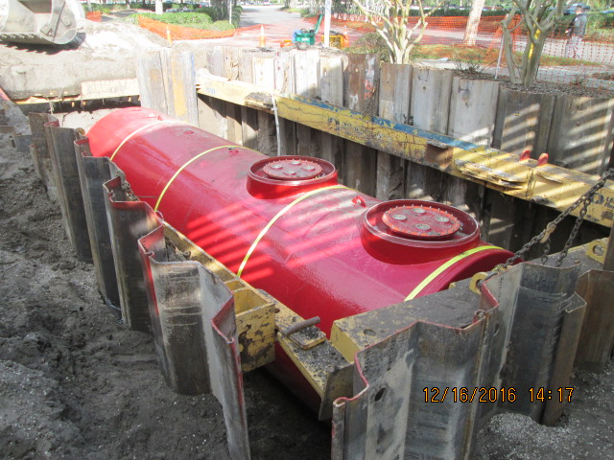
Installation of an Underground Storage Tank
USTs must be installed by a Pollutant Storage System Contractor (PSSC), a general contractor licensed by the Department of Business and Professional Regulation.

Slide 7
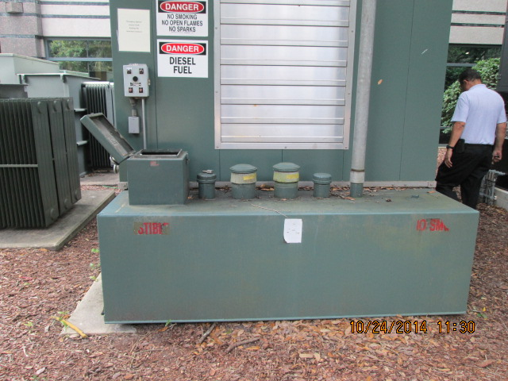
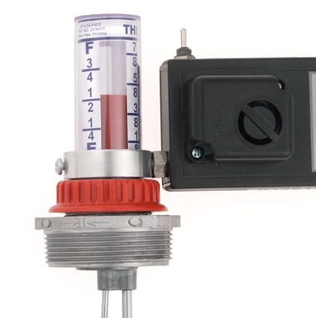
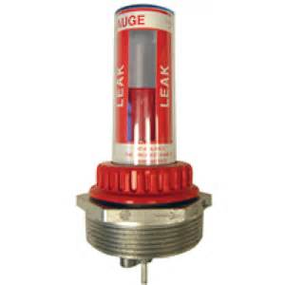
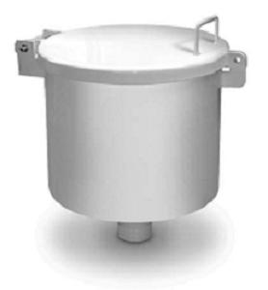
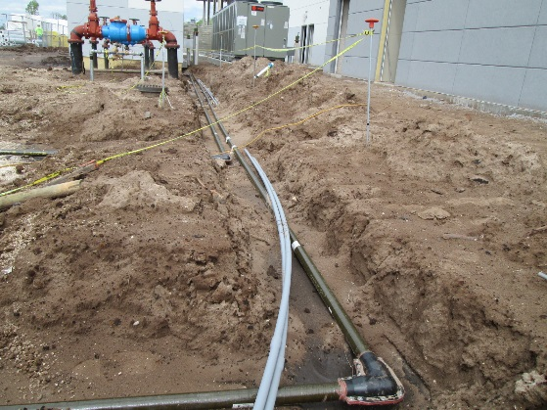
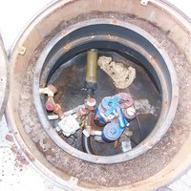
Your Storage Tank System
In general, manufacturers of storage tank system components must register their equipment with the Department before the equipment can be used in the State of Florida. You must ensure that the equipment that you plan to install is listed with the Department, as applicable. Storage Tank System Equipment Registration
AST
Overfill Protection
Release Detection
Underground Piping
Spill Containment
Sump

Slide 8
Financial Responsibility
The facility owner is required to demonstrate and maintain Financial Responsibility (FR) related to the storage tank system from installation through closure.
FR is the ability to pay for the cleanup of a discharge and 3rd party liability resulting from a discharge.
Typical FR mechanisms include insurance policies and financial tests (self-insurance).
Storage Tank Financial Responsibility

Slide 9
Release Detection
Storage tank systems shall have a method or combination of methods of release detection that can detect a new release from any portion of the storage tank system.
Release detection must be conducted on a monthly basis, and not to exceed every 35 days.
Records of all release detection results and findings must be maintained for 3 years and be available for inspection.
Release detection devices are required to have start-up as well as annual operability testing.

Slide 10
Reminder
Other state, federal or local requirements may apply.

Slide 11
District Contact Info
DEP-CENTRAL DISTRICT – 3319 Maguire Blvd, Ste. 232, Orlando, FL 32803-3767; Phone (407) 897-4132
DEP-NORTHEAST DISTRICT – 8800 Baymeadows Way West, Ste. 100, Jacksonville, FL 32256-7526; Phone (904) 256-1700
DEP- NORTHWEST DISTRICT – 160 Governmental Center, Pensacola, FL 32502-5794; Phone (850) 595-0586
DEP-SOUTH DISTRICT – 2295 Victoria Avenue, Ste. 364, Fort Myers, FL 33901-3875; Phone (239) 344-5695
DEP-SOUTHEAST DISTRICT – 3301 Gun Club Rd., MSC 7210-1, West Palm Beach, FL 33406-3007; Phone (561) 681-6600
DEP-SOUTHWEST DISTRICT – 13051 N. Telecom Parkway, Temple Terrace, FL 33637-0926; Phone (813) 470-5874
Storage Tank District and County Contacts

Slide 12
New Emergency Generator Outreach
Thank You
Submit additional questions to William Burns, Environmental Administrator, Compliance Assistance Program
Bill.Burns@dep.state.fl.us or 850-245-8842
Nothing herein is intended to modify Florida Statutes, Department rules or guidance documents incorporated within those rules.

