Slide 1


ETHANOL / BIODIESEL PROGRAM
*This meeting will be recorded and made available to the public through the Ethanol/Biodiesel website.
Notes:
We will be discussing the current State of Florida, Department of Environmental Protection Program concerning those storage tank systems effected by material incompatibility while storing Ethanol-containing fuels and/or Biodiesel. As we make our way through this presentation, there are specific times set aside for question-and-answer periods. Now…let us begin.
By what authority can a facility operator or owner request reimbursement for petroleum storage systems and what is the process?

Slide 2

Agenda
Ethanol/Biodiesel (E/B) Program Authorization
Application Development
Review of Application
Vendor Registration
Purchase Order
Request Payment

Slide 3

Ethanol/Biodiesel Program
Section 376.3071(15), Florida Statutes (F.S.)
Effective date, July 1, 2020
Up to $10 million per year from the Inland Protection Trust Fund

Slide 4
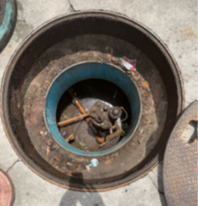
Ethanol/Biodiesel Program
A petroleum storage system owner or operator may request payment from the department for the repair or replacement of petroleum storage tanks, integral piping, or ancillary equipment that may have been damaged, or is subject to damage, by the storage of fuels blended with ethanol or biodiesel or for other preventive measures to ensure compatibility with ethanol or biodiesel. 376.3071(15)(a), Florida Statutes

Slide 5
Application Development
Part 1 – Ethanol/Biodiesel Application
Applicant and claim information
Part 2 – Ethanol/Biodiesel Affidavit & Certifications
As required by section 376.3071(15)(a)1.a., F.S., this form and supporting documentation provide “… An affidavit from a petroleum storage system specialty contractor attesting to an opinion that the petroleum storage system may have been damaged as a result of the storage of fuel blended with ethanol or biodiesel or may not be compatible with fuels containing ethanol or biodiesel…”
Application forms can be found at:
https://floridadep.gov/waste/permitting-compliance-assistance/content/ethanol-biodiesel-program

Slide 6
Application Development
Supporting Documentation
Supporting documentation must include:
Signed and notarized affidavit from a Pollutant Storage System Contractor (PSSC)
Copy of a current Inspection Report
Detailed Scope of Work (SOW)
Demonstration of reasonableness of cost
Tank or pipeline replacement:
Certified CPA Statement of Depreciation
Tanks older than 20 years not eligible
Eligible work completed between July 1, 2015 and June 30, 2019
  PSSC Certification of Work Completed

Slide 7
Common Application Errors
  Part 1
  Inconsistent facility IDs
  Applicant point of contact inconsistent with signature
  Type of payment sought is different on Parts 1 and 2
  Fuel types don’t match Department records
  Applications for work completed prior to July 1, 2015 or after June 30, 2019

Slide 8
Common Application Errors
  Part 2
  Affidavit is inconsistent with the Scope of Work (SOW)
  Affidavit does not provide facility-specific detail
  Documentation provided does not support the SOW
  Number of pages declared on affidavit must be accurate and include supporting documentation
  An unlicensed employee of the PSSC, instead of the PSSC, signs the application

Slide 9
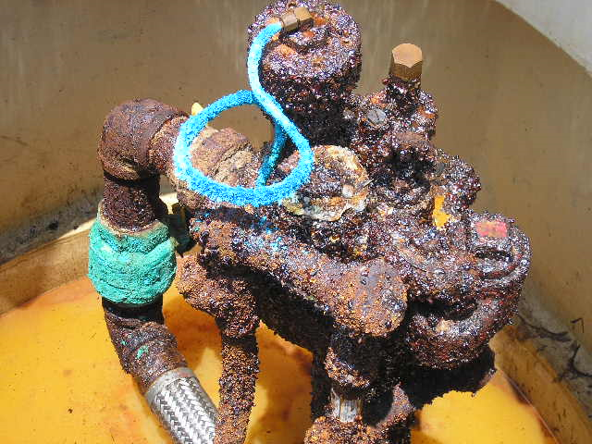
Avoiding Common Application Errors
  Read instructions carefully
  Ensure that information is consistent between Parts 1 and 2
  Contact us if you have questions

Slide 10
Application Submission
Complete application must include:
  Part 1 – Applicant and claim information
  Part 2 – Affidavit and certifications
  Supporting documentation
  Appropriate signatures
Submit to:
  EthanolBioD_Program@FloridaDEP.gov, or
  Department of Environmental Protection
  Division of Waste Management
  Ethanol/Biodiesel Application Form
  2600 Blair Stone Road, Mail Station 4505
  Tallahassee, Florida 32399-2400
NOTE – Please do not send links to a file or portal when submitting electronically

Slide 11
Reasonableness of Cost
Supporting documentation must include demonstration of reasonableness of cost for the Scope of Work (SOW)
376.3071(15)(a)2., Florida Statutes
Methods include:
  Provide SOW and cost proposals from 3 different PSSCs
  Provide SOW and associated costs from completed work with a similar scope, or
  Supply an average or range of standard industry costs for similar or comparable projects

Slide 12
Application Review
  Initial application review is in order of receipt
  Requests for Additional Information (RAIs) are issued:
    For incomplete or incorrect applications
    Until all program criteria are met
  Once all program criteria are met, an Approval Order is issued to the applicant

Slide 13

Vendor Registration
Register as a vendor at My Florida Market Place (Vendor Registration)
Receive vendor verification and User ID
Submit your Substitute Form W-9 electronically

Slide 14
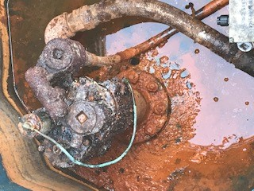
Purchase Order / Payment
Applicants will be notified via MFMP of Purchase Order (P.O.) approval
P.O.s are valid for 180 days from date of notification
All compliance violations for a facility must be resolved before payment can be distributed

Slide 15
Ineligible Costs or Conditions
Payments may not be made for the following:
Proposal costs or costs for application preparation
Certified public accountant costs
Costs in excess of the P.O. amount
Repair or replacement costs for equipment that has previously been repaired or replaced and paid for under this program
Facilities that are out of compliance
Damage to petroleum storage systems due to other causes
See s. 376.3071(15)(g), F.S.

Slide 16
Ethanol/Biodiesel Program Deliverables and Invoicing Requirements
Submit invoices to: EthanolBioD_Program@FloridaDEP.gov
Use this naming convention for both Subject Line and Document Name: [Complete/Partial] Invoice Submittal – [Facility ID]
Invoice package must include:
  All costs, detail of work performed, and dates of service/work performed
  PSSC attestation and proof of payment
  Proof of prior notification to County inspectors
Applicant must submit an invoice within 30 days of the completion of work
NOTE: Invoices will not be paid until an inspection report is available for Department review – This may delay some payments until after the PO is closed.

Slide 17
Questions?
Ethanol/Biodiesel Program –
  EthanolBioD_Program@FloridaDEP.gov
My Florida Marketplace –
  MFMP Customer Service Desk
  Phone: 866-352-3776
  Available: Monday-Friday, 8:00 a.m. - 6:00 p.m. EST
  Vendors: VendorHelp@myfloridamarketplace.com
  Billing Questions: FeeProcessing@myfloridamarketplace.com

Slide 18

Amanda Dorsett (850) 245-8931
Jeff Gregg (850) 245-8816

