Slide 1
Hazardous Waste
Generator Improvement Rule
LQGs
2018
Notes:
Note: The new rule has not been adopted by the State of Florida yet. It is not effective until it is adopted.

Slide 2
Acronyms
Acronyms used throughout this slideshow presentation:
HW/hw- Hazardous Waste
LDR- Land Disposal Restrictions
LQG/LQGs- Large Quantity Generator(s)

Slide 3
Generator Requirements
40 CFR 262.1
Independent requirement means a requirement of Part 262 that states an event, action, or standard that must occur or be met; and that applies without relation to, or irrespective of, the purpose of obtaining a conditional exemption from storage facility permit, interim status, and operating requirements under §§262.14, 262.15, 262.16, 262.17, or Subpart K or Subpart L of this Part.

Slide 4
Independent Requirements - Violations
40 CFR 262.10(g)(1)
A generator’s violation of an independent requirement is subject to penalty and injunctive relief under section 3008 of RCRA.

Slide 5
Independent Requirements
[40 CFR 262.10(a)(1)(iii)]
Independent requirements of an LQG
(A) Section 262.11 - Hazardous waste determination and recordkeeping;
(B) Section 262.13 - Generator category determination;
(C) Section 262.18 - EPA ID No.’s and re-notification for LQGs;
(D) Part 262 Subpart B - Manifest requirements for LQGs;
(E) Part 262 Subpart C - Pre-transport requirements for to LQGs;
(F) Part 262 Subpart D - Recordkeeping and reporting applicable to small and large quantity generators, except §262.44; and
(G) Part 262 Subpart H - Transboundary movements of hazardous waste for recovery or disposal.

Slide 6
Waste Determination
[40 CFR 262.11]
A person who generates a solid waste, as defined in 40 CFR 261.2, must make an accurate determination as to whether that waste is a hazardous waste in order to ensure wastes are properly managed according to applicable RCRA regulations.
Hazardous Waste Determinations are covered in more detail in a separate PowerPoint presentation.

Slide 7
Waste Determination
[40 CFR 262.11(a)]
40 CFR 262.11 Hazardous waste determination and recordkeeping.
A hazardous waste determination is made using the following steps:
(a) The hazardous waste determination for each solid waste must be made at the point of waste generation, before any dilution, mixing, or other alteration of the waste occurs, and at any time in the course of its management that it has, or may have, changed its properties as a result of exposure to the environment or other factors that may change the properties of the waste such that the RCRA classification of the waste may change.

Slide 8
Waste Determination
[40 CFR 262.11(b-c)]
(b) A person must determine whether the solid waste is excluded from regulation under 40 CFR 261.4.
(c) If the waste is not excluded under 40 CFR 261.4, the person must then use knowledge of the waste to determine whether the waste meets any of the listing descriptions under subpart D of 40 CFR part 261. Acceptable knowledge that may be used in making an accurate determination as to whether the waste is listed may include waste origin, composition, the process producing the waste, feedstock, and other reliable and relevant information. If the waste is listed, the person may file a delisting petition under 40 CFR 260.20 and 260.22 to demonstrate to the Administrator that the waste from this particular site or operation is not a hazardous waste.

Slide 9
Waste Determination
[40 CFR 262.11(d)(1)]
(d) The person then must also determine whether the waste exhibits one or more hazardous characteristics as identified in subpart C of 40 CFR part 261 by following the procedures in paragraph (d)(1) or (2) of this section, or a combination of both.
(1) The person must apply knowledge of the hazard characteristic of the waste in light of the materials or the processes used to generate the waste. Acceptable knowledge may include process knowledge (e.g., information about chemical feedstocks and other inputs to the production process); knowledge of products, by-products, and intermediates produced by the manufacturing process; chemical or physical characterization of wastes; information on the chemical and physical properties of the chemicals used or produced by the process or otherwise contained in the waste; testing that illustrates the properties of the waste; or other reliable and relevant information about the properties of the waste or its constituents. A test other than a test method set forth in subpart C of 40 CFR part 261, or an equivalent test method approved by the Administrator under 40 CFR 260.21, may be used as part of a person's knowledge to determine whether a solid waste exhibits a characteristic of hazardous waste. However, such tests do not, by themselves, provide definitive results. Persons testing their waste must obtain a representative sample of the waste for the testing, as defined at 40 CFR 260.10.

Slide 10
Waste Determination
[40 CFR 262.11(d)(2)]
(d)(2) When available knowledge is inadequate to make an accurate determination, the person must test the waste according to the applicable methods set forth in subpart C of 40 CFR part 261 or according to an equivalent method approved by the Administrator under 40 CFR 260.21 and in accordance with the following:
(i) Persons testing their waste must obtain a representative sample of the waste for the testing, as defined at 40 CFR 260.10.
(ii) Where a test method is specified in subpart C of 40 CFR part 261, the results of the regulatory test, when properly performed, are definitive for determining the regulatory status of the waste.

Slide 11
Waste Determination
[40 CFR 262.11(e)]
(e) If the waste is determined to be hazardous, the generator must refer to parts 261, 264, 265, 266, 267, 268, and 273 of this chapter for other possible exclusions or restrictions pertaining to management of the specific waste.

Slide 12
Waste Determination
[40 CFR 262.11(f)]
(f) Recordkeeping for small and large quantity generators.
A small or large quantity generator must maintain records supporting its hazardous waste determinations, including records that identify whether a solid waste is a hazardous waste, as defined by 40 CFR 261.3. Records must be maintained for at least three years from the date that the waste was last sent to on-site or off-site treatment, storage, or disposal. These records must comprise the generator's knowledge of the waste and support the generator's determination, as described at paragraphs (c) and (d) of this section. The records must include, but are not limited to, the following types of information: The results of any tests, sampling, waste analyses, or other determinations made in accordance with this section; records documenting the tests, sampling, and analytical methods used to demonstrate the validity and relevance of such tests; records consulted in order to determine the process by which the waste was generated, the composition of the waste, and the properties of the waste; and records which explain the knowledge basis for the generator's determination, as described at paragraph (d)(1) of this section. The periods of record retention referred to in this section are extended automatically during the course of any unresolved enforcement action regarding the regulated activity or as requested by the Administrator.
Notes:
New

Slide 13
Waste Determination
[40 CFR 262.11(g)]
(g) Identifying hazardous waste numbers for small and large quantity generators.
If the waste is determined to be hazardous, small quantity generators and large quantity generators must identify all applicable EPA hazardous waste numbers (EPA hazardous waste codes) in subparts C and D of part 261 of this chapter. Prior to shipping the waste off site, the generator also must mark its containers with all applicable EPA hazardous waste numbers (EPA hazardous waste codes) according to §262.32.
Notes:
New

Slide 14
Independent Requirements
[40 CFR 262.10(a)(1)(iii)]
Independent requirements of an LQG
(A) Section 262.11 - Hazardous waste determination and recordkeeping;
(B) Section 262.13 - Generator category determination;
(C) Section 262.18 - EPA ID No.’s and re-notification for LQGs;
(D) Part 262 Subpart B - Manifest requirements for LQGs;
(E) Part 262 Subpart C - Pre-transport requirements for LQGs;
(F) Part 262 Subpart D - Recordkeeping and reporting applicable to small and large quantity generators, except §262.44; and
(G) Part 262 Subpart H - Transboundary movements of hazardous waste for recovery or disposal.

Slide 15
Generator Category Determination
[40 CFR 262.13]
40 CFR 262.13 Generator category determination.
A generator must determine its generator category. A generator's category is based on the amount of hazardous waste generated each month and may change from month to month. This section sets forth procedures to determine whether a generator is a very small quantity generator, a small quantity generator, or a large quantity generator for a particular month, as defined in §260.10 of this chapter.
Notes:
New

Slide 16
Generator Category Determination
[40 CFR 262.13(a)]
(a) Generators of either acute hazardous waste or non-acute hazardous waste. A generator who either generates acute hazardous waste or non-acute hazardous waste in a calendar month shall determine its generator category for that month by doing the following:
(1) Counting the total amount of hazardous waste generated in the calendar month;
(2) Subtracting from the total any amounts of waste exempt from counting as described in paragraphs (c) and (d) of this section (see slides below for exceptions); and
(3) Determining the resulting generator category for the hazardous waste generated using Table 1 of this section.

Slide 17
Generator Category Determination
[40 CFR 262.13(b)]
(b) Generators of both acute and non-acute hazardous wastes. A generator who generates both acute hazardous waste and non-acute hazardous waste in the same calendar month shall determine its generator category for that month by doing the following:
(1) Counting separately the total amount of acute HW and the total amount of non-acute HW generated in the calendar month;
(2) Subtracting from each total any amounts of waste exempt from counting as described in paragraphs (c) and (d) of this section;
(3) Determining separately the resulting generator categories for the quantities of acute and non-acute hazardous waste generated using Table 1 of this section; and
(4) Comparing the resulting generator categories from paragraph (b)(3) of this section and applying the more stringent generator category to the accumulation and management of both non-acute HW and acute HW generated for that month.

Slide 18
Generator Category Determination
[40 CFR 262.13 Table 1]
Qty of acute HW generated in a calendar month | Qty of non-acute HW generated in a calendar month | Qty of residues from cleanup of acute HW generated in a calendar month | Generator Category
> 1 kg | Any amount | Any amount | LQG
Any amount | ≥ 1,000 kg | Any amount | LQG
Any amount | Any amount | > 100 kg | LQG
≤ 1 kg | > 100 kg and < 1,000 kg | ≤ 100 kg | SQG
≤ 1 kg | ≤ 100 kg | ≤ 100 kg | VSQG

Slide 19
Generator Category Determination
Wastes NOT Counted
[40 CFR 262.13(c)(1-4)]
(c) When making the monthly quantity-based determinations required by this part, the generator must include all hazardous waste that it generates, except hazardous waste that:
(1) Is exempt from regulation under 40 CFR 261.4(c) through (f), 261.6(a)(3), 261.7(a)(1), or 261.8;
(2) Is managed immediately upon generation only in on-site elementary neutralization units, wastewater treatment units, or totally enclosed treatment facilities as defined in 40 CFR 260.10;
(3) Is recycled, without prior storage or accumulation, only in an on-site process subject to regulation under 40 CFR 261.6(c)(2);
(4) Is used oil managed under the requirements of 40 CFR 261.6(a)(4) and 40 CFR part 279;

Slide 20
Generator Category Determination
Wastes NOT Counted
[40 CFR 262.13(c)(5-8)]
(5) Is spent lead-acid batteries managed under the requirements of 40 CFR part 266 subpart G;
(6) Is universal waste managed under 40 CFR 261.9 and 40 CFR part 273;
(7) Is a hazardous waste that is an unused commercial chemical product (…) that is generated solely as a result of a laboratory clean-out conducted at an eligible academic entity pursuant to §262.213. For purposes of this provision, the term eligible academic entity shall have the meaning as defined in §262.200; or
(8) Is managed as part of an episodic event in compliance with the conditions of subpart L of this part.

Slide 21
Generator Category Determination
Wastes NOT Counted
[40 CFR 262.13(d)(1-3)]
…In determining the quantity of hazardous waste generated in a calendar month, a generator need not include:
Hazardous waste removed from on-site accumulation, so long as it was previously counted once;
(2) Hazardous waste generated by on-site treatment (including reclamation) of the generator's hazardous waste, so long as the hazardous waste that is treated was previously counted once; and
(3) Hazardous waste spent materials that are generated, reclaimed, and subsequently reused on-site, so long as such spent materials have been previously counted once.

Slide 22
Generator Category Determination
[40 CFR 262.13(e)]
(e) Based on the generator category as determined under this section, the generator must meet the applicable independent requirements listed in §262.10.
A generator’s category also determines which of the provisions of §§262.14, 262.15, 262.16 or 262.17 must be met to obtain an exemption from the storage facility permit, interim status, and operating requirements when accumulating hazardous waste.

Slide 23
Generator Category Determination
Wastes
[40 CFR 262.13(f)(2)]
(f)(2) Small quantity generator and large quantity generator wastes
(i) Hazardous wastes generated by a small quantity generator or large quantity generator may be mixed with solid waste. These mixtures are subject to the following: the mixture rule in §§261.3(a)(2)(iv), (b)(2) and (3), and (g)(2)(i); the prohibition of dilution rule at §268.3(a); the land disposal restriction requirements of §268.40 if a characteristic hazardous waste is mixed with a solid waste so that it no longer exhibits the hazardous characteristic; and the hazardous waste determination requirement at §262.11.
(ii) If the resulting mixture is found to be a hazardous waste, this resultant mixture is a newly-generated hazardous waste. A small quantity generator must count both the resultant mixture amount plus the other hazardous waste generated in the calendar month to determine whether the total quantity exceeds the small quantity generator calendar monthly quantity limits identified in the definition of generator categories found in §260.10 of this chapter. If so, to remain exempt from the permitting, interim status, and operating standards, the small quantity generator must meet the conditions for exemption applicable to a large quantity generator. The small quantity generator must also comply with the applicable independent requirements for a large quantity generator.

Slide 24
Independent Requirements
[40 CFR 262.10(a)(1)(iii)]
Independent requirements of an LQG
(A) Section 262.11 - Hazardous waste determination and recordkeeping;
(B) Section 262.13 - Generator category determination;
(C) Section 262.18 - EPA ID No.’s and re-notification for LQGs;
(D) Part 262 Subpart B - Manifest requirements for LQGs;
(E) Part 262 Subpart C - Pre-transport requirements for LQGs;
(F) Part 262 Subpart D - Recordkeeping and reporting applicable to small and large quantity generators, except §262.44; and
(G) Part 262 Subpart H - Transboundary movements of hazardous waste for recovery or disposal.

Slide 25
EPA ID Numbers and Re-Notification
[40 CFR 262.18(a-c)]
(a) A generator must not treat, store, dispose of, transport, or offer for transportation, hazardous waste without having received an EPA identification number from the Administrator.
(b) A generator who has not received an EPA identification number must obtain one by applying to the Administrator using EPA Form 8700-12. Upon receiving the request the Administrator will assign an EPA identification number to the generator.
(c) A generator must not offer its hazardous waste to transporters or to treatment, storage, or disposal facilities that have not received an EPA identification number.
Notes:
New

Slide 26
EPA ID Numbers and Re-Notification
[40 CFR 262.18(d)]
(d) Re-notification
A SQG must re-notify DEP starting in 2021 and every 4 years thereafter using form 8700-12FL. This re-notification must be submitted by September 1st of each year in which re-notifications are required.
A LQG must re-notify DEP by March 1 of each even-numbered year thereafter using form 8700-12FL. A LQG may submit this re-notification as part of its Biennial Report required under 262.41.

Slide 27
EPA ID Numbers and Re-Notification
[40 CFR 262.18(e)]
(e) A recognized trader must not arrange for import or export of hazardous waste without having received an EPA identification number from the Administrator.

Slide 28
Independent Requirements
[40 CFR 262.10(a)(1)(iii)]
Independent requirements of an LQG
(A) Section 262.11 - Hazardous waste determination and recordkeeping;
(B) Section 262.13 - Generator category determination;
(C) Section 262.18 - EPA ID No.’s and re-notification for LQGs;
(D) Part 262 Subpart B - Manifest requirements for LQGs;
(E) Part 262 Subpart C - Pre-transport requirements for LQGs;
(F) Part 262 Subpart D - Recordkeeping and reporting applicable to small and large quantity generators, except §262.44; and
(G) Part 262 Subpart H - Transboundary movements of hazardous waste for recovery or disposal.

Slide 29
Manifest Requirements for LQGs
[40 CFR 262.20(a)]
40 CFR 262.20 General requirements.
(a)(1) A generator who transports, or offers for transport a hazardous waste for offsite treatment, storage, or disposal, or a treatment, storage, and disposal facility who offers for transport a rejected hazardous waste load, must prepare a Manifest (OMB Control number 2050-0039) on EPA Form 8700-22, and, if necessary, EPA Form 8700-22A, according to the instructions included in the appendix to this part.
(2) The revised manifest form and procedures in 40 CFR 260.10, 261.7, 262.20, 262.21, 262.27, 262.32, 262.34, 262.54, 262.60, and the appendix to part 262, shall not apply until September 5, 2006. The manifest form and procedures in 40 CFR 260.10, 261.7, 262.20, 262.21, 262.32, 262.34, 262.54, 262.60, and the appendix to part 262, contained in the 40 CFR, parts 260 to 265, edition revised as of July 1, 2004, shall be applicable until September 5, 2006.

Slide 30
Manifest Requirements for LQGs
[40 CFR 262.20(a)(3)]
(3) Electronic manifest. In lieu of using the manifest form specified in paragraph (a)(1) of this section, a person required to prepare a manifest under paragraph (a)(1) of this section may prepare and use an electronic manifest, provided that the person:
(i) Complies with the requirements in §262.24 for use of electronic manifests, and
(ii) Complies with the requirements of 40 CFR 3.10 for the reporting of electronic documents to EPA.

Slide 31
Manifest Requirements for LQGs
[40 CFR 262.20(b-d)]
(b) A generator must designate on the manifest one facility which is permitted to handle the waste described on the manifest.
(c) A generator may also designate on the manifest one alternate facility which is permitted to handle his waste in the event an emergency prevents delivery of the waste to the primary designated facility.
(d) If the transporter is unable to deliver the hazardous waste to the designated facility or the alternate facility, the generator must either designate another facility or instruct the transporter to return the waste.

Slide 32
Manifest Requirements for LQGs
[40 CFR 262.20(f)]
(f) The requirements of this subpart and §262.32(b) do not apply to the transport of hazardous wastes on a public or private right-of-way within or along the border of contiguous property under the control of the same person, even if such contiguous property is divided by a public or private right-of-way. Notwithstanding 40 CFR 263.10(a), the generator or transporter must comply with the requirements for transporters set forth in 40 CFR 263.30 and 263.31 in the event of a discharge of hazardous waste on a public or private right-of-way.

Slide 33
Manifest Requirements for LQGs
[40 CFR 262.22]
40 CFR 262.22 - Number of copies.
The manifest consists of at least the number of copies which will provide the generator, each transporter, and the owner or operator of the designated facility with one copy each for their records and another copy to be returned to the generator.

Slide 34
Manifest Requirements for LQGs
[40 CFR 262.23(a-c)]
40 CFR 262.23 – Use of the manifest.
The generator must:
Sign the manifest certification by hand; and
(2) Obtain the handwritten signature of the initial transporter and date of acceptance on the manifest; and
(3) Retain one copy, in accordance with §262.40(a).
(b) The generator must give the transporter the remaining copies of the manifest.
(c) For shipments of hazardous waste within the United States solely by water (bulk shipments only), the generator must send three copies of the manifest dated and signed in accordance with this section to the owner or operator of the designated facility or the last water (bulk shipment) transporter to handle the waste in the United States if exported by water. Copies of the manifest are not required for each transporter.

Slide 35
Manifest Requirements for LQGs
[40 CFR 262.23(d)]
(d) For rail shipments of hazardous waste within the United States which originate at the site of generation, the generator must send at least three copies of the manifest dated and signed in accordance with this section to:
(1) The next non-rail transporter, if any; or (2) The designated facility if transported solely by rail; or (3) The last rail transporter to handle the waste in the United States if exported by rail.

Slide 36
Manifest Requirements for LQGs
[40 CFR 262.23(e)]
(e) For shipments of hazardous waste to a designated facility in an authorized State which has not yet obtained authorization to regulate that particular waste as hazardous, the generator must assure that the designated facility agrees to sign and return the manifest to the generator, and that any out-of-state transporter signs and forwards the manifest to the designated facility.

Slide 37
Manifest Requirements for LQGs
[40 CFR 262.23(f)(1)]
(f) For rejected shipments of hazardous waste or container residues contained in non-empty containers that are returned to the generator by the designated facility (following the procedures of 40 CFR 264.72(f) or 265.72(f)), the generator must:
(1) Sign either: (i) Item 20 of the new manifest if a new manifest is used for the returned shipment; or (ii) Item 18c of the original manifest if the original manifest is used for the returned shipment;

Slide 38
Manifest Requirements for LQGs
[40 CFR 262.23(f)(2-4)]
(f) cont.
(2) Provide the transporter a copy of the manifest; (3) Within 30 days of delivery of the rejected shipment or container residues contained in non-empty containers, send a copy of the manifest to the designated facility that returned the shipment to the generator; and (4) Retain at the generator’s site a copy of each manifest for at least three years from the date of delivery.

Slide 39
Manifest Requirements for LQGs
[40 CFR 262.24(a)]
40 CFR 262.24 – Use of the electronic manifest.
(a) Legal equivalence to paper manifests. Electronic manifests that are obtained, completed, and transmitted in accordance with §262.20(a)(3), and used in accordance with this section in lieu of EPA Forms 8700–22 and 8700–22A are the legal equivalent of paper manifest forms bearing handwritten signatures, and satisfy for all purposes any requirement in these regulations to obtain, complete, sign, provide, use, or retain a manifest.

Slide 40
Manifest Requirements for LQGs
[40 CFR 262.24(a)]
(a)(1) Any requirement in these regulations to sign a manifest or manifest certification by hand, or to obtain a handwritten signature, is satisfied by signing with or obtaining a valid and enforceable electronic signature within the meaning of 262.25. (2) Any requirement in these regulations to give, provide, send, forward, or return to another person a copy of the manifest is satisfied when an electronic manifest is transmitted to the other person by submission to the system. (3) Any requirement in these regulations for a generator to keep or retain a copy of each manifest is satisfied by retention of a signed electronic manifest in the generator’s account on the national e-Manifest system, provided that such copies are readily available for viewing and production if requested by any EPA or authorized state inspector. (4) No generator may be held liable for the inability to produce an electronic manifest for inspection under this section if the generator can demonstrate that the inability to produce the electronic manifest is due exclusively to a technical difficulty with the electronic manifest system for which the generator bears no responsibility.

Slide 41
Manifest Requirements for LQGs
[40 CFR 262.24(b-d)]
(b) A generator may participate in the electronic manifest system either by accessing the electronic manifest system from its own electronic equipment, or by accessing the electronic manifest system from portable equipment brought to the generator’s site by the transporter who accepts the hazardous waste shipment from the generator for off-site transportation. (c) Restriction on use of electronic manifests. A generator may prepare an electronic manifest for the tracking of hazardous waste shipments involving any RCRA hazardous waste only if it is known at the time the manifest is originated that all waste handlers named on the manifest participate in the electronic manifest system. (d) Requirement for one printed copy. To the extent the Hazardous Materials regulation on shipping papers for carriage by public highway requires shippers of hazardous materials to supply a paper document for compliance with 49 CFR 177.817, a generator originating an electronic manifest must also provide the initial transporter with one printed copy of the electronic manifest.

Slide 42
Manifest Requirements for LQGs
[40 CFR 262.24(e-f)]
(e) Special procedures when electronic manifest is unavailable. If a generator has prepared an electronic manifest for a hazardous waste shipment, but the electronic manifest system becomes unavailable for any reason prior to the time that the initial transporter has signed electronically to acknowledge the receipt of the hazardous waste from the generator, then the generator must obtain and complete a paper manifest and if necessary, a continuation sheet (EPA Forms 8700–22 and 8700–22A) in accordance with the manifest instructions in the appendix to this part, and use these paper forms from this point forward in accordance with the requirements of §262.23.
(f) Special procedures for electronic signature methods undergoing tests. If a generator has prepared an electronic manifest for a hazardous waste shipment, and signs this manifest electronically using an electronic signature method which is undergoing pilot or demonstration tests aimed at demonstrating the practicality or legal dependability of the signature method, then the generator shall also sign with an ink signature the generator/offeror certification on the printed copy of the manifest provided under paragraph (d) of this section.

Slide 43
Manifest Requirements for LQGs
[40 CFR 262.24(g)]
(g) Imposition of user fee. A generator who is a user of the electronic manifest may be assessed a user fee by EPA for the origination of each electronic manifest. EPA shall maintain and update from time-to-time the current schedule of electronic manifest user fees, which shall be determined based on current and projected system costs and level of use of the electronic manifest system. The current schedule of electronic manifest user fees shall be published as an appendix to this part.

Slide 44
Manifest Requirements for LQGs
[40 CFR 262.25(a-b)]
40 CFR 262.25 Electronic manifest signatures.
Electronic signature methods for the e-Manifest system shall:
(a) Be a legally valid and enforceable signature under applicable EPA and other Federal requirements pertaining to electronic signatures; and
(b) Be a method that is designed and implemented in a manner that EPA considers to be as cost-effective and practical as possible for the users of the manifest.

Slide 45
Manifest Requirements for LQGs
[40 CFR 262.27(a)]
40 CFR 262.27 Waste minimization certification.
A generator who initiates a shipment of hazardous waste must certify to one of the following statements in Item 15 of the uniform hazardous waste manifest:
‘‘I am a large quantity generator. I have a program in place to reduce the volume and toxicity of waste generated to the degree I have determined to be economically practicable and I have selected the practicable method of treatment, storage, or disposal currently available to me which minimizes the present and future threat to human health and the environment;’’ or
(Is for SQGs)

Slide 46
Manifest Requirements for LQGs

Slide 47
Manifest Requirements for LQGs
[Appendix to Part 262]
U.S. EPA Form 8700-22 Instructions
Instructions for generators
Item 1. Generator’s U.S. EPA Identification Number
Enter the generator’s U.S. EPA twelve digit identification number, or the State generator identification number if the generator site does not have an EPA identification number.
Item 2. Page 1 of __
Enter the total number of pages used to complete this Manifest (i.e., the first page (EPA Form 8700–22) plus the number of Continuation Sheets (EPA Form 8700–22A), if any).

Slide 48
Manifest Requirements for LQGs
[Appendix to Part 262]
U.S. EPA Form 8700-22 Instructions
Instructions for generators
Item 3. Emergency Response Phone Number
Enter a phone number for which emergency response information can be obtained in the event of an incident during transportation. The emergency response phone number must: 1. Be the number of the generator or the number of an agency or organization who is capable of and accepts responsibility for providing detailed information about the shipment; 2. Reach a phone that is monitored 24 hours a day at all times the waste is in transportation (including transportation related storage); and 3. Reach someone who is either knowledgeable of the hazardous waste being shipped and has comprehensive emergency response and spill cleanup/incident mitigation information for the material being shipped or has immediate access to a person who has that knowledge and information about the shipment.
Notes:
NOTE: Emergency Response phone number information should only be entered in Item 3 when there is one phone number that applies to all the waste materials described in Item 9b. If a situation (e.g., consolidated shipments) arises where more than one Emergency Response phone number applies to the various wastes listed on the manifest, the phone numbers associated with each specific material should be entered after its description in Item 9b.

Slide 49
Manifest Requirements for LQGs
[Appendix to Part 262]
U.S. EPA Form 8700-22 Instructions
Instructions for generators
Item 4. Manifest Tracking Number
This unique tracking number must be preprinted on the manifest by the forms printer.
Item 5. Generator’s Mailing Address, Phone Number and Site Address
Enter the name of the generator, the mailing address to which the completed manifest signed by the designated facility should be mailed, and the generator’s telephone number. Note, the telephone number (including area code) should be the normal business number for the generator, or the number where the generator or his authorized agent may be reached to provide instructions in the event the designated and/or alternate (if any) facility rejects some or all of the shipment. Also enter the physical site address from which the shipment originates only if this address is different than the mailing address.

Slide 50
Manifest Requirements for LQGs
[Appendix to Part 262]
U.S. EPA Form 8700-22 Instructions
Instructions for generators
Item 6. Transporter 1 Company Name, and U.S. EPA ID Number
Enter the company name and U.S. EPA ID number of the first transporter who will transport the waste. Vehicle or driver information may not be entered here.
Item 7. Transporter 2 Company Name and U.S. EPA ID Number
If applicable, enter the company name and U.S. EPA ID number of the second transporter who will transport the waste. Vehicle or driver information may not be entered here. If more than two transporters are needed, use a Continuation Sheet(s) (EPA Form 8700– 22A).

Slide 51
Manifest Requirements for LQGs
[Appendix to Part 262]
U.S. EPA Form 8700-22 Instructions
Instructions for generators
Item 8. Designated Facility Name, Site Address, and U.S. EPA ID Number
Enter the company name and site address of the facility designated to receive the waste listed on this manifest. Also enter the facility’s phone number and the U.S. EPA twelve digit identification number of the facility.

Slide 52
Manifest Requirements for LQGs
[Appendix to Part 262]
U.S. EPA Form 8700-22 Instructions
Instructions for generators
Item 9. U.S. DOT Description (Including Proper Shipping Name, Hazard Class or Division, Identification Number, and Packing Group)
Item 9a. If the wastes identified in Item 9b consist of both hazardous and nonhazardous materials, then identify the hazardous materials by entering an ‘‘X’’ in this Item next to the corresponding hazardous material identified in Item 9b. If applicable, enter the name of the person accepting the waste on behalf of the second transporter. That person must acknowledge acceptance of the waste described on the manifest by signing and entering the date of receipt. Item 9b. Enter the U.S. DOT Proper Shipping Name, Hazard Class or Division, Identification Number (UN/NA) and Packing Group for each waste as identified in 49 CFR 172. Include technical name(s) and reportable quantity references, if applicable.
Notes:
NOTE: If additional space is needed for waste descriptions, enter these additional descriptions in Item 27 on the Continuation Sheet (EPA Form 8700–22A). Also, if more than one Emergency Response phone number applies to the various wastes described in either Item 9b or Item 27, enter applicable Emergency Response phone numbers immediately following the shipping descriptions for those Items.

Slide 53
Manifest Requirements for LQGs
[Appendix to Part 262]
U.S. EPA Form 8700-22 Instructions
Instructions for generators
Item 10. Containers (Number and Type)
Enter the number of containers for each waste and the appropriate abbreviation from Table I (below) for the type of container.
TABLE I—TYPES OF CONTAINERS
BA = Burlap, cloth, paper, or plastic bags.
CF = Fiber or plastic boxes, cartons, cases.
CM = Metal boxes, cartons, cases (including roll-offs).
CW = Wooden boxes, cartons, cases.
CY = Cylinders.
DF = Fiberboard or plastic drums, barrels, kegs.
DM = Metal drums, barrels, kegs.
DT = Dump truck.
DW = Wooden drums, barrels, kegs.
HG = Hopper or gondola cars.
TC = Tank cars.
TP = Portable tanks.
TT = Cargo tanks (tank trucks).

Slide 54
Manifest Requirements for LQGs
[Appendix to Part 262]
U.S. EPA Form 8700-22 Instructions
Instructions for generators
Item 11. Total Quantity
Enter, in designated boxes, the total quantity of waste. Round partial units to the nearest whole unit, and do not enter decimals or fractions. To the extent practical, report quantities using appropriate units of measure that will allow you to report quantities with precision. Waste quantities entered should be based on actual measurements or reasonably accurate estimates of actual quantities shipped. Container capacities are not acceptable as estimates.

Slide 55
Manifest Requirements for LQGs
[Appendix to Part 262]
U.S. EPA Form 8700-22 Instructions
Instructions for generators
Item 12. Units of Measure (Weight/Volume)
Enter, in designated boxes, the appropriate abbreviation from Table II (below) for the unit of measure.
TABLE II—UNITS OF MEASURE
G = Gallons (liquids only).
K = Kilograms.
L = Liters (liquids only).
M = Metric Tons (1000 kilograms).
N = Cubic Meters.
P = Pounds.
T = Tons (2000 pounds).
Y = Cubic Yards.
Note: Tons, Metric Tons, Cubic Meters, and Cubic Yards
should only be reported in connection with very large bulk
shipments, such as rail cars, tank trucks, or barges.

Slide 56
Manifest Requirements for LQGs
[Appendix to Part 262]
U.S. EPA Form 8700-22 Instructions
Instructions for generators
Item 13. Waste Codes
Enter up to six federal and state waste codes to describe each waste stream identified in Item 9b. State waste codes that are not redundant with federal codes must be entered here, in addition to the federal waste codes which are most representative of the properties of the waste.

Slide 57
Manifest Requirements for LQGs
[Appendix to Part 262]
U.S. EPA Form 8700-22 Instructions
Instructions for generators
Item 14. Special Handling Instructions and Additional Information.
1. Generators may enter any special handling or shipment-specific information necessary for the proper management or tracking of the materials under the generator’s or other handler’s business processes, such as waste profile numbers, container codes, bar codes, or response guide numbers. Generators also may use this space to enter additional descriptive information about their shipped materials, such as chemical names, constituent percentages, physical state, or specific gravity of wastes identified with volume units in Item 12. 2. This space may be used to record limited types of federally required information for which there is no specific space provided on the manifest, including any alternate facility designations; the manifest tracking number of the original manifest for rejected wastes and residues that are re-shipped under a second manifest; and the specification of PCB waste descriptions and PCB out of-service dates required under 40 CFR 761.207. Generators, however, cannot be required to enter information in this space to meet state regulatory requirements.

Slide 58
Manifest Requirements for LQGs
[Appendix to Part 262]
U.S. EPA Form 8700-22 Instructions
Instructions for generators
Item 15. Generator’s/Offeror’s Certifications
1. The generator must read, sign, and date the waste minimization certification statement. In signing the waste minimization certification statement, those generators who have not been exempted by statute or regulation from the duty to make a waste minimization certification under section 3002(b) of RCRA are also certifying that they have complied with the waste minimization requirements. The Generator’s Certification also contains the required attestation that the shipment has been properly prepared and is in proper condition for transportation (the shipper’s certification). The content of the shipper’s certification statement is as follows: ‘‘I hereby declare that the contents of this consignment are fully and accurately described above by the proper shipping name, and are classified, packaged, marked, and labeled/placarded, and are in all respects in proper condition for transport by highway according to applicable international and national governmental regulations. If export shipment and I am the Primary Exporter, I certify that the contents of this consignment conform to the terms of the attached EPA Acknowledgment of Consent.’’ When a party other than the generator prepares the shipment for transportation, this party may also sign the shipper’s certification statement as the offeror of the shipment.
Notes:
NOTE: All of the above information except the handwritten signature required in Item 15 may be pre-printed.

Slide 59
Manifest Requirements for LQGs
[Appendix to Part 262]
U.S. EPA Form 8700-22 Instructions
Instructions for generators
Item 15. Generator’s/Offeror’s Certifications (Continued)
2. Generator or Offeror personnel may preprint the words, ‘‘On behalf of’’ in the signature block or may hand write this statement in the signature block prior to signing the generator/offeror certification, to indicate that the individual signs as the employee or agent of the named principal.
Notes:
NOTE: All of the above information except the handwritten signature required in Item 15 may be pre-printed.

Slide 60
Manifest Requirements for LQGs
[Appendix to Part 262]
U.S. EPA Form 8700-22 Instructions
Instructions for international shipment block
Item 16. International Shipments
For export shipments, the primary exporter must check the export box, and enter the point of exit (city and state) from the United States. For import shipments, the importer must check the import box and enter the point of entry (city and state) into the United States. For exports, the transporter must sign and date the manifest to indicate the day the shipment left the United States.

Slide 61
Manifest Requirements for LQGs
[Appendix to Part 262]
U.S. EPA Form 8700-22 Instructions
III. Instructions for transporters
Item 17. Transporters’ Acknowledgments of Receipt
Enter the name of the person accepting the waste on behalf of the first transporter. That person must acknowledge acceptance of the waste described on the manifest by signing and entering the date of receipt. Only one signature per transportation company is required. Signatures are not required to track the movement of wastes in and out of transfer facilities, unless there is a change of custody between transporters. If applicable, enter the name of the person accepting the waste on behalf of the second transporter. That person must acknowledge acceptance of the waste described on the manifest by signing and entering the date of receipt.
Notes:
NOTE: Transporters carrying imports, who are acting as importers, may have responsibilities to enter information in the International Shipments Block. Transporters carrying exports may also have responsibilities to enter information in the International Shipments Block. See above instructions for Item 16.

Slide 62
Manifest Requirements for LQGs
[Appendix to Part 262]
U.S. EPA Form 8700-22 Instructions
Instructions for owners and operators of treatment, storage, and disposal facilities
Item 18. Discrepancy
Item 18a. Discrepancy Indication Space
1. The authorized representative of the designated (or alternate) facility’s owner or operator must note in this space any discrepancies between the waste described on the Manifest and the waste actually received at the facility. Manifest discrepancies are: significant differences (as defined by §§264.72(b) and 265.72(b)) between the quantity or type of hazardous waste designated on the manifest or shipping paper, and the quantity and type of hazardous waste a facility actually receives, rejected wastes, which may be a full or partial shipment of hazardous waste that the TSDF cannot accept, or container residues, which are residues that exceed the quantity limits for ‘‘empty’’ containers set forth in 40 CFR 261.7(b).

Slide 63
Manifest Requirements for LQGs
[Appendix to Part 262]
U.S. EPA Form 8700-22 Instructions
Instructions for owners and operators of treatment, storage, and disposal facilities
Item 18. Discrepancy (Continued)
Item 18a. Discrepancy Indication Space
2. For rejected loads and residues (40 CFR 264.72(d), (e), and (f), or 40 CFR 265.72(d), (e), or (f)), check the appropriate box if the shipment is a rejected load (i.e., rejected by the designated and/or alternate facility and is sent to an alternate facility or returned to the generator) or a regulated residue that cannot be removed from a container. Enter the reason for the rejection or the inability to remove the residue and a description of the waste. Also, reference the manifest tracking number for any additional manifests being used to track the rejected waste or residue shipment on the original manifest. Indicate the original manifest tracking number in Item 14, the Special Handling Block and Additional Information Block of the additional manifests.

Slide 64
Manifest Requirements for LQGs
[Appendix to Part 262]
U.S. EPA Form 8700-22 Instructions
Instructions for owners and operators of treatment, storage, and disposal facilities
Item 18. Discrepancy (Continued)
Item 18a. Discrepancy Indication Space
3. Owners or operators of facilities located in unauthorized States (i.e., states in which the U.S. EPA administers the hazardous waste management program) who cannot resolve significant differences in quantity or type within 15 days of receiving the waste must submit to their Regional Administrator a letter with a copy of the Manifest at issue describing the discrepancy and attempts to reconcile it (40 CFR 264.72(c) and 265.72(c)).

Slide 65
Manifest Requirements for LQGs
[Appendix to Part 262]
U.S. EPA Form 8700-22 Instructions
Instructions for owners and operators of treatment, storage, and disposal facilities
Item 18. Discrepancy (Continued)
Item 18a. Discrepancy Indication Space
4. Owners or operators of facilities located in authorized States (i.e., those States that have received authorization from the U.S. EPA to administer the hazardous waste management program) should contact their State agency for information on where to report discrepancies involving ‘‘significant differences’’ to state officials.

Slide 66
Manifest Requirements for LQGs
[Appendix to Part 262]
U.S. EPA Form 8700-22 Instructions
Instructions for owners and operators of treatment, storage, and disposal facilities
Item 18. Discrepancy (Continued)
Item 18b. Alternate Facility (or Generator) for Receipt of Full Load Rejections
Enter the name, address, phone number, and EPA Identification Number of the Alternate Facility which the rejecting TSDF has designated, after consulting with the generator, to receive a fully rejected waste shipment. In the event that a fully rejected shipment is being returned to the generator, the rejecting TSDF may enter the generator’s site information in this space. This field is not to be used to forward partially rejected loads or residue waste shipments.

Slide 67
Manifest Requirements for LQGs
[Appendix to Part 262]
U.S. EPA Form 8700-22 Instructions
Instructions for owners and operators of treatment, storage, and disposal facilities
Item 18. Discrepancy (Continued)
Item 18c. Alternate Facility (or Generator) Signature
The authorized representative of the alternate facility (or the generator in the event of a returned shipment) must sign and date this field of the form to acknowledge receipt of the fully rejected wastes or residues identified by the initial TSDF.

Slide 68
Manifest Requirements for LQGs
[Appendix to Part 262]
U.S. EPA Form 8700-22 Instructions
Instructions for owners and operators of treatment, storage, and disposal facilities
Item 19. Hazardous Waste Report Management Method Codes
Enter the most appropriate Hazardous Waste Report Management Method code for each waste listed in Item 9. The Hazardous Waste Report Management Method code is to be entered by the first treatment, storage, or disposal facility (TSDF) that receives the waste and is the code that best describes the way in which the waste is to be managed when received by the TSDF.

Slide 69
Manifest Requirements for LQGs
[Appendix to Part 262]
U.S. EPA Form 8700-22 Instructions
Instructions for owners and operators of treatment, storage, and disposal facilities
Item 20. Designated Facility Owner or Operator Certification of Receipt (Except As Noted in Item 18a)
Enter the name of the person receiving the waste on behalf of the owner or operator of the facility. That person must acknowledge receipt or rejection of the waste described on the Manifest by signing and entering the date of receipt or rejection where indicated. Since the Facility Certification acknowledges receipt of the waste except as noted in the Discrepancy Space in Item 18a, the certification should be signed for both waste receipt and waste rejection, with the rejection being noted and described in the space provided in Item 18a. Fully rejected wastes may be forwarded or returned using Item 18b after consultation with the generator. Enter the name of the person accepting the waste on behalf of the owner or operator of the alternate facility or the original generator. That person must acknowledge receipt or rejection of the waste described on the Manifest by signing and entering the date they received or rejected the waste in Item 18c. Partially rejected wastes and residues must be re-shipped under a new manifest, to be initiated and signed by the rejecting TSDF as offeror of the shipment.

Slide 70
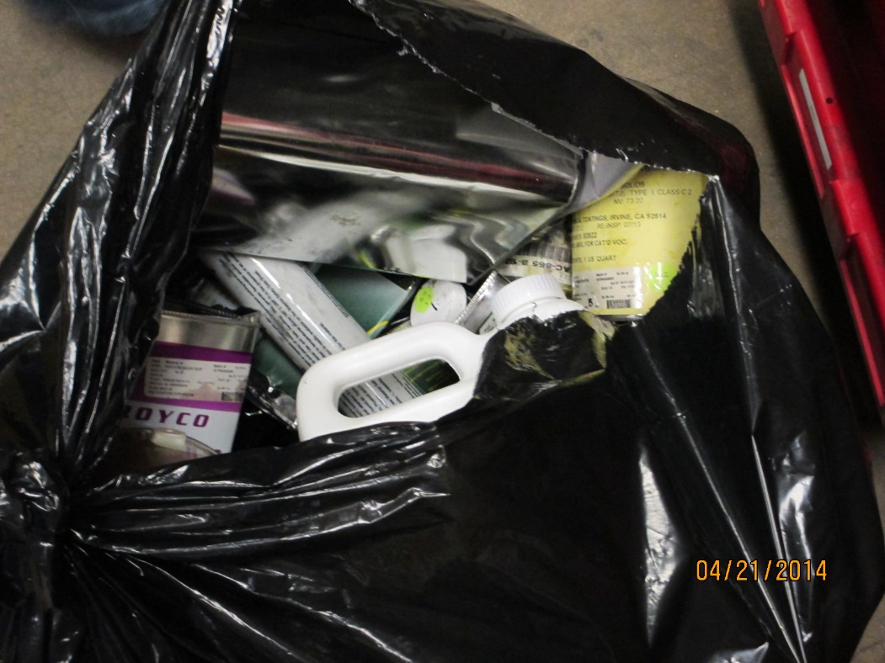
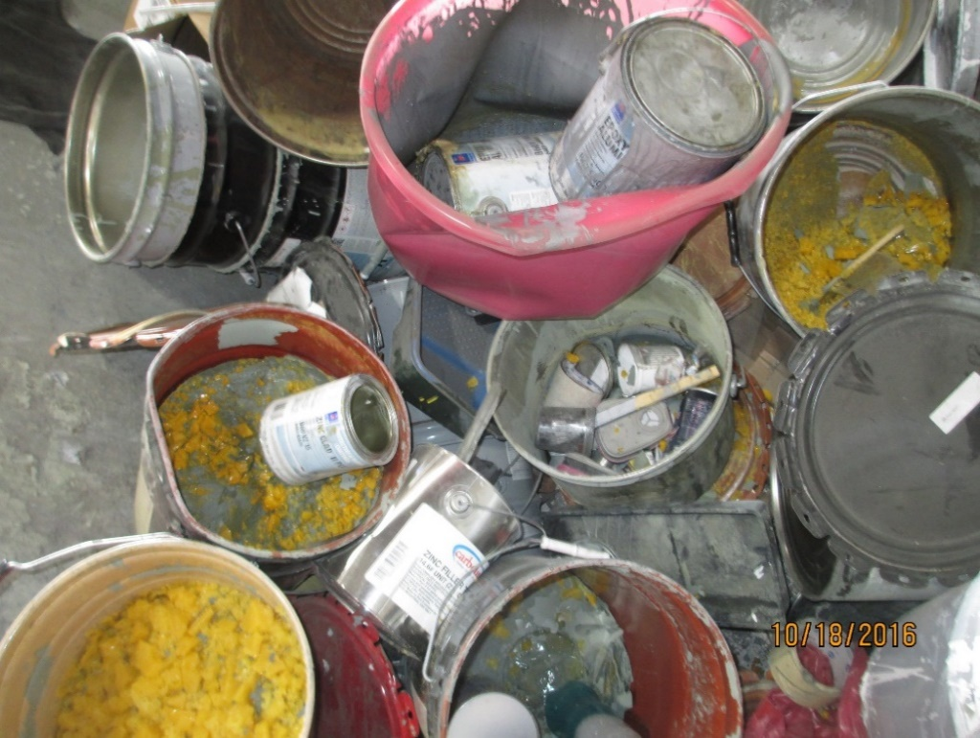
LQG Improperly Managing Waste
Don’t
Notes:
Hazardous waste incorrectly containerized, not labeled, and open containers.

Slide 71
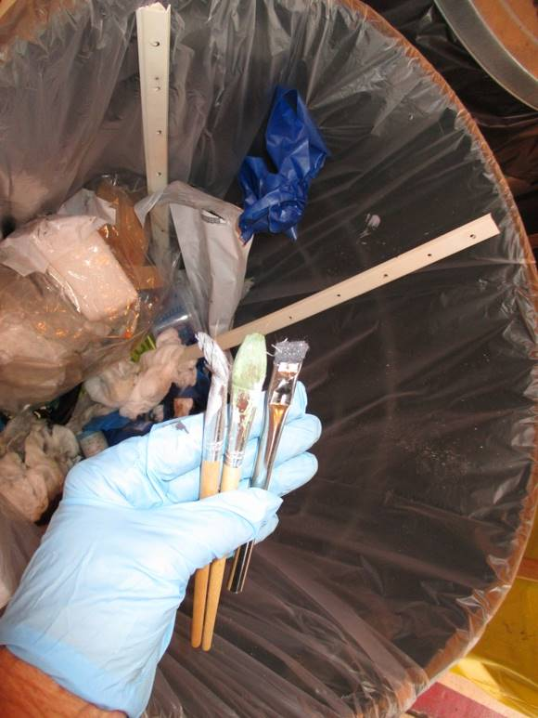
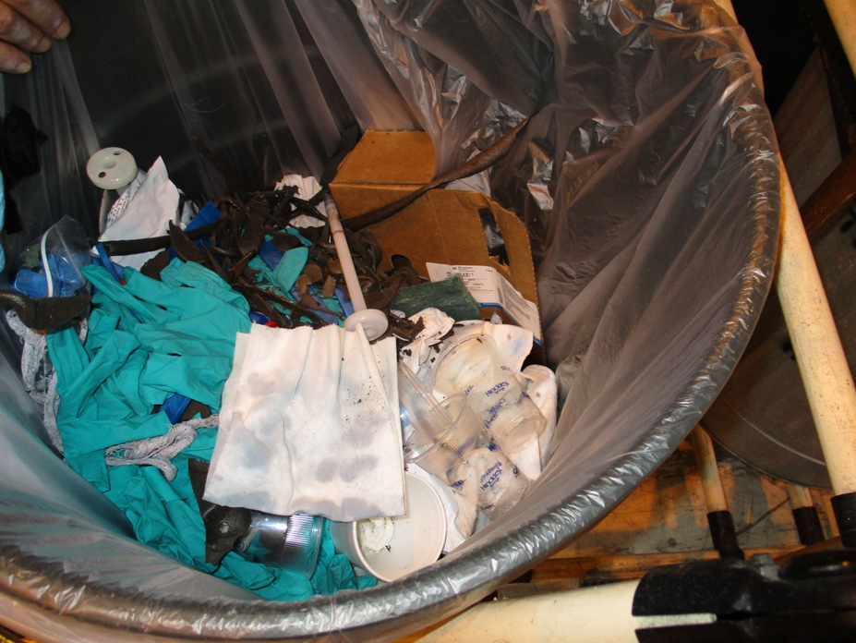
Hazardous Waste in Trash
Don’t
Notes:
Hazardous waste solvents and alodine and paint brushes are thrown away into the trash.

Slide 72
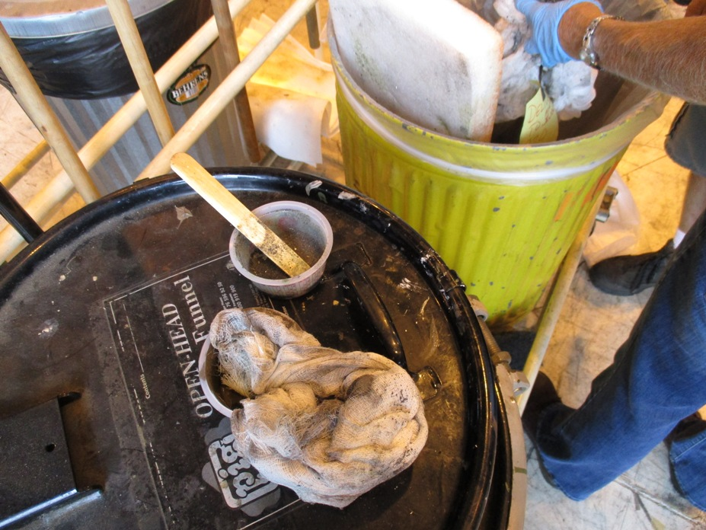
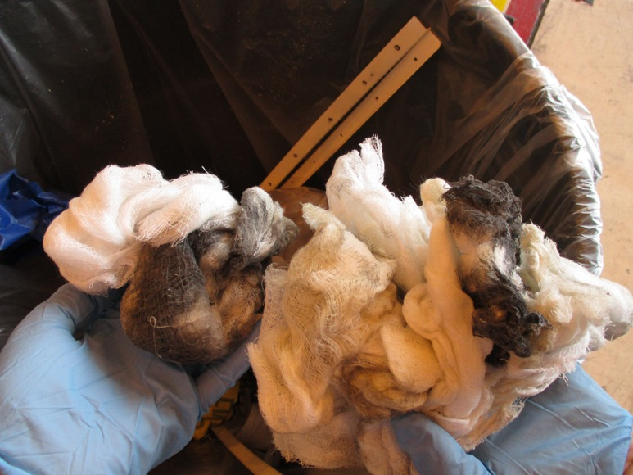
Hazardous Waste in Trash
Don’t
Notes:
Hazardous waste solvent rags and hazardous waste sealant in trash.

Slide 73
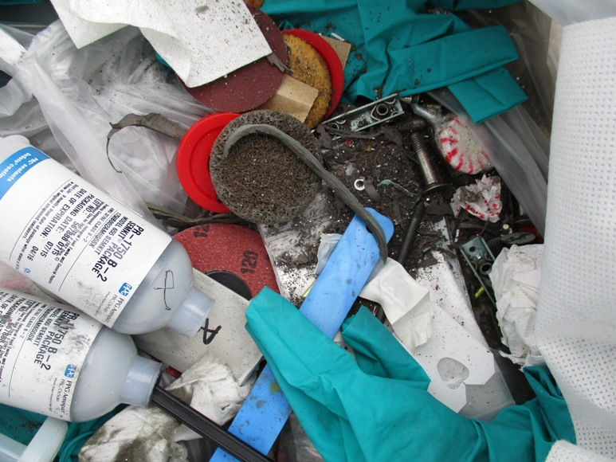
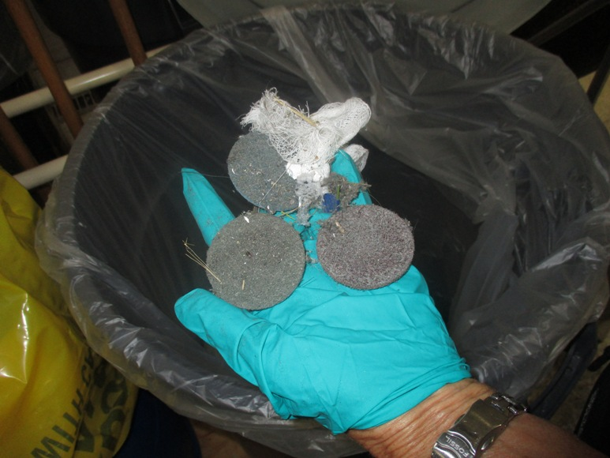
Hazardous Waste in Trash
Don’t
Notes:
Metal grindings and grinding discs in trash.
What were you grinding?
Painted or unpainted?
How is the Inspector supposed to know?

Slide 74
Independent Requirements
[40 CFR 262.10(a)(1)(iii)]
Independent requirements of an LQG
(A) Section 262.11 - Hazardous waste determination and recordkeeping;
(B) Section 262.13 - Generator category determination;
(C) Section 262.18 - EPA ID No.’s and re-notification for LQGs;
(D) Part 262 Subpart B - Manifest requirements for LQGs;
(E) Part 262 Subpart C - Pre-transport requirements for LQGs;
(F) Part 262 Subpart D -Recordkeeping and reporting applicable to small and large quantity generators, except §262.44; and
(G) Part 262 Subpart H - Transboundary movements of hazardous waste for recovery or disposal.

Slide 75
Pre-Transport Requirements for LQGs
[40 CFR 262 Subpart C]
40 CFR 262.30 – Packaging.
40 CFR 262.31 – Labeling.
40 CFR 262.32 – Marking.
40 CFR 262.33 – Placarding.
40 CFR 262.35 – Liquids in landfills prohibition.

Slide 76
Pre-Transport Requirements for LQGs
Packaging
[40 CFR 262.30]
40 CFR 262.30 – Packaging.
Before transporting hazardous waste or offering hazardous waste for transportation off-site, a generator must package the waste in accordance with the applicable Department of Transportation regulations on packaging under 49 CFR parts 173, 178, and 179.

Slide 77
Pre-Transport Requirements for LQGs
Labeling
[40 CFR 262.31]
40 CFR 262.31 – Labeling.
Before transporting or offering hazardous waste for transportation off-site, a generator must label each package in accordance with the applicable Department of Transportation regulations on hazardous materials under 49 CFR part 172.

Slide 78
Pre-Transport Requirements for LQGs
Marking
[40 CFR 262.32(a-b)]
40 CFR 262.32 – Marking.
(a) Before transporting or offering hazardous waste for transportation off-site, a generator must mark each package of hazardous waste in accordance with the applicable Department of Transportation regulations on hazardous materials under 49 CFR part 172;
(b) Before transporting hazardous waste or offering hazardous waste for transportation off site, a generator must mark each container of 119 gallons or less used in such transportation with the following words and information in accordance with the requirements of 49 CFR 172.304:
(1) HAZARDOUS WASTE—Federal Law Prohibits Improper Disposal. If found, contact the nearest police or public safety authority or the U.S. Environmental Protection Agency.
(2) Generator's Name and Address ____.
(3) Generator's EPA Identification Number ____.
(4) Manifest Tracking Number ____.
(5) EPA Hazardous Waste Number(s) ____.

Slide 79
Pre-Transport Requirements for LQGs
Marking
[40 CFR 262.32(c-d)]
(c) A generator may use a nationally recognized electronic system, such as bar coding, to identify the EPA Hazardous Waste Number(s), as required by paragraph (b)(5) or paragraph (d).
(d) Lab packs that will be incinerated in compliance with §268.42(c) are not required to be marked with EPA Hazardous Waste Number(s), except D004, D005, D006, D007, D008, D010, and D011, where applicable.
Notes:
(d) Is new

Slide 80
Pre-Transport Requirements for LQGs
Placarding
[40 CFR 262.33]
40 CFR 262.33 – Placarding.
Before transporting hazardous waste or offering hazardous waste for transportation off-site, a generator must placard or offer the initial transporter the appropriate placards according to Department of Transportation regulations for hazardous materials under 49 CFR part 172, subpart F.

Slide 81
Pre-Transport Requirements for LQGs
Liquids in Landfills
[40 CFR 262.35]
40 CFR 262.35 – Liquids in landfills prohibition.
The placement of bulk or non-containerized liquid hazardous waste or hazardous waste containing free liquids (whether or not sorbents have been added) in any landfill is prohibited. Prior to disposal in a hazardous waste landfill, liquids must meet additional requirements as specified in §§264.314 and 265.314.
Notes:
New

Slide 82
Independent Requirements
[40 CFR 262.10(a)(1)(iii)]
Independent requirements of an LQG
(A) Section 262.11 - Hazardous waste determination and recordkeeping;
(B) Section 262.13 - Generator category determination;
(C) Section 262.18 - EPA ID No.’s and re-notification for LQGs;
(D) Part 262 Subpart B - Manifest requirements for LQGs;
(E) Part 262 Subpart C - Pre-transport requirements for LQGs;
(F) Part 262 Subpart D - Recordkeeping and reporting applicable to small and large quantity generators, except §262.44; and
(G) Part 262 Subpart H - Transboundary movements of hazardous waste for recovery or disposal.

Slide 83
Recordkeeping for LQGs
[40 CFR 262.40(a-d)]
40 CFR 262.40 – Recordkeeping.
(a) A generator must keep a copy of each manifest signed in accordance with §262.23(a) for three years or until he receives a signed copy from the designated facility which received the waste. This signed copy must be retained as a record for at least three years from the date the waste was accepted by the initial transporter.
(b) A generator must keep a copy of each Biennial Report and Exception Report for a period of at least three years from the due date of the report.
(c) See §262.11(f) for recordkeeping requirements for documenting hazardous waste determinations.
(d) The periods or retention referred to in this section are extended automatically during the course of any unresolved enforcement action regarding the regulated activity or as requested by the Administrator.
Notes:
(c) Is new

Slide 84
Biennial report for LQGs
[40 CFR 262.41(a-c)]
40 CFR 262.41 Biennial report for LQGs
(a) A generator who is a large quantity generator for at least one month of an odd-numbered year (reporting year) who ships any hazardous waste off-site to a treatment, storage or disposal facility within the United States must complete and submit EPA Form 8700–13 A/B to the Regional Administrator by March 1 of the following even-numbered year and must cover generator activities during the previous year.
(b) Any generator who is a large quantity generator for at least one month of an odd-numbered year (reporting year) who treats, stores, or disposes of hazardous waste on site must complete and submit EPA Form 8700–13 A/B to the Regional Administrator by March 1 of the following even-numbered year covering those wastes in accordance with the provisions of 40 CFR parts 264, 265, 266, 267 and 270. This requirement also applies to large quantity generators that receive hazardous waste from very small quantity generators pursuant to §262.17(f).
(c) Exports of hazardous waste to foreign countries are not required to be reported on the Biennial Report form. A separate annual report requirement is set forth at §262.83(g) for hazardous waste exporters.
Notes:
New

Slide 85
Exception reporting for LQGs
[40 CFR 262.42(a)]
40 CFR 262.42 Exception reporting.
(a)(1) A generator of 1,000 kilograms or greater of hazardous waste in a calendar month, or greater than 1 kg of acute hazardous waste listed in §261.31 or §261.33(e) in a calendar month, who does not receive a copy of the manifest with the handwritten signature of the owner or operator of the designated facility within 35 days of the date the waste was accepted by the initial transporter must contact the transporter and/or the owner or operator of the designated facility to determine the status of the hazardous waste.
(2) A generator of 1,000 kilograms or greater of hazardous waste in a calendar month, or greater than 1 kg of acute hazardous waste listed in §261.31or §261.33(e) in a calendar month, must submit an Exception Report to the EPA Regional Administrator for the Region in which the generator is located if he has not received a copy of the manifest with the handwritten signature of the owner or operator of the designated facility within 45 days of the date the waste was accepted by the initial transporter. The Exception Report must include: (i) A legible copy of the manifest for which the generator does not have confirmation of delivery; (ii) A cover letter signed by the generator or his authorized representative explaining the efforts taken to locate the hazardous waste and the results of those efforts.
Notes:
(b) Is for SQGs

Slide 86
Exception reporting for LQGs
[40 CFR 262.42(c)]
(c) For rejected shipments of hazardous waste or container residues contained in non-empty containers that are forwarded to an alternate facility by a designated facility using a new manifest (following the procedures of 40 CFR 264.72(e)(1) through (6) or 40 CFR 265.72(e)(1) through (6)), the generator must comply with the requirements of paragraph (a) or (b) of this section, as applicable, for the shipment forwarding the material from the designated facility to the alternate facility instead of for the shipment from the generator to the designated facility. For purposes of paragraph (a) or (b) of this section for a shipment forwarding such waste to an alternate facility by a designated facility: (1) The copy of the manifest received by the generator must have the handwritten signature of the owner or operator of the alternate facility in place of the signature of the owner or operator of the designated facility, and (2) The 35/45/60-day timeframes begin the date the waste was accepted by the initial transporter forwarding the hazardous waste shipment from the designated facility to the alternate facility.

Slide 87
Additional reporting for LQGs
[40 CFR 262.43]
40 CFR 262.43 Additional Reporting
The Administrator, as deemed necessary under sections 2002(a) and 3002(a)(6) of the Act, may require generators to furnish additional reports concerning the quantities and disposition of wastes identified or listed in 40 CFR part 261.
Notes:
New

Slide 88
Independent Requirements
[40 CFR 262.10(a)(1)(iii)]
Independent requirements of an LQG
(A) Section 262.11 - Hazardous waste determination and recordkeeping;
(B) Section 262.13 - Generator category determination;
(C) Section 262.18 - EPA ID No.’s and re-notification for LQGs;
(D) Part 262 Subpart B - Manifest requirements for LQGs;
(E) Part 262 Subpart C - Pre-transport requirements for LQGs;
(F) Part 262 Subpart D - Recordkeeping and reporting applicable to small and large quantity generators, except §262.44; and
(G) Part 262 Subpart H - Transboundary movements of hazardous waste for recovery or disposal.

Slide 89
Transboundary Movements of HW for LQGs
[40 CFR 262 Subpart H]
40 CFR 262.80 – 40 CFR 262.89 (40 CFR 262.85-262.89 [Reserved]) – These sections cover imports and exports of hazardous waste.
These will not be covered in this Workshop.
Notes:
New

Slide 90
Generator Requirements
40 CFR 262.1
Condition for Exemption means any requirement in 262.14, 262.15, 262.16, 262.17, 262.70, or Subpart K or Subpart L of this part that states an event, action, or standard that must occur or be met in order to obtain an exemption from any applicable requirement in Parts 124, 264 through 268, and 270 of this chapter, or from any requirement for notification under section 3010 of RCRA.
Notes:
New

Slide 91
Conditions for Exemption for LQGs
[40 CFR 262.17]
Conditions for exemption for LQGs that accumulate hazardous waste are found in 40 CFR 262.17

Slide 92
Condition for Exemption - Violations
40 CFR 262.10(g)(2)
(2) A generator’s noncompliance with a condition for exemption in this part is not subject to penalty or injunctive relief under section 3008 of RCRA as a violation of a 40 CFR part 262 condition for exemption. Noncompliance by any generator with an applicable condition for exemption from storage permit and operations requirements means that the facility is a storage facility operating without an exemption from the permit, interim status, and operations requirements in 40 CFR parts 124, 264 through 267, and 270 of this chapter, and the notification requirements of section 3010 of RCRA. Without an exemption, any violations of such storage requirements are subject to penalty and injunctive relief under section 3008 of RCRA.

Slide 93
Conditions for Exemption for LQGs
[40 CFR 262.17(a)]
40 CFR 262.17
An LQG may accumulate hazardous waste on site without a permit, and without complying with the requirements of parts 124, 264 - 267, and 270 of this chapter, or the notification requirements of section 3010 of RCRA, provided that all of the following conditions for exemption are met:
(a) Accumulation. A large quantity generator accumulates hazardous waste on site for no more than 90 days, unless in compliance with the accumulation time limit extension or F006 accumulation conditions for exemption in paragraphs (b) through (e) of this section. The following accumulation conditions also apply:

Slide 94
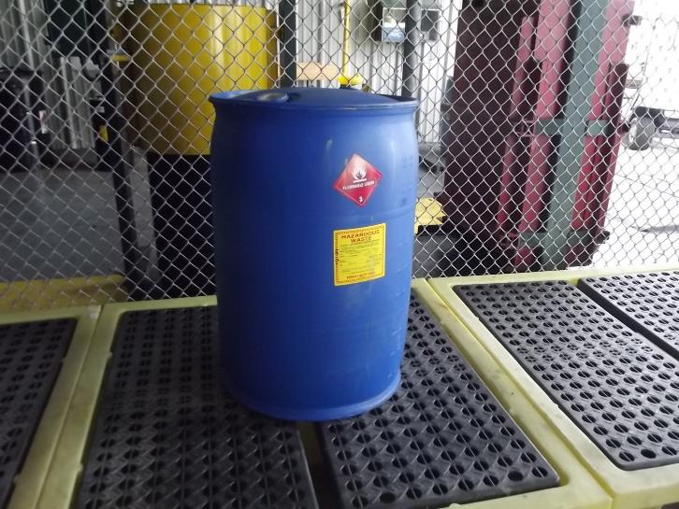
Conditions for Exemption for LQGs
LQG Containers - Condition
[40 CFR 262.17(a)(1)(i)]
(a)(1) Accumulation of hazardous waste in containers.
(i) Air Emission Standards- The applicable requirements of subparts AA, BB, and CC of 40 CFR part 265;

Slide 95
Conditions for Exemption for LQGs
LQG Containers - Condition
[40 CFR 262.17(a)(1)(ii)]
(a)(1) Accumulation of hazardous waste in containers.
(ii) Condition of containers - If a container holding hazardous waste is not in good condition, or if it begins to leak, the large quantity generator must immediately transfer the hazardous waste from this container to a container that is in good condition, or immediately manage the waste in some other way that complies with the conditions for exemption of this section.
Notes:
Old 265.171

Slide 96
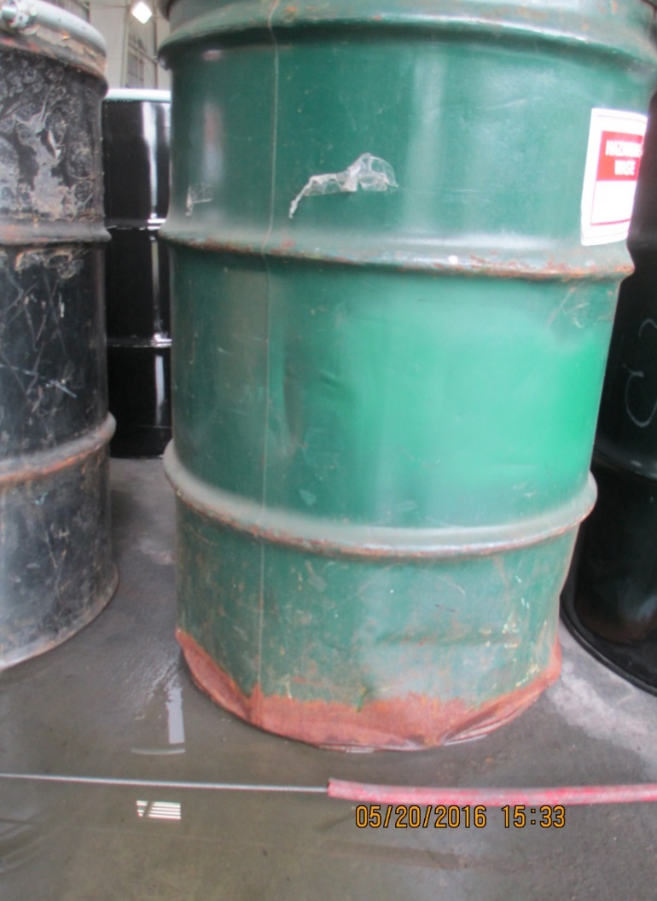
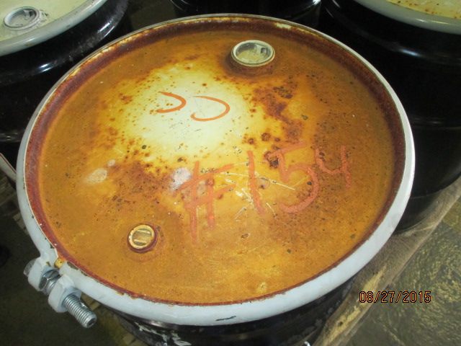
Conditions for Exemption for LQGs
LQG Containers - Condition
[40 CFR 262.17(a)(1)(ii)]
Poor Condition
Notes:
LQG containers in poor condition.

Slide 97
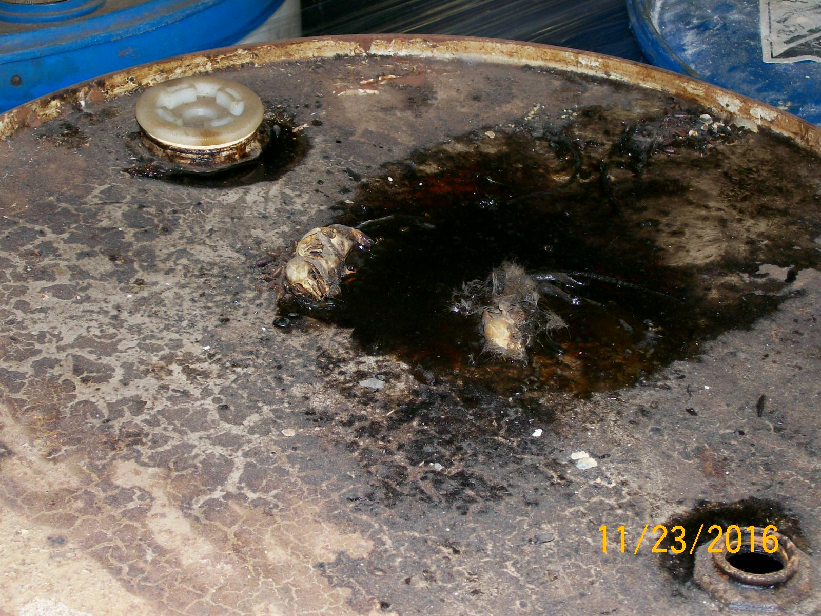
Conditions for Exemption for LQGs
LQG Containers - Condition
[40 CFR 262.17(a)(1)(ii)]
Poor Condition
Notes:
LQG container in poor condition. Note - Those are dead rats stuck to the top of the drum.

Slide 98
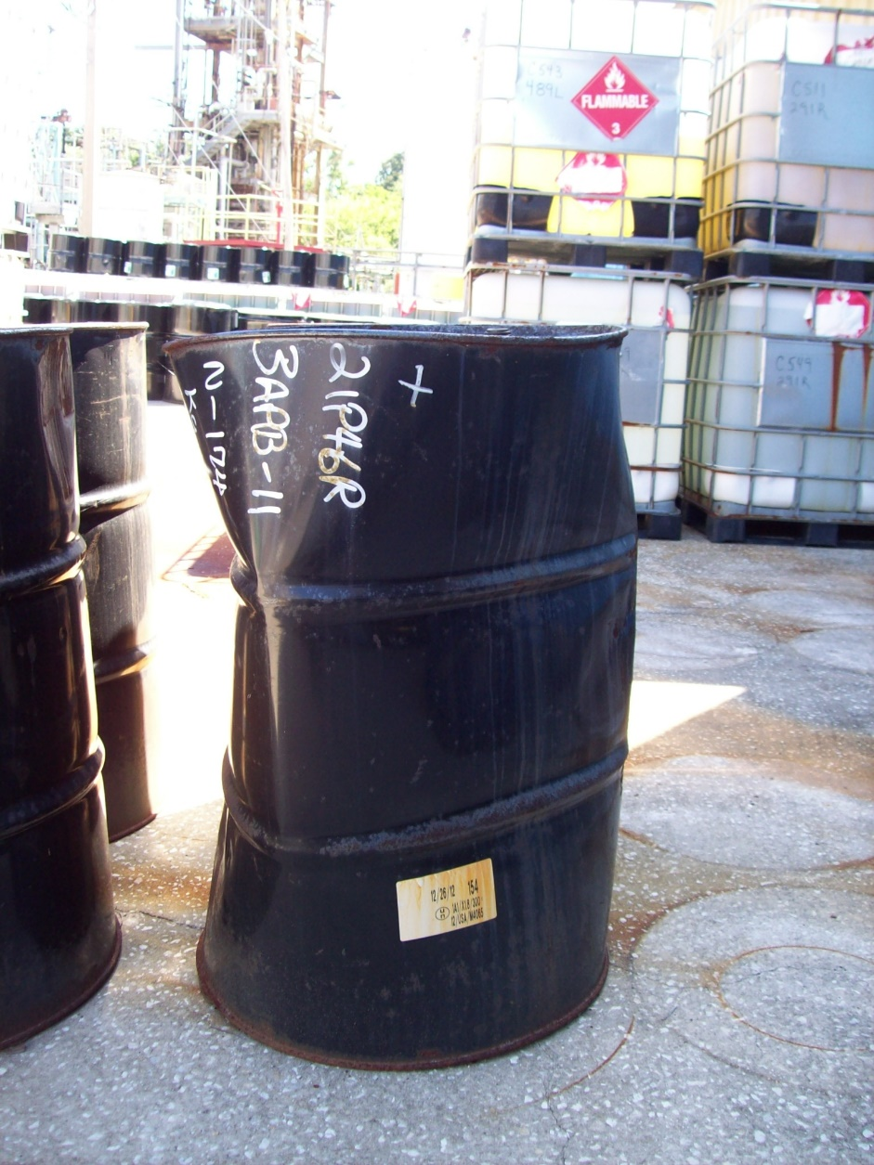
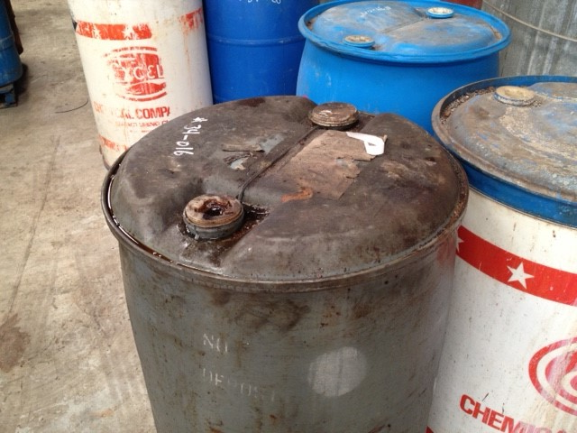
Conditions for Exemption for LQGs
LQG Containers - Condition
[40 CFR 262.17(a)(1)(ii)]
Poor Condition
Notes:
LQG containers in poor condition.

Slide 99
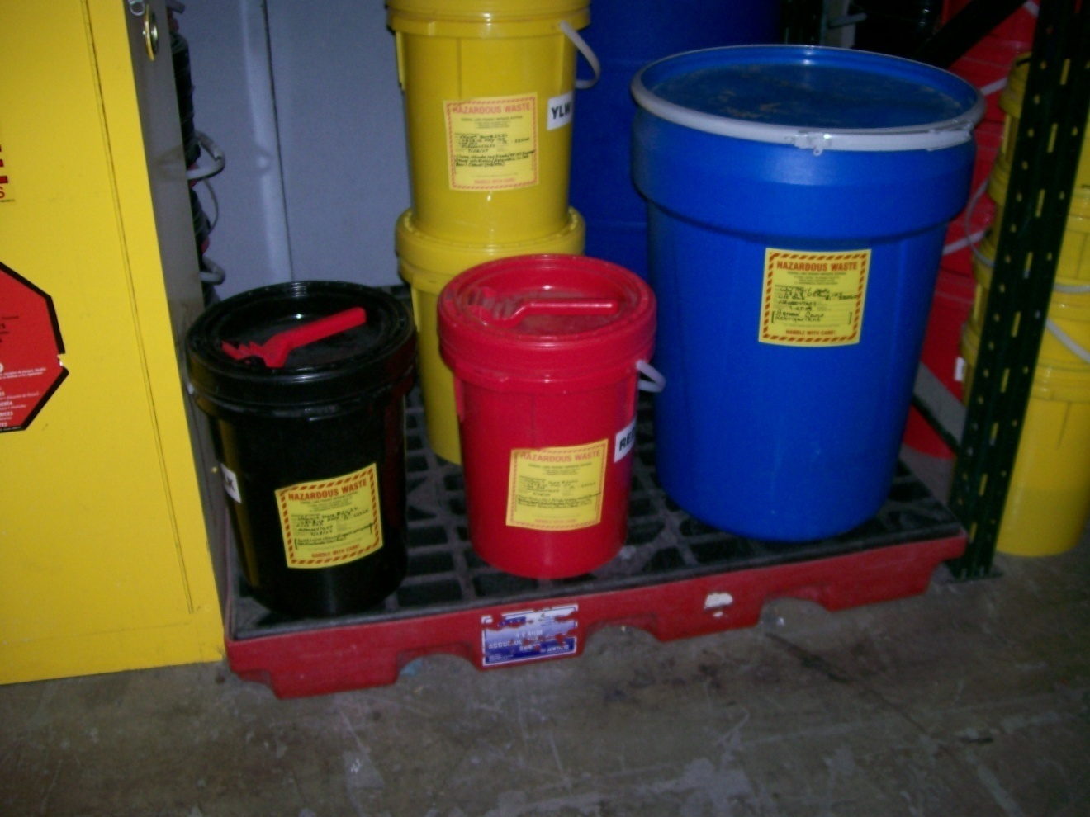
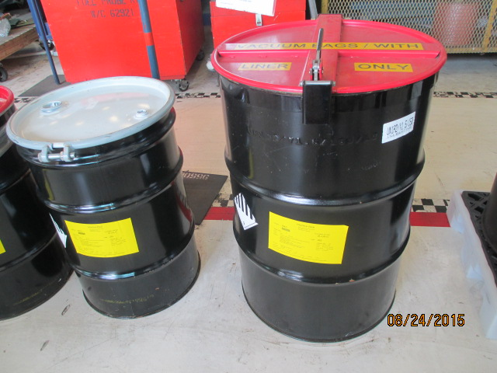
Conditions for Exemption for LQGs
LQG Containers – Condition
[40 CFR 262.17(a)(1)(ii)]
Good condition
Notes:
LQG containers in good condition.

Slide 100
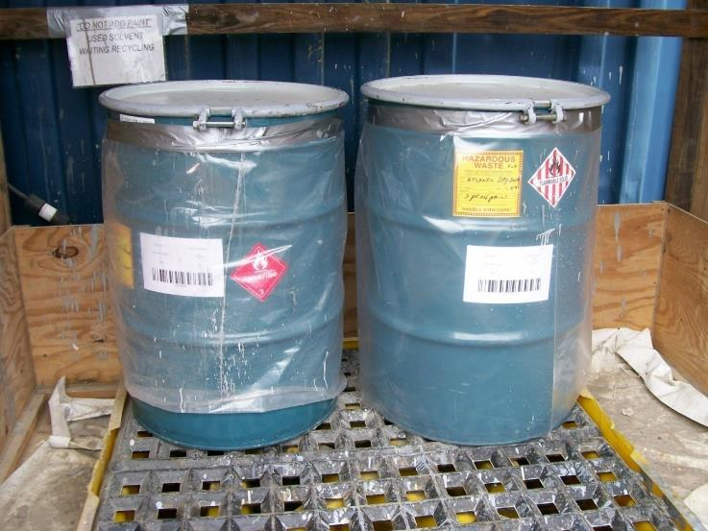
Conditions for Exemption for LQGs
LQG Containers – Condition
[40 CFR 262.17(a)(1)(ii)]
Good condition
Notes:
LQG containers in good condition.

Slide 101
Conditions for Exemption for LQGs
LQG Containers - Compatibility
[40 CFR 262.17(a)(1)(iii)]
(a)(1) Accumulation of hazardous waste in containers.
(iii) - Compatibility of waste with containers. The large quantity generator must use a container made of or lined with materials that will not react with, and are otherwise compatible with, the hazardous waste to be accumulated, so that the ability of the container to contain the waste is not impaired.
Notes:
Old 265.172

Slide 102
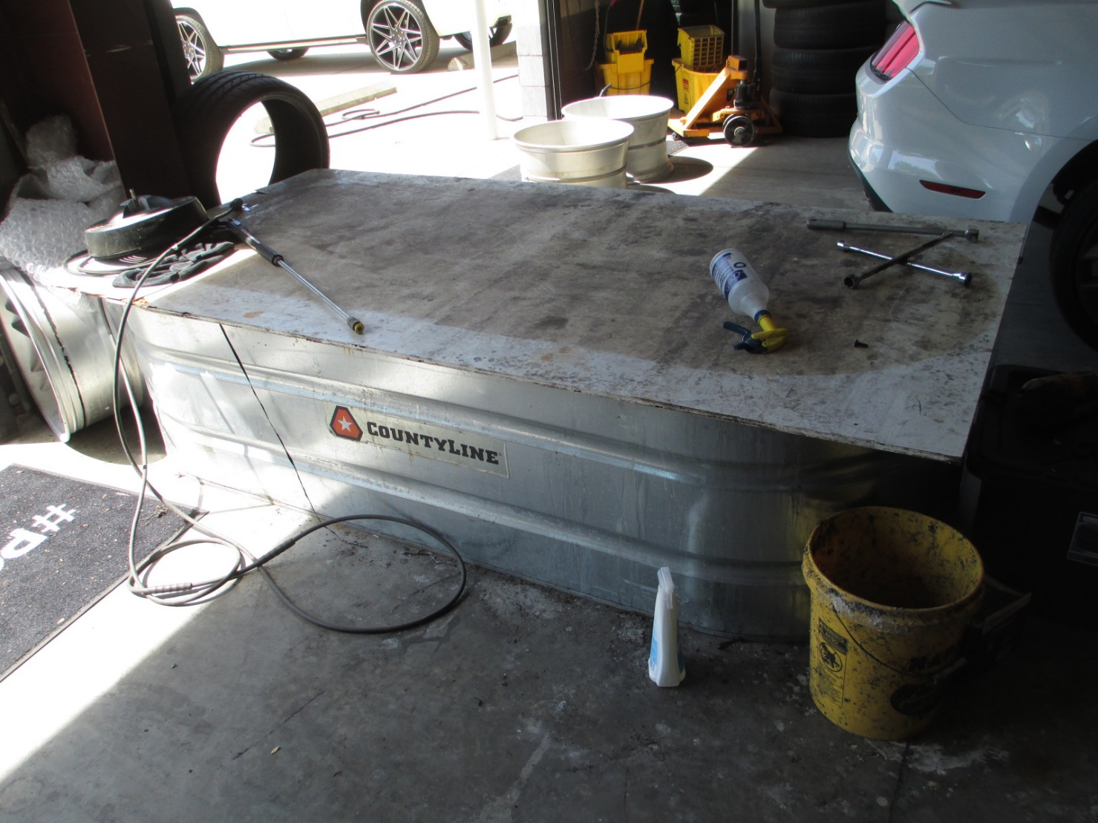
Conditions for Exemption for LQGs
LQG Containers - Compatibility
[40 CFR 262.17(a)(1)(iii)]
Before - Don’t
Notes:
Picture of before. Metal container with acidic methylene chloride stripper in it.

Slide 103
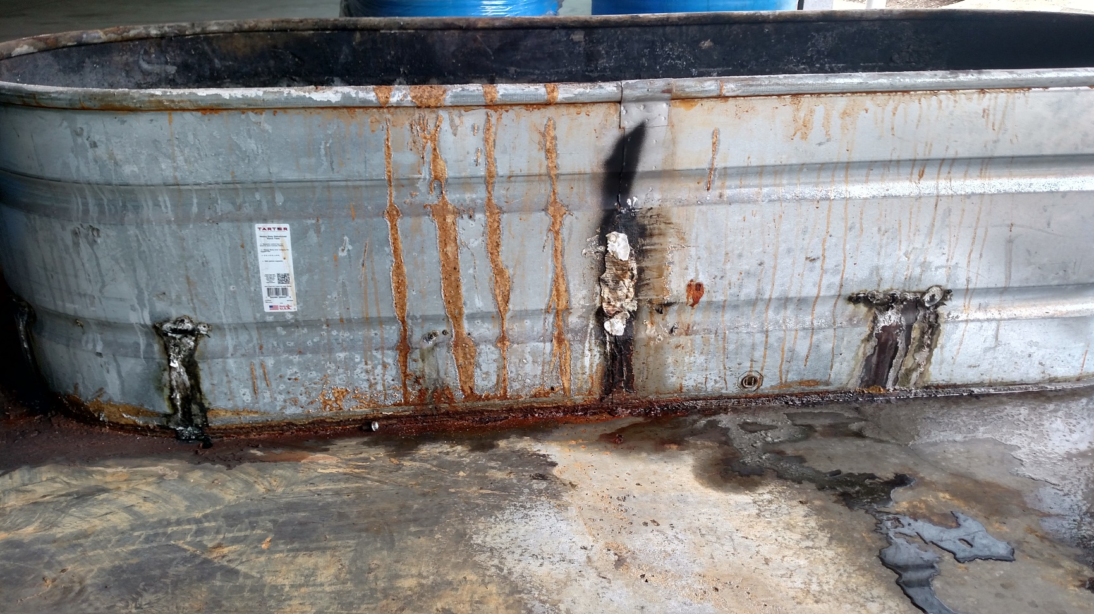
Conditions for Exemption for LQGs
LQG Containers - Compatibility
[40 CFR 262.17(a)(1)(iii)]
After - Don’t
Notes:
Picture of after.

Slide 104
Conditions for Exemption for LQGs
LQG Containers - Closed
[40 CFR 262.17(a)(1)(iv)(A)]
(a)(1) Accumulation of hazardous waste in containers.
(iv) Management of containers.
(A) A container holding hazardous waste must always be closed during accumulation, except when it is necessary to add or remove waste.
Notes:
Old 265.173

Slide 105
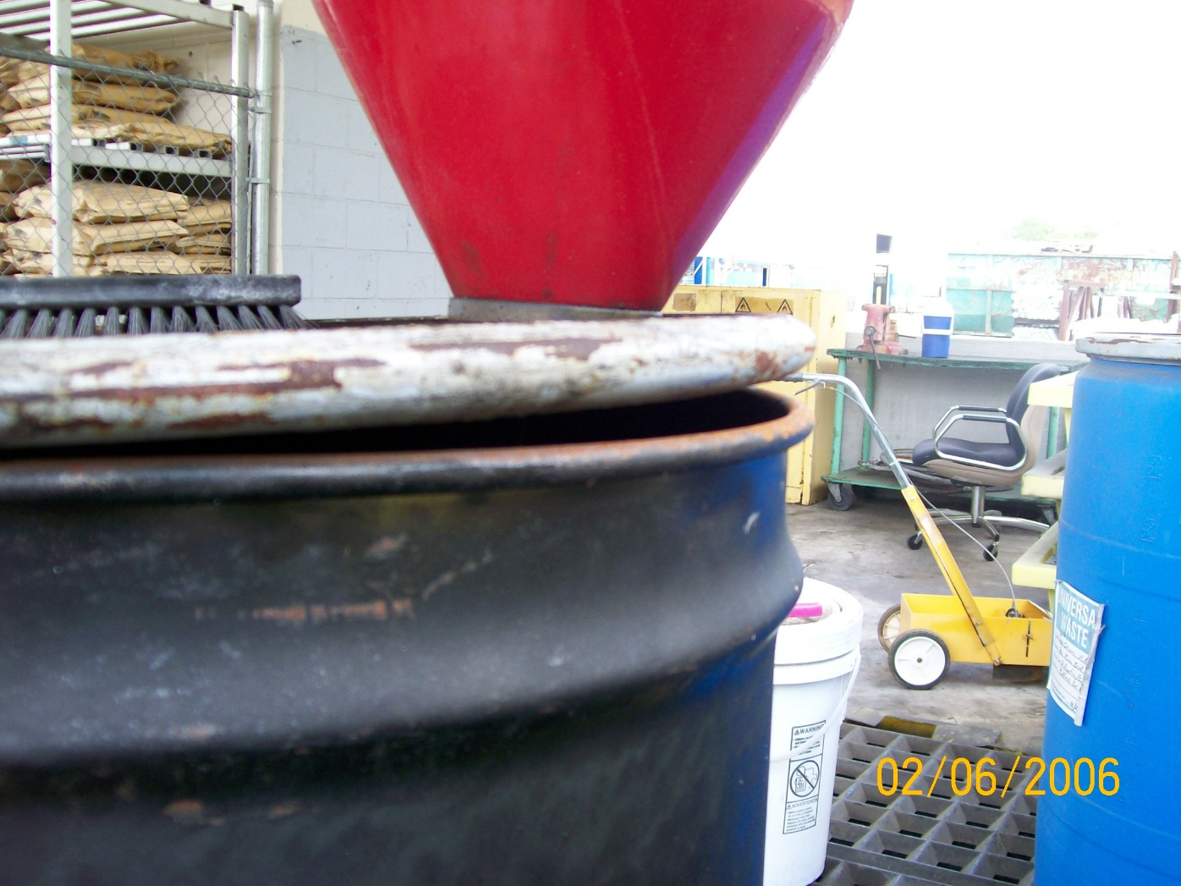
Conditions for Exemption for LQGs
LQG Containers - Closed
[40 CFR 262.17(a)(1)(iv)(A)]
Don’t

Slide 106
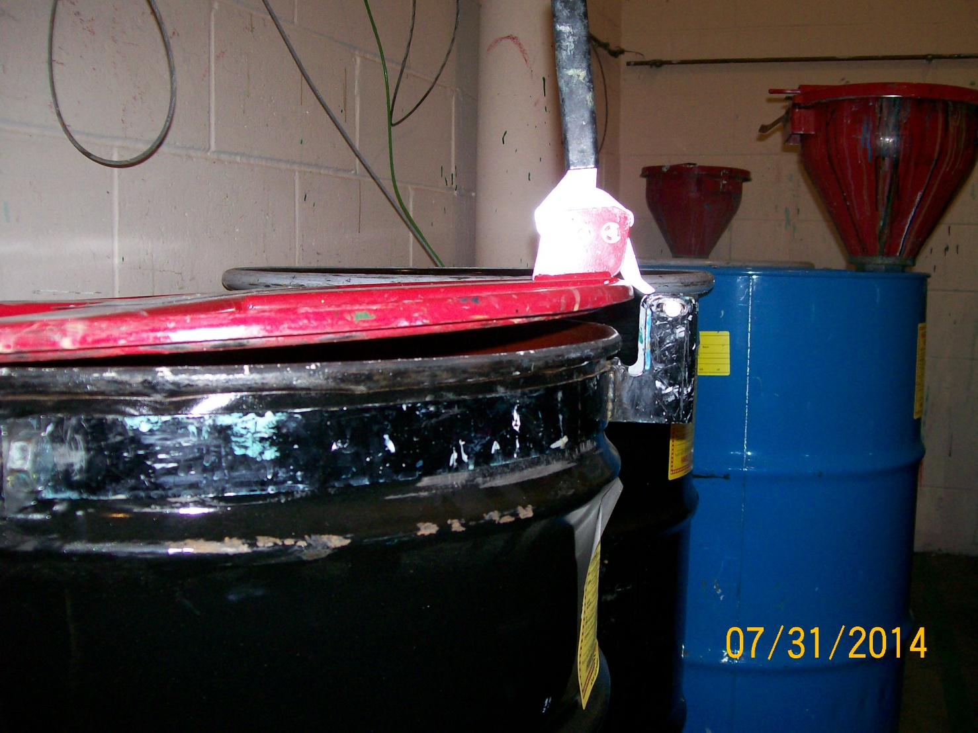
Conditions for Exemption for LQGs
LQG Containers - Closed
[40 CFR 262.17(a)(1)(iv)(A)]
Don’t

Slide 107
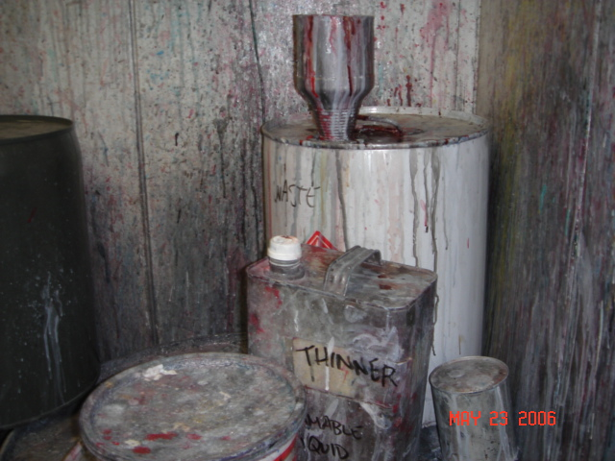
Conditions for Exemption for LQGs
LQG Containers – Closed
[40 CFR 262.17(a)(1)(iv)(A)]
Don’t

Slide 108
Conditions for Exemption for LQGs
LQG Container Management
[40 CFR 262.17(a)(1)(iv)(B)]
(a)(1) Accumulation of hazardous waste in containers.
(iv) Management of containers.
(B) A container holding hazardous waste must not be opened, handled, or accumulated in a manner that may rupture the container or cause it to leak.

Slide 109
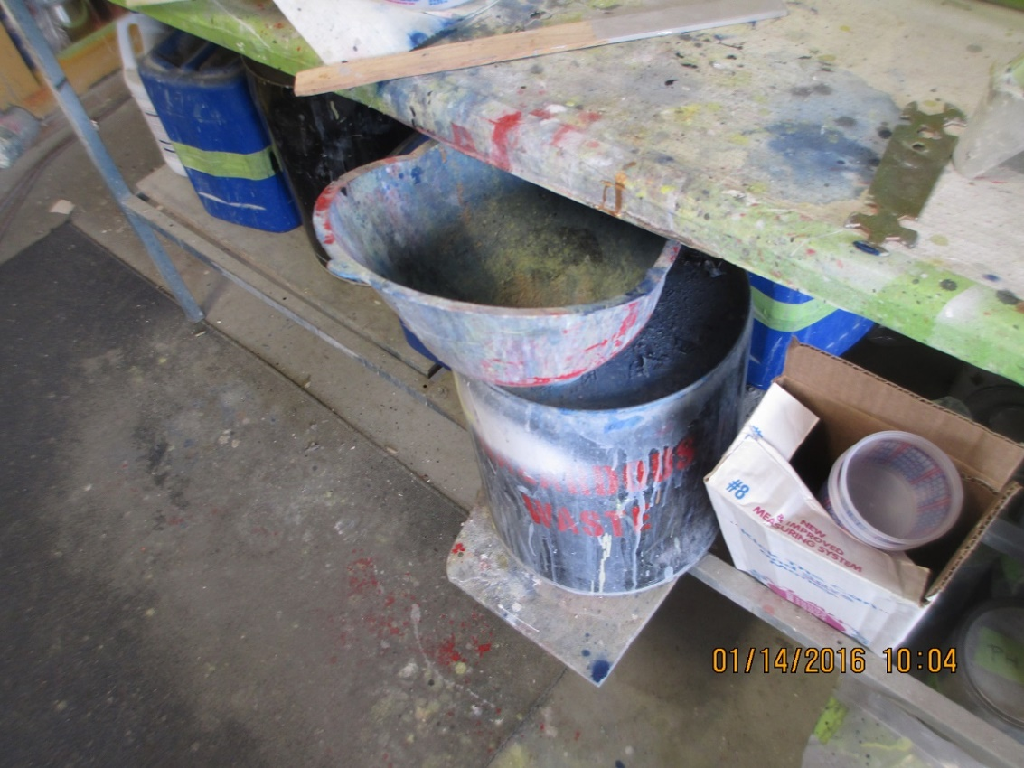
Conditions for Exemption for LQGs
LQG Container Management
[40 CFR 262.17(a)(1)(iv)(B)]
Don’t

Slide 110
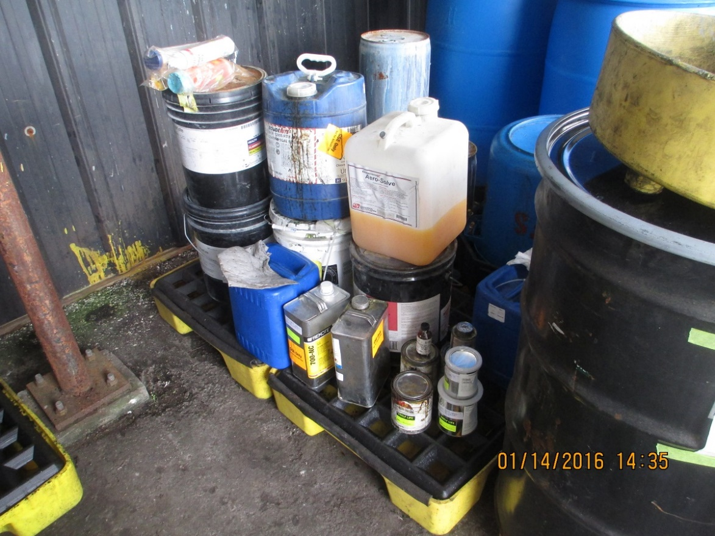
Conditions for Exemption for LQGs
LQG Container Management
[40 CFR 262.17(a)(1)(iv)(B)]
Don’t

Slide 111
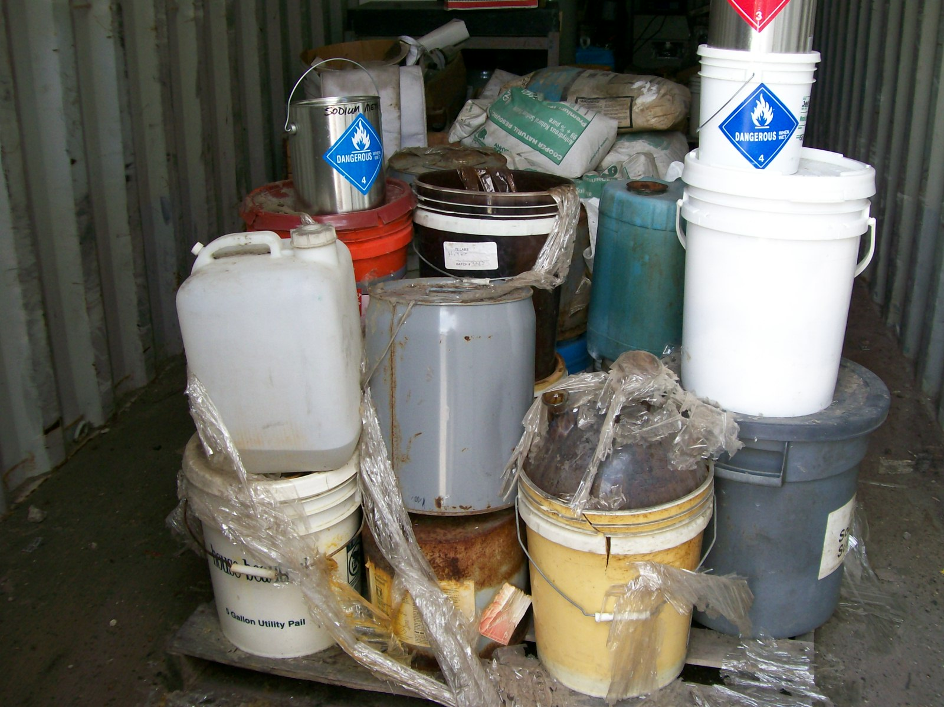
Conditions for Exemption for LQGs
LQG Container Management
[40 CFR 262.17(a)(1)(iv)(B)]
Don’t

Slide 112
Conditions for Exemption for LQGs
LQG Container Inspections
[40 CFR 262.17(a)(1)(v)]
(a)(1) Accumulation of hazardous waste in containers.
(v) Inspections. At least weekly, the large quantity generator must inspect central accumulation areas. The large quantity generator must look for leaking containers and for deterioration of containers caused by corrosion or other factors. See paragraph (a)(1)(ii) of this section for remedial action required if deterioration or leaks are detected.
Notes:
Updated language.

Slide 113
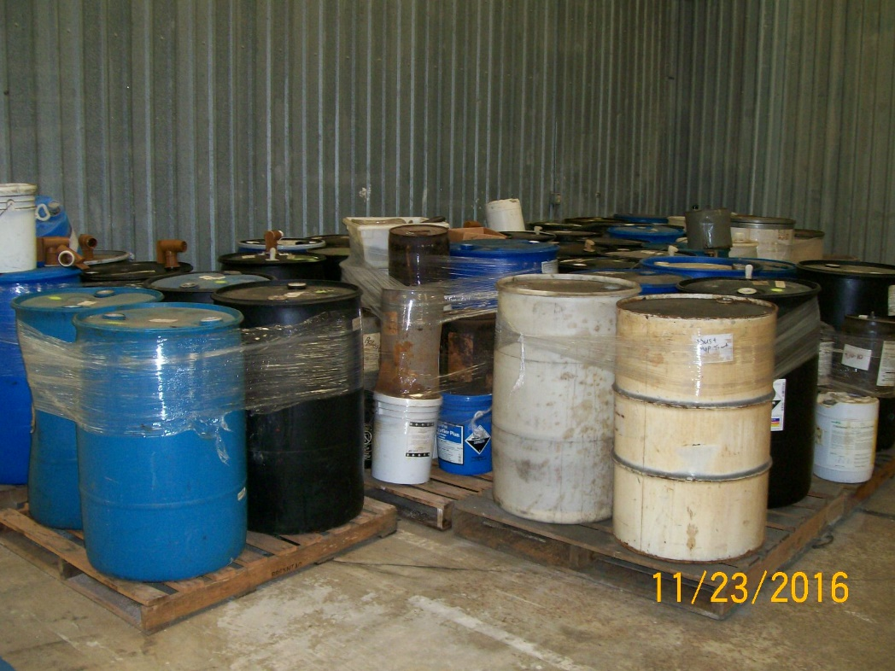
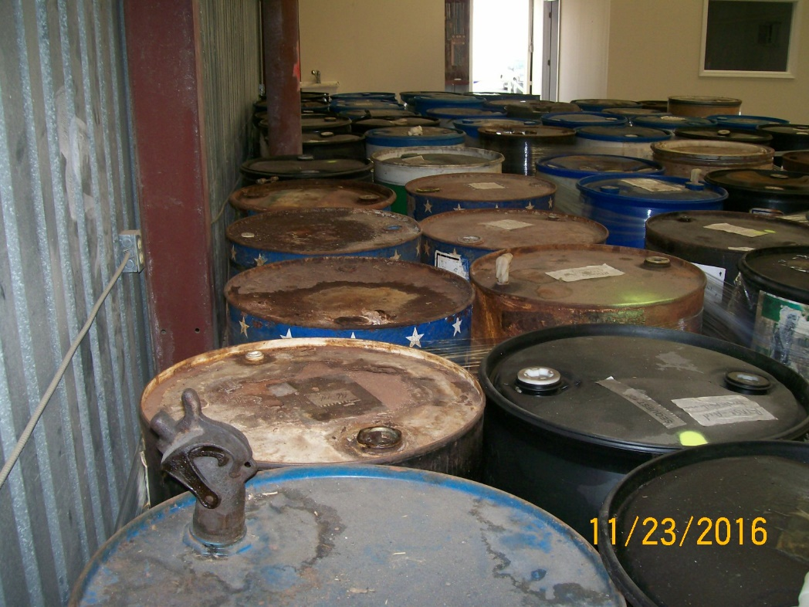
Conditions for Exemption for LQGs
[40 CFR 262.17 (a)(1)(v)]
Notes:
Do these drums look like they are inspected weekly?

Slide 114
LQG Container Inspections
State Requirement
[62-730.160(5), FAC]
(5) Generators of hazardous waste who accumulate hazardous waste on-site under 40 CFR 262.34 [as adopted in subsection 62-730.160(1), F.A.C.], shall maintain written documentation of the inspections required under 40 CFR Part 265 [as adopted in subsection 62-730.180(2), F.A.C.]. The generator shall keep the written documentation of the inspections under this section for at least three years from the date of the inspection. At a minimum, this documentation shall include the date and time of the inspection, the legibly printed name of the inspector, the number of containers, the condition of the containers, a notation of the observations made, and the date and nature of any repairs or other remedial actions.
Notes:
Note: This citation number may change when the new rule is adopted. It looks like it will be (3) then. The language will also change slightly for the 40 CFR part.

Slide 115
Conditions for Exemption for LQGs
LQG Containers
[40 CFR 262.17(a)(1)(vi)(A)]
(a)(1) Accumulation of hazardous waste in containers.
(vi) Special conditions for accumulation of ignitable and reactive wastes.
(A) Containers holding ignitable or reactive waste must be located at least 15 meters (50 feet) from the facility's property line unless a written approval is obtained from the authority having jurisdiction over the local fire code allowing hazardous waste accumulation to occur within this restricted area. A record of the written approval must be maintained as long as ignitable or reactive hazardous waste is accumulated in this area.
Notes:
Old 265.176. Language has changed about variance.

Slide 116
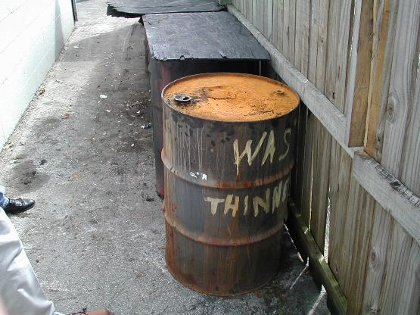
LQG Ignitable Container Management
Conditions for Exemption for LQGs
LQG Containers
[40 CFR 262.17(a)(1)(vi)(A)]
  50 foot setback from property boundary for ignitable or reactive waste for LQGs
Bad – too close to property line.
Notes:
Old 265.176

Slide 117
Conditions for Exemption for LQGs
LQG Containers
[40 CFR 262.17(a)(1)(vi)(B)]
(a)(1) Accumulation of hazardous waste in containers.
(vi) Special conditions for accumulation of ignitable and reactive wastes
(B) The large quantity generator must take precautions to prevent accidental ignition or reaction of ignitable or reactive waste. This waste must be separated and protected from sources of ignition or reaction including but not limited to the following: Open flames, smoking, cutting and welding, hot surfaces, frictional heat, sparks (static, electrical, or mechanical), spontaneous ignition (e.g., from heat-producing chemical reactions), and radiant heat. While ignitable or reactive waste is being handled, the large quantity generator must confine smoking and open flame to specially designated locations. “No Smoking” signs must be conspicuously placed wherever there is a hazard from ignitable or reactive waste.
Notes:
Old 265.17. Note that this used to be a note in 265.176 that referred to 265.17. Now it is clear.

Slide 118
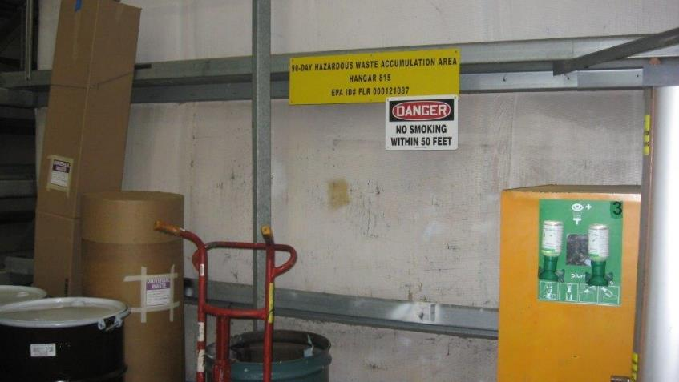
Conditions for Exemption for LQGs
LQG Containers
[40 CFR 262.17(a)(1)(vi)(B)]
Notes:
Old 265.17. Note that this used to be a note that referred to 265.17. Now it is clear.

Slide 119
Conditions for Exemption for LQGs
LQG Containers
[40 CFR 262.17(a)(1)(vii)(A)]
(a)(1) Accumulation of hazardous waste in containers.
(vii) Special conditions for accumulation of incompatible wastes.
Incompatible wastes, or incompatible wastes and materials, (see appendix V of part 265 for examples) must not be placed in the same container, unless §265.17(b) of this chapter is complied with.
Examples of incompatibly: Alcohols with Calcium, Lithium, Metal hydrides or Potassium
Potential consequences: Fire, explosion, or heat generation; generation of flammable or toxic gases.
Examples of incompatibly: Acetylene sludge with acid sludge, alkaline cleaner with battery acid, spent caustic with spent mixed acid and/or spent sulfuric acid
Potential consequences: Heat generation; violent reaction.
Notes:
Old 265.177
265.17(b) - Where specifically required by other sections of this part, the treatment, storage, or disposal of ignitable or reactive waste, and the mixture or commingling of incompatible wastes, or incompatible wastes and materials, must be conducted so that it does not:
(1) Generate extreme heat or pressure, fire or explosion, or violent reaction;
(2) Produce uncontrolled toxic mists, fumes, dusts, or gases in sufficient quantities to threaten human health;
(3) Produce uncontrolled flammable fumes or gases in sufficient quantities to pose a risk of fire or explosions;
(4) Damage the structural integrity of the device or facility containing the waste; or
(5) Through other like means threaten human health or the environment

Slide 120
Conditions for Exemption for LQGs
LQG Containers
[40 CFR 262.17(a)(1)(vii)(B)]
(a)(1) Accumulation of hazardous waste in containers.
(vii) Special conditions for accumulation of incompatible wastes.
(B) Hazardous waste must not be placed in an unwashed container that previously held an incompatible waste or material (see appendix V of part 265 for examples), unless §265.17(b) of this chapter is complied with.
Examples of incompatibly: Chlorates with acetic acid and other organic acids and chlorine with concentrated mineral acids
Potential consequences: Fire, explosion, or violent reaction.
Notes:
265.17(b) (b) Where specifically required by other sections of this part, the treatment, storage, or disposal of ignitable or reactive waste, and the mixture or commingling of incompatible wastes, or incompatible wastes and materials, must be conducted so that it does not:
(1) Generate extreme heat or pressure, fire or explosion, or violent reaction;
(2) Produce uncontrolled toxic mists, fumes, dusts, or gases in sufficient quantities to threaten human health;
(3) Produce uncontrolled flammable fumes or gases in sufficient quantities to pose a risk of fire or explosions;
(4) Damage the structural integrity of the device or facility containing the waste; or
(5) Through other like means threaten human health or the environment

Slide 121
Conditions for Exemption for LQGs
LQG Containers
[40 CFR 262.17(a)(1)(vii)(C)]
(a)(1) Accumulation of hazardous waste in containers.
(vii) Special conditions for accumulation of incompatible wastes.
(C) A container holding a hazardous waste that is incompatible with any waste or other materials accumulated or stored nearby in other containers, piles, open tanks, or surface impoundments must be separated from the other materials or protected from them by means of a dike, berm, wall, or other device.

Slide 122
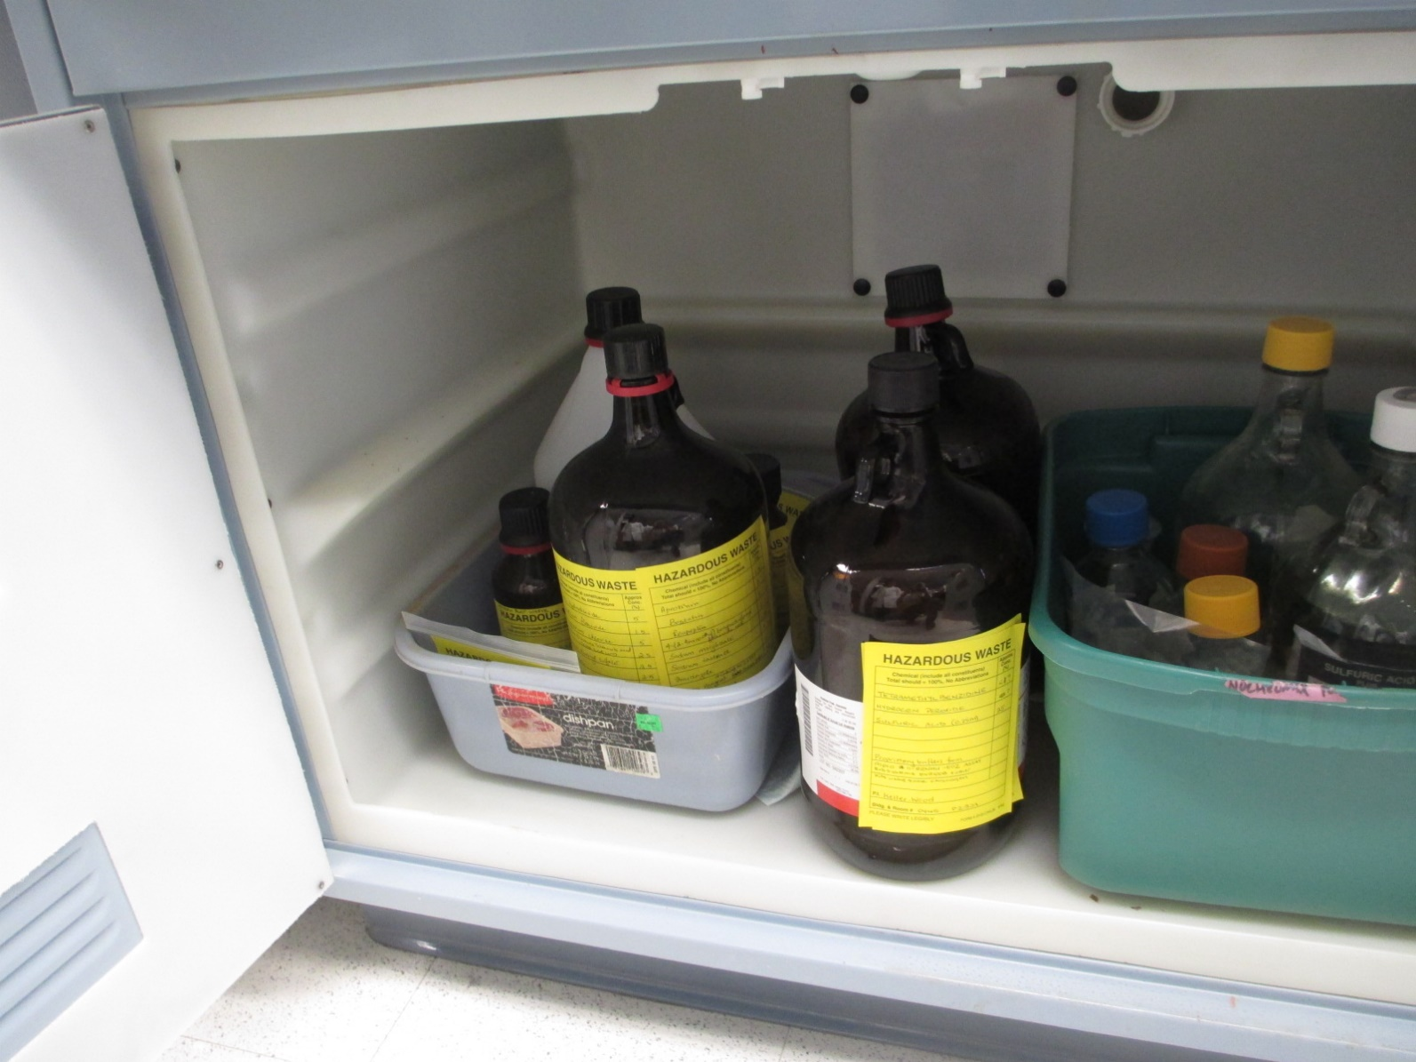
Conditions for Exemption for LQGs
LQG Containers
[40 CFR 262.17(a)(1)(vii)(C)]
Do
Notes:
Picture of compatibility.

Slide 123
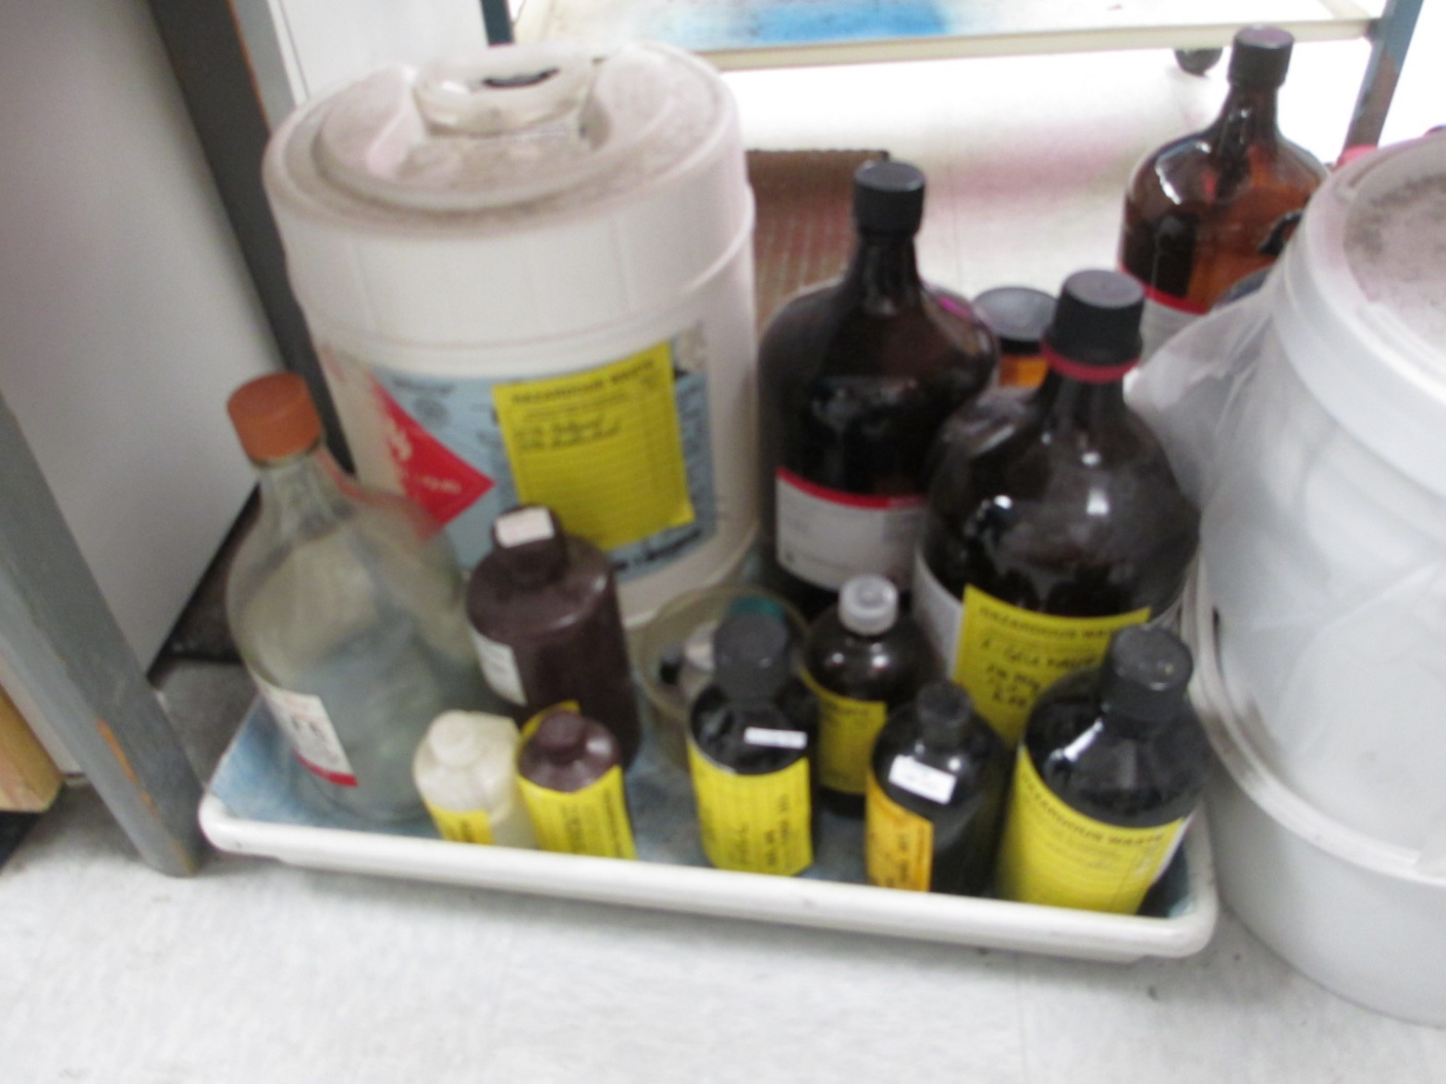
Conditions for Exemption for LQGs
LQG Containers
[40 CFR 262.17(a)(1)(vii)(C)]
Don’t
Notes:
Picture of incompatibility.

Slide 124
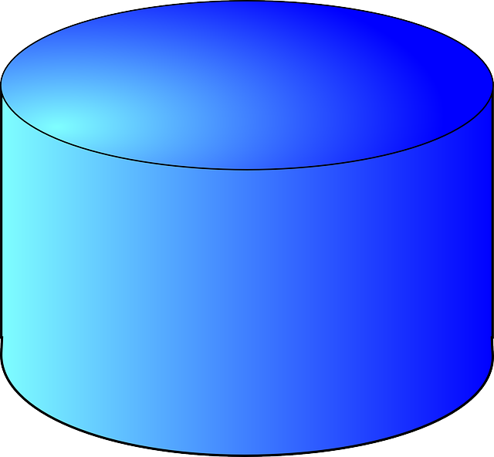
Conditions for Exemption for LQGs
LQG Tanks
[40 CFR 262.17(a)(2)]
LQG Tanks are not covered in this Workshop.

Slide 125
Conditions for Exemption for LQGs
Drip Pads
[40 CFR 262.17(a)(3)]
LQG Drip Pads are not covered in this Workshop.

Slide 126
Conditions for Exemption for LQGs
Containment Buildings
[40 CFR 262.17(a)(4)]
LQG Containment Buildings are not covered in this Workshop.

Slide 127
Conditions for Exemption for LQGs
LQG Container Labeling
[40 CFR 262.17(a)(5)(i)(A)]
(5) Labeling and marking of containers and tanks.
(i) An LQG must mark or label its containers with the following:
(A)The words “Hazardous Waste”;
Notes:
Old 262.34(a)(3)

Slide 128
LQG Container - Labels
[40 CFR 262.17(a)(5)(i)(A)]

Slide 129
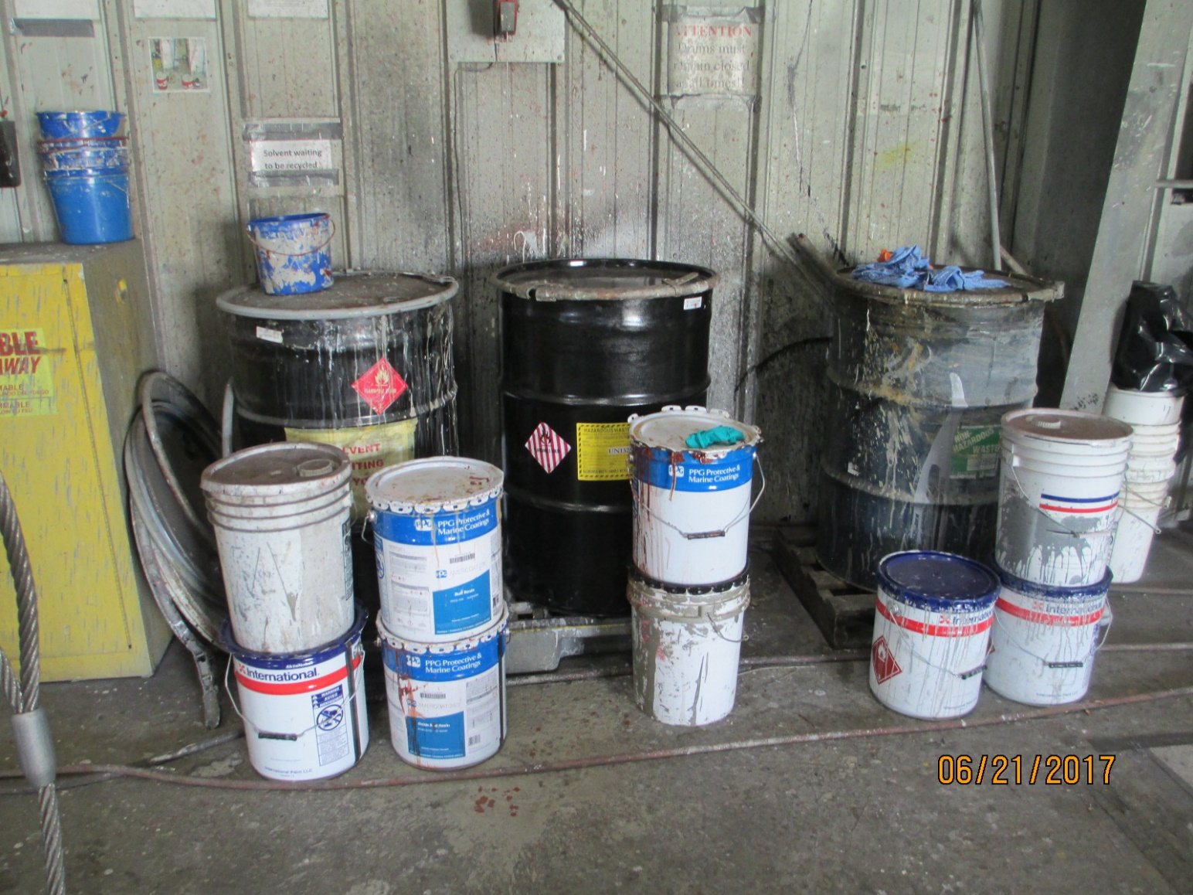
LQG Container - Labels
[40 CFR 262.17(a)(5)(i)(A)]
Don’t
Notes:
The containers of paint are not labeled. The hazardous waste drums were full, so the buckets were put on the floor next to the drums.

Slide 130
Conditions for Exemption for LQGs
LQG Container - Labeling
[40 CFR 262.17(a)(5)(i)(B)]
(5) Labeling and marking of containers and tanks.
(i) An LQG must mark or label its containers with the following:
(B) An indication of the hazards of the contents (examples include, but are not limited to, the applicable hazardous waste characteristic(s) (i.e., ignitable, corrosive, reactive, toxic); hazard communication consistent with the Department of Transportation requirements at 49 CFR part 172 subpart E (labeling) or subpart F (placarding); a hazard statement or pictogram consistent with the Occupational Safety and Health Administration Hazard Communication Standard at 29 CFR 1910.1200; or a chemical hazard label consistent with the National Fire Protection Association code 704); and
Notes:
New

Slide 131



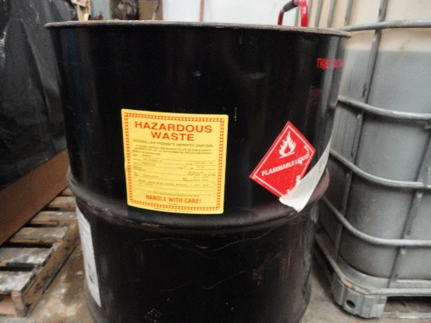
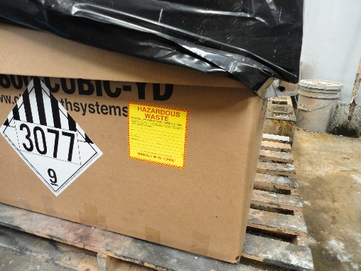
Characteristic Label Examples
[40 CFR 262.17(a)(5)(i)(B)]
Hazardous waste characteristics - Ignitable, Corrosive, Reactive, Toxic
DOT Hazard Communication – 49 CFR Part 172 Subparts E or F

Slide 132
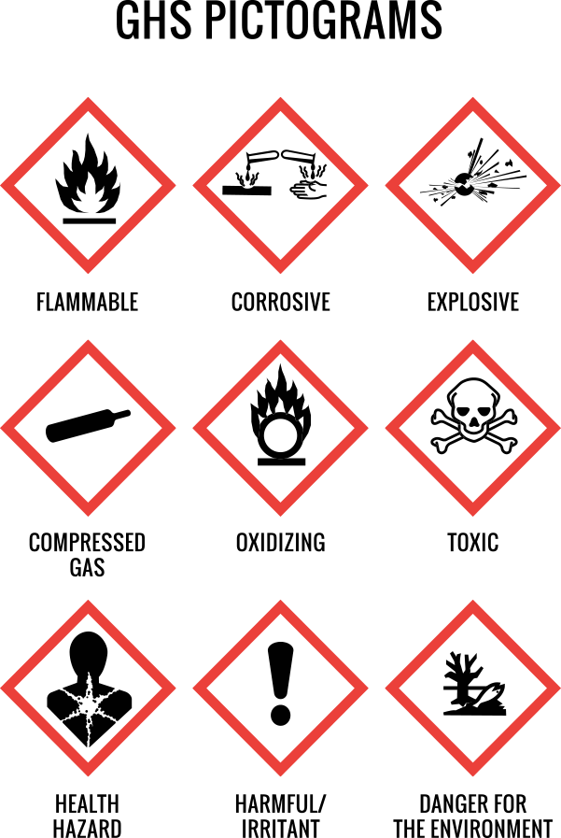
Characteristic Label Examples
[40 CFR 262.17(a)(5)(i)(B)]
OSHA hazard statement or pictogram – 29 CFR 1910.1200

Slide 133
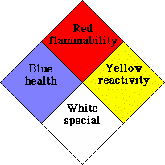
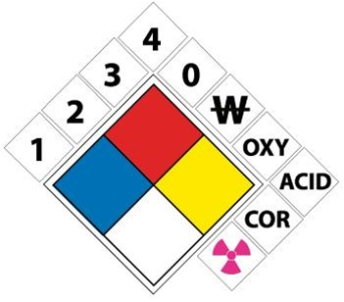
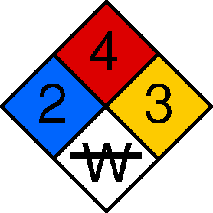
Characteristic Label Examples
[40 CFR 262.17(a)(5)(i)(B)]
NFPA chemical hazard label – Code 704

Slide 134
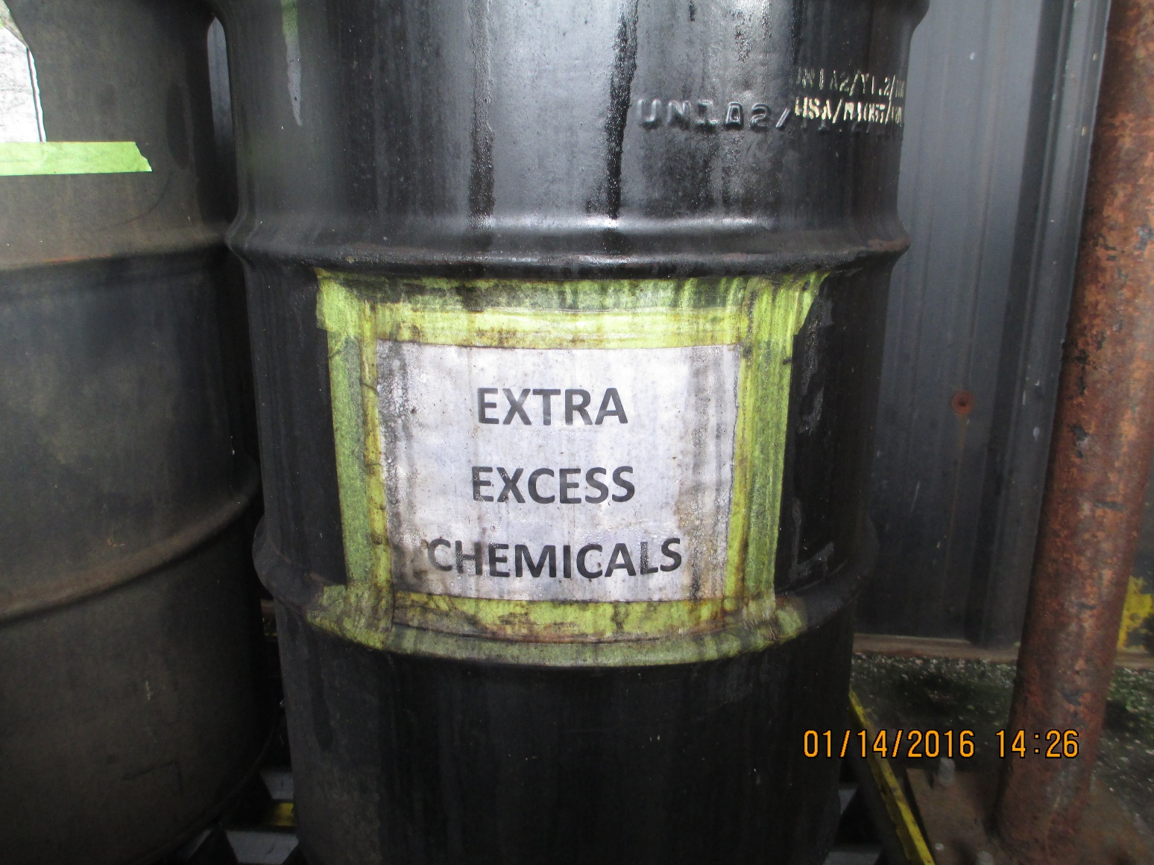
Characteristic Label Examples
[40 CFR 262.17(a)(5)(i)(B)]
Don’t

Slide 135
Conditions for Exemption for LQGs
LQG Container Labeling
[40 CFR 262.17(a)(5)(i)(C)]
(5) Labeling and marking of containers and tanks.
LQG must label containers:
(C) The date upon which each period of accumulation begins clearly visible for inspection on each container.
Notes:
Old 262.34(a)(2) language has been updated.

Slide 136
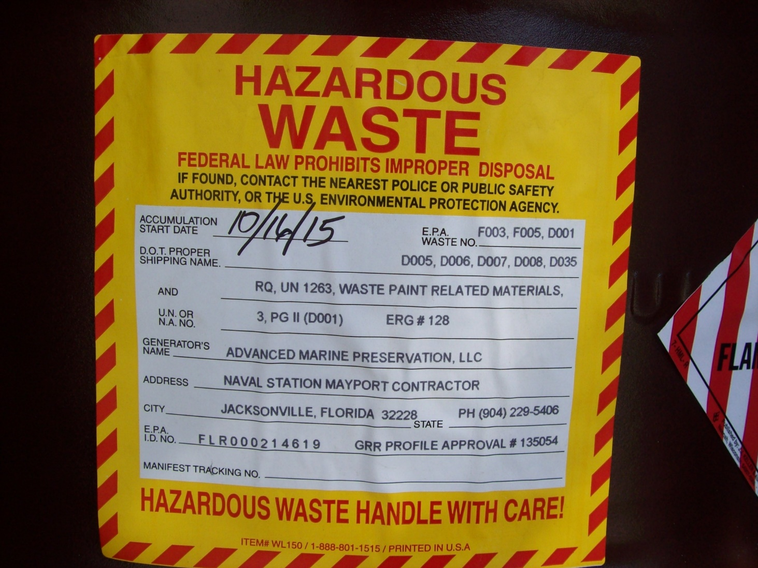
Conditions for Exemption for LQGs
LQG Container Labeling
[40 CFR 262.17(a)(5)(i)(C)]
Do

Slide 137
Conditions for Exemption for LQGs
LQG Tank Labeling
[40 CFR 262.17(a)(5)(ii)]
HW LQG Tanks are not covered in this Workshop

Slide 138
Satellite Accumulation
[40 CFR 262.15]
Let’s take a few minutes to discuss Satellite Accumulation at LQGs while we are talking about container requirements.
40 CFR 262.15 Satellite accumulation area regulations for small and large quantity generators.

Slide 139
Satellite Accumulation
[40 CFR 262.15(a)]
Satellite Accumulation – Conditions for Exemption
(a) An LQG generator may comply with the conditions for exemption in 40 CFR 262.15 instead of complying with the conditions for exemption in §262.17(a), except as required in §262.15(a)(7) and (8). The conditions for exemption for satellite accumulation are:

Slide 140
Satellite Accumulation for LQGs
[40 CFR 262.15(a)]
(a) A generator may accumulate as much as 55 gallons of non-acute hazardous waste and/or either one quart of liquid acute hazardous waste listed in §261.31 or §261.33(e) of this chapter or 1 kg (2.2 lbs) of solid acute hazardous waste listed in §261.31 or §261.33(e) of this chapter in containers:
at or near any point of generation where wastes initially accumulate
which is under the control of the operator of the process generating the waste
Without a permit (…)
Provided that all of the conditions for exemption in this section are met:

Slide 141
Satellite Accumulation for LQGs
Container Condition
[40 CFR 262.15(a)(1)]
(a)
(1) If a container holding hazardous waste is not in good condition, or if it begins to leak, the generator must immediately transfer the hazardous waste from this container to a container that is in good condition and does not leak, or immediately transfer and manage the waste in a central accumulation area operated in compliance with §262.17(a).
Notes:
Old 265.171 Was applicable to SAAs before

Slide 142
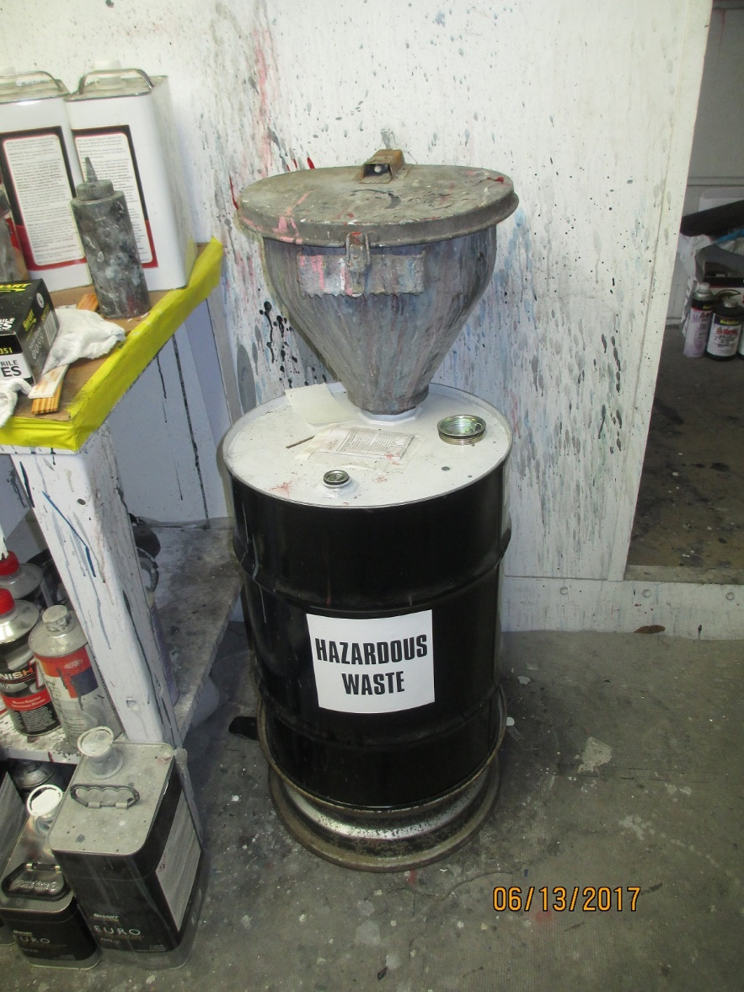
Satellite Accumulation for LQGs
Container Condition
[40 CFR 262.15(a)(1)]
Do

Slide 143
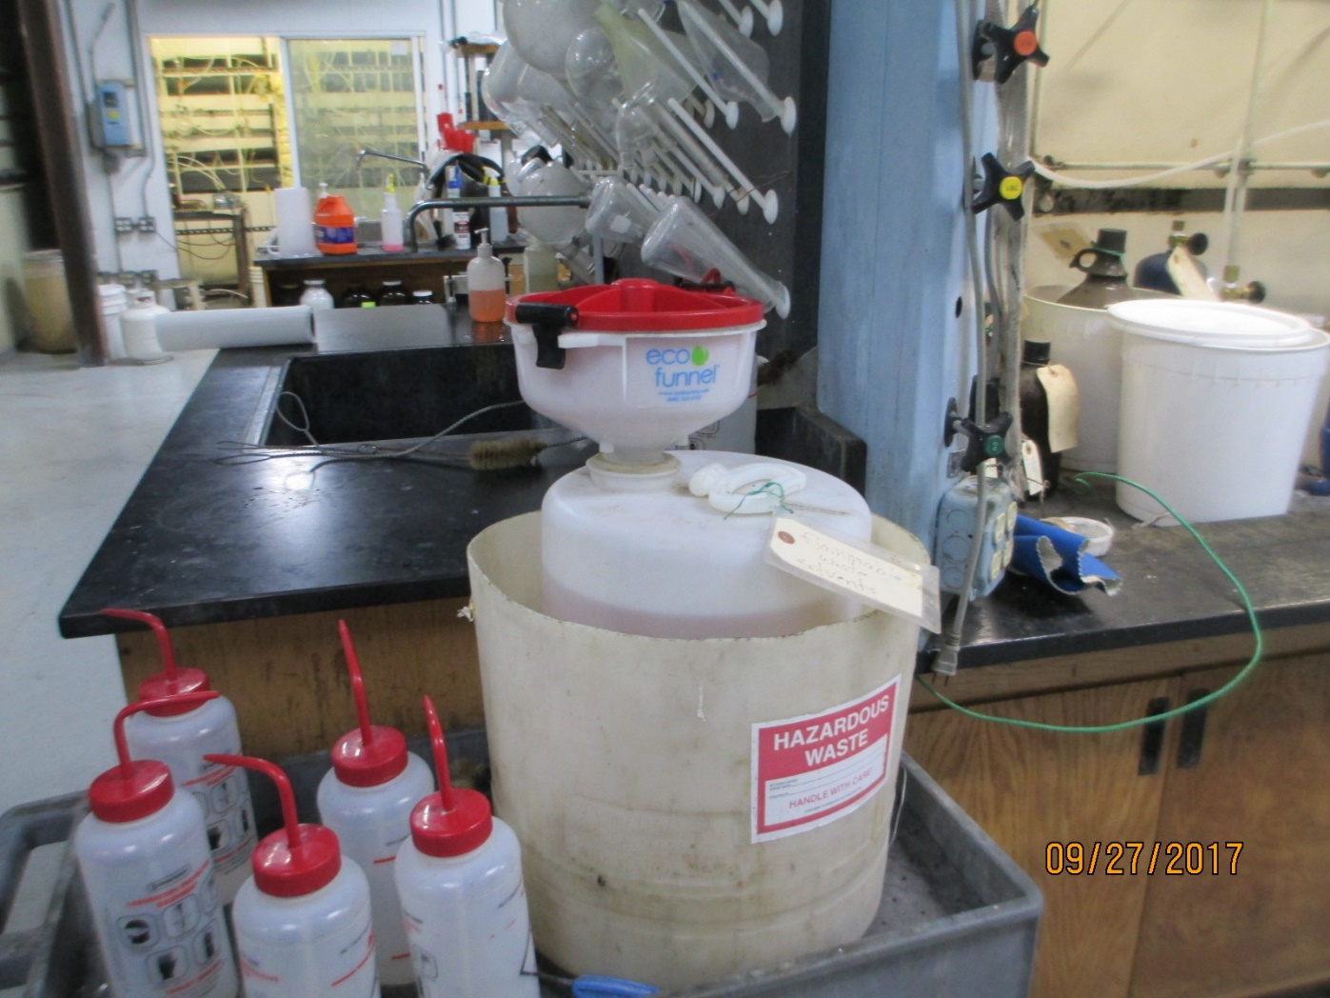
Satellite Accumulation for LQGs
Container Condition
[40 CFR 262.15(a)(1)]
Do

Slide 144
Satellite Accumulation for LQGs
Container Compatibility
[40 CFR 262.15(a)(2)]
(a)
(2) The generator must use a container made of or lined with materials that will not react with, and are otherwise compatible with, the hazardous waste to be accumulated, so that the ability of the container to contain the waste is not impaired.
Notes:
Old 265.172. Was applicable to SAAs before.

Slide 145
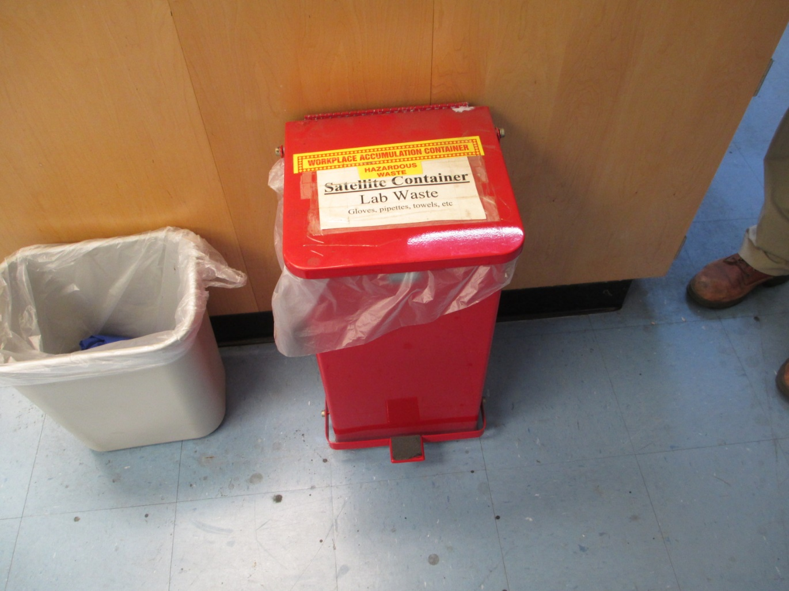
Satellite Accumulation for LQGs
Container Compatibility
[40 CFR 262.15(a)(2)]
Do

Slide 146
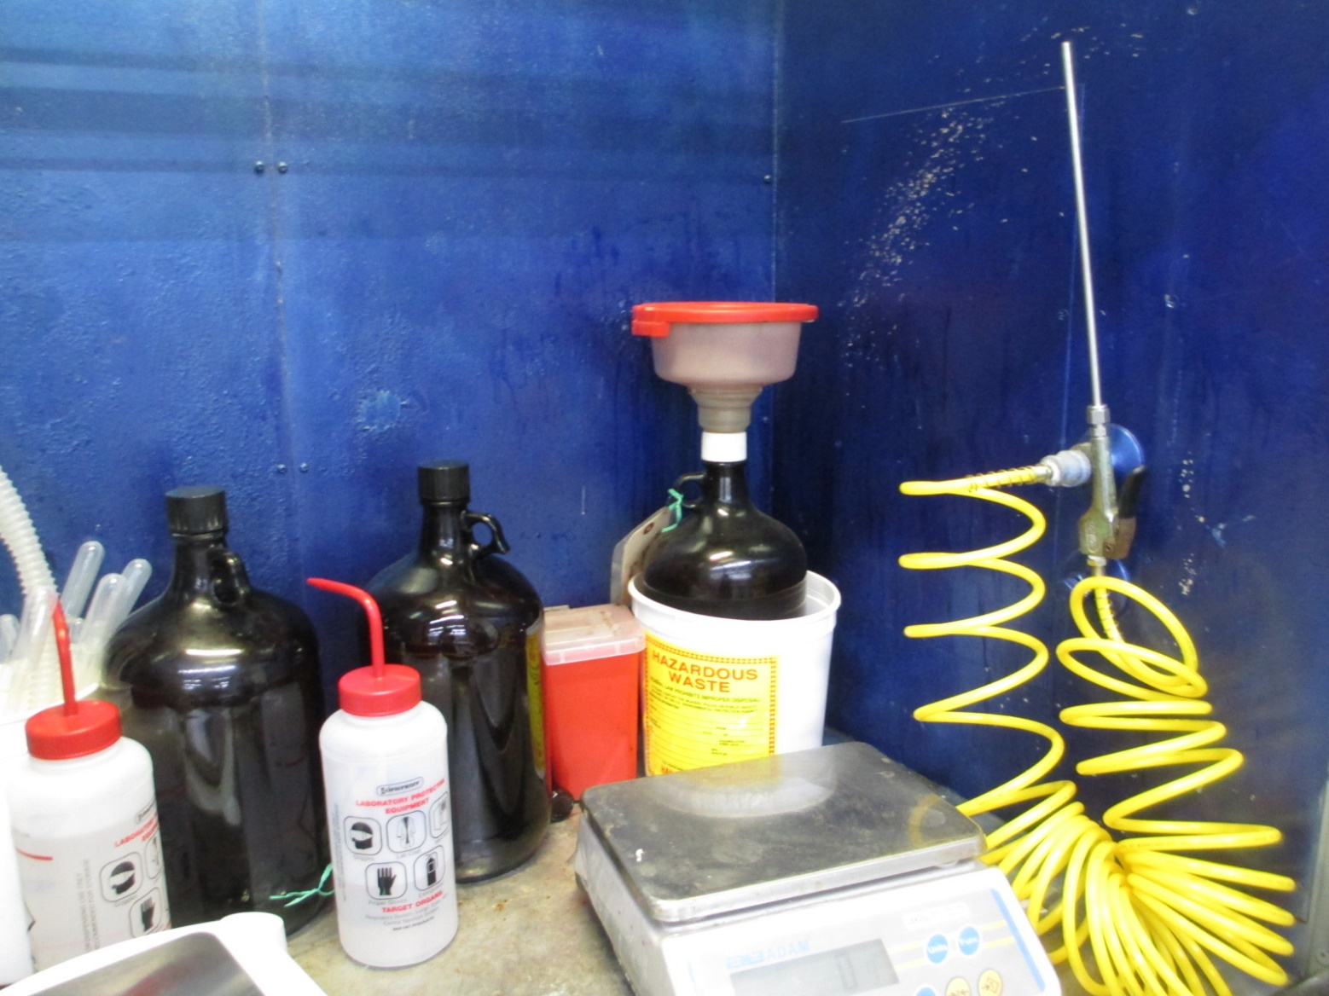
Satellite Accumulation for LQGs
Container Compatibility
[40 CFR 262.15(a)(2)]
Do

Slide 147
Satellite Accumulation for LQGs
Incompatibles
[40 CFR 262.15(a)(3)]
(a)
(3) Special standards for incompatible wastes.
(i) Incompatible wastes, or incompatible wastes and materials, (see appendix V of part 265 for examples) must not be placed in the same container, unless §265.17(b) of this chapter is complied with.
(ii) Hazardous waste must not be placed in an unwashed container that previously held an incompatible waste or material (see appendix V of part 265 for examples), unless §265.17(b) of this chapter is complied with.
(iii) A container holding a hazardous waste that is incompatible with any waste or other materials accumulated nearby in other containers must be separated from the other materials or protected from them by any practical means.
Notes:
New - The old 265.177 was not applicable for SAAs before

Slide 148
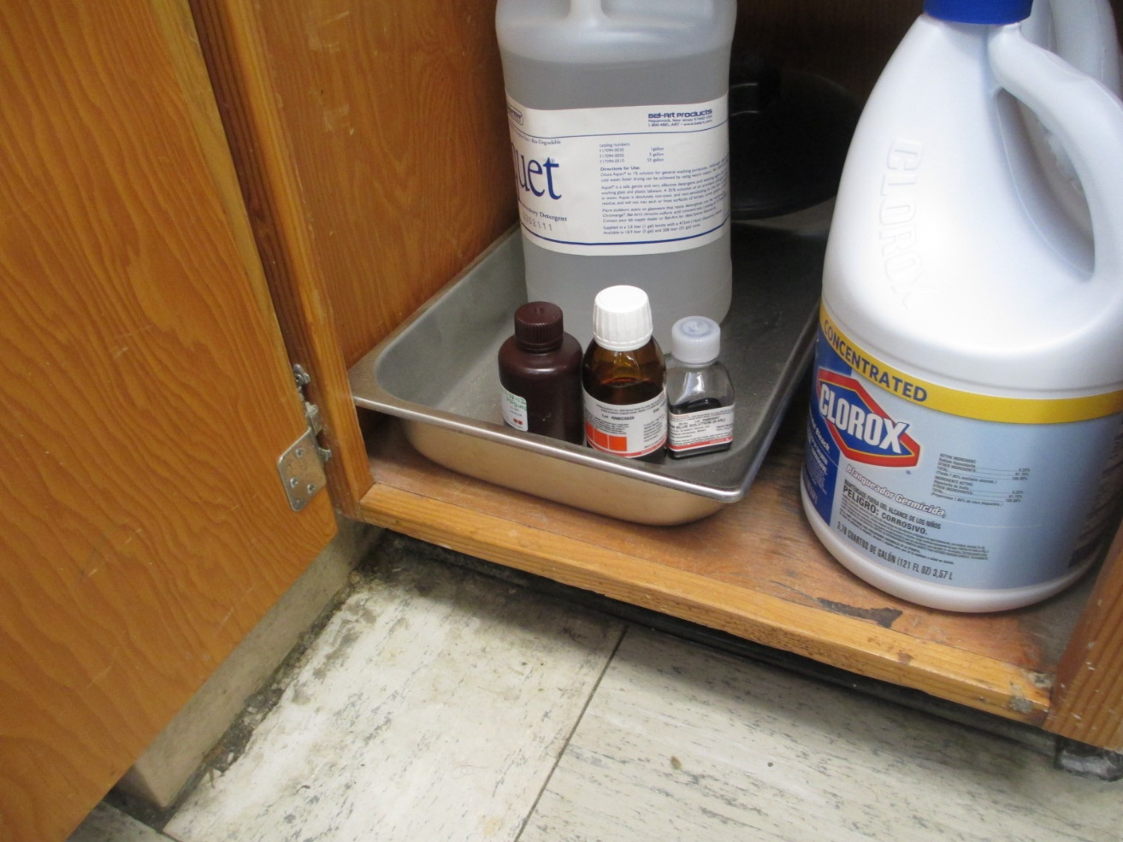
Satellite Accumulation for LQGs
Incompatibles
[40 CFR 262.15(a)(3)]
Do

Slide 149
Satellite Accumulation for LQGs
Closed Containers
[40 CFR 262.15(a)(4)]
(a)
(4) A container holding hazardous waste must be closed at all times during accumulation, except:
(i) When adding, removing, or consolidating waste; or
(ii) When temporary venting of a container is necessary
(A) For the proper operation of equipment, or
(B) To prevent dangerous situations, such as build-up of extreme pressure.
Notes:
Old 265.173 with updated language. Was applicable for SAAs before.

Slide 150
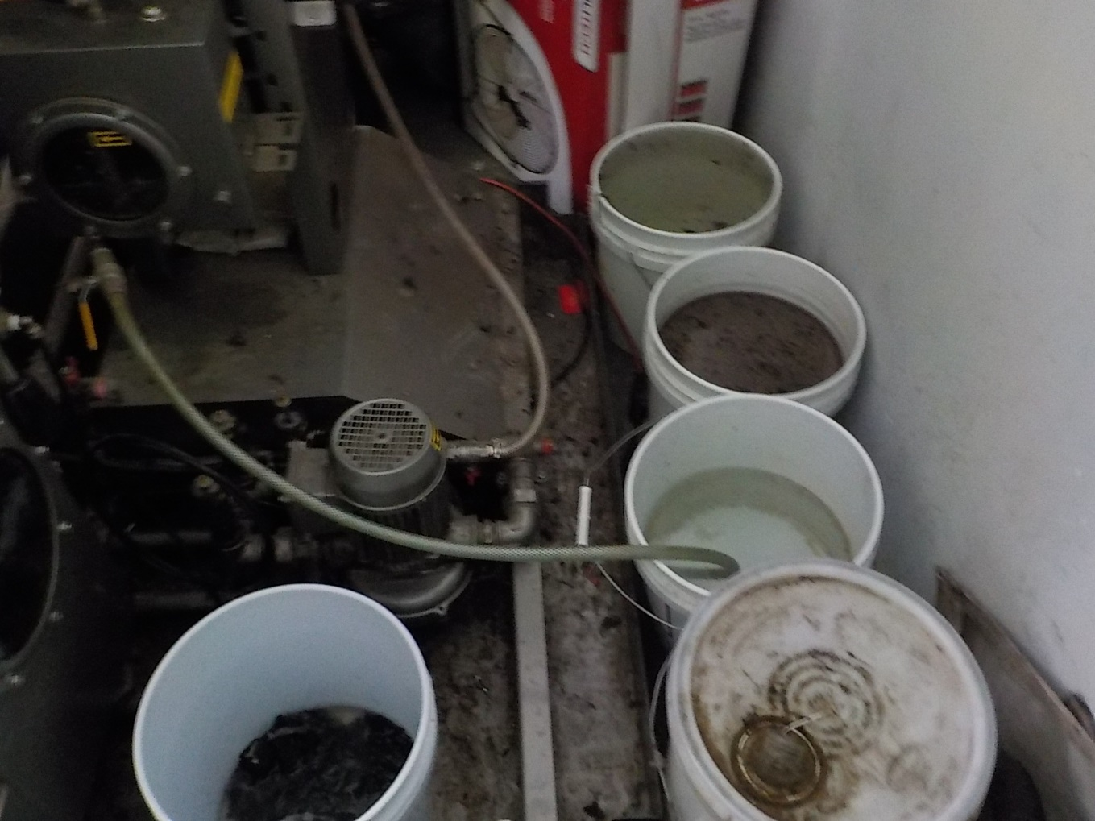
Satellite Accumulation for LQGs
Closed Containers
[40 CFR 262.15(a)(4)]
Don’t

Slide 151
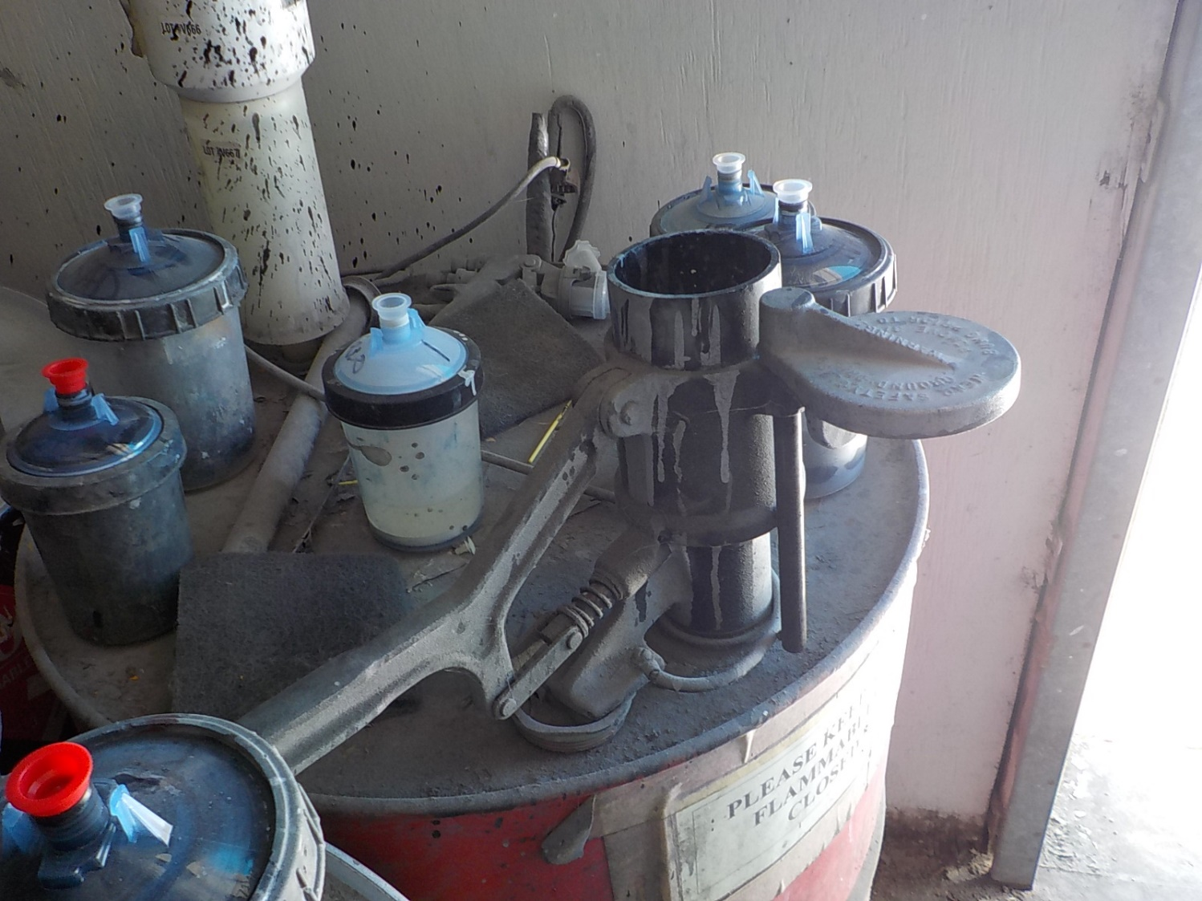
Satellite Accumulation for LQGs
Closed Containers
[40 CFR 262.15(a)(4)]
Don’t

Slide 152
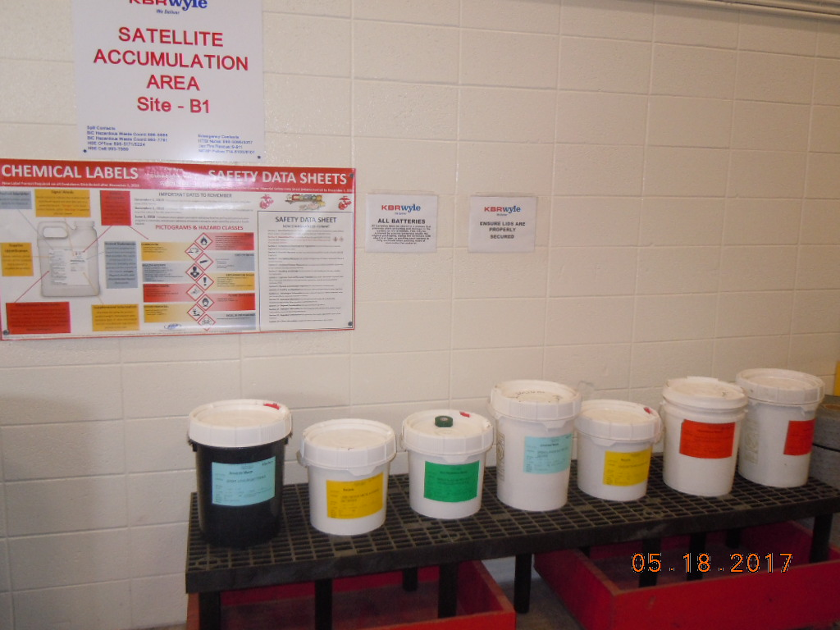
Satellite Accumulation for LQGs
Closed Containers
[40 CFR 262.15(a)(4)]
Do

Slide 153
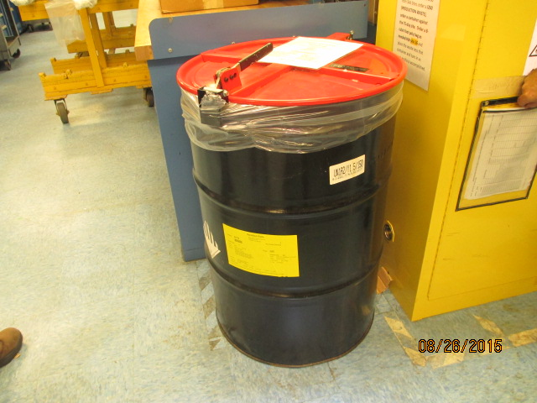
Satellite Accumulation for LQGs
Closed Containers
[40 CFR 262.15(a)(4)]
Do

Slide 154

Satellite Accumulation for LQGs
Container labels
[40 CFR 262.15(a)(5)(i)]
(a)
(5) A generator must mark or label its container with the following:
(i) The words “Hazardous Waste” and
Notes:
Updated language. No longer need words to describe contents.

Slide 155
Satellite Accumulation for LQGs
Container labels
[40 CFR 262.15(a)(5)(ii)]
(a)
(5) A generator must mark or label its container with the following:
(ii) An indication of the hazards of the contents (examples include, but are not limited to, the applicable hazardous waste characteristic(s) (i.e., ignitable, corrosive, reactive, toxic); hazard communication consistent with the Department of Transportation requirements at 49 CFR part 172 subpart E (labeling) or subpart F (placarding); a hazard statement or pictogram consistent with the Occupational Safety and Health Administration Hazard Communication Standard at 29 CFR 1910.1200; or a chemical hazard label consistent with the National Fire Protection Association code 704).
Notes:
New

Slide 156

Satellite Accumulation for LQGs
Container labels
[40 CFR 262.15(a)(5)(ii)]
Do

Slide 157

Satellite Accumulation for LQGs
Container labels
[40 CFR 262.15(a)(5)(ii)]
Don’t
Notes:
Liquid paint waste is not a flammable solid. Also, note the DOT marking is sideways.

Slide 158
Satellite Accumulation for LQGs
[40 CFR 262.15(a)(6)(i)]
(a)
(6) A generator who accumulates either acute hazardous waste listed in §261.31 or §261.33(e) of this chapter or non-acute hazardous waste in excess of the amounts listed in paragraph (a) of this section at or near any point of generation must do the following:
(i) Comply within three consecutive calendar days with the applicable central accumulation area regulations in §262.17(a), or
Notes:
Updated language

Slide 159
Satellite Accumulation for LQGs
[40 CFR 262.15(a)(6)(ii)]
(a)
(6)(ii) Remove the excess from the satellite accumulation area within three consecutive calendar days to either:
(A) A central accumulation area operated in accordance with the applicable regulations in §262.17(a);
(B) An on-site interim status or permitted treatment, storage, or disposal facility, or
(C) An off-site designated facility; and

Slide 160
Satellite Accumulation for LQGs
[40 CFR 262.15(a)(6)(iii)]
(a)
(6)(iii) During the three-consecutive-calendar-day period the generator must continue to comply with paragraphs (a)(1) through (5) of this section. The generator must mark or label the container(s) holding the excess accumulation of hazardous waste with the date the excess amount began accumulating.
(a)(7) is for SQGs

Slide 161
Satellite Accumulation for LQGs
[40 CFR 262.15(a)(8)]
(a)
(8) All satellite accumulation areas operated by LQGs must meet the Preparedness, Prevention and Emergency Procedures 40 CFR 262 Subpart M.
These will be discussed in a few minutes when we cover <90-day container accumulation area requirements.
Notes:
New

Slide 162
Conditions for Exemption for LQGs
[40 CFR 262.17]
  Let’s return to Conditions for Exemption in 262.17.

Slide 163
Conditions for Exemption for LQGs
LQG Emergency Procedures
[40 CFR 262.17(a)(6)]
(a)
(6) Emergency procedures. The large quantity generator complies with the standards in subpart M of this part, Preparedness, Prevention and Emergency Procedures for Large Quantity Generators.

Slide 164
Subpart M—Preparedness, Prevention, and Emergency Procedures for LQGs
[40 CFR 262.250]
  40 CFR 262 Subpart M
  40 CFR 262.250 Applicability.
  The regulations of this subpart apply to those areas of a large quantity generator where hazardous waste is generated or accumulated on site.
Notes:
Subpart M applies to SAAs and <90-day accumulation areas. This is new.
The bold text is interesting. See preamble page 85792

Slide 165
Subpart M—Preparedness, Prevention, and Emergency Procedures for LQGs
[40 CFR 262.251]
  40 CFR 262.251 Maintenance and operation of facility
  A large quantity generator must maintain and operate its facility to minimize the possibility of a fire, explosion, or any unplanned sudden or non-sudden release of hazardous waste or hazardous waste constituents to air, soil, or surface water which could threaten human health or the environment.
Notes:
Old 265.31

Slide 166

LQGs
Improper Maintenance and Operation
Don’t

Slide 167


LQGs Improper Maintenance and Operation
Don’t
Notes:
Hazardous waste blast dust is leaking from this blast booth.

Slide 168

LQGs
Improper Maintenance and Operation
Don’t

Slide 169

LQGs
Proper Maintenance and Operation
Do

Slide 170

LQGs
Proper Maintenance and Operation
Do

Slide 171
Subpart M—Preparedness, Prevention, and Emergency Procedures for LQGs
[40 CFR 262.252]
40 CFR 262.252 Required equipment.
All areas deemed applicable by §262.250 must be equipped with the items in paragraphs (a) through (d) of this section (unless none of the hazards posed by waste handled at the facility could require a particular kind of equipment specified below or the actual hazardous waste generation or accumulation area does not lend itself for safety reasons to have a particular kind of equipment specified below). A large quantity generator may determine the most appropriate locations within its facility to locate equipment necessary to prepare for and respond to emergencies:
Notes:
Old 265.32

Slide 172
Subpart M—Preparedness, Prevention, and Emergency Procedures for LQGs
[40 CFR 262.252]
  An internal communications or alarm system capable of providing immediate emergency instruction (voice or signal) to facility personnel;
  A device, such as a telephone (immediately available at the scene of operations) or a hand-held two-way radio, capable of summoning emergency assistance from local police departments, fire departments, or state or local emergency response teams;
  Portable fire extinguishers, fire control equipment (including special extinguishing equipment, such as that using foam, inert gas, or dry chemicals), spill control equipment, and decontamination equipment; and
  Water at adequate volume and pressure to supply water hose streams, or foam producing equipment, or automatic sprinklers, or water spray systems.

Slide 173


Subpart M—Preparedness, Prevention, and Emergency Procedures for LQGs
[40 CFR 262.252(c)]
Don’t

Slide 174


Subpart M—Preparedness, Prevention, and Emergency Procedures for LQGs
[40 CFR 262.252(c)]
Don’t
Notes:
Eyewashes obstructed or too far away may be a violation.

Slide 175


Subpart M—Preparedness, Prevention, and Emergency Procedures for LQGs
[40 CFR 262.252(c)]
Do

Slide 176
Subpart M—Preparedness, Prevention, and Emergency Procedures for LQGs
[40 CFR 262.253]
  40 CFR 262.253 Testing and maintenance of equipment.
  All communications or alarm systems, fire protection equipment, spill control equipment, and decontamination equipment, where required, must be tested and maintained as necessary to assure its proper operation in time of emergency.
Notes:
Old 265.33

Slide 177

Subpart M—Preparedness, Prevention, and Emergency Procedures for LQGs
[40 CFR 262.253]
Don’t
Notes:
Do you think this has been tested?

Slide 178

Subpart M—Preparedness, Prevention, and Emergency Procedures for LQGs
[40 CFR 262.253]
Don’t
Notes:
Do you think this has been tested? Can you even find the eyewash and shower in this picture?

Slide 179
Subpart M—Preparedness, Prevention, and Emergency Procedures for LQGs
[40 CFR 262.254(a-b)]
40 CFR 262.254 Access to communications or alarm system.
(a) Whenever hazardous waste is being poured, mixed, spread, or otherwise handled, all personnel involved in the operation must have immediate access (e.g., direct or unimpeded access) to an internal alarm or emergency communication device, either directly or through visual or voice contact with another employee, unless such a device is not required under §262.252
(b) In the event there is just one employee on the premises while the facility is operating, the employee must have immediate access (e.g., direct or unimpeded access) to a device, such as a telephone (immediately available at the scene of operation) or a hand-held two-way radio, capable of summoning external emergency assistance, unless such a device is not required under §262.252.
Notes:
Old 265.34

Slide 180
Subpart M—Preparedness, Prevention, and Emergency Procedures for LQGs
[40 CFR 262.255]
40 CFR 262.255 Required aisle space.
The large quantity generator must maintain aisle space to allow the unobstructed movement of personnel, fire protection equipment, spill control equipment, and decontamination equipment to any area of facility operation in an emergency, unless aisle space is not needed for any of these purposes.
Notes:
Old 265.35. Federal requirement.

Slide 181

Subpart M—Preparedness, Prevention, and Emergency Procedures for LQGs
[40 CFR 262.255]
Do

Slide 182

Subpart M—Preparedness, Prevention, and Emergency Procedures for LQGs
[40 CFR 262.255]
Do

Slide 183

Subpart M—Preparedness, Prevention, and Emergency Procedures for LQGs
[40 CFR 262.255]
Don’t

Slide 184

Subpart M—Preparedness, Prevention, and Emergency Procedures for LQGs
[40 CFR 262.255]
Don’t

Slide 185
Subpart M—Preparedness, Prevention, and Emergency Procedures for LQGs
[40 CFR 262.256(a)(1)]
40 CFR 262.256 Arrangements with local authorities.
(a)The large quantity generator must attempt to make arrangements with the local police department, fire department, other emergency response teams, emergency response contractors, equipment suppliers, and local hospitals, taking into account the types and quantities of hazardous wastes handled at the facility. Arrangements may be made with the Local Emergency Planning Committee, if it is determined to be the appropriate organization with which to make arrangements.
(1) A large quantity generator attempting to make arrangements with its local fire department must determine the potential need for the services of the local police department, other emergency response teams, emergency response contractors, equipment suppliers and local hospitals.
Notes:
Old 265.37. Language updated.

Slide 186
Subpart M—Preparedness, Prevention, and Emergency Procedures for LQGs
[40 CFR 262.256(a)(2-3)]
  (2) As part of this coordination, the large quantity generator shall attempt to make arrangements, as necessary, to familiarize the above organizations with the layout of the facility, the properties of the hazardous waste handled at the facility and associated hazards, places where personnel would normally be working, entrances to roads inside the facility, and possible evacuation routes as well as the types of injuries or illnesses which could result from fires, explosions, or releases at the facility.
  (3) Where more than one police or fire department might respond to an emergency, the large quantity generator shall attempt to make arrangements designating primary emergency authority to a specific fire or police department, and arrangements with any others to provide support to the primary emergency authority

Slide 187
Subpart M—Preparedness, Prevention, and Emergency Procedures for LQGs
[40 CFR 262.256(b-c)]
  (b) The large quantity generator shall maintain records documenting the arrangements with the local fire department as well as any other organization necessary to respond to an emergency. This documentation must include documentation in the operating record that either confirms such arrangements actively exist or, in cases where no arrangements exist, confirms that attempts to make such arrangements were made.
  (c) A facility possessing 24-hour response capabilities may seek a waiver from the authority having jurisdiction (AHJ) over the fire code within the facility’s state or locality as far as needing to make arrangements with the local fire department as well as any other organization necessary to respond to an emergency, provided that the waiver is documented in the operating record.
Notes:
New language

Slide 188
Subpart M—Preparedness, Prevention, and Emergency Procedures for LQGs
[40 CFR 262.260(a-b)]
40 CFR 262.260 Purpose and implementation of contingency plan.
(a) A large quantity generator must have a contingency plan for the facility. The contingency plan must be designed to minimize hazards to human health or the environment from fires, explosions, or any unplanned sudden or non-sudden release of hazardous waste or hazardous waste constituents to air, soil, or surface water. (b) The provisions of the plan must be carried out immediately whenever there is a fire, explosion, or release of hazardous waste or hazardous waste constituents which could threaten human health or the environment.
Notes:
Old 265 Subpart D. Old 265.51.

Slide 189
Subpart M—Preparedness, Prevention, and Emergency Procedures for LQGs
[40 CFR 262.261(a-c)]
40 CFR 262.261 Content of contingency plan.
(a) The contingency plan must describe the actions facility personnel must take to comply with §§262.260 and 262.265 in response to fires, explosions, or any unplanned sudden or non-sudden release of hazardous waste or hazardous waste constituents to air, soil, or surface water at the facility. (b) If the generator has already prepared a Spill Prevention, Control, and Countermeasures (SPCC) Plan in accordance with part 112 of this chapter, or some other emergency or contingency plan, it need only amend that plan to incorporate hazardous waste management provisions that are sufficient to comply with the standards of this part. The generator may develop one contingency plan that meets all regulatory standards. EPA recommends that the plan be based on the National Response Team’s Integrated Contingency Plan Guidance (‘‘One Plan’’). (c) The plan must describe arrangements agreed to with the local police department, fire department, other emergency response teams, emergency response contractors, equipment suppliers, local hospitals or, if applicable, the Local Emergency Planning Committee, pursuant to §262.256.
Notes:
Old 265.52

Slide 190
Subpart M—Preparedness, Prevention, and Emergency Procedures for LQGs
[40 CFR 262.261(d-f)]
(d) The plan must list names and emergency telephone numbers of all persons qualified to act as emergency coordinator (see §262.264), and this list must be kept up to date. Where more than one person is listed, one must be named as primary emergency coordinator and others must be listed in the order in which they will assume responsibility as alternates. In situations where the generator facility has an emergency coordinator continuously on duty because it operates 24 hours per day, every day of the year, the plan may list the staffed position (e.g., operations manager, shift coordinator, shift operations supervisor) as well as an emergency telephone number that can be guaranteed to be answered at all times.
(e) The plan must include a list of all emergency equipment at the facility (such as fire extinguishing systems, spill control equipment, communications and alarm systems (internal and external), and decontamination equipment), where this equipment is required. This list must be kept up to date. In addition, the plan must include the location and a physical description of each item on the list, and a brief outline of its capabilities.
(f) The plan must include an evacuation plan for generator personnel where there is a possibility that evacuation could be necessary. This plan must describe signal(s) to be used to begin evacuation, evacuation routes, and alternate evacuation routes (in cases where the primary routes could be blocked by releases of hazardous waste or fires).
Notes:
Updated language

Slide 191
Subpart M—Preparedness, Prevention, and Emergency Procedures for LQGs
[40 CFR 262.262(a)]
40 CFR 262.262(a) Copies of contingency plan.
A copy of the contingency plan and all revisions to the plan must be maintained at the large quantity generator and -
(a) The large quantity generator must submit a copy of the contingency plan and all revisions to all local emergency responders (i.e., police departments, fire departments, hospitals and State and local emergency response teams that may be called upon to provide emergency services). This document may also be submitted to the Local Emergency Planning Committee, as appropriate.
Notes:
Old 265.53

Slide 192
Subpart M—Preparedness, Prevention, and Emergency Procedures for LQGs
[40 CFR 262.262(b)(1-5)]
(b) A large quantity generator that first becomes subject to these provisions after May 30, 2017 or a large quantity generator that is otherwise amending its contingency plan must at that time submit a quick reference guide of the contingency plan to the local emergency responders identified at paragraph (a) of this section or, as appropriate, the Local Emergency Planning Committee. The quick reference guide must include the following elements: (1) The types/names of hazardous wastes in layman’s terms and the associated hazard associated with each hazardous waste present at any one time (e.g., toxic paint wastes, spent ignitable solvent, corrosive acid); (2) The estimated maximum amount of each hazardous waste that may be present at any one time; (3) The identification of any hazardous wastes where exposure would require unique or special treatment by medical or hospital staff; (4) A map of the facility showing where hazardous wastes are generated, accumulated and treated and routes for accessing these wastes; (5) A street map of the facility in relation to surrounding businesses, schools and residential areas to understand how best to get to the facility and also evacuate citizens and workers;
Notes:
New

Slide 193
Subpart M—Preparedness, Prevention, and Emergency Procedures for LQGs
[40 CFR 262.262(b)(6-8)]
(b) cont.
(6) The locations of water supply (e.g., fire hydrant and its flow rate); (7) The identification of on-site notification systems (e.g., a fire alarm that rings off site, smoke alarms); and (8) The name of the emergency coordinator(s) and 7/24-hour emergency telephone number(s) or, in the case of a facility where an emergency coordinator is continuously on duty, the emergency telephone number for the emergency coordinator.
Notes:
New

Slide 194
Subpart M—Preparedness, Prevention, and Emergency Procedures for LQGs
[40 CFR 262.262(c)]
(c) Generators must update, if necessary, their quick reference guides, whenever the contingency plan is amended and submit these documents to the local emergency responders identified at paragraph (a) of this section or, as appropriate, the Local Emergency Planning Committee.
Notes:
New

Slide 195
Subpart M—Preparedness, Prevention, and Emergency Procedures for LQGs
[40 CFR 262.263(a-e)]
40 CFR 262.263 Amendment of contingency plan.
The contingency plan must be reviewed, and immediately amended, if necessary, whenever: (a) Applicable regulations are revised; (b) The plan fails in an emergency; (c) The generator facility changes— in its design, construction, operation, maintenance, or other circumstances— in a way that materially increases the potential for fires, explosions, or releases of hazardous waste or hazardous waste constituents, or changes the response necessary in an emergency; (d) The list of emergency coordinators changes; or (e) The list of emergency equipment changes.
Notes:
Old 265.54

Slide 196
Subpart M—Preparedness, Prevention, and Emergency Procedures for LQGs
[40 CFR 262.264]
40 CFR 262.264 Emergency coordinator.
At all times, there must be at least one employee either on the generator’s premises or on call (i.e., available to respond to an emergency by reaching the facility within a short period of time) with the responsibility for coordinating all emergency response measures and implementing the necessary emergency procedures outlined in §262.265. Although responsibilities may vary depending on factors such as type and variety of hazardous waste(s) handled by the facility, as well as type and complexity of the facility, this emergency coordinator must be thoroughly familiar with all aspects of the generator’s contingency plan, all operations and activities at the facility, the location and characteristics of hazardous waste handled, the location of all records within the facility, and the facility’s layout. In addition, this person must have the authority to commit the resources needed to carry out the contingency plan.
Notes:
Old 265.55. Updated language.

Slide 197
Subpart M—Preparedness, Prevention, and Emergency Procedures for LQGs
[40 CFR 262.265(a-b)]
40 CFR 262.265 Emergency Procedures.
(a) Whenever there is an imminent or actual emergency situation, the emergency coordinator (or his designee when the emergency coordinator is on call) must immediately: (1) Activate internal facility alarms or communication systems, where applicable, to notify all facility personnel; and (2) Notify appropriate state or local agencies with designated response roles if their help is needed. (b) Whenever there is a release, fire, or explosion, the emergency coordinator must immediately identify the character, exact source, amount, and areal extent of any released materials. The emergency coordinator may do this by observation or review of the facility records or manifests and, if necessary, by chemical analysis.
Notes:
Old 265.56

Slide 198
Subpart M—Preparedness, Prevention, and Emergency Procedures for LQGs
[40 CFR 262.265(c-d)(1)]
(c) Concurrently, the emergency coordinator must assess possible hazards to human health or the environment that may result from the release, fire, or explosion. This assessment must consider both direct and indirect effects of the release, fire, or explosion (e.g., the effects of any toxic, irritating, or asphyxiating gases that are generated, or the effects of any hazardous surface water run-offs from water or chemical agents used to control fire and heat-induced explosions). (d) If the emergency coordinator determines that the facility has had a release, fire, or explosion which could threaten human health, or the environment, outside the facility, the emergency coordinator must report the findings as follows: (1) If the assessment indicates that evacuation of local areas may be advisable, the emergency coordinator must immediately notify appropriate local authorities. The emergency coordinator must be available to help appropriate officials decide whether local areas should be evacuated; and

Slide 199
Subpart M—Preparedness, Prevention, and Emergency Procedures for LQGs
[40 CFR 262.265(d)(2)]
(2) The emergency coordinator must immediately notify either the government official designated as the on scene coordinator for that geographical area, or the National Response Center (using their 24-hour toll free number 800/424–8802). The report must include: (i) Name and telephone number of reporter; (ii) Name and address of the generator; (iii) Time and type of incident (e.g., release, fire); (iv) Name and quantity of material(s) involved, to the extent known; (v) The extent of injuries, if any; and (vi) The possible hazards to human health, or the environment, outside the facility.

Slide 200
Subpart M—Preparedness, Prevention, and Emergency Procedures for LQGs
[40 CFR 262.265(e-g)]
(e) During an emergency, the emergency coordinator must take all reasonable measures necessary to ensure that fires, explosions, and releases do not occur, recur, or spread to other hazardous waste at the generator’s facility. These measures must include, where applicable, stopping processes and operations, collecting and containing released hazardous waste, and removing or isolating containers.
(f) If the generator stops operations in response to a fire, explosion or release, the emergency coordinator must monitor for leaks, pressure buildup, gas generation, or ruptures in valves, pipes, or other equipment, wherever this is appropriate.
(g) Immediately after an emergency, the emergency coordinator must provide for treating, storing, or disposing of recovered waste, contaminated soil or surface water, or any other material that results from a release, fire, or explosion at the facility. Unless the generator can demonstrate, in accordance with §261.3(c) or (d) of this chapter, that the recovered material is not a hazardous waste, then it is a newly generated hazardous waste that must be managed in accordance with all the applicable requirements and conditions for exemption in parts 262, 263, and 265 of this chapter.
Notes:
(g) Has updated language from comment

Slide 201
Subpart M—Preparedness, Prevention, and Emergency Procedures for LQGs
[40 CFR 262.265(h)]
(h) The emergency coordinator must ensure that, in the affected area(s) of the facility:
No hazardous waste that may be incompatible with the released material is treated, stored, or disposed of until cleanup procedures are completed; and
(2) All emergency equipment listed in the contingency plan is cleaned and fit for its intended use before operations are resumed.

Slide 202
Subpart M—Preparedness, Prevention, and Emergency Procedures for LQGs
[40 CFR 262.265(i)]
(i) The generator must note in the operating record the time, date, and details of any incident that requires implementing the contingency plan. Within 15 days after the incident, the generator must submit a written report on the incident to the Regional Administrator. The report must include: (1) Name, address, and telephone number of the generator; (2) Date, time, and type of incident (e.g., fire, explosion); (3) Name and quantity of material(s) involved; (4) The extent of injuries, if any; (5) An assessment of actual or potential hazards to human health or the environment, where this is applicable; and (6) Estimated quantity and disposition of recovered material that resulted from the incident.
Notes:
Updated language

Slide 203
Conditions for Exemption for LQGs
[40 CFR 262.17(a)]
Back to Conditions for Exemption for LQGs

Slide 204
Conditions for Exemption for LQGs
LQG Emergency Procedures
[40 CFR 262.17(a)(7)(i)(A)]
(a)(7) Personnel training.
(i)
(A) Facility personnel must successfully complete a program of classroom instruction, online training (e.g., computer-based or electronic), or on-the-job training that teaches them to perform their duties in a way that ensures compliance with this part. The large quantity generator must ensure that this program includes all the elements described in the document required under paragraph (a)(7)(iv) of this section.
Notes:
Old 265.16. Updated language

Slide 205


Conditions for Exemption for LQGs
Emergency Procedures – Personnel Training
[40 CFR 262.17(a)(7)(i)(A)]
Do

Slide 206

Conditions for Exemption for LQGs
Emergency Procedures – Personnel Training
[40 CFR 262.17(a)(7)(i)(A)]
Don’t

Slide 207
Conditions for Exemption for LQGs
LQG Emergency Procedures
[40 CFR 262.17(a)(7)(i)(B)]
(a)(7)(i)
(B) This program must be directed by a person trained in hazardous waste management procedures, and must include instruction which teaches facility personnel hazardous waste management procedures (including contingency plan implementation) relevant to the positions in which they are employed.

Slide 208
Conditions for Exemption for LQGs
LQG Emergency Procedures
[40 CFR 262.17(a)(7)(i)(C)]
(a)(7)(i)
(C) At a minimum, the training program must be designed to ensure that facility personnel are able to respond effectively to emergencies by familiarizing them with emergency procedures, emergency equipment, and emergency systems, including where applicable: (1) Procedures for using, inspecting, repairing, and replacing facility emergency and monitoring equipment; (2) Key parameters for automatic waste feed cut-off systems; (3) Communications or alarm systems; (4) Response to fires or explosions; (5) Response to ground-water contamination incidents; and (6) Shutdown of operations.

Slide 209

Conditions for Exemption for LQGs
Emergency Procedures – Personnel Training
[40 CFR 262.17(a)(7)(i)(A)]
Don’t
Notes:
Don’t

Slide 210
Conditions for Exemption for LQGs
LQG Emergency Procedures
[40 CFR 262.17(a)(7)(i)(D)]
(a)(7)(i)
(D) For facility employees that receive emergency response training pursuant to Occupational Safety and Health Administration regulations 29 CFR 1910.120(p)(8) and 1910.120(q), the large quantity generator is not required to provide separate emergency response training pursuant to this section, provided that the overall facility training meets all the conditions of exemption in this section.

Slide 211
Conditions for Exemption for LQGs
LQG Emergency Procedures
[40 CFR 262.17(a)(7)(ii)]
(a)(7)
(ii) Facility personnel must successfully complete the program required in paragraph (a)(7)(i) of this section within six months after the date of their employment or assignment to the facility, or to a new position at the facility, whichever is later. Employees must not work in unsupervised positions until they have completed the training standards of paragraph (a)(7)(i) of this section.

Slide 212
Conditions for Exemption for LQGs
LQG Emergency Procedures
[40 CFR 262.17(a)(7)(iii)]
(a)(7)
(iii) Facility personnel must take part in an annual review of the initial training required in paragraph (a)(7)(i) of this section.

Slide 213
Conditions for Exemption for LQGs
LQG Emergency Procedures
[40 CFR 262.17(a)(7)(iv)]
(a)(7)
(iv) The large quantity generator must maintain the following documents and records at the facility: (A) The job title for each position at the facility related to hazardous waste management, and the name of the employee filling each job; (B) A written job description for each position listed under paragraph (a)(7)(iv)(A) of this section. This description may be consistent in its degree of specificity with descriptions for other similar positions in the same company location or bargaining unit, but must include the requisite skill, education, or other qualifications, and duties of facility personnel assigned to each position; (C) A written description of the type and amount of both introductory and continuing training that will be given to each person filling a position listed under paragraph (a)(7)(iv)(A) of this section; (D) Records that document that the training or job experience, required under paragraphs (a)(7)(i), (ii), and (iii) of this section, has been given to, and completed by, facility personnel.

Slide 214
Conditions for Exemption for LQGs
LQG Emergency Procedures
[40 CFR 262.17(a)(7)(v)]
(a)(7)
(v) Training records on current personnel must be kept until closure of the facility. Training records on former employees must be kept for at least three years from the date the employee last worked at the facility. Personnel training records may accompany personnel transferred within the same company.

Slide 215
Conditions for Exemption for LQGs
LQG Closure
[40 CFR 262.17(a)(8)(i)]
(a)(8) Closure. A large quantity generator accumulating hazardous wastes in containers, tanks, drip pads, and containment buildings, prior to closing a unit at the facility, or prior to closing the facility, must meet the following conditions:
(i) Notification for closure of a waste accumulation unit. A large quantity generator must perform one of the following when closing a waste accumulation unit: (A) Place a notice in the operating record within 30 days after closure identifying the location of the unit within the facility; or (B) Meet the closure performance standards of paragraph (a)(8)(iii) of this section for container, tank, and containment building waste accumulation units or paragraph (a)(8)(iv) of this section for drip pads and notify EPA following the procedures in paragraph (a)(8)(ii)(B) of this section for the waste accumulation unit. If the waste accumulation unit is subsequently reopened, the generator may remove the notice from the operating record.
Notes:
New for LQGs.

Slide 216
Conditions for Exemption for LQGs
LQG Closure
[40 CFR 262.17(a)(8)(ii)(A-B)]
(a)(8)(ii) Notification for closure of the facility.
Notify EPA using form 8700–12 no later than 30 days prior to closing the facility.
Notify EPA using form 8700–12 within 90 days after closing the facility that it has complied with the closure performance standards of paragraph (a)(8)(iii) or (iv) of this section. If the facility cannot meet the closure performance standards of paragraph (a)(8)(iii) or (iv) of this section, notify EPA using form 8700–12 that it will close as a landfill under §265.310 of this chapter in the case of a container, tank or containment building unit(s), or for a facility with drip pads, notify using form 8700–12 that it will close under the standards of §265.445(b).

Slide 217
Conditions for Exemption for LQGs
LQG Closure
[40 CFR 262.17(a)(8)(ii)(C)]
(8)(a)(ii) cont.
(C) A large quantity generator may request additional time to clean close, but it must notify EPA using form 8700–12 within 75 days after the date provided in paragraph (a)(8)(ii)(A) of this section to request an extension and provide an explanation as to why the additional time is required.

Slide 218
Conditions for Exemption for LQGs
LQG Closure
[40 CFR 262.17(a)(8)(iii)(1-2)]
(a)(8)(iii) Closure performance standards for container, tank systems, and containment building waste accumulation units.
(A) At closure, the generator must close the waste accumulation unit or facility in a manner that:
Minimizes the need for further maintenance by controlling, minimizing, or eliminating, to the extent necessary to protect human health and the environment, the post-closure escape of hazardous waste, hazardous constituents, leachate, contaminated run-off, or hazardous waste decomposition products to the ground or surface waters or to the atmosphere,
Removes or decontaminates all contaminated equipment, structures and soil and any remaining hazardous waste residues from waste accumulation units including containment system components (pads, liners, etc.), contaminated soils and subsoils, bases, and structures and equipment contaminated with waste, unless §261.3(d) of this chapter applies.

Slide 219
Conditions for Exemption for LQGs
LQG Closure
[40 CFR 262.17(a)(8)(iii)(3-4)]
(a)(8)(iii) cont.
(3) Any hazardous waste generated in the process of closing either the generator’s facility or unit(s) accumulating hazardous waste must be managed in accordance with all applicable standards of parts 262, 263, 265 and 268 of this chapter, including removing any hazardous waste contained in these units within 90 days of generating it and managing these wastes in a RCRA Subtitle C hazardous waste permitted treatment, storage and disposal facility or interim status facility.
(4) If the generator demonstrates that any contaminated soils and wastes cannot be practicably removed or decontaminated as required in paragraph (a)(8)(ii)(A)(2) of this section, then the waste accumulation unit is considered to be a landfill and the generator must close the waste accumulation unit and perform post-closure care in accordance with the closure and post-closure care requirements that apply to landfills (§265.310 of this chapter). In addition, for the purposes of closure, post-closure, and financial responsibility, such a waste accumulation unit is then considered to be a landfill, and the generator must meet all of the requirements for landfills specified in subparts G and H of part 265 of this chapter.

Slide 220
Conditions for Exemption for LQGs
LQG Closure
[40 CFR 262.17(a)(8)(iv-v)]
(a)(8)
(iv) Closure performance standards for drip pad waste accumulation units. At closure, the generator must comply with the closure requirements of paragraphs (a)(8)(ii) and (a)(8)(iii)(A)(1) and (3) of this section, and §265.445(a) and (b) of this chapter.
(v) The closure requirements of paragraph (a)(8) of this section do not apply to satellite accumulation areas.

Slide 221
Conditions for Exemption for LQGs
LQG Land Disposal Restrictions
[40 CFR 262.17(a)(9)]
(9) LQG must comply with Land Disposal Restrictions (LDRs) under 40 CFR Part 268.
LDRs are covered in greater detail in a separate PowerPoint. The following slides are a quick summary.

Slide 222
LDR Notice Contents
All applicable waste codes
Treatability group
Constituents subject to regulation, if not all regulated constituents
Manifest document number of shipment
Waste analysis data where available
One time notice

Slide 223
Land Disposal Restrictions
[40 CFR Part 268]
LDR waste analysis
LDR notification
LDR certification
LDR waste analysis plan
Retain documentation for three years

Slide 224
Conditions for Exemption for LQGs
LQG LDRs
[40 CFR 262.17(b)]
  (b) Accumulation time limit extension. A large quantity generator who accumulates hazardous waste for more than 90 days is subject to the requirements of 40 CFR parts 124, 264 through 268, and part 270 of this chapter, and the notification requirements of section 3010 of RCRA, unless it has been granted an extension to the 90-day period. Such extension may be granted by EPA if hazardous wastes must remain on site for longer than 90 days due to unforeseen, temporary, and uncontrollable circumstances. An extension of up to 30 days may be granted at the discretion of the Regional Administrator on a case-by-case basis.
  (c), (d) and (e) are for F006 waste issues.
Notes:
Old 262.34(b). Updated language.
(c), (d) and (e) are for F006 waste issues.

Slide 225
Conditions for Exemption for LQGs
LQG LDRs
[40 CFR 262.17(f)]
  (f) Consolidation of hazardous waste received from very small quantity generators. Large quantity generators may accumulate on site hazardous waste received from very small quantity generators under control of the same person (as defined in §260.10 of this chapter), without a storage permit or interim status and without complying with the requirements of parts 124, 264 through 268, and 270 of this chapter, and the notification requirements of section 3010 of RCRA, provided that they comply with the following conditions. ‘‘Control,’’ for the purposes of this section, means the power to direct the policies of the generator, whether by the ownership of stock, voting rights, or otherwise, except that contractors who operate generator facilities on behalf of a different person shall not be deemed to ‘‘control’’ such generators.
Notes:
New

Slide 226
Conditions for Exemption for LQGs
LQG LDRs
[40 CFR 262.17(f)(1)]
  (f)(1)The large quantity generator notifies EPA at least thirty (30) days prior to receiving the first shipment from a very small quantity generator(s) using EPA Form 8700–12; and
  Identifies on the form the name(s) and site address(es) for the very small quantity generator(s) as well as the name and business telephone number for a contact person for the very small quantity generator(s); and
  (ii) Submits an updated Site ID form (EPA Form 8700–12) within 30 days after a change in the name or site address for the very small quantity generator.

Slide 227
Conditions for Exemption for LQGs
LQG LDRs
[40 CFR 262.17(f)(2)]
  (f)(2) The large quantity generator maintains records of shipments for three years from the date the hazardous waste was received from the very small quantity generator. These records must identify the name, site address, and contact information for the very small quantity generator and include a description of the hazardous waste received, including the quantity and the date the waste was received.

Slide 228
Conditions for Exemption for LQGs
LQG LDRs
[40 CFR 262.17(f)(3)]
  (f)(3) The large quantity generator complies with the independent requirements identified in §262.10(a)(1)(iii) and the conditions for exemption in this section for all hazardous waste received from a very small quantity generator. For purposes of the labeling and marking regulations in paragraph (a)(5) of this section, the large quantity generator must label the container or unit with the date accumulation started (i.e., the date the hazardous waste was received from the very small quantity generator). If the large quantity generator is consolidating incoming hazardous waste from a very small quantity generator with either its own hazardous waste or with hazardous waste from other very small quantity generators, the large quantity generator must label each container or unit with the earliest date any hazardous waste in the container was accumulated on site.

Slide 229
Conditions for Exemption for LQGs
LQG LDRs
[40 CFR 262.17(g)(1-2)]
  (g) Rejected load. A large quantity generator who sends a shipment of hazardous waste to a designated facility with the understanding that the designated facility can accept and manage the waste and later receives that shipment back as a rejected load or residue in accordance with the manifest discrepancy provisions of §264.72 or §265.72 of this chapter may accumulate the returned waste on site in accordance with paragraphs (a) and (b) of this section. Upon receipt of the returned shipment, the generator must: (1) Sign Item 18c of the manifest, if the transporter returned the shipment using the original manifest; or (2) Sign Item 20 of the manifest, if the transporter returned the shipment using a new manifest.

Slide 230
Questions?
Hazardous Waste Program
8800 Baymeadows Way West
Suite 100
Jacksonville, Florida 32256
(904) 256-1700
(904) 256-1588 fax

