Slide 1
Hazardous Waste Transporters
40 CFR Part 263 and 62-730.170, FAC

Slide 2
Overview
40 CFR Part 260.10, Definition:
Hazardous Waste Transporter means a person engaged in the off-site transportation of hazardous waste by air, rail, highway, or water.
Title 40 Code of Federal Regulations (CFR) Part 263;
Manifests (EPA Form 8700-22/22A);
Recordkeeping;
Hazardous Waste Discharges and Cleanup.
Chapter 62-730.170, Florida Administrative Code (FAC).

Slide 3
Requirements – Notification: 40 CFR 263.11
A Transporter must not transport hazardous wastes without having received an EPA identification number.
Form 8700-12FL (effective 04/23/2013).
Is not required solely for “on-site” transportation by Generators or permitted facilities.

Slide 4
Requirements – 62-730.170, FAC
Financial responsibility for accidents = at least $1 million per occurrence for personal injury and property / environmental damage;
Annual registration by Sep 1 (or Mar 1 if also a Used Oil Transporter);
Annual documentation of financial coverage;
Notification of any change in facility information, operation, or status;
Maintain copies of registration in Transporter vehicles (good to have copy of financial coverage).

Slide 5
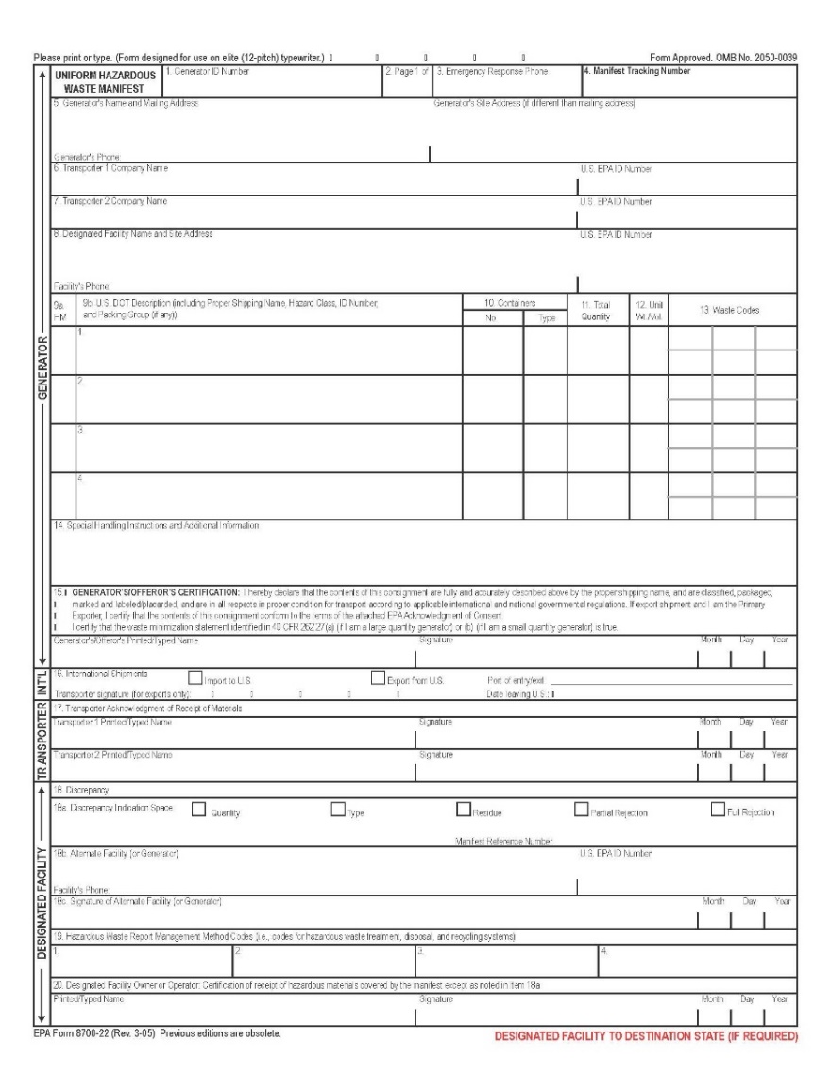
Manifest System - 40 CFR 263.20
To accept hazardous waste, the Generator must sign manifest;
Generator may authorize someone to sign “on behalf of” the Generator;
Before transporting, the Transporter must sign and date the manifest;
The Transporter must leave one signed copy with the Generator before leaving the Generator’s property;
The manifest must accompany the waste.

Slide 6
Manifest Form 8700-22/22A
Complete all blocks 1-20
Name, address, and EPA ID# of the Generator;
Name, address, and EPA ID# of the Transporter(s);
Name, address, and EPA ID# of the designated facility (permitted TSD);
Manifest tracking number;
Description and quantity of hazardous waste with EPA waste codes;
Signature(s) of subsequent Transporter(s);
Signatures signifying proper delivery or reason why delivery could not be certified.

Slide 7
Signing a Manifest
Item # 15 on a manifest: “I hereby declare that the contents of this consignment are fully and accurately described above by the proper shipping name, and are classified, packaged, marked and labeled / placarded, and are in all respects in proper condition for transport according to applicable international and national governmental regulations.” AND “I certify that the waste minimization statement of 40 CFR 262.27…is true. “I am a large (or small) quantity generator. I have a program in place (or made a good faith effort) to reduce the volume and toxicity of waste…AND I have selected the (best available) practicable method of treatment, storage, or disposal…which minimizes the present and future threat to human health and the environment.”

Slide 8
E-Manifests – 40 CFR 263.20(a)(4) - (8)
The Hazardous Waste Electronic Manifest (E-Manifest) System | US EPA
https://www.epa.gov/e-manifest/frequent-questions-about-final-rule-user-fees-electronic-hazardous-waste-manifest-system

Slide 9
Manifest System – 40 CFR 263.20(c)
The Transporter must ensure that the manifest accompanies the waste.
In the case of exports occurring under EPA-issued consent, a movement document must also accompany the waste.
This Photo by Unknown Author is licensed under CC BY

Slide 10
Manifest System – 40 CFR 263.20(d)
A Transporter who delivers a hazardous waste to another Transporter or designated facility must:
Obtain the date of delivery and the handwritten signature of that Transporter or of the owner or operator of the designated facility on the manifest;
Retain one copy for three years;
Give the remaining copies of the manifest to the accepting Transporter or designated facility.

Slide 11
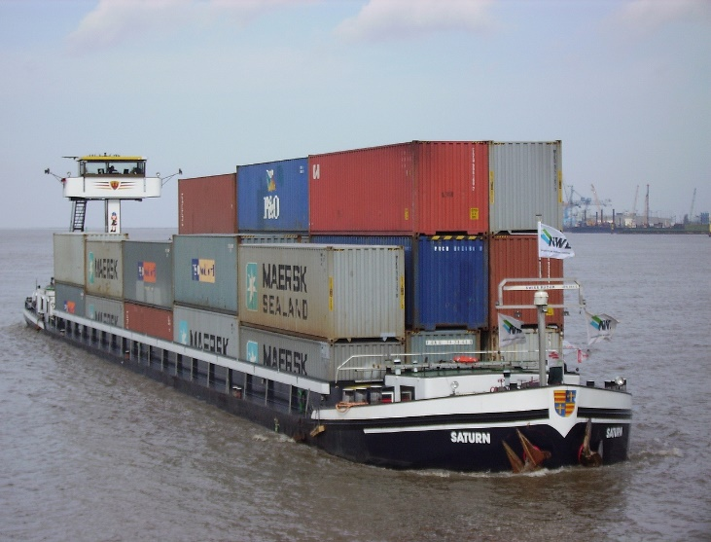
Manifest System – Water 40 CFR 263.20(e)
A Transporter who delivers a hazardous waste by water (bulk shipment) to a designated facility must:
Include a manifest/shipping paper and a movement document if applicable;
Obtain the date of delivery and the handwritten signature of the owner/operator of the designated facility on the manifest/shipping paper;
Provide the date of delivery and a handwritten signature of acceptance on the manifest/shipping paper to the deliverer of the waste to forward to the designated facility;
Retain one copy for three years.

Slide 12
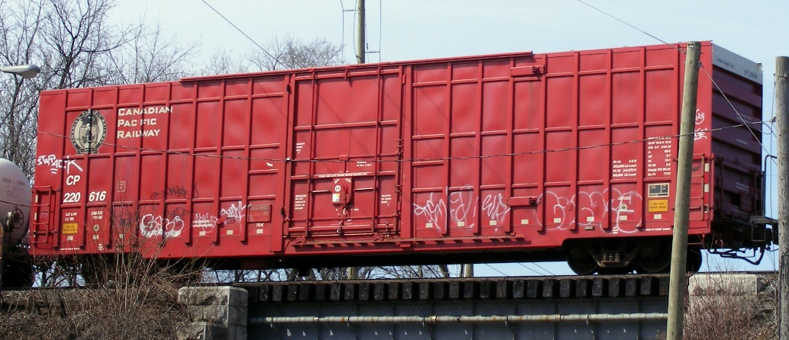
Manifest System – Rail 40 CFR 263.20(f)
Initial rail Transporter (when accepting from a non-rail Transporter) must:
Sign and date manifest;
Return a signed copy to non-rail Transporter;
Forward at least three copies to one of the following:
Next non-rail Transporter, if any;
The designated facility, if the shipment is delivered to that facility by rail;
The last rail Transporter designated in the U.S.
Retain one copy of the manifest/shipping paper for three years.

Slide 13
Manifest System – Rail 40 CFR 263.20(f)
Rail Transporter delivering to a designated facility or non-rail Transporter must:
Obtain the date of delivery and the handwritten signature of the owner/operator of the designated facility or non-rail Transporter on the manifest/shipping paper;
Retain one copy of the manifest/shipping paper for three years.
Non-rail Transporter accepting from a rail Transporter must:
Sign and date the manifest and provide a copy to the rail Transporter.

Slide 14
Manifest System - Exports 40 CFR 263.20(g)
Transporters who export hazardous waste must:
Sign and date the International Shipments block with date waste left the U.S.;
Retain one copy for three years;
Return a signed copy to the Generator;
Give a copy of the manifest to a U.S. Customs official at the point of departure from the U.S.

Slide 15
Manifest System – Reclamation Agreement 40 CFR 263.20(h)
Waste being transported from a SQG (not an LQG) pursuant to a Reclamation Agreement is exempt from manifesting requirements of 40 CFR 263.20 and recordkeeping requirements of 40 CRF 263.22 if the Transporter keeps a log or shipping paper with the following:
Generator’s name, address, EPA ID;
Quantity of waste accept;
All DOT-required shipping information;
Date waste accept; and
Information accompanies waste to reclamation facility; and
Transporter retains these records for three years after the end of the Agreement.

Slide 16
Compliance with the Manifest – 40 CFR 263.21(a)
The Transporter must deliver the entire quantity of hazardous waste accepted from a Generator or a Transporter to:
The designated facility on the manifest; or
The alternate designated facility, if the hazardous waste cannot be delivered to a designated facility because an emergency prevents delivery; or
The next Transporter; or
The place outside of the U.S. designated by the Generator.

Slide 17
Compliance with the Manifest – 40 CFR 263.21(b)(1)
If the hazardous waste cannot be delivered (other than rejection), then the Transporter is responsible for contacting the Generator for further instructions AND must revise the manifest according to the Generator’s instructions.

Slide 18
Compliance with the Manifest – 40 CFR 263.21(b)(2)
IF hazardous waste is rejected by the designated facility while the Transporter is on the facility’s premises, THEN the Transporter must obtain the following:
(i) For partial load rejection…a copy of the original manifest that includes the facility’s date and signature…If the Transporter is forwarding the rejected part of the shipment or a regulated container residue to an alternate facility or returning it to the Generator, the Transporter must obtain a new manifest to accompany the shipment…
(ii) For a full load rejection that will be taken back by the Transporter, a copy of the original manifest that includes the rejecting facility’s signature and date attesting to the rejection…

Slide 19
Recordkeeping - 40 CFR 263.22
(a) – (d): A Transporter of hazardous waste (by vehicle, water or rail) must keep a copy of the manifest signed by the Generator, himself, and the next designated Transporter and the owner/operator of the designated facility for a period of three years from the date the hazardous waste was accepted by the initial Transporter.

Slide 20
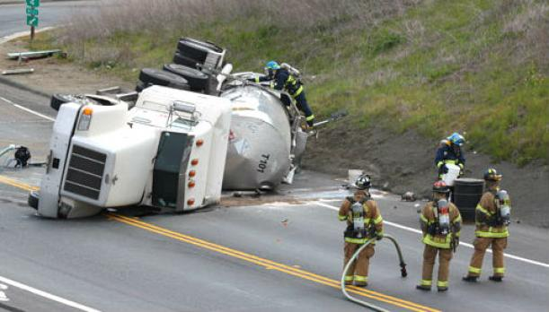
Discharges - 40 CFR 263.30
(a) In the event of a discharge of hazardous waste during transportation, the Transporter must take appropriate immediate action to protect human health and the environment.
(b) If a discharge of hazardous waste occurs during transportation and a federal/state/local official determines that immediate removal of the waste is necessary to protect human health or the environment, that official may authorize the removal of the waste by Transporters who do not have EPA ID numbers and without preparation of the manifest.

Slide 21
Discharges - 40 CFR 263.30
(c) An air, rail, highway or water Transporter who has a reportable hazardous waste discharge under 49 CFR 171.15 must:
Give notice to the National Response Center (if required) at 1-800-424-8802 or http://www.nrc.uscg.mil/
Report in writing as required by 49 CFR 171.16 or electronically at https://hazmatonline.phmsa.dot.gov/incident/
Note: Transporters are also subject to CERCLA for reportable quantity releases of hazardous waste found in 40 CFR 302.4

Slide 22
Discharge Cleanup – 40 CFR 263.31
A Transporter must clean- up any hazardous waste discharge that occurs during transportation or take such action as may be required or approved by federal, state, or local officials so that the hazardous waste discharged no longer presents a hazard to human health and the environment.

Slide 23
Regulatory Update
EPA Final Rule: Hazardous Waste Export-Import Revisions (https://www.epa.gov/hwgenerators/final-rule-hazardous-waste-export-import-revisions)
Effective December 31, 2016; phased implementation.
The final rule establishes:
Improved export and import shipment tracking;
One consolidated and streamlined set of requirements applying to all imports and exports;
Mandatory electronic reporting to EPA; and
Linking the consent to export with the electronic export information submitted to U.S. Customs and Border Protection (CBP).

Slide 24
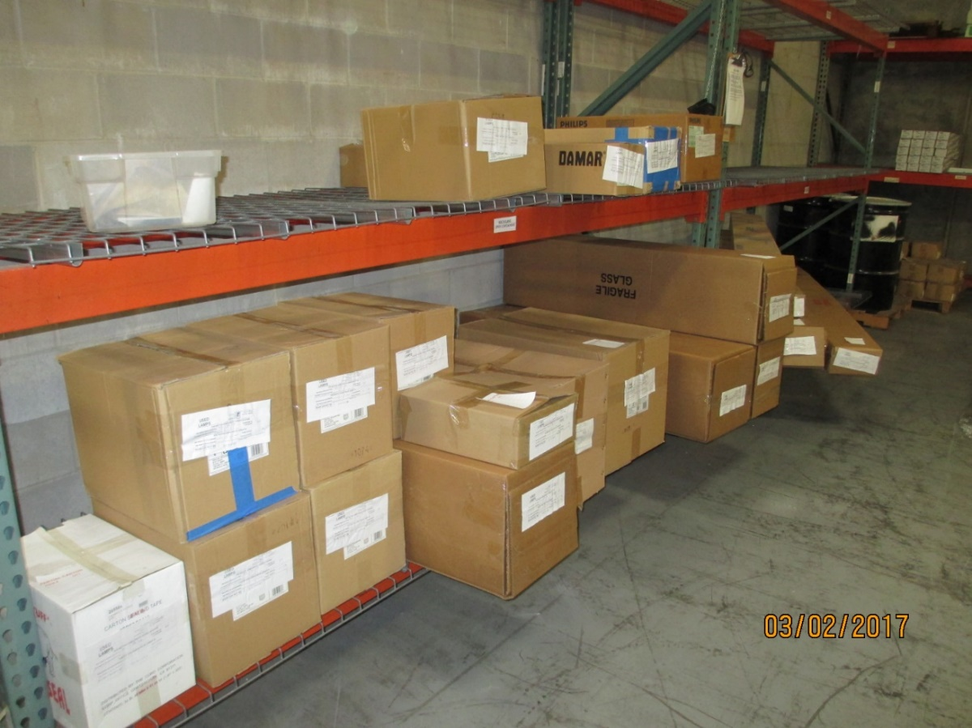
Universal Waste Transporters
40 CFR Part 273.9, Definitions:
Universal Waste Transporter means a person engaged in the off-site transportation of universal waste by air, rail, highway, or water.
Universal Waste Transfer Facility means any transportation-related facility including loading docks, parking areas, storage areas and other similar areas where shipments of universal waste are held during the normal course of transportation for ≤10 days.

Slide 25
UW Prohbitions – 40 CFR 273.51
A UW Transporter is:
(a) Prohibited from disposing of UW; and
(b) Prohibited from diluting or treating UW except by responding to a release under 273.54.

Slide 26
UW Management – 40 CFR 273.52
(a) A Transporter must comply with DOT regulations in 49 CFR part 171 through 180 for transport of any UW that meets the definition of hazardous material in 49 CFR 171.8. Because UW does not require a hazardous waste manifest, it is not considered hazardous waste under DOT regulations.
(b) Some UW materials are regulated by DOT as hazardous materials because they meet the criteria for one or more hazard classes specified in 49 CFR 173.2. Because UW shipments do not require a manifest, they may not be described by the DOT proper shipping name “hazardous waste, (l) or (s), n.o.s.”, nor may the proper shipping name be modified by adding the word “waste”.

Slide 27
UW Storage Time Limits – 40 CFR 273.53
(a) A UW Transporter may only store the UW at a UW Transfer Facility for ten days or less.
(b) If a UW Transporter stores UW for more than ten days, the Transporter becomes a UW Handler and must comply with the applicable requirements of 273.10-20 (SQH standards) or 273.30-40 (LQG standards) while storing the waste.

Slide 28
UW Response to Releases – 40 CFR 273.54
(a) A UW Transporter must immediately contain all releases of UW and other residues from UW.
(b) A UW Transporter must determine whether any material resulting from the release is hazardous waste, and if so, comply with 40 CFR parts 260 through 272.

Slide 29
UW Off-site Shipments – 40 CFR 273.55
(a) A UW Transporter is prohibited from transporting the UW to a place other than a UW Handler, a destination facility, or a foreign destination.
(b) If the UW being shipped off-site meets DOT's definition of hazardous materials under 49 CFR 171.8, the shipment must be properly described on a shipping paper in accordance with the applicable DOT regulations under 49 CFR part 172.

Slide 30
UW Exports – 40 CFR 273.56
A UW Transporter transporting a shipment of UW to a foreign destination is subject to the requirements of 40 CFR Part 262, subpart H.

Slide 31
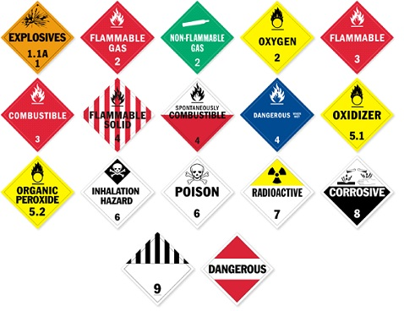
U.S. DOT
49 CFR Parts 171 through 179
Packaging
Marking
Labeling
Placarding
Manifest
Training

Slide 32
References
EPA Hazardous Waste Manifest System http://www3.epa.gov/epawaste/hazard/transportation/manifest/e-man.htm
EPA Modification of the Uniform Hazardous Waste Manifest http://www3.epa.gov/epawaste/hazard/transportation/manifest/mods.htm
EPA Notification http://www3.epa.gov/epawaste/inforesources/data/form8700/8700-12.pdf
EPA Notification of RCRA Subtitle C Activity January 2015 http://www3.epa.gov/epawaste/inforesources/data/form8700/8700-12.pdf
DEP State Manifest Requirements http://www.dep.state.fl.us/waste/categories/hazardous/pages/EPAmanifest.htm
DEP Hazardous Waste Manifests http://www.dep.state.fl.us/waste/categories/hwRegulation/pages/Manifest.htm
DEP Forms http://www.dep.state.fl.us/waste/quick_topics/forms/pages/62-730.htm#62-730.900(1)(b)
U.S. DOT Incident Reporting http://www.phmsa.dot.gov/hazmat/incident-report and https://hazmatonline.phmsa.dot.gov/services/publication_documents/IncidentReporting.pdf
DEP Instructions for Transporter Registration http://dep.state.fl.us/waste/quick_topics/publications/shw/HWRegulation/InstructHazWasteTransReg_06Jun14.pdf
EPA/U.S. DOT Memorandum of Understanding http://www.phmsa.dot.gov/portal/site/PHMSA/menuitem.6f23687cf7b00b0f22e4c6962d9c8789/?vgnextoid=a2fdcafec2b1d110VgnVCM1000009ed07898RCRD&vgnextchannel=78a47fd9b896b110VgnVCM1000009ed07898RCRD&vgnextfmt=print
EPA Transporter Training Module http://www.epa.gov/sites/production/files/2015-09/documents/trans.pdf

Slide 33
Questions?
Hazardous Waste Program
8800 Baymeadows Way West
Suite 100 Jacksonville, Florida 32256 (904) 256-1700

