Slide 1
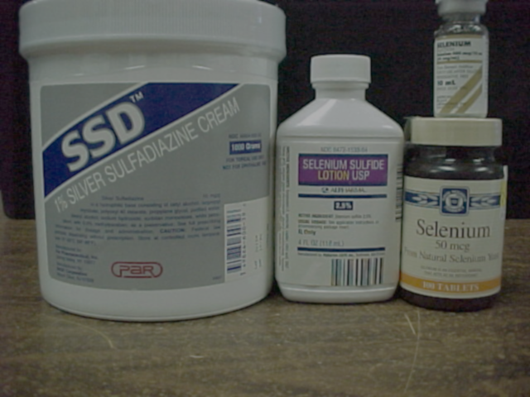

Management Standards for Hazardous Waste Pharmaceuticals
November 2019

Slide 2
Management Standards for Hazardous Waste Pharmaceuticals
  New regulations under 40 CFR 266 Subpart P for the management of Hazardous Waste (HW) pharmaceuticals by healthcare facilities and reverse distributors.
    Conditional exemption for DEA controlled substances
    Redefines when Subpart P containers are RCRA Empty
    Establishes EPA policy on status of unsold retail items managed at reverse logistics centers
  Prohibition on sewering of HW pharmaceuticals
  Amendment to P075 Acute HW listing for nicotine & salts

Slide 3
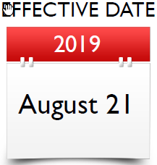
Effective Dates
  August 21, 2019 – Federal Regulation Effective Date
  Part 266 Subpart P effective after authorized states adopt (states are required to adopt by July 1, 2021 or 2022)
  Nicotine amendment effective after authorized states adopt (states not required to adopt)
  Sewer prohibition effective in ALL states, regardless of whether Subpart P is adopted & applies to ALL generators, including VSQG’s

Slide 4
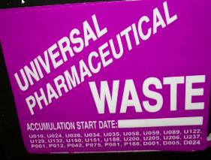
Effective Dates
  August 21, 2019 – State of Florida Effective Date
  June 26, 2019 – Florida adopts 40 CFR 266 Subpart P, the sewering prohibition and nicotine amendment by reference
  August 16, 2019 – Florida repeals the Universal Pharmaceutical Waste Regulation, 62-730.186, FAC

Slide 5
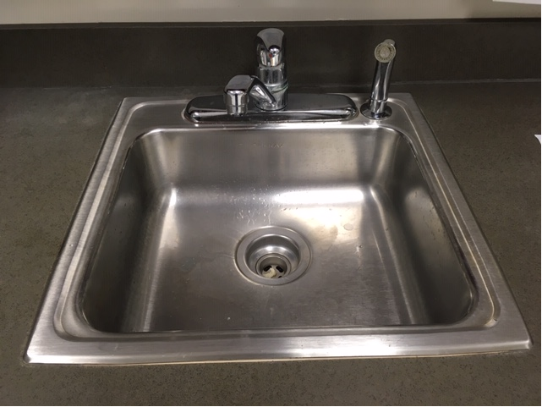
Sewer Prohibition
  As of August 21, 2019, healthcare facilities are prohibited from discharging HW pharmaceuticals to a sewer system
  Applies to all generators, including VSQG’s
  Includes HW controlled substances and HW pharmaceutical wastage

Slide 6
Exclusion Amendment
The following materials are not solid waste for the purposes of this Part: Domestic sewage; and
    Any mixture of domestic sewage and other wastes that passes through a sewer system to a publicly-owned treatment works (POTW) for treatment, except as prohibited by 40 CFR 266.505 and Clean Water Act requirements at 40 CFR 403.5(b). “Domestic sewage” means untreated sanitary wastes that pass through a sewer system
40 CFR 261.4(a)(1)(ii)

Slide 7
Pretreatment Standards – Prohibited Discharges
Specific Prohibitions
  The following pollutants shall not be introduced into a POTW:
    Pollutants which create a fire or explosion hazard in the POTW, including, but not limited to, wastestreams with a closed cup flashpoint of less than 140 °F (60 °C)
    Pollutants which will cause corrosive structural damage to the POTW, but in no case discharges with pH lower than 5.0, unless the works is specifically designed to accommodate such discharges
40 CFR 403.5(b)(1)
Notes:
There are also additional prohibitions.

Slide 8
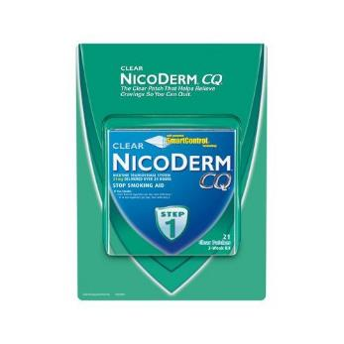
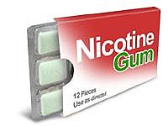
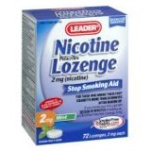
Amendment of the Nicotine Listing
EPA is amending the P075 listing for nicotine to exempt FDA approved over-the-counter nicotine replacement therapies
  EPA has concluded that nicotine patches, gums, and lozenges do not meet the regulatory criteria for acute HW
  Nicotine patches, gums, and lozenges can be discarded as Non-HW
≠ P075
Notes:
FDA approved over-the-counter nicotine replacement therapies can be discarded as non-hazardous waste, but facilities are reminded that even though these products can be managed as non-hazardous solid waste, that the product labels direct you to keep out of reach of children and pets. Therefore, EPA recommends taking necessary precautions when OTC NRTs are discarded in dumpsters or regular trash such as having locks on dumpsters/trash cans or keeping waste containers in a locked area.

Slide 9
Amendment of the Nicotine Listing
Other unused formulations of nicotine will still be considered P075 when discarded, including
  E-Liquid / e-Juice in e-cigarettes, cartridges, or vials
  Prescription nicotine (e.g., nasal spray, inhaler)
  Legacy pesticides containing nicotine
  Nicotine used in research and manufacturing

Slide 10

40 CFR Part 266 Subpart P

Slide 11
What is NOT covered today that is in Subpart P?
  Reverse Distribution of Prescription Pharmaceuticals
  Reverse Logistics for Unsold Retail Items

Slide 12
Applicability
The final rule applies to healthcare facilities that generate, accumulate, or otherwise handle HW pharmaceuticals and reverse distributors engaged in the management of prescription HW pharmaceuticals.
40 CFR 266.500

Slide 13
New Definitions
Pharmaceutical
Hazardous Waste Pharmaceutical
  Non-Creditable HW Pharmaceutical
  Potentially Creditable HW Pharmaceutical
  Evaluated HW Pharmaceutical
Healthcare Facility
  Long-Term Care Facility
Household pharmaceutical waste
Reverse Distributor
40 CFR 266.500

Slide 14
Pharmaceutical
Any drug or dietary supplement for use by humans or other animals
Any electronic nicotine delivery system
  Electronic cigarette or vaping pen
Any liquid nicotine (e-liquid) packaged for retail sale for use in electronic nicotine delivery systems
  Pre-filled cartridges or vials
40 CFR 266.500

Slide 15
Pharmaceutical
The definition of ‘‘pharmaceutical’’ applies to finished product electronic nicotine delivery systems, including components and parts, sealed in final packaging intended for consumer use (e.g., electronic cigarettes and vaping pens) and e-liquid that is packaged for retail for use in the electronic nicotine delivery systems (e.g., pre-filled cartridges and vials that are sold separately to consumers or as part of kits)
E-liquid used by manufacturers of tobacco products (as defined by the FD&C Act) is not included in the final definition of ‘‘pharmaceutical”
  That means e-liquid that is sold or distributed for further manufacturing, mixing, or packaging into a finished electronic nicotine delivery system is not included
40 CFR 266.500

Slide 16
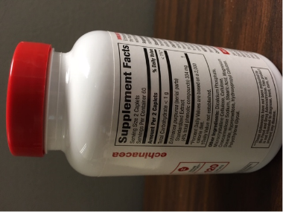
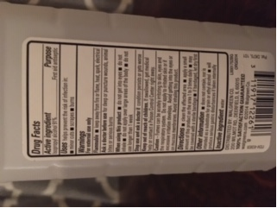
Definition of Pharmaceutical (Continued)
Pharmaceuticals Includes, but is not limited to:
Dietary Supplements
Prescription Drugs
Over-the-Counter Drugs
Homeopathic Drugs
Compounded Drugs
Investigational New Drugs
Pharmaceuticals Remaining in Non-Empty Containers
PPE Contaminated with Pharmaceuticals
Clean-Up Material from Spills of Pharmaceuticals
Pharmaceuticals does NOT include:
Dental Amalgam
Sharps
Medical Waste
Dietary Supplement Label
Drug Facts Label
Notes:
If a dietary supplement is required by the FDA to include a “Supplement Facts” panel on the label, it would meet the definition.
Chemicals that have a pharmaceutical and non pharmaceutical use (e.g. isopropyl alcohol is used to clean wounds and to clean instruments and surfaces) are included in the definition if they are required by the FDA to include “drug facts” on the label.
Only PPE that is already considered HW under the “contained in” policy because it is contaminated with pharmaceuticals will fall under the definition. For example, the contained in policy would not apply to gloves that have touched a Warafin pill during patient care. However, if a worker spill a hazardous waste pharmaceutical on their PPE, the PPE would be considered a HW pharmaceutical.

Slide 17
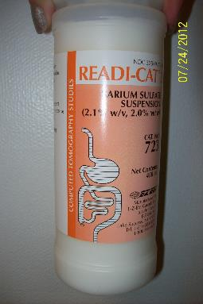
Hazardous Waste Pharmaceutical
A pharmaceutical that is a solid waste as defined in 40 CFR 261.2
  Exhibits one or more characteristics identified in 40 CFR 261 Subpart C or
  Is listed in 40 CFR 261 Subpart D
40 CFR 266.500

Slide 18
Hazardous Waste Pharmaceutical
What is not a HW Pharmaceutical:
A pharmaceutical is not a solid waste, as defined in 40 CFR 261.2, and therefore not a HW pharmaceutical, if it is legitimately used / reused (e.g., lawfully donated for its intended purpose) or reclaimed
An over-the-counter pharmaceutical, dietary supplement, or homeopathic drug is not a solid waste, as defined in 40 CFR 261.2, and therefore not a HW pharmaceutical, if it has a reasonable expectation of being legitimately used / reused (e.g., lawfully redistributed for its intended purpose) or reclaimed
Household Waste Pharmaceutical is a solid waste, as defined in 40 CFR 261.2, but is excluded from being a HW under 40 CFR 261.4(b)(1)
40 CFR 266.500

Slide 19
Hazardous Waste Pharmaceutical
Donations:
A pharmaceutical is not a solid waste if it is lawfully donated for its intended purpose
This would include donations to a charity, non-governmental organization, or to a healthcare facility that is participating in a donation or repository program that is authorized by the state.
Repurposing pharmaceuticals happens under narrow circumstances and state donation and repository laws dictate the conditions under which pharmaceuticals may be donated
In addition to the state regulations, the FDA has guidelines for the donation of pharmaceuticals for international relief efforts, as does the World Health Organization

Slide 20
Hazardous Waste Pharmaceutical
3 Types of HW Pharmaceuticals:
  Non-Creditable HW Pharmaceuticals
  Potentially Creditable HW Pharmaceuticals
  Evaluated HW Pharmaceuticals
40 CFR 266.500

Slide 21
Non-Creditable HW Pharmaceutical
A prescription HW pharmaceutical that does not have a reasonable expectation to be eligible for manufacturer credit
A non-prescription HW pharmaceutical that does not have a reasonable expectation to be legitimately used / reused or reclaimed
40 CFR 266.500

Slide 22
Non-Creditable HW Pharmaceutical
Non-Creditable HW Pharmaceutical
Examples include, but are not limited to:
  Free samples of pharmaceuticals received by healthcare facilities
  Investigational drugs
  Pharmaceuticals more than 1 year past their expiration date
  Residues of pharmaceuticals remaining in empty containers
  Floor sweepings and spill cleanup from spills of pharmaceuticals & PPE
  Pharmaceuticals removed from original container & repackaged for dispensing
  Pharmaceuticals in leaking or damaged packaging
  Dispensed pharmaceuticals returned to pharmacy after third-party payer compensation received
40 CFR 266.500

Slide 23
Potentially Creditable HW Pharmaceutical
A prescription HW pharmaceutical that has a reasonable expectation to receive manufacturer credit and is
  In original manufacturer packaging (except pharmaceuticals that were subject to a recall)
  Undispensed; and
  Unexpired or less than 1 year past expiration date
This term does not include evaluated HW pharmaceuticals or non-prescription pharmaceuticals (e.g., OTC drugs, dietary supplements, homeopathic drugs)
40 CFR 266.500
Notes:
EPA used the word undispensed to make clear that it is not just that a patient refused to take a pharmaceutical, but rather that it was never dispensed to the patient at all.
“Partials”, or opened containers that have had some contents removed, and generics may be considered potentially creditable.

Slide 24
Evaluated HW Pharmaceutical
A prescription HW pharmaceutical that has been evaluated by a reverse distributor in accordance with 40 CFR 266.510(a)(3) and will not be sent to another reverse distributor for further evaluation or verification of manufacturer credit
40 CFR 266.500

Slide 25
Healthcare Facility
Any person that is lawfully authorized to:
  Provide preventative, diagnostic, therapeutic, rehabilitative, maintenance or palliative care, and counseling, service, assessment or procedure with respect to the physical or mental condition, or functional status, of a human or animal or that affects the structure or function of the human or animal body; or
  Distribute, sell, or dispense pharmaceuticals, including OTC pharmaceuticals, dietary supplements, homeopathic drugs, or prescription pharmaceuticals
40 CFR 266.500

Slide 26
Healthcare Facility
Healthcare Facility includes, but is not limited to:
Wholesale distributors
Hospitals
Psychiatric hospitals
Ambulatory surgical centers
Health clinics
Physician’s offices
Optical & Dental providers
Chiropractors
Long-Term care facilities
Pharmacies (including compounding)
Retailers of pharmaceuticals
Veterinary clinics & hospitals
Healthcare Facility does NOT include:
Pharmaceutical manufacturers
Reverse distributors
Reverse logistics centers
40 CFR 266.500
Notes:
Definition includes locations that sell pharmaceuticals over the internet, through the mail or through other distribution mechanisms.
Definition also includes third-party logistics providers that engage in forward distribution and military medical logistics facilities.
Definition does not include independently located coroners and medical examiners, but does include coroners/medical examiners co-located with healthcare facilities, as they are physically part of the healthcare facility.

Slide 27
Long-Term Care Facility
A licensed entity that provides assistance with activities of daily living, including managing and administering pharmaceuticals to one or more individuals at the facility
40 CFR 266.500

Slide 28
Long-Term Care Facility
Long-Term Care Facility includes, but is not limited to:
Hospice facilities
Nursing facilities
Skilled nursing facilities
Nursing and skilled nursing care portions of continuing care retirement communities
Long-Term Car Facility does NOT include:
Group homes
Independent living communities
Assisted living facilities
Independent and assisted living portions of continuing care retirement communities
40 CFR 266.500
Notes:
Hazardous waste (including pharmaceuticals) generated at LTCFs will no longer be excluded as household hazardous waste: It will be regulated as hazardous waste.
EPA decided that even though ALFs sometimes provide medication management, they would not include ALFs in the definition to be consistent with other agencies definitions.

Slide 29

Household Waste Pharmaceutical
A pharmaceutical that is a solid waste, as defined in 40 CFR 261.2, but is excluded from being HW under 40 CFR 261.4(b)(1).
A household includes:
  Single/multiple residences
  Hotels/motels
  Bunkhouses/ranger stations/ crew quarters
  Campgrounds/picnic grounds/ day-use recreation areas
To be considered household waste the following must be met:
  Waste must be generated by individuals on the premise of a temporary or permanent residence; and
  The waste stream must be composed primarily of materials found in wastes generated by consumers in their homes
40 CFR 266.500 & 261.4(b)(1)

Slide 30
Reverse Distributor
Means any person that receives and accumulates prescription pharmaceuticals that are potentially creditable HW pharmaceuticals for the purpose of facilitating or verifying manufacturer credit
Any person, including forward distributors, third-party logistics providers, and pharmaceutical manufacturers, that processes prescription pharmaceuticals for the facilitation or verification of manufacturer credit is considered a reverse distributor
  A DEA-registered reverse distributor may or may not meet EPA’s definition of a reverse distributor
40 CFR 266.500
Notes:
Reverse distribution applies to only prescription pharmaceuticals, while reverse logistics applies to over-the-counter pharmaceuticals and other retail items.

Slide 31
Applicability- Do I have to comply with Subpart P?
  A healthcare facility that is a VSQG when counting all of its HW, including both its HW pharmaceuticals and its non-pharmaceutical HW, remains subject to 40 CFR 262.14 (VSQG Requirements) and is not subject to this subpart, except for 40 CFR 266.505 (Sewering Prohibition) and 40 CFR 266.507 (Empty Containers) and the optional provisions of 40 CFR 266.504
40 CFR 266.501(a)
Notes:
This regulation effects Florida differently then most states due to our previous universal waste regulation. Facilities should not rely on their previous generator status to determine the applicability of Subpart P.
Potentially creditable HW pharmaceuticals transported to a reverse distributor are considered a solid and a hazardous waste from the point of generation at the healthcare facility and therefore must be counted when determining whether the healthcare facility is a VSQG regulated under 40 CFR 262.14 or whether it is regulated under 40 CFR part 266 Subpart P for its HW pharmaceuticals.

Slide 32
Applicability
  A healthcare facility that is a SQG, LQG, or Reverse Distributor when counting all of its HW, including both its HW pharmaceuticals and its non-pharmaceutical HW, must comply with Subpart P.
  In other words, Subpart P applies to a healthcare facility that generates:
    More than 100 kg of hazardous waste per calendar month; or
    More than 1 kg of acute hazardous waste per calendar month; or
    More than 100 kg of any residue or contaminated soil, water, or other debris resulting form the cleanup of a spill into or on any land or water of any acute hazardous wastes listed in 40 CFR 261.31 or 261.33(e) per calendar month

Slide 33


Applicability
Generates 50 kg pharmaceutical HW
VSQG NOT subject to Subpart P
Healthcare Facility A
100 kg total of HW
Generates 50 kg non-pharmaceutical HW
Notes:
Example of a facility not Subject to Subpart P (with the exception of the sewering prohibition, empty container standards and optional provisions).

Slide 34
VSQG Healthcare Facilities
  A healthcare facility that is a VSQG when counting all of its HW, including both its HW pharmaceuticals and its non-pharmaceutical HW, has the option of complying with 40 CFR 266.501(d) (opting into ALL Subpart P) for the management of HW pharmaceuticals as an alternative to complying with 40 CFR 262.14 (VSQG Requirements) and the optional provisions of 40 CFR 266.504
[40 CFR 266.501(b)]
Notes:
A VSQG may choose to opt into Subpart P if it does not want to have to keep track of how much HW pharmaceuticals it is generating on a monthly basis or if it generates an unpredictable or fluctuating amount of HW pharmaceuticals each month that might exceed one or more of the VSQG monthly quantity thresholds.

Slide 35
VSQG Healthcare Facilities – Non-Optional Provisions
  VSQGs that do not opt into Subpart P
  Must still comply with the hazardous waste sewering prohibition
  Must comply with the empty container standards
  May comply with the optional provisions of 40 CFR 266.504
[40 CFR 266.501]

Slide 36
VSQG Healthcare Facilities – Optional Provisions
  A VSQG healthcare facility can continue to send potentially creditable HW pharmaceuticals to a reverse distributor
  A VSQG healthcare facility can send its HW pharmaceuticals off-site to another healthcare facility provided the receiving healthcare facility:
    Meets 266.502(l) – Under control of same ‘person’, manages the non-creditable HW pharmaceuticals in compliance with 266 Subpart P
    Meets 266.503(b) – Under control of same ‘person’, manages the potentially creditable HW pharmaceuticals in compliance with 266 Subpart P
[40 CFR 266.504]
Notes:
If you are VSQG and don’t choose to opt into Subpart P, you can still take advantage of the optional provisions, without any action.

Slide 37
VSQG Healthcare Facilities – Optional Provisions
  A Long-Term Care Facility that is a VSQG can dispose of its HW pharmaceuticals in an on-site collection receptacle that complies with DEA regulations
    DEA collection receptacles can only be used for controlled substances that are from the ultimate user
  A Long-Term Care Facility with 20 beds or fewer will be “presumed” to be a VSQG and not subject to 40 CFR 266 Subpart P, except the sewer prohibition
    A Long-Term Care facility with more than 20 beds must demonstrate that it is a VSQG
[40 CFR 266.504]

Slide 38
How Does This Effect My Generator Category?
There are no generator categories for HW pharmaceuticals under Subpart P
Non-pharmaceutical HW remains subject to the 40 CFR 262 generator regulations and the associated generator categories.
Complying with Subpart P may allow you to drop a generator category (e.g. your facility generates over the VSQG thresholds and is therefore subject to Subpart P for its HW pharmaceuticals, but becomes a VSQG for its non-pharmaceutical HW after complying with Subpart P because it is non longer required to count its HW pharmaceuticals toward its generator category).

Slide 39

How Does This Effect My Generator Category?
SQG MUST comply with Subpart P
Generates 51 kg pharmaceutical HW
Generates 101 kg HW total
Healthcare Facility B
Generates 50 kg non-pharmaceutical HW
Now drop to a VSQG generator status!
Notes:
An example of a “Subpart P VSQG” – a healthcare facility that generates over one or more of the VSQG quantity thresholds and is therefore subject to Subpart P for its HW pharmaceuticals but becomes a VSQG for its non-pharmaceutical HW after complying with Subpart P because it is no longer required to count its HW pharmaceuticals toward its generator category.

Slide 40
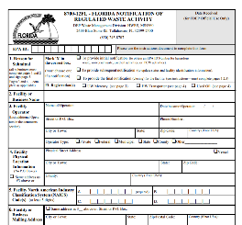
Healthcare Facilities Standards
Notification: All Healthcare facilities must notify DEP using the Florida Notification of Regulated Waste Activity form, 8700-12FL, that they are operating under 40 CFR Part 266 Subpart P. This includes VSQGs opting in to Subpart P.
  Facilities not required to submit a biennial report in 2020 for their non-pharmaceutical HW must notify within 60 days of the rule going into effect in October 2019
  Facilities that are required to submit a biennial report may notify on their normal biennial reporting cycle, by March 1, 2020
  A copy of the notification must be kept on file for as long as the healthcare facility is subject to this Subpart
[40 CFR 266.502(a)(1)]

Slide 41
Healthcare Facilities Standards
Withdrawal: A Healthcare facility that operated under 40 CFR 266 Subpart P but becomes a VSQG and elects to withdraw from this Subpart must notify DEP using the Florida Notification of Regulated Waste Activity form, 8700-12FL, that they are no longer operating under 40 CFR Part 266 Subpart P
  The Notification form must be submitted before the facility can begin operating as a VSQG under 40 CFR 262.14
  A healthcare facility must keep a copy of its withdrawal on file for 3 years from the date of the signature on the notification form.
[40 CFR 266.502(a)(2)]

Slide 42
DEA Controlled Substances
  Only a small number of HW that are also DEA controlled substances
  Two new conditional exemptions for healthcare facilities and reverse distributors for:
    RCRA HW that are also DEA controlled substances
    Household waste pharmaceuticals collected in DEA authorized collection receptacles (kiosks)
[40 CFR 266.506(a)]

Slide 43
DEA Controlled Substances & RCRA HW
Name of Drug | Other Name(s) | Medical Uses | RCRA HW Code | DEA CS Schedule | Comment
Chloral; chloral hydrate | Acetaldehyde, trichloro-; Aquachloral, Notec, Somnote, Supprettes | Sedative | D034 Toxic | IV | Used in hospital pediatric units; common ingredient in vet anesthetics
Fentanyl sublingual spray | Subsys | Analgesic | D001 Ignitable | II | Ignitable due to alcohol content
Phenobarbital | Bellergal-S, Donnatal, Luminal | Anticonvulsant | D001 Ignitable | IV | Ignitable due to alcohol content
Testosterone gels / solutions | Androgel, Axiron, Fortesta, Testim | Hormone | D001 Ignitable | III | Ignitable due to alcohol content
Valium injectable gel | Diazepam, Diastat | Anti-anxiety | D001 Ignitable | IV | Ignitable due to alcohol content
Notes:
RCRA HW that are also controlled substances.

Slide 44
DEA Controlled Substances – Conditions for Exemption
HW pharmaceuticals must be:
  Managed in compliance with sewer prohibition
  Collected, stored, transported, and disposed of in accordance with DEA regulations for controlled substances
[40 CFR 266.506(b)]

Slide 45

DEA Controlled Substances – Conditions for Exemption
Destroyed by a method DEA has publicly deemed in writing to meet their non-retrievable standard of destruction or combusted at:
  A permitted large municipal waste combustor
  A permitted small municipal waste combustor
  A permitted hospital, medical and infectious waste incinerator
  A permitted commercial and industrial solid waste incinerator
  A permitted hazardous waste combustor
[40 CFR 266.506(b)]

Slide 46
Empty Containers
Residues of HW in empty containers
Containers of HW pharmaceuticals are subject to 40 CFR 266.507 for determining when they are considered empty, in lieu of this section, except as provided by 40 CFR 266.507(c) and (d)
40 CFR 261.7(c)
Notes:
EPA changed the language in the 261 RCRA empty standards to reflect the new empty container standards for HW pharmaceuticals. And remember, if you are a VSQG healthcare facility, you will still be required to comply with these new empty container standards for your HW pharmaceuticals.

Slide 47
Empty Containers
Considered empty and the residues are not regulated as HW provided pharmaceuticals have been removed using practices commonly employed to remove materials from that type of container
Stock bottle, dispensing bottle, vial, or ampule (not to exceed 1 liter or 10,000 pills);
Unit-dose container (unit-dose packet, cup, wrapper, blister pack or delivery device)
40 CFR 266.507(a)
Notes:
Containers that held acute HW pharmaceuticals do not need to be triple-rinsed. Contents of containers that held non-acute HW pharmaceuticals do not need to be measured. Containers may be disposed of as non-hazardous waste provided all pharmaceuticals have been removed using commonly employed practices.
EPA strongly encourages BMPs such as locked dumpsters and defacing labels to prevent diversion of the containers.

Slide 48
Empty Containers
  A container that has held a HW that is a compressed gas is empty when the pressure in the container approaches atmospheric
40 CFR 261.7(b)(2)

Slide 49
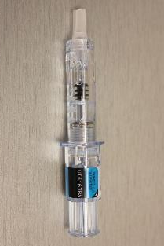
Residues of HW Pharmaceuticals
Syringes are considered empty and the residues are not regulated as HW provided the contents have been removed by fully depressing the plunger of the syringe
If not empty, and containing a HW pharmaceutical, the syringe must be managed and disposed of as a non-creditable HW pharmaceutical
40 CFR 266.507(b)

Slide 50

Residues of HW Pharmaceuticals
Intravenous (IV) bags are considered empty provided the pharmaceuticals in the IV bag have been fully administered to a patient
If an IV bag is not empty, the IV bag must be placed with its remaining HW pharmaceuticals into a container that is managed and disposed of as a non-creditable HW pharmaceutical, unless the IV bag held non-acute hazardous waste pharmaceuticals and is empty as defined in 40 CFR 261.7(b)(1)
40 CFR 266.507(c)

Slide 51
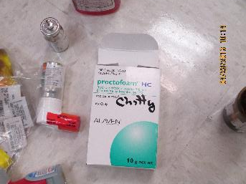
Residues of HW Pharmaceuticals
HW pharmaceuticals remaining in all other types of unused, partially administered, or fully administered containers must be managed as non-creditable HW pharmaceuticals, unless the container held non-acute HW pharmaceuticals and is empty as defined in 40 CFR 261.7(b)(1) or (2)
This includes, but is not limited to, residues in inhalers, aerosol cans, nebulizers, tubes of ointments, gels, or creams
40 CFR 266.507(d)

Slide 52
Empty Containers – Traditional Standards
A container or an inner liner removed from a container that has held any HW, except a waste that is a compressed gas or that is identified as an acute hazardous waste listed in 40 CFR 261.31 or 261.33(e) of this chapter is empty if:
(i) All wastes have been removed that can be removed using the practices commonly employed to remove materials from that type of container, e.g., pouring, pumping, and aspirating, and
(ii) No more than 2.5 centimeters (one inch) of residue remain on the bottom of the container or inner liner, or
(iii)(A) No more than 3 percent by weight of the total capacity of the container remains in the container or inner liner if the container is less than or equal to 119 gallons in size; or
(B) No more than 0.3 percent by weight of the total capacity of the container remains in the container or inner liner if the container is greater than 119 gallons in size
40 CFR 261.7(b)(1)

Slide 53
Empty Containers
 | “RCRA Empty”
 | Non-acute HW pharmaceuticals | Acute HW pharmaceuticals*
Stock/dispensing bottles (1 L or 10,000 pills) & Unit-dose containers | Remove contents | Remove contents
Syringes | Fully depress plunger | Fully depress plunger
IV Bags | Fully administer contents or 40 CFR 261.(b)(1) | Fully administer contents
Other Containers | 40 CFR 261.7(b)(1) or (2) | Can not be RCRA empty
* No triple rinsing of containers with acute hazardous waste pharmaceuticals
Notes:
If a container that held HW pharmaceuticals is not empty, it must be managed as non-creditable HW pharmaceuticals.

Slide 54
Non-Creditable Hazardous Waste Pharmaceuticals
Standards for Non-Creditable Hazardous Waste Pharmaceuticals – found at 40 CFR 266.502
[40 CFR 266.502]

Slide 55
Non-Creditable Hazardous Waste Pharmaceuticals
HW Determination for Non-Creditable HW pharmaceuticals
  A healthcare facility that generates a solid waste that is a non-creditable pharmaceutical must determine whether that pharmaceutical is a HW pharmaceutical
  Applies to both potentially creditable and non-creditable waste pharmaceuticals
  If a healthcare facility chooses to manage ALL of its non-creditable waste pharmaceuticals as non-creditable HW then individual determinations are not necessary
[40 CFR 266.502(c)]
Notes:
Having a third party come on site and make hazardous waste determinations for commingled non-creditable waste pharmaceuticals at any time (typically prior to transport) is permissible.
Pharmaceuticals being stored pursuant a preservation order, investigation, or judicial proceeding are subject to RCRA when under this preservation order.

Slide 56
Non-Creditable Hazardous Waste Pharmaceuticals
Container Standards
  Structurally sound
  Compatible with its contents
  Lacks evidence of leakage, spillage, or damage that could cause leakage
[40 CFR 266.502(d)(1)]

Slide 57
Non-Creditable Hazardous Waste Pharmaceuticals
Ignitable or reactive HW pharmaceuticals, or commingled incompatible HW pharmaceutical containers must be managed so the container does not have the potential to:
  Generate extreme heat or pressure, fire or explosion, or violent reaction
  Produce uncontrolled toxic mists, fumes, dust, or gases in sufficient quantities to threaten human health
  Produce uncontrolled flammable fumes or gases in sufficient quantities to pose a risk of fire or explosion
  Damage the structural integrity of the container
  Through other like means threaten human health or the environment
[40 CFR 266.502(d)(2)]

Slide 58
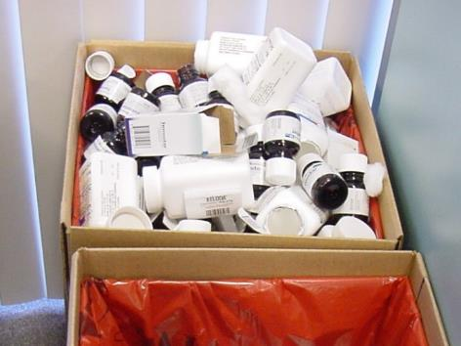

Non-Creditable Hazardous Waste Pharmaceuticals
A healthcare facility must keep containers of non-creditable HW pharmaceuticals closed and secured in a manner that prevents unauthorized access to its contents
[40 CFR 266.502(d)(3)]
Notes:
Healthcare facilities may choose to utilize containers that are designed to prevent unauthorized access to their contents when located in areas with uncontrolled access or store containers in areas with controlled access, such as locked storage lockers, locked closets, locked rooms or behind pharmacy counters, to prevent unauthorized access.

Slide 59
Non-Creditable Hazardous Waste Pharmaceuticals
A healthcare facility may accumulate HW pharmaceuticals and non-HW waste pharmaceuticals in the same container
  Except that non-creditable HW pharmaceuticals prohibited from being combusted because of the dilution prohibition of 40 CFR 268.3(c) must be accumulated in separate containers and labeled with all applicable HW codes
[40 CFR 266.502(d)(4)]

Slide 60
Non-Creditable Hazardous Waste Pharmaceuticals
The HW pharmaceuticals not suitable for incineration include:
  Characteristic metal wastes (i.e., D004–D011)
  Listed wastes U151 (mercury), U205 (selenium sulfide), and P012 (arsenic trioxide)
  Unless they contain greater than 1% total organic carbon
  Clarification of the LDR Dilution Prohibition & Combustion of Inorganic Metal Bearing Waste https://archive.epa.gov/epawaste/hazard/tsd/td/web/txt/memorcra.txt
[40 CFR 268 Appendix XI]
Notes:
Note: while is it permissible for HW pharmaceuticals containing metals to be incinerated if the total organic carbon is greater than 1%, EPA strongly recommends they be segregated and treated via other acceptable methods that comply with LDR.

Slide 61
Non-Creditable Hazardous Waste Pharmaceuticals
Labeling
  A healthcare facility must label or clearly mark each container of non-creditable HW pharmaceuticals with the phrase ‘‘Hazardous Waste Pharmaceuticals’’
  NOTE: Hazard or waste code (except those prohibited from combustion) of the HW Pharmaceutical is not required to be on the container
[40 CFR 266.502(e)]

Slide 62
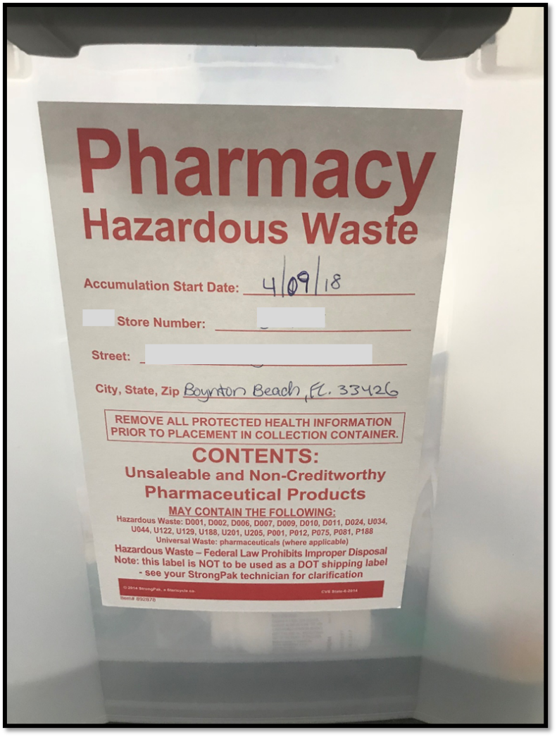
Pharmaceutical labeling
Not correct
Label must read “Hazardous Waste Pharmaceuticals’’

Slide 63
Non-Creditable Hazardous Waste Pharmaceuticals
Accumulation Time
  A healthcare facility may accumulate non-creditable HW pharmaceuticals on site for one year or less without a permit
[40 CFR 266.502(f)]

Slide 64
Non-Creditable Hazardous Waste Pharmaceuticals
Methods for documenting accumulation time:
  Marking the container with the date the HW pharmaceuticals became a waste
  Maintaining an inventory system that identified the date the HW pharmaceuticals being accumulated first became a waste
  Placing the HW pharmaceuticals in a specific area and identifying the earliest date any of the HW pharmaceuticals in the area became a waste
[40 CFR 266.502(f)]

Slide 65
Non-Creditable Hazardous Waste Pharmaceuticals
Land Disposal Restrictions
  HW pharmaceuticals generated by a healthcare facility are subject to the land disposal restrictions of 40 CFR Part 268
  The healthcare facility must comply with 40 CFR 268.7(a) requirements - determine if waste is restricted from land disposal
    Except, it is not required to identify the HW codes on the land disposal restriction notification
[40 CFR 266.502(g)]

Slide 66
Non-Creditable Hazardous Waste Pharmaceuticals
Shipping Non-Creditable HW Pharmaceuticals
  A healthcare facility must ship non-creditable HW pharmaceuticals off-site to a designated facility (Permitted RCRA TSD) in compliance with:
  Before transporting, or offering for transport off-site:
    Package the waste in accordance with DOT regulations on hazardous materials
    Label each package in accordance with DOT regulations on hazardous materials
    Mark each package in accordance with DOT regulations on hazardous materials
[40 CFR 266.508(a)(1)]

Slide 67
Non-Creditable Hazardous Waste Pharmaceuticals
Shipping Non-Creditable HW Pharmaceuticals
  Mark each container of 119 gallons or less with the following:
      HAZARDOUS WASTE—Federal Law Prohibits Improper Disposal. If found, contact the nearest police or public safety authority or the U.S. Environmental Protection Agency.
      Healthcare Facility’s or Reverse distributor’s
      Name and Address ______________________
      Healthcare Facility’s or Reverse distributor’s
      EPA Identification Number ________________
      Manifest Tracking Number ________________
[40 CFR 266.508(a)(1)]

Slide 68
Non-Creditable Hazardous Waste Pharmaceuticals
A healthcare facility must ship non-creditable HW pharmaceuticals off-site to a designated facility (Permitted RCRA TSD) in compliance with:
  Manifest requirements of 40 CFR 262 Subpart B, except:
    A healthcare facility shipping non-creditable HW pharmaceuticals is not required to list all applicable HW codes in Item 13 of EPA Form 8700–22
    A healthcare facility shipping non-creditable HW pharmaceuticals must write the word ‘‘PHARMS’’ in Item 13 of EPA Form 8700–22
[40 CFR 266.508(a)(2)]

Slide 69
Non-Creditable Hazardous Waste Pharmaceuticals
Procedures for Managing Rejected Shipments of Non-Creditable HW Pharmaceuticals are found at 40 CFR 266.502(h)
Procedures for Exception reporting by healthcare facilities for missing copies of the manifest are found at 40 CFR 266.502(i)(2)
Healthcare facilities are not subject to Biennial Reporting requirements under 40 CFR 262.41 with respect to non-creditable HW pharmaceuticals per 40 CFR 266.502(i)(1)
[40 CFR 266.502]

Slide 70
Non-Creditable Hazardous Waste Pharmaceuticals
Training of Personnel Managing Non-Creditable HW Pharmaceuticals
  A healthcare facility must ensure that all personnel that manage non-creditable hazardous waste pharmaceuticals are thoroughly familiar with proper waste handling and emergency procedures relevant to their responsibilities during normal facility operations and emergencies
[40 CFR 266.502(b)]
Notes:
Information can be disseminated verbally, via printed materials, or other means.

Slide 71
Non-Creditable Hazardous Waste Pharmaceuticals
Recordkeeping Requirements:
  Manifest copies - 3 years
  Exception reports – 3 years
  Test results, waste analyses, and HW determinations – 3 years from the date the waste was last sent for treatment, storage, or disposal
  All records must be readily available upon request by an inspector
[40 CFR 266.502(j)]

Slide 72
Non-Creditable Hazardous Waste Pharmaceuticals
Response to spills
  A healthcare facility must immediately contain all spills of non-creditable HW pharmaceuticals and manage the spill clean-up materials as non-creditable HW pharmaceuticals in accordance with the requirements of this subpart
[40 CFR 266.502(k)]

Slide 73
Non-Creditable Hazardous Waste Pharmaceuticals
Accepting HW pharmaceuticals from off-site VSQG healthcare facility:
  A healthcare facility may accept non-creditable HW pharmaceuticals from an off-site healthcare facility that is a VSQG under 40 CFR 262.14, without a permit, provided the receiving healthcare facility:
    Is under the control of the same ‘person’ or has a contractual/documented business relationship whereby the receiving healthcare facility supplies pharmaceuticals to the VSQG
    Is operating under 40 CFR 266 Subpart P
    Manages the HW pharmaceuticals that it receives in compliance with Subpart P
    Keeps records of HW pharmaceutical shipments it receives for 3 years
[40 CFR 266.502(l)]

Slide 74
Potentially Creditable Hazardous Waste Pharmaceuticals
Standards for Potentially Creditable Hazardous Waste Pharmaceuticals – found at 40 CFR 266.503
[40 CFR 266.503]

Slide 75
Potentially Creditable Hazardous Waste Pharmaceuticals
Hazardous waste determination for potentially creditable pharmaceuticals
  A healthcare facility that generates a solid waste that is a potentially creditable pharmaceutical must determine if it is a potentially creditable HW pharmaceutical
  A healthcare facility may choose to manage its potentially creditable non-HW pharmaceuticals as potentially creditable HW pharmaceuticals under this subpart
[40 CFR 266.503(a)]
Notes:
Under this section, a facility has two options:
Make a HW determination on each potentially creditable waste pharmaceutical and determine individually which are hazardous waste and thus subject to regulation under Subpart P; or
Commingle all potentially creditable pharmaceutical waste whether or not it is HW and manage the commingled pharmaceuticals under this subpart and thereby not have to make individual hazardous waste determinations.
Once the wastes are commingled they are subject to all applicable Subpart P management standards while they remain commingled.
The reverse distributor is permitted to segregate the non-hazardous waste pharmaceuticals from the HW pharmaceuticals and make a new HW determination.
If they are not commingled, there are no labeling, container or accumulation time limits, but EPA recommends BMPs such as placing original container and packaging containing liquids and aerosols in separate individual containers before placing in an accumulation container.

Slide 76
Potentially Creditable Hazardous Waste Pharmaceuticals
There are no accumulation time limits, container standards or labeling requirements for potentially creditable HW pharmaceuticals.
[40 CFR 266.503(e)]
Notes:
As a best management practice, EPA encourages healthcare facilities to place the original containers, and packaging containing liquids and aerosol pharmaceuticals, in separate individual containers (i.e. , sealed storage bag) before placing them in the accumulation container.

Slide 77
Potentially Creditable Hazardous Waste Pharmaceuticals
Accepting potentially creditable HW pharmaceuticals from off-site VSQG healthcare facility:
  A healthcare facility may accept potentially creditable HW pharmaceuticals from an off-site healthcare facility that is a VSQG under 40 CFR 262.14, without a permit, provided the receiving healthcare facility:
    Is under the control of the same ‘person’ or has a contractual/documented business relationship whereby the facility supplies pharmaceuticals to the VSQG
    Is operating under 40 CFR 266 Subpart P
    Manages the HW pharmaceuticals that it receives in compliance with Subpart P
    Keeps records of HW pharmaceutical shipments it receives for 3 years
[40 CFR 266.503(b)]

Slide 78
Potentially Creditable Hazardous Waste Pharmaceuticals
Healthcare facilities are prohibited from sending HW other than potentially creditable HW pharmaceuticals to a reverse distributor
[40 CFR 266.503(c)]
Notes:
EPA was very clear that they do not want reverse distributors performing the function of a TSDF.

Slide 79
Potentially Creditable Hazardous Waste Pharmaceuticals
Response to spills of potentially creditable HW pharmaceuticals
  A healthcare facility must immediately contain all spills of potentially creditable HW pharmaceuticals and manage the spill clean-up materials as non-creditable HW pharmaceuticals in accordance with the requirements of this subpart
[40 CFR 266.503(f)]

Slide 80
Potentially Creditable Hazardous Waste Pharmaceuticals
Shipping Potentially Creditable HW Pharmaceuticals
  A healthcare facility or reverse distributor who transports or offers for transport potentially creditable HW pharmaceuticals offsite to a reverse distributor must comply with all applicable U.S. DOT regulations in 49 CFR part 171 through 180 for any potentially creditable HW pharmaceutical that meets the definition of hazardous material in 49 CFR 171.8
[40 CFR 266.509(a)]

Slide 81
Potentially Creditable Hazardous Waste Pharmaceuticals
Shipping Potentially Creditable HW Pharmaceuticals
  Delivery Confirmation
    Upon receipt of each shipment of potentially creditable HW pharmaceuticals, the receiving reverse distributor must provide confirmation (paper or electronic) to the healthcare facility or reverse distributor that initiated the shipment that the shipment has arrived at its destination and is under the custody and control of the reverse distributor
[40 CFR 266.509(b)]
Notes:
A facility may use carriers such as USPS, UPS and FedEx for shipments of potentially creditable HW pharmaceuticals as long as personnel are present to receive and take control of the shipments upon arrival and a delivery confirmation service that meets the requirements is used.
Barcoded tracking or radio frequency identification could also potentially meet the requirement.

Slide 82
Potentially Creditable Hazardous Waste Pharmaceuticals
Shipping Potentially Creditable HW Pharmaceuticals
  If delivery confirmation is not received within 35 calendar days
    The healthcare facility or reverse distributor that initiated the shipment must contact the carrier and the intended recipient (i.e., the reverse distributor) promptly to report that the delivery confirmation was not received and to determine the status of the potentially creditable hazardous waste pharmaceuticals
[40 CFR 266.509(c)]

Slide 83
Potentially Creditable Hazardous Waste Pharmaceuticals
Recordkeeping
  A healthcare facility that initiates a shipment of potentially creditable HW pharmaceuticals to a reverse distributor must keep the following records (paper or electronic) for each shipment for 3 three years from the date of shipment:
    The confirmation of delivery; and
    The shipping paper prepared in accordance with 49 CFR Part 172 Subpart C, if applicable
  All records must be readily available upon request by an inspector
[40 CFR 266.503(e)]

Slide 84
Non-creditable vs. Potentially Creditable HW
 | Non-creditable HW pharmaceuticals | Potentially creditable HW pharmaceuticals
Labeling | ☑ | None
Container Standards | ☑ | None
Maximum Accumulation Time | ☑ | None
Hazardous Waste Determinations* | ☑ | ☑
Over-managing non-hazardous pharmaceuticals & commingling with HW pharmaceuticals | Allowed | Allowed
Include HW pharmaceuticals on BR | No | No
*Not required for either type if managing all pharmaceutical waste as hazardous

Slide 85

Questions?
Hazardous Waste Program
8800 Baymeadows Way West
Suite 100
Jacksonville, Florida 32256
(904) 256-1700
(904) 256-1588 fax

