Slide 1
Noticing Package
NOTICING PACKAGE
Melike Altun, EM

Slide 2
Who is Going to Prepare the Noticing Package?
WHO IS GOING TO PREPARE THE NOTICING PACKAGE?
THE PERSON RESPONSIBLE FOR SITE REHABILITATION (PRSR) WILL PREPARE THE PACKAGE!
  IF IT IS AN ACTIVE STATE-FUNDED CLEANUP, THE DEPARTMENT ACTS AS A PRSR AND THE DEPARTMENT’S SITE MANAGER WILL PREPARE THE PACKAGE.
  IF THE DEPARTMENT CEASES TO CONDUCT THE SITE REHABILITATION BECAUSE OF THE FUNDING CAP REACHED, THEN THE DEPARTMENT IS NO LONGER THE PRSR AND THE NEW PRSR WILL ASSUME ALL NOTIFICATION REQUIREMENTS.
  WHAT IF THE SCORE CHANGES? THE DEPARTMENT IS NOT REQUIRED TO DO NOTICING IF SITE SCORE IS NOT IN WORKING RANGE AND IT IS NOT AN ACTIVE CLEANUP SITE.

Slide 3
Should I Prepare the Package Whenever I Have Time?
No!
SHOULD I PREPARE THE PACKAGE WHENEVER I HAVE TIME?
NO!
THE PRSR IS REQUIRED TO PROVIDE ACTUAL NOTICE TO THE DIVISION OF WASTE MANAGEMENT (DWM) WITHIN TEN DAYS OF DISCOVERY OF CONTAMINATION
AND ALSO
THE DEPARTMENT HAS 30 DAYS TO PROCESS THE NOTICING PACKAGES SUBMITTED AND SEND THE NOTICING LETTERS TO RPOS OF PROPERTIES.
WHAT DO I NEED TO DO NOW ?

Slide 4
STEP 1:
BE FAMILIAR WITH “GUIDANCE FOR CONTAMINATION NOTICING”
THAT IS LOCATED AT http://www.floridadep.gov/ waste/district-business-support/content/public-notification-discovery-contamination

Slide 5
Fill Out an Initial Notice of Contamination Form
STEP 2: FILL OUT AN INITIAL NOTICE OF CONTAMINATION FORM
PER RULE, NOTIFICATION MUST BE PROVIDED USING THE “INITIAL NOTICE OF CONTAMINATION BEYOND PROPERTY BOUNDARIES” FORM LISTED IN SECTION .900 OF EACH RULE.
YOU WILL FIND A COPY OF THE FORM AT:
http://www.floridadep.gov/waste/petroleum-restoration/forms/initial-notice-contamination-beyond-property-boundaries
FILL OUT THE SECOND PAGE OF THE FORM FOR EACH RECORD OWNER OF REAL PROPERTIES (RPOS) WHERE CONTAMINATION HAS BEEN DISCOVERED.

Slide 6
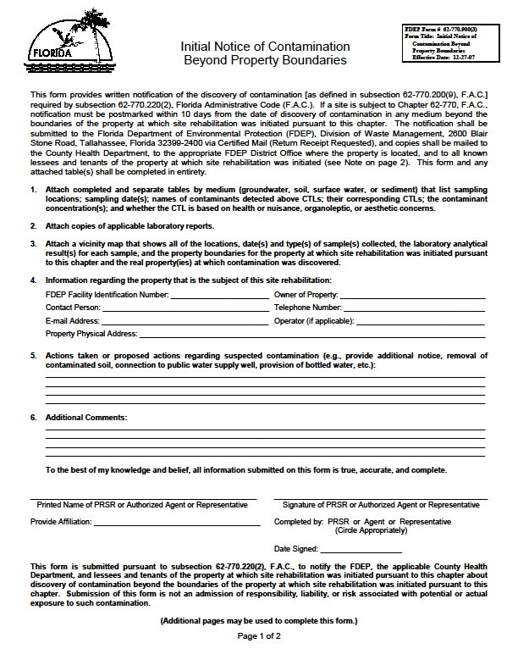
Screenshot of Initial Notice of Contamination Beyond Property Boundaries

Slide 7
STEP 3: COMPILE SUPPORTING DOCUMENTATION AS LISTED BELOW
VICINITY MAP THAT SHOWS SAMPLING LOCATIONS
PLUME MAPS
DATA TABLES AND LAB REPORTS PROVIDED BY CLEANUP CONTRACTOR
USE PARCEL MAPS SHOWING PROPERTY BOUNDARIES TO
MAKE SURE THAT ALL OF THE PROPERTIES ARE COUNTED.
THESE PARCEL MAPS ARE AVALIABLE FROM MOST COUNTY PROPERTY APPRAISERS’ WEB SITES, A LIST THAT CAN BE FOUND AT:
http://www.myflorida.com/dor/property/appraisers.html.

Slide 8
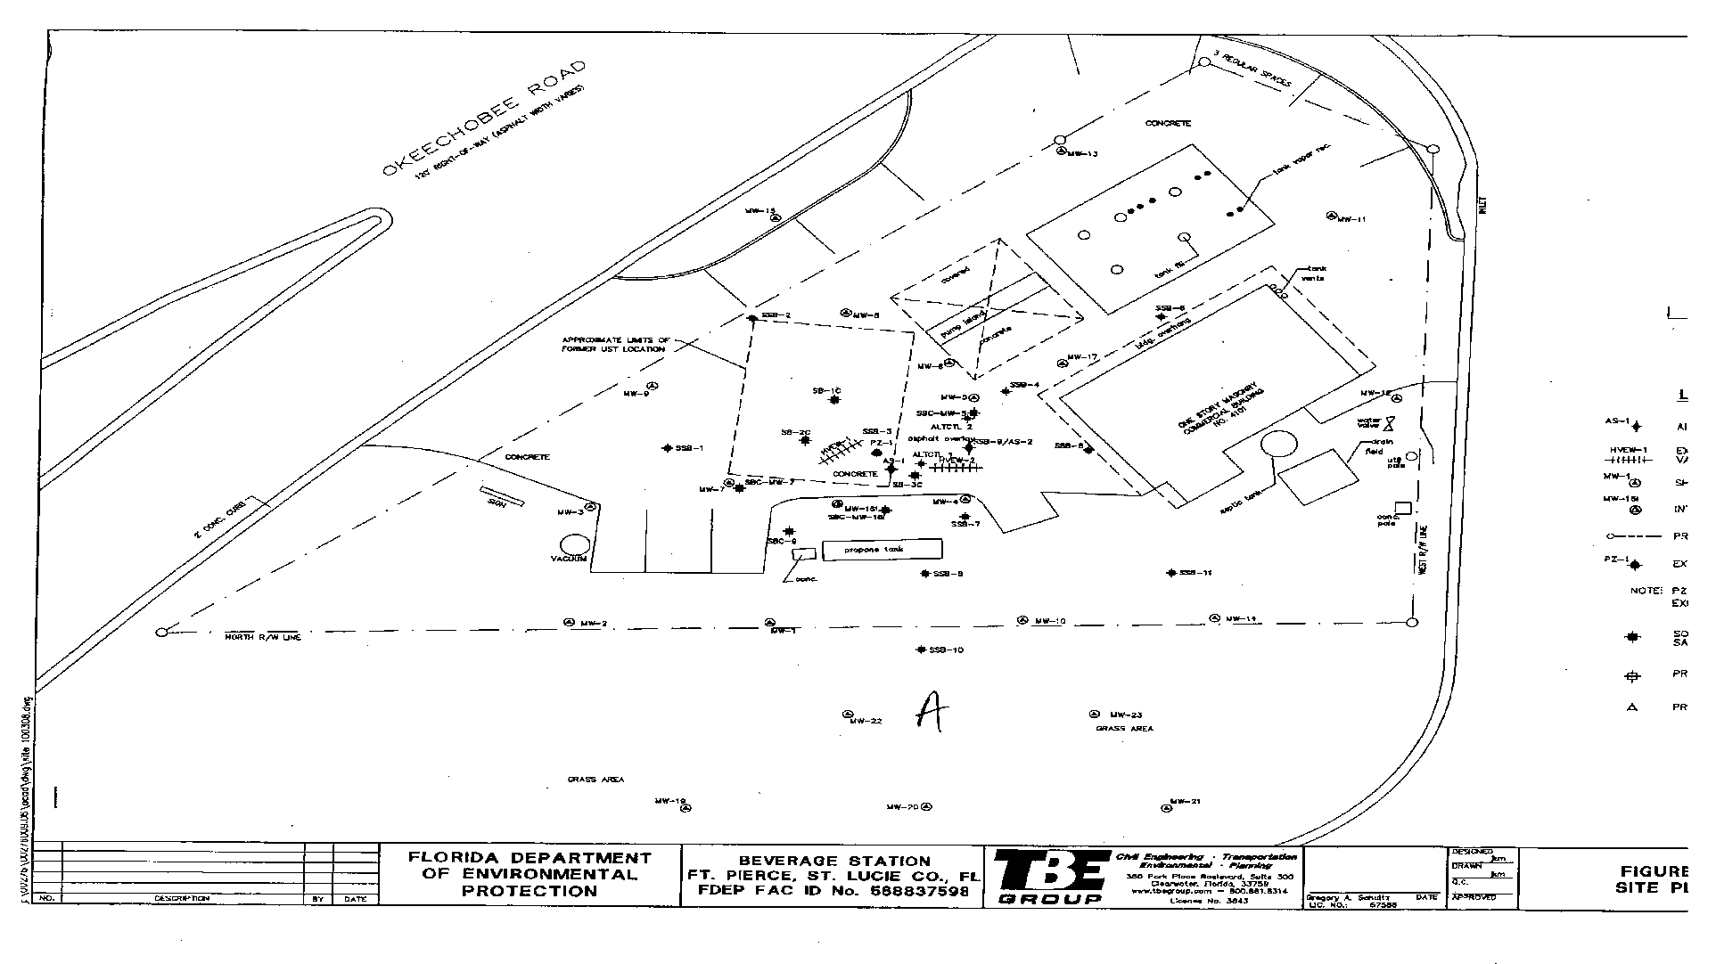
Screenshot of example Site Map
SITE MAP
IDENTIFY PROPERTY BOUNDARIES WHERE SITE REHABILITATION WAS INITIATED
MARK “WELL” OR “SB” LOCATIONS CLEARLY
IF YOU HAVE DATA POINTS USED CLOSE TO PROPERTY BORDERS, MAKE SURE THAT IT IS LOCATED IN OFF-SITE PROPERTY. IF YOU ARE NOT SURE, CALL CONTRACTOR TO VERIFY
ROW, COUNTY ROADS AND DOT ROADS ARE TO BE NOTIFIED IF THERE IS CONTAMINATION DISCOVERED

Slide 9
Two Eligible Program Sites:
A – With Imminent Threat Status
B- With Score 31
TWO ELIGIBLE PROGRAM SITES:
A WITH IMMINENT THREAT STATUS
B WITH SCORE 31

Slide 10
Screenshot of example Soil Analytical Results Map

Slide 11
WILL THE DEPARTMENT TAKE ADDITIONAL STEPS WHEN IT IS ACTING AS THE PRSR AT A STATE –FUNDED CLEANUP SITE?
YES!
  THE DEPARTMENT WILL DO ADDITIONAL NOTICING FOR SUSPECTED CONTAMINANTS.
  THE DEPARTMENT WILL ALSO EXPAND NOTICING TO NERBY RESIDENTS, TENANTS AND NON-OCCUPANT RPOs.
DO YOU HAVE A PLUME MAP(S) SIGNED AND SEALED
BY P.G. OR P.E. ?

Slide 12
Screenshot of Example Map
IDENTIFY PLUME
IDENTIFY PROPERTIES THAT ARE IN THE PLUME
COMPARE WITH AN ACTUAL
AREAL MAP

Slide 13
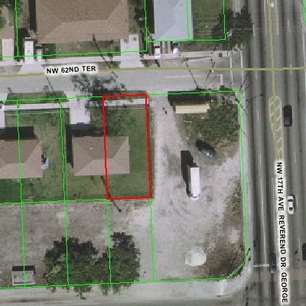
Screenshot of Parcel Boundary Map
http://www.myflorida.com/dor/property/appraisers.html

Slide 14
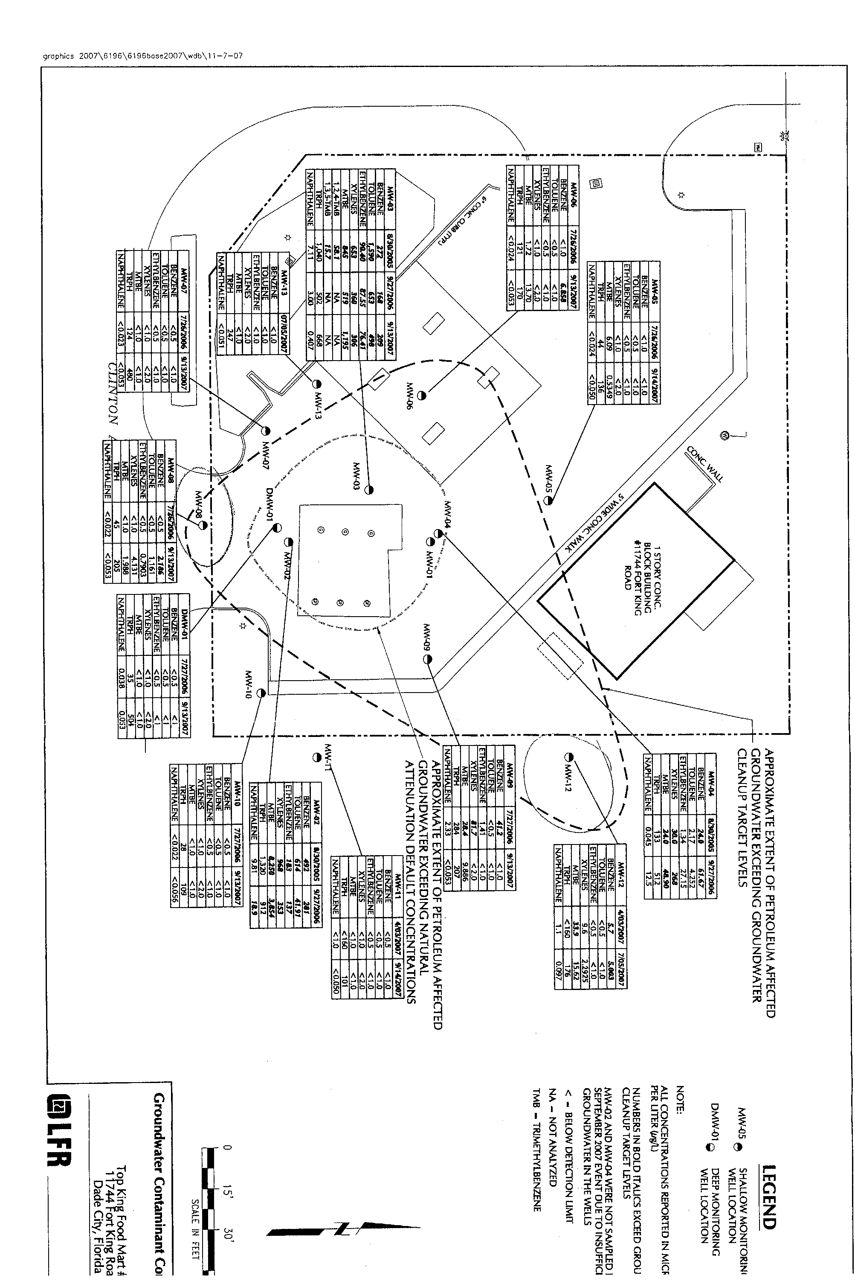
Screenshot of Property Map
THE SAME OWNER OWNS THE CLEANUP SITE & THE OFF-SITE PROPERTY
THE SAME OWNER OWNS THE CLEANUP SITE & THE OFF-SITE PROPERTY
A
B

Slide 15
Tables
TABLES
THE DEPARTMENT HAS CREATED TWO SPREADSHEET TEMPLATES THAT ARE EVAILABLE AT:
http://www.floridadep.gov/waste/district-business-support/content/public-notification-discovery-contamination
SEPARATE TABLES BY MEDIUM THAT LIST SAMPLE LOCATIONS AND DATES; NAMES OF CONTAMINANTS DETECTED ABOVE CLEANUP TARGET LEVELS (CTLS) AND THEIR CORRESPONDING CTLS; CONTAMINANT CONCENTRATIONS; AND WHETHER THE CTLS IS BASED ON HEALTH, NUISANCE ORGANOLEPTIC, OR AESTHETIC CONCERNS.

Slide 16
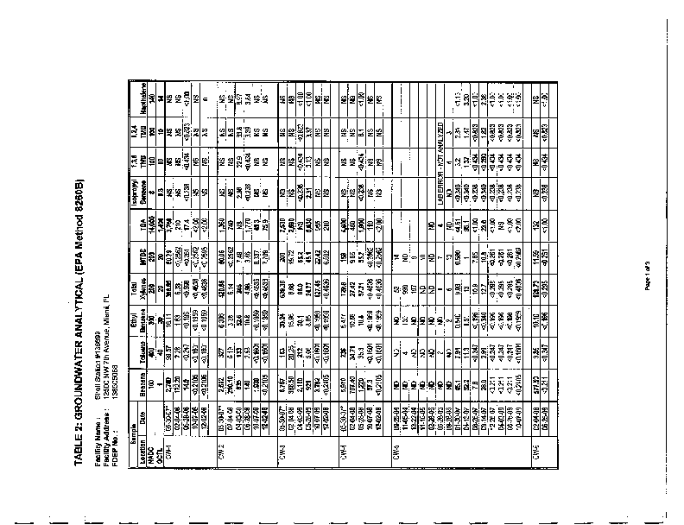
Screenshot of Example Groundwater Analytical Report

Slide 17
As the Rule Requires
AS THE RULE REQUIRES,
1. SEND THE ORIGINAL BY “CERTIFIED MAIL” TO:
DIVISION OF WASTE MANAGEMENT
FLORIDA DEPARTMENT OF ENVIRONMENTAL PROTECTION
2600 BLAIR STONE ROAD, MAIL STATION 4500
TALLAHASSEE, FLORIDA 32399-2400
2. MAKE TWO ADDITIONAL COPIES OF THE ORIGINAL PACKAGE AND MAIL THEM TO:
APPROPRIATE DEPARTMENT DISTRICT OFFICE AND
THE COUNTY HEALTH DEPARTMENT
http://www.doh.state.fl.us/chdsitelist.htm
3. ADDITIONAL COPIES WILL BE MAILED TO THE LESSEES AND TENANTS
OF THE PROPERTY AT WHICH SITE REHABILITIATION WAS INITIATED
DO NOT INCLUDE THE LIST OF RECORD OWNERS OF PROPERTIES AT
WHICH CONTAMINATION DISCOVERED WITH THESE PACKAGES (TAKE PAGE 2 OF THE FORM OUT FROM PACKAGE)

Slide 18
Screenshot of Initial Notice of Contamination Beyond Property Boundaries

Slide 19
Expanded Initial Notice of Contamination!
EXPANDED INITIAL NOTICE OF CONTAMINATION !
IF A CONTAMINANT PLUME MAP IS NOT YET AVAILABLE,
ALL PROPERTIES WITHIN A 250 FOOT RADIUS OF THE LOCATION OF SUCH ANALYTICAL RESULTS FOR GROUNDWATER OR SURFACE WATER SAMPLES (NOT SOIL
OR SEDIMENT SAMPLES) WILL RECEIVE AN EXPANDED INITIAL NOTICE OF CONTAMINATION.

Slide 20
Are Site Managers Responsible for Expanded Noticing?
ARE SITE MANAGERS RESPONSIBLE FOR EXPANDED NOTICING?
“NO”
THE DIVISION ADMINISTRATIVE SERVICES CONTRACTOR WILL PROVIDE EXPANDED NOTICE FOR PROPERTIES THAT ARE WITHIN A 250-FOOT RADIUS OF THE CONFIRMED SAMPLE LOCATION
HOW THEY WILL DO IT ???

Slide 21
Screenshot of Example Site Map
SITE MAP
THE DIVISION ADMINISTRATIVE SERVICES CONTRACTOR WILL
REVIEW THE FILE AND WILL ASK QUESTIONS SUCH AS:
IS THERE A CONFIRMED GROUNDWATER SAMPLE(S)? “YES”
IS THIS A “STATE LEAD SITE ? “YES”
IS THERE A WELL DEFINED PLUME MAP? “NO”

Slide 22
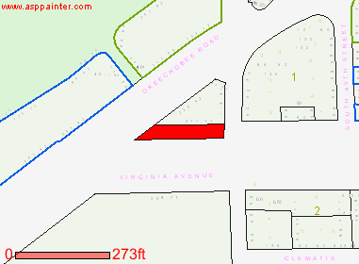
Screenshot of Parcel Boundary Map

Slide 23
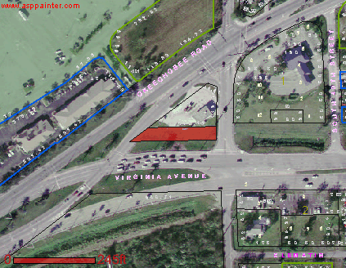
Screenshot of Parcel Boundary Map

Slide 24
Contamination Notification Checklist for Active State Funded Cleanup Sites

Slide 25
If you have any questions please come see me
IF YOU HAVE ANY QUESTIONS PLEASE
Melike.Altun@dep.state.fl.us
Letha.Osborn@york-claims.com

