Slide 1
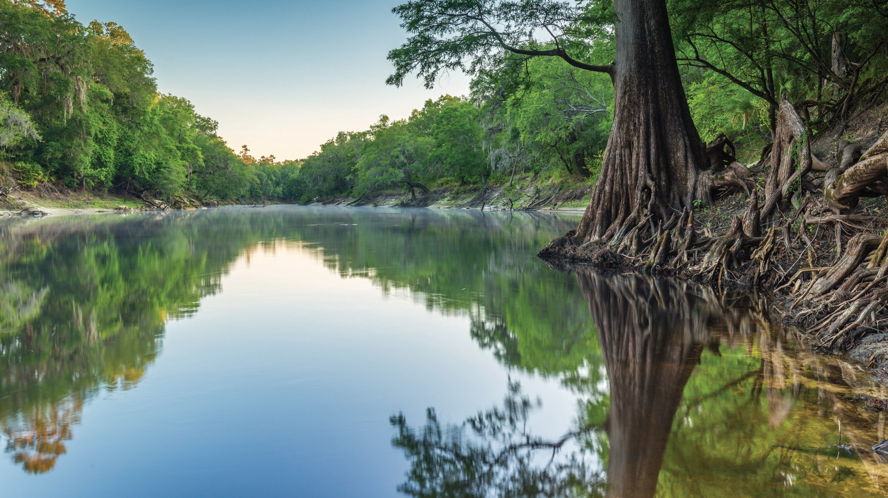
OUTSTANDING FLORIDA SPRING RULE DEVELOPMENT WORKSHOP
62-41.400 – 403, FLORIDA ADMINISTRATIVE CODE
James C. Albright
Office of Water Policy and Ecosystems Restoration
Florida Department of Environmental Protection
Apopka Service Center/SJRWMD | September 12, 2024

Slide 2
Public Comment Logistics
Public comment cards are available.
Please fill out your name, organization (if applicable), and contact information and return to DEP staff.
We are not taking public comments via the webinar.
We will also be accepting written public comments at the following email address:
OWP_rulemaking@floridadep.gov

Slide 3
OUTSTANDING FLORIDA SPRINGS RULE DEVELOPMENT WORKSHOP AGENDA
Workshop Agenda:
1. Call to Order
2. Draft Rules
62-41.400 – Scope of Rules and Definitions
62-41.401 – Uniform Definition of Harmful to the Water Resource
62-41.402 – Uniform Conditions for Issuance of Permits
62-41.403 – Additional Protections
3. Public Comments
4. Next Steps
5. Adjourn

Slide 4
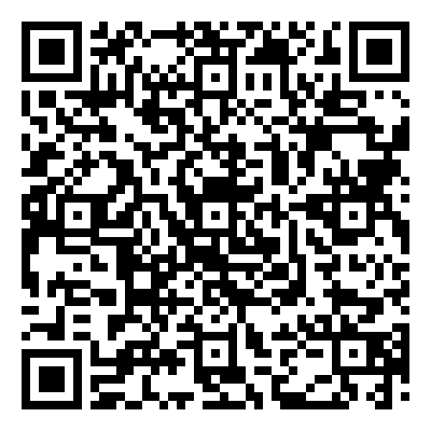
Link to the Outstanding Florida Springs Rulemaking Website
https://floridadep.gov/water-policy/water-policy/content/outstanding-florida-springs-ofs

Slide 5
RULE DEVELOPMENT OVERVIEW
For Outstanding Florida Springs (OFS), section 373.219(3), F.S., requires the department to adopt:
Uniform rules for issuing consumptive use permits (CUPs) which prevent groundwater withdrawals that are harmful to the water resources.
A uniform definition of the term “harmful to the water resources” to provide water management districts with minimum standards necessary to be consistent with the overall water policy of the state.
Water management districts can adopt a definition that is more protective of the water resources consistent with local or regional conditions and objectives.

Slide 6
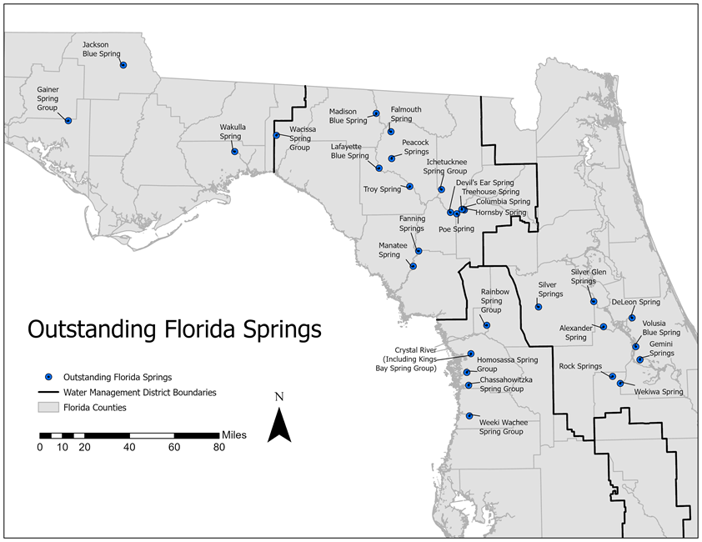
62-41.400 - SCOPE OF RULES AND DEFINITIONS
Defines the scope of the rule series as minimum standards to the evaluation of CUPs.
The rule series regulates consumptive uses “to ensure they are not harmful to an Outstanding Florida Spring or its spring run as defined in section 373.802(5) and 373.802(8), F.S.”

Slide 7
62-41.401 - UNIFORM DEFINITION OF HARMFUL TO THE WATER RESOURCES
62-41.401(1) defines “harmful to the water resources” as a consumptive use that adversely impacts the OFS or its spring run.
62-41.401(2) states that applicants shall provide reasonable assurance that there are no adverse impacts caused by the withdrawal on an individual or cumulative basis.
62-41.401(3) details the information that shall be submitted as reasonable assurance that harm to the water resources will not occur due to the proposed water withdrawal or diversion.

Slide 8
62-41.402 - UNIFORM CONDITIONS FOR ISSUANCE OF PERMITS
No permit issued by the agencies for the consumptive use of water shall authorize groundwater withdrawals that are harmful to the water resources.
For withdrawals that potentially impact an OFS, permittees must provide reasonable assurance that the conditions of issuance are met.

Slide 9
62-41.403 - ADDITIONAL PROTECTIONS
62-41.403(1) states that nothing in these rules shall prevent agencies from adopting a definition of “harmful to the water resources” that is more protective.
62-41.403(2) sets the following conditions for all OFS recovery strategies:
Prevents new water use authorizations for withdrawals from private residential irrigation wells constructed in the Upper Floridan aquifer after [effective date] where a lower quality water source is available for irrigation or public supply or reclaimed water is available at or immediately adjacent to the property boundary.

Slide 10
62-41.403 - ADDITIONAL PROTECTIONS
62-41.403(3) is a provision for establishing OFS Supplemental Conservation Measures.
States that this rule will be used in conjunction with the Supplemental Conservation Measures and incorporates these measures by rule.
62-41.403(4) clarifies that the Supplemental Conservation Measures do not replace more stringent measures.
States that the supplemental Conservation Measures referenced in 62-41.403(3) shall be incorporated by all individual permittees unless a more stringent permit rule already applies.

Slide 11
OFS SUPPLEMENTAL CONSERVATION MEASURES
Public Supply Water Conservation Measures:
“In addition to the water conservation plan requirements in the applicable District’s applicant’s handbooks, a public supply permittee with the potential to impact an OFS shall implement additional conservation measures.”
Water conservation public education program for public supply permittees.
< 1 million gallons per day (mgd) requires a minimum of the first 3 public education measures.
> 1 mgd requires all 10 public education measures.

Slide 12
OFS SUPPLEMENTAL CONSERVATION MEASURES
Public Supply Public Education Measures
Provide conservation information in customer bills, electronic billing, or separate mailings or emails
Post conservation information on applicant’s website
Provide information on landscape irrigation conservation measures
Provide conservation speakers, posters, literature, videos, and other information of schools and community organizations
Make conservation public service announcements
Provide exhibits in public places, such as trade shows, festivals, shopping malls, utility offices, and government buildings
Provide articles and/or reports to local news media
Implement indoor/outdoor water use audit customer assistance program
Landscape irrigation audits & operation instructions to businesses & residents
Other communications, including efficient landscape demonstration projects

Slide 13
OFS SUPPLEMENTAL CONSERVATION MEASURES
Public Supply Water Conservation Reporting:
Public Supply Annual Report (PSAR) for all Public Suppliers > 1 mgd unless a PSAR requirement already in place submitted to the Districts by April 1.
Residential per capita goals of 100 gallons per capita per day (gpcd), or a 6% reduction of average residential per capita daily water use every 5 years. Those not achieving this per capita goal must submit a plan and implementation timeline.
Evaluate effectiveness of public supply water conservation plans every 5 years.

Slide 14
OFS SUPPLEMENTAL CONSERVATION MEASURES
Agricultural Water Conservation Measures:
Permittees > 1 mgd potentially impacting a spring must demonstrate implementation of elements in conservation plan.
Permittees must evaluate irrigation system efficiency and undertake necessary maintenance, repairs, and upgrades.
Implementation and tracking of currently implemented or planned conservation measures required.

Slide 15
OFS SUPPLEMENTAL CONSERVATION MEASURES
Commercial/Industrial/Institutional, Landscape Recreation and Mining/Dewatering Water Conservation Measures:
Permittees with >100,000 gallons per day (gpd) allocation must evaluate and update conservation plans.
Assessment of effectiveness and projected benefits required.

Slide 16
PUBLIC COMMENTS
Participants will be given 3 minutes to make their comments.
Written comments may be submitted to the email address below:
OWP_rulemaking@floridadep.gov
The department is providing a 3-week public comment period.
Please submit public comments by October 3, 2024.

Slide 17
WHERE DO WE GO FROM HERE?
Next Steps
DEP will address comments received at this public workshop and during the subsequent comment period.
Notice of Proposed Rule and Statement of Estimated Regulatory Cost to be developed this Fall.

Slide 18
THANK YOU
James Albright
Office of Water Policy and Ecosystems Restoration
Florida Department of Environmental Protection
Contact Information:
850-245-3139
James.Albright@FloridaDEP.gov

