Slide 1
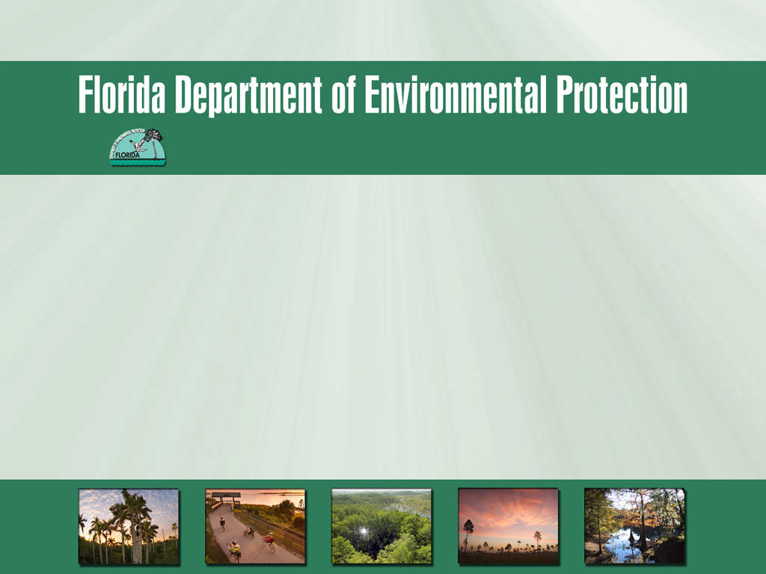
Petroleum Restoration Program
Site Managers Workshop
Orlando, Florida
March 25 – 26, 2014
Division of Waste Management
PETROLEUM RESTORATION PROGRAM
Site Managers Workshop
Orlando, Florida
March 25 - 26, 2014

Slide 2
INTRODUCTION AND WELCOME
DAY 2
 | DAY 2 (Wednesday, March 26, 2014)
 | Site Management Training
8:00 - 8:30 am | ATCs - Direct Assign and RCI | Kyle Kilga
8:30 - 9:00 am | PR/PO w/MFMP | Rickey Beasley
9:00 - 9:30 am | Activities and Deliverables/Submittals | Kyle Kilga
9:30 - 10:00 am | Invoicing and Change Orders | Kyle Kilga
10:00 - 10:15 am | Break
10:15 - 10:45 am | STCM/OCULUS | Grace Rivera
 | Site Closure
10:45 - 11:00 am | Site Conceptual Model/Remedial Strategies | John Wright
11:00 - 11:15 am | Risk Based Closure Options | John Wright
11:15 - 11:30 am | LSSI Closures | Diane Pickett
11:30 - 11:45 am | IC Process & FDOT MOU | John Wright
11:45 - 12:00 pm | Closure Sampling Guidelines | Diane Pickett
12:00 - 12:15 pm | Questions and Answers | All
12:15 - 1:30 pm | Lunch
1:30 - 1:40 pm | Cost Shares - PAC, PCPP, SRFA | Ken Busen
1:40 - 2:00 pm | Site Inspection - Assessment and Remediation Sites | Ken Busen
2:00 - 2:15 pm | Break
2:15 - 3:15 pm | Remediation (PE) round table discussion | Wright
3:15 pm | Adjourned

Slide 3
ATCs – RCI, Direct Assign and the spi
March 26, 2014
Kyle Kilga

Slide 4
SOW/SPI Development to Assignment
RCI

Slide 5
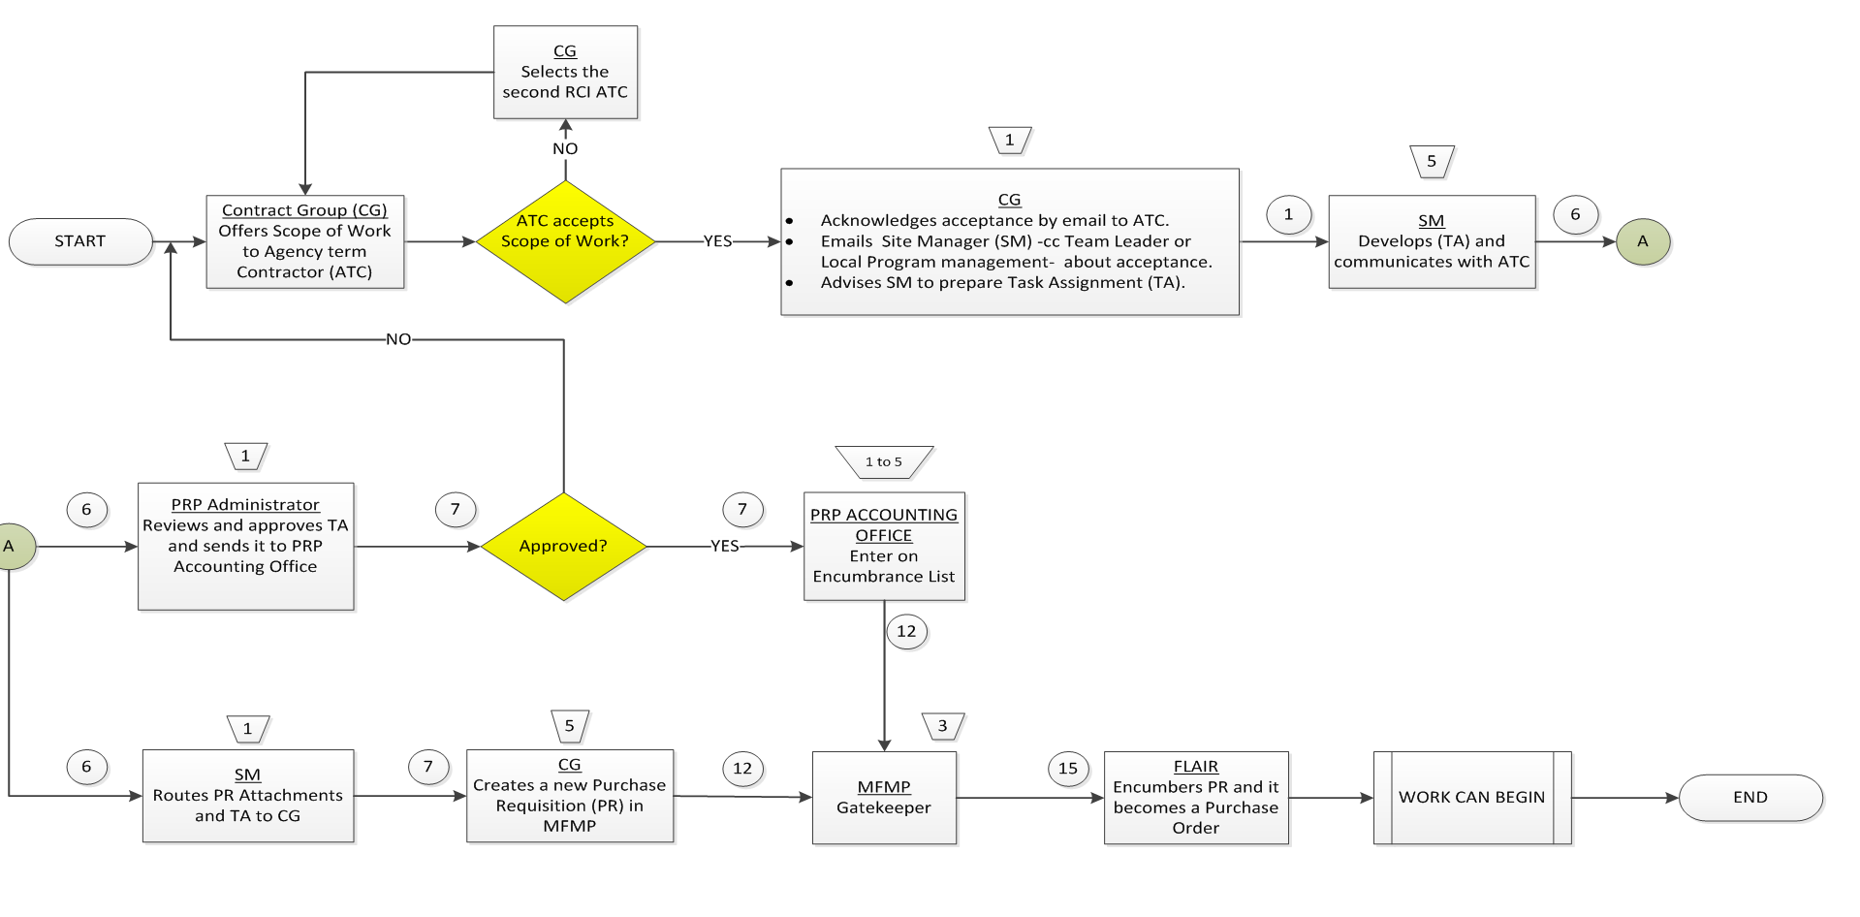
Assignment to Purchase Order

Slide 6
SPI – Schedule of Pay Items workbook
SOW Units
Rate Sheet
Invoice Rate Sheet
Invoice
Invoice Instructions
Required Documents
Release of Claims
Subcontractor Utilization Form
SPI

Slide 7
QUESTIONS
???

Slide 8
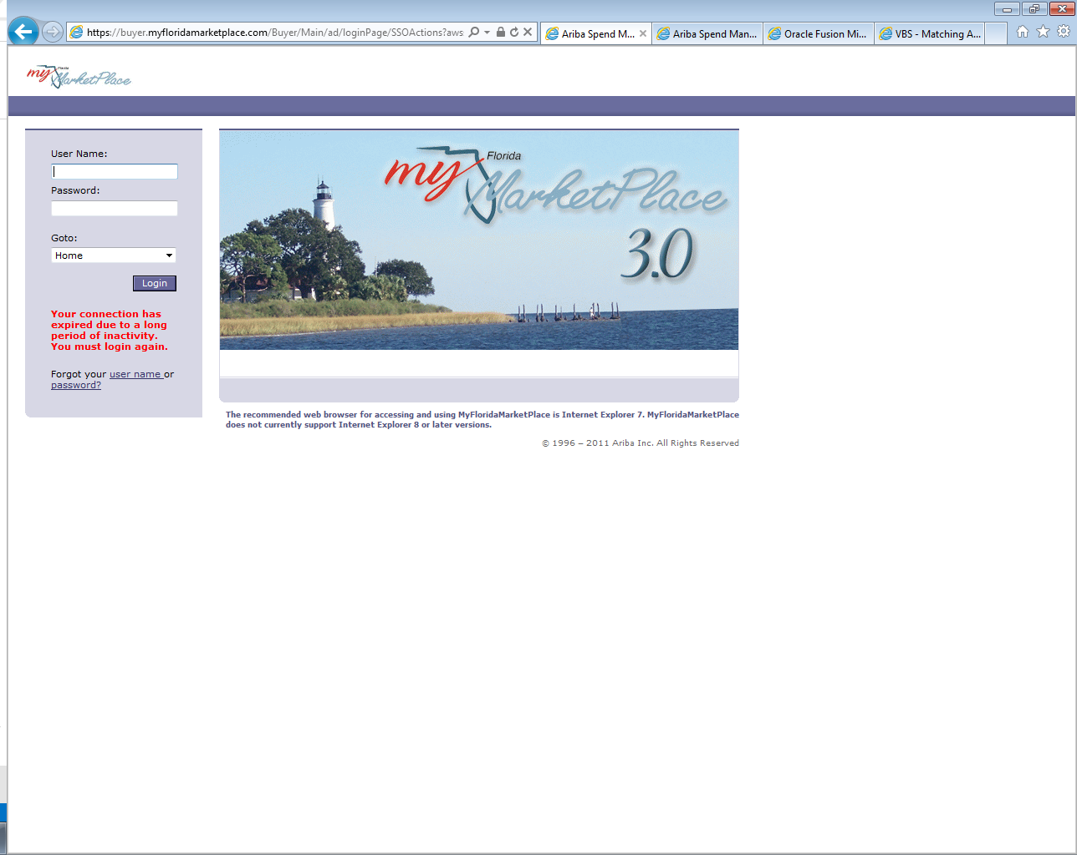
MFMP Buyer

Slide 9
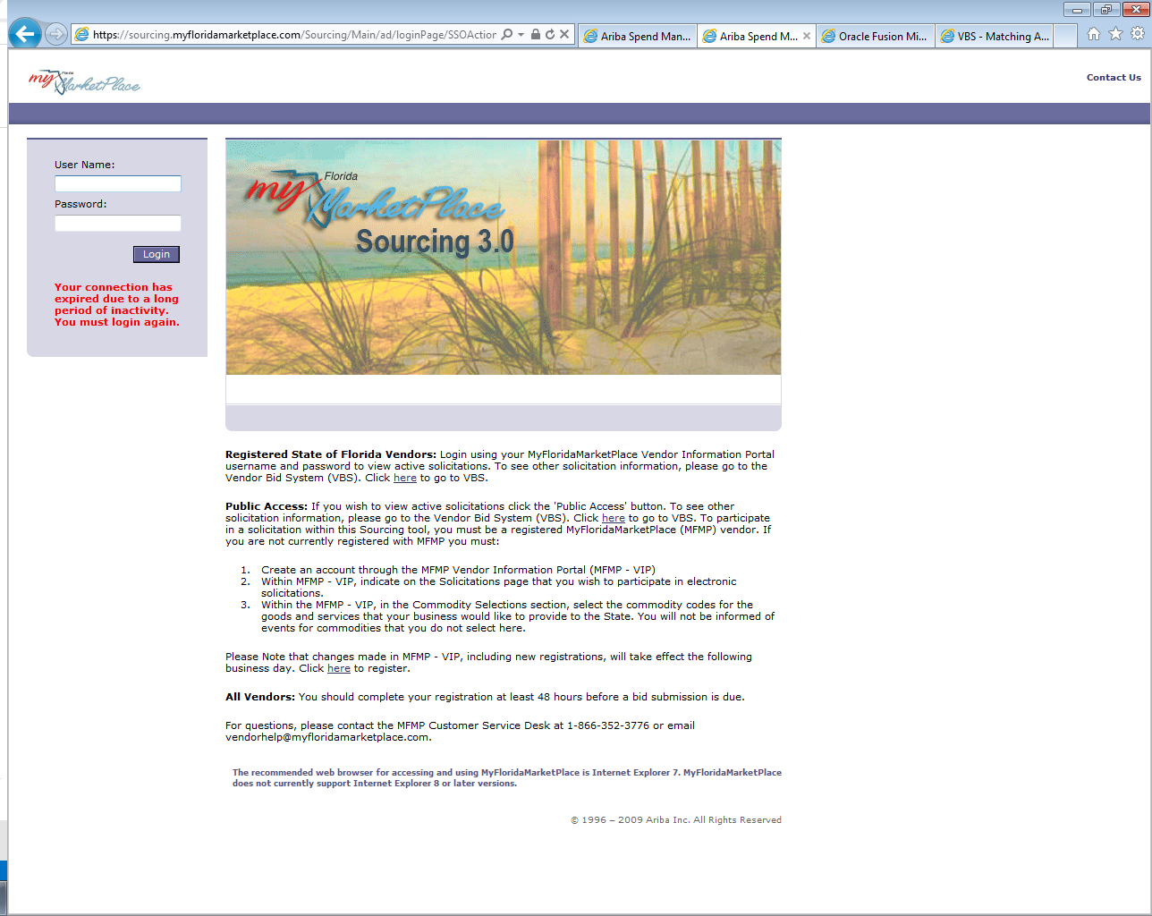
MFMP Sourcing 3.0 (eQuote)

Slide 10
Buyer vs Sourcing 3.0
MFMP Buyer – Purchase Requisition (PR) development & approval, Purchase Order (PO), Invoice creation, and Invoice Reconciliation (IR)
Sourcing 3.0 – eQuote

Slide 11
Purchase Requisition Approval
Prior to the release of a PO the PR goes through an approval flow in MFMP.
Approvers: PRP Accounting - Site Manager – Supervisor – PRP Contracts – Program Administrator – Financial Manager – Division Director – Deputy Secretary – Secretary
Review and approval of PR is a top priority.

Slide 12
PR Site Manager Approval
Site Manager receives Ariba email to approve a PR.
Site Manager logs onto MFMP Buyer to reviews PR documents
Site Mangers Approves PR

Slide 13
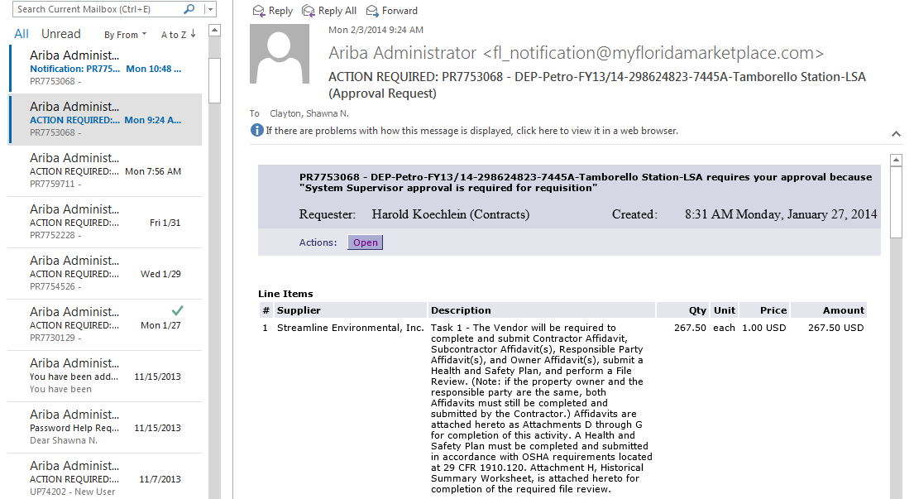
Receipt of Ariba Email and Access to Purchase Requisition

Slide 14
Log into MFMP Buyer

Slide 15
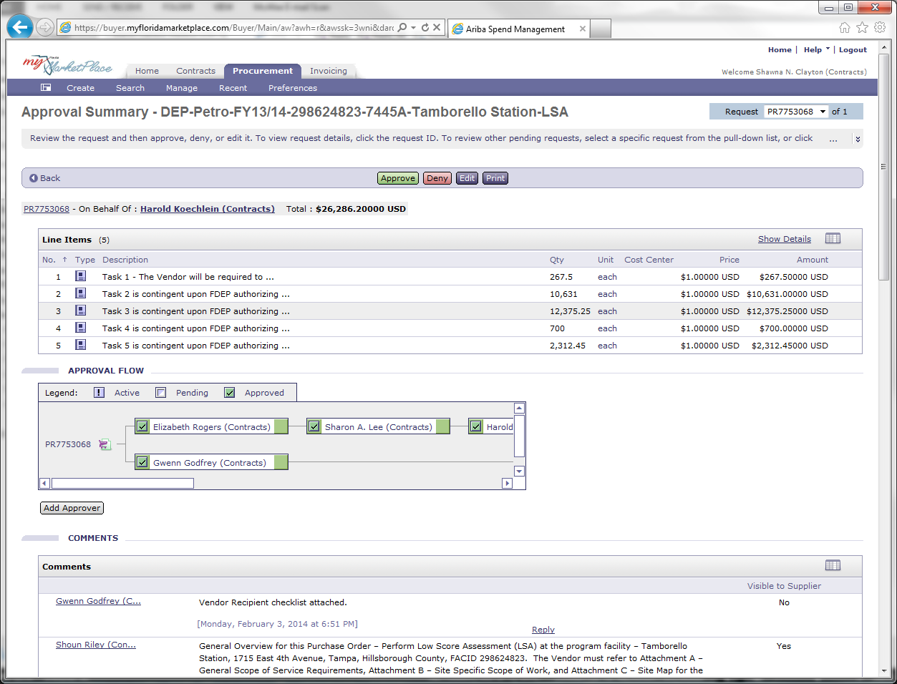
Review Purchase Requisition

Slide 16
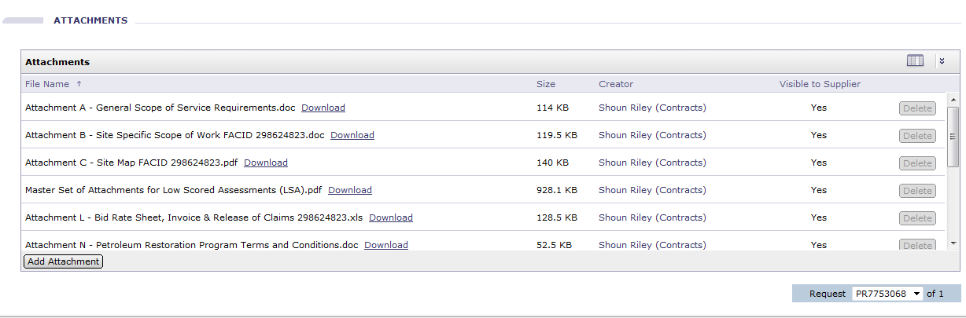
Review Scope of Work & Rate Sheet
The site manager must download the the scope of work and Rate Sheet, Invoice & Release of Claims documents.
This must be done prior to the approval of the PR.
If any corrections are needed the Site Manager should notify the creator of the PR. (Creator name is located in the attachment section)

Slide 17
Approve Purchase Requisition

Slide 18
Delegation of Authority
When a site manager takes leave he or she must delegate authority to approve PR’s.
You can not delegate authority downward.
If a staff member is out of office and cannot log into MFMP to delegate authority please contact PRP contracts.

Slide 19
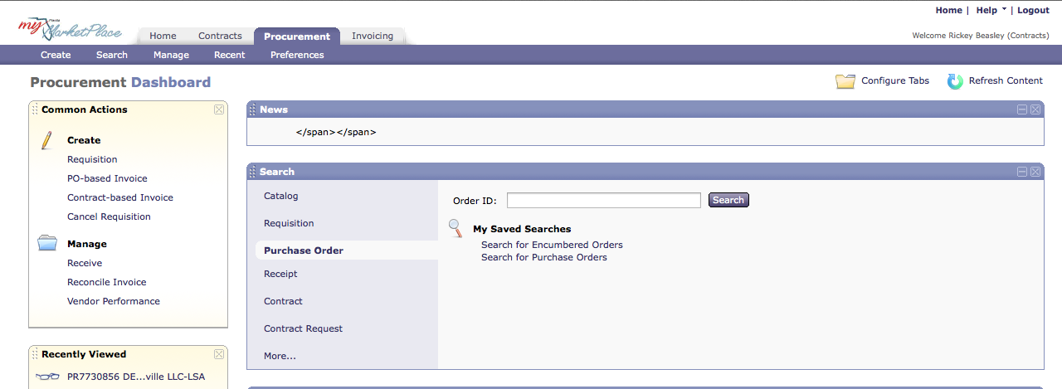
Click the Preferences Tab

Slide 20
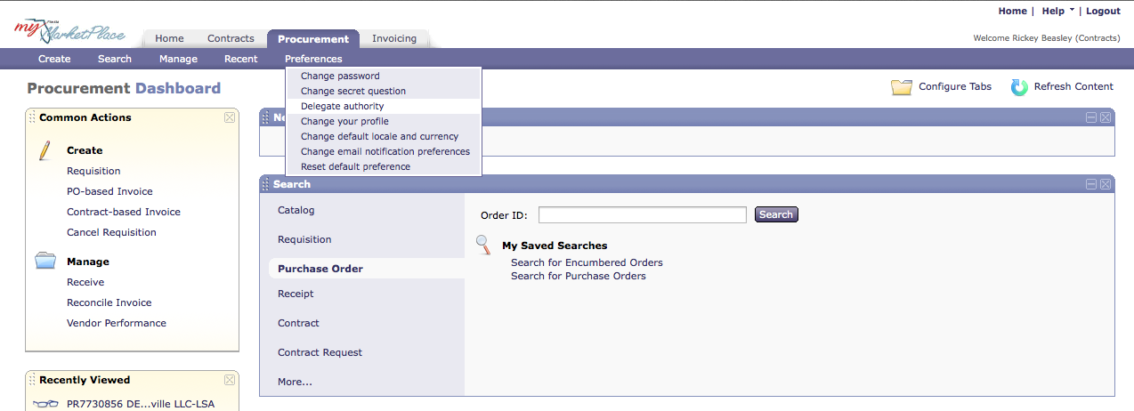
Select Delegate Authority from the drop down menu

Slide 21
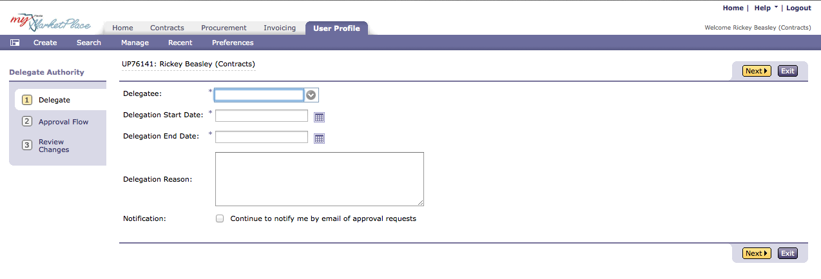
Fill out the all appropriate areas

Slide 22
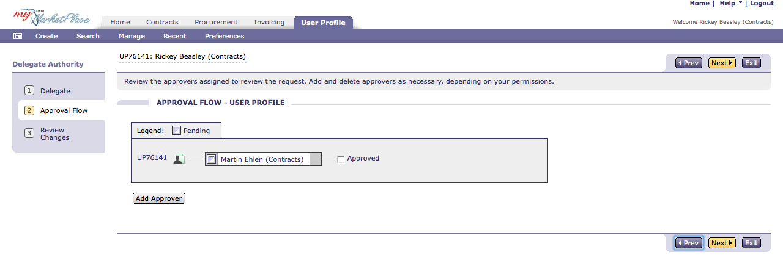
View the approval flow

Slide 23

Questions

Slide 24
Guidance, Activities, deliverables and submittals
Kyle Kilga
Petroleum Restoration Program
March 26, 2014

Slide 25
What Comes Next???
SOWs & SPIs
to
PR/PO
Time to get to work!

Slide 26
Site Management
What Guidance Do I Follow?
Various Procurement Methods
eQuote – 57 LSA and 5 WA
ITB – 12 RAC, O&M, PT
ITN – ATC – DA/RCI

Slide 27
Purchase Order
Contains all guidance requirements expectations for the services procured
Read all text, comments and attachments

Slide 28
eQuote – 57 LSA and 5 WA
Attachment A – General Scope of Service Requirements
  Detail of activities, includes reference to program guidance documents (SOP)
Attachment B – Site-Specific Scope of Work
  Facts about what is proposed in each task including summary of units and project schedule (proposal/ WO)
Attachment L – Site-Specific Rate Sheet (Template)
  # units authorized/bid price
  Backup to Invoice
Attachment P – Vendor Resume
  Submitted with bids but many need revisions
Terms and Conditions
Guidance Regarding Purchase Orders Issued from LSA eQuotes
February 6, 2014

Slide 29
ITB – 12 RAC, O&M, PT
Attachment A – Site-Specific Scope of Work
  Detail of activities, includes reference to program guidance documents (SOP)
  Facts about what is proposed in each task including summary of units and project schedule (proposal/ WO)
Attachment B – Site-Specific Rate Sheet (Template)
  # units authorized/bid price
  Backup to Invoice
Attachment C – Terms and Conditions
Subcontractor Utilization Form

Slide 30
ITN – ATC – DA/RCI
Scope of Work (SOW)
Schedule of Pay Items (SPI) Workbook
ATC Master Agreement (includes bookmark to ATC rates)

Slide 31
STCM
OCULUS
REMINDERS
Dates
Contractor cannot begin work until PO Start Date
Contractor must complete all work prior to PO End Date
Pay close attention to Task Due Dates in PO
Correct STCM Due Dates to match PO Task Due Dates
PO End Date is Period of Service End Date
Communicate with Contractor

Slide 32
Forthcoming Guidance
Subcontractors
Per Diem
Change Orders – in field/emergency
Monthly Invoicing
Subcontractor Utilization Form
Contractor Evaluation Forms
  Interim
  Annual

Slide 33
QUESTIONS???

Slide 34
PURCHASE ORDER BASED CHANGE ORDERS, DELIVERABLES and INVOICING
Kyle Kilga
Kyle.Kilga@dep.state.fl.us
850-245-8855

Slide 35
Change Orders – Informal
Informal – Via email with concurrence between vendor and site manager
Must be inserted into OCULUS
Examples:
    Qualified personnel (LSA eQuotes)
    Scope of Work – Must be within the quantity awarded
    Change in well or boring location
    Reductions unless contractor requests formal change order

Slide 36
Change Orders – Formal
Formal – Request for Change Form
  May be prepared by contractor or site manager but requires both signatures prior to routing for approval
  Review and approval process thru Team/LP on to Program Administrator
  Contracts Group
    Updates Rate Sheet or SPI Workbook incorporating changes to units
    Prepares MFMP Purchase Requisition attaching
      Request for Change form w/backup documentation
      Updated Rate Sheet or SPI Workbook
    Route thru approval in MFMP
    PO Issued
  This process may take up to 2 weeks so be proactive and plan before sending the contractor into the field

Slide 37
Change Orders – Formal
  Examples:
    Increase in number of units authorized
    Adding new Pay Items
    Moving units from one Task to another Task
    Reimbursable Pay Items without costs
    Adding Pay Items not part of the master Schedule of Pay Items
    PO End Dateand PO identified Due Dates - Do not require PA approval and can be sent directly to PRP.contracts after Team/LP approval
      LSA eQuotes –
        Cannot add items that were not originally identified in the rate sheet
          Minimal exceptions (contact me or Rickey Beasley)
        Cannot exceed $35,000 eQuote threshold

Slide 38

Request for Change Form
Task # - Changes to multiple Tasks required a separate Request for Change form for each Task
CO # - must be sequential for each PO
Site Manager must verify Unit Rate to the most current Rate Sheet.
Manual changes to Total Authorized Cost is NOT ALLOWED – contractor must correct and resubmit

Slide 39
DELIVERABLES
Contractor Deliverables Must Include
Latest Invoice Rate Sheet with quantities to be invoiced populated
Copies of Formal and Informal Changes
Site Manager must Sign & Approve the Rate Sheet
After verifying each pay item quantity was satisfactorily completed
Manual changes can be made by the site manager, but should be discussed with the contractor prior to issuing the Deliverable Review Letter.
Deliverable Letter must include the following sentence
The approved costs for completion of this deliverable/task is $XX,XXX.XX as detailed on the attached rate sheet.
Signed Rate Sheet must be attached to the Deliverable Review Letter when emailed to the contractor and must be inserted into OCULUS together.

Slide 40

INVOICE PROCESS

Slide 41
INVOICE PROCESS
MFMP Site Manager Approval
  Verify Attached Deliverable Review Letter and Rate Sheet is yours.
  Add Certification Statement
  I, XXXXXX YYYYYY, certify that I am the Contract Manager and the provided information is true and correct; the goods and services have been satisfactorily received and payment is now due. I understand that the office of the State Chief Financial Officer reserves the right to require additional documentation and/or to conduct periodic post-audits of any agreements.

Slide 42
Questions???

Slide 43
STCM
Grace Rivera

Slide 44
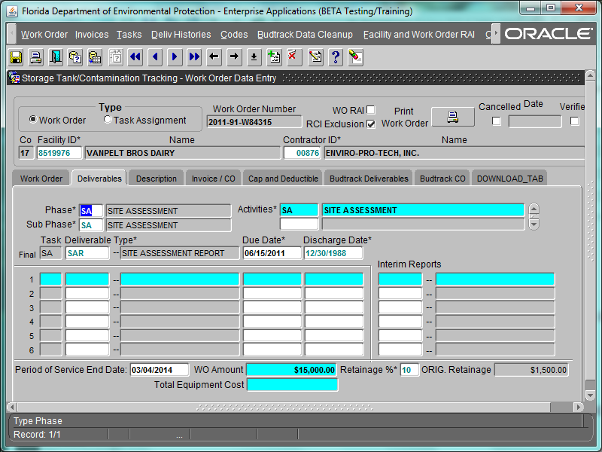
Now Available in STCM
RCI Exclusion
PBC
LSSI
Cost Share
Period of Service Unlocked

Slide 45
Now Available in STCM
Sub Phase

Slide 46
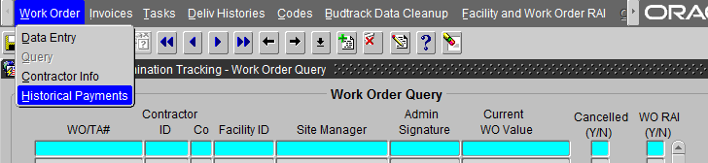
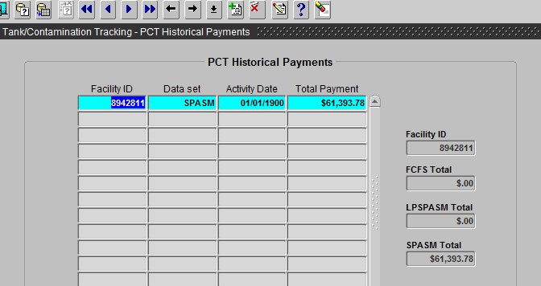
Now Available in STCM
Historical Payment Information Phase

Slide 47
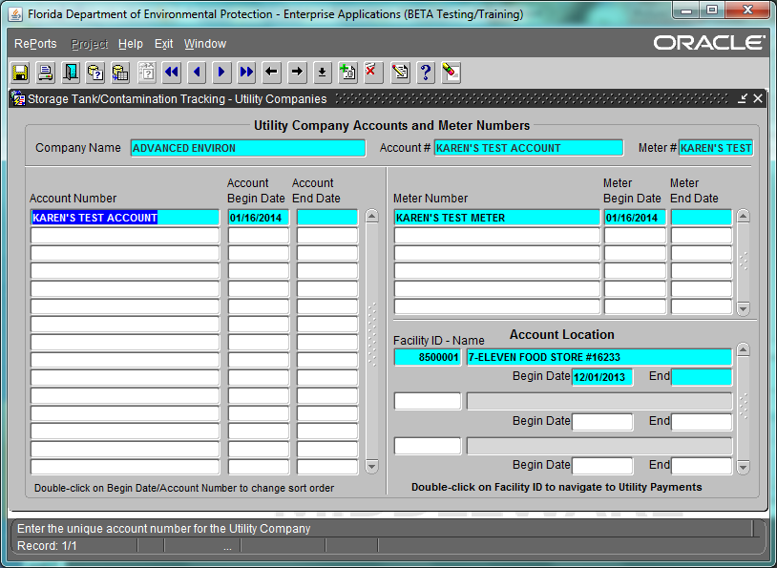
Coming Soon to STCM
Utility Information

Slide 48
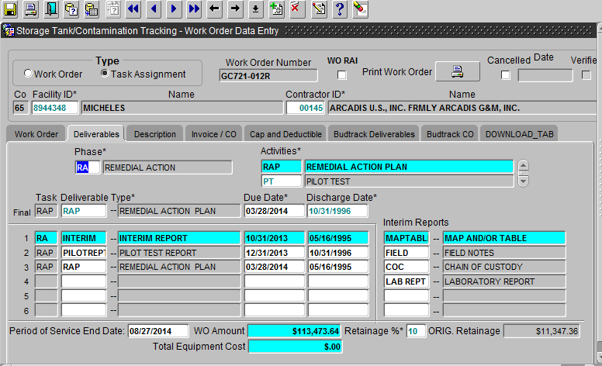
Report and Discharge Association
Report and Discharge Association in the Work Order

Slide 49
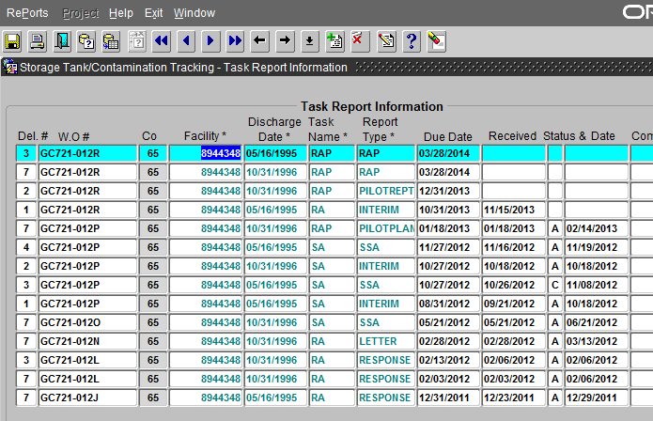
Reports and Discharges
Report and Discharge Association in the Reports Section
Lucky Number 7
Discharge Dates

Slide 50
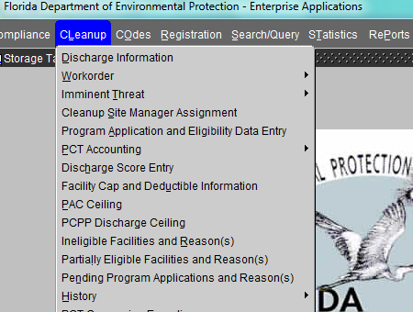
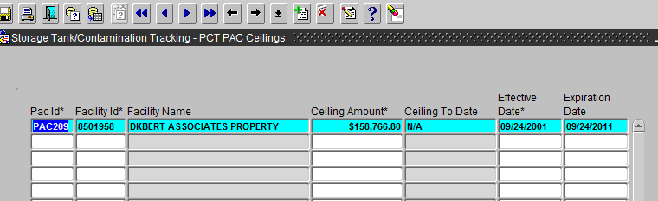
PAC and PCPP Ceiling Information

Slide 51
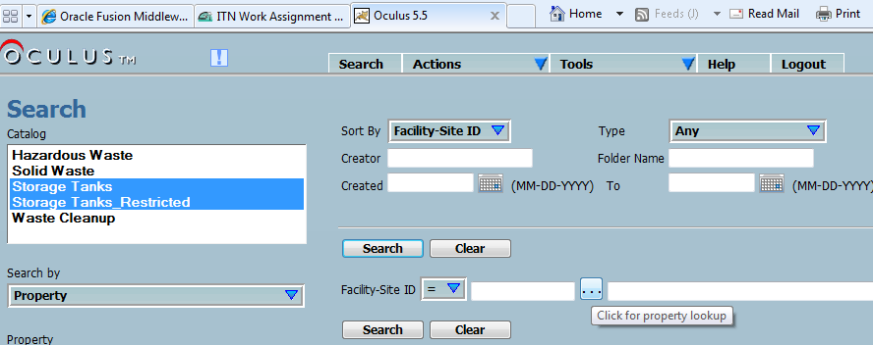
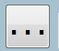
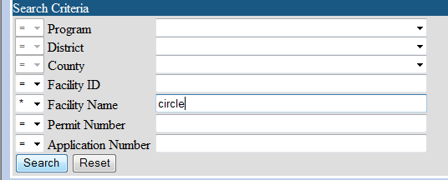
OCULUS Lookup
Property
Contractor
etc

Slide 52
PRP Competitive Procurement Webpage
http://www.dep.state.fl.us/waste/categories/pcp/pages/procurement.htm
Weekly Updates
Links to My Florida Marketplace
Relative Capacity Index Definition
RCI Encumbrance Balance Report
Agency Term Contractor List by Region

Slide 53
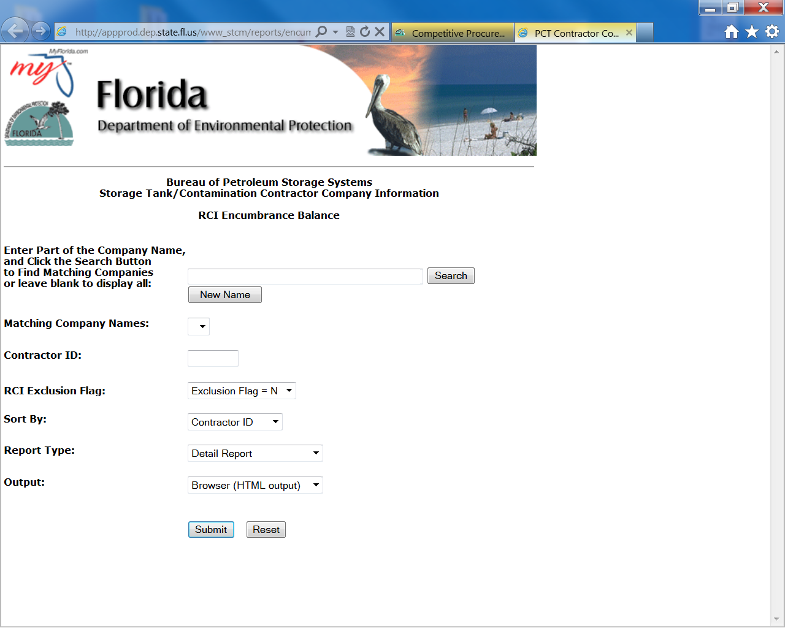
RCI Encumbrance Balance

Slide 54
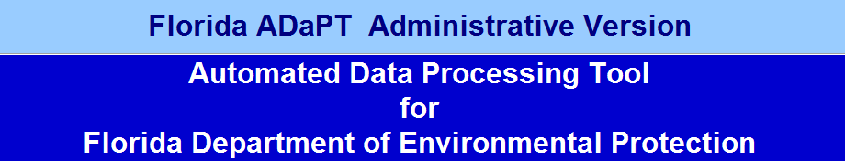
Automated Data Processing Tool
All Scopes of Work will require ADaPT Electronic Laboratory Deliverables
Upload into OCULUS in current format under Lab Report
DWM ADaPT Webpage
http://www.dep.state.fl.us/waste/ADaPT/

Slide 55
Questions

Slide 56

Site Conceptual Model
The Site Conceptual Model
What’s the Big Deal?
John F. Wright, P.E.

Slide 57
The Site Conceptual Model
What Is It?
It is the Explanation for Everything you Know and Observe at a Site.

Slide 58
The Site Conceptual Model
What Goes Into The CSM?
Site History
Discharge History
Assessment Information
Pilot Test Data
Results of Previous Remediation Efforts at the site
Monitoring Data

Slide 59
The Site Conceptual Model
When Should It Be Updated?
Continuously
Every Report, Figure, Piece of Data Must Agree With the CSM, or the CSM must Change to Reflect the New Information.
We Should Always be Asking: Does the Data make Sense?

Slide 60
The Site Conceptual Model
Why Is This So Important?
The CSM Should be the Basis Upon Which Every Response Is Based.
Whether and Where to Perform RA
How Often to Monitor and What to Monitor For
When to Stop Remedial Action and Pursue Natural Attenuation or a Conditional Closure

Slide 61
The Site Conceptual Model
Some Questions to Ask
What is Causing the Plume to Expand?
  Pumping Wells?
  Utility Conduits?
Are All the Source Areas Identified?
Is thee a Continuous Source?

Slide 62
The Site Conceptual Model
Final Thoughts:
In Order to Succeed, You Must Identify the Critical Questions to Ask and Answer.
An Evaluation of the Site Data and Formation of A Site Conceptual Model will Allow You to Do This.

Slide 63
Remedial Strategies
Focus on Risk Management
Presence of Contamination is no Longe Enough to Justify Remedial Action
We Should Ask:
  Is the Plume Expanding?
  Are There Completed Exposure Pathways?
  What is the Potential of the Spread of Contamination From Soil to Groundwater?

Slide 64
Remedial Strategies
We Should Also Consider Flux
Flux is a Measure of How a Chemical Moves in the Subsurface
Flux is Also Important in Remedy Selection
  We may no Have to Remove Every Last Molecule
  We May Just Have to Reduce the Flux

Slide 65
Remedial Strategies
Active Remediation:
Success With Active Remediation Is All About Distribution and Contact
When Site Conditions Do Not Favor D&C, Success Is Difficult to Achieve
Lack of D&C Leads to Rebound and/or Failure

Slide 66
No More Alternative Procedures
Chapter 62-770, F.A.C., Required An Alternative Procedure Order For Remedial Action Prior to Completion of A Site Assessment
Chapter 62-780, F.A.C. Does Not Include Provisions For Alternative Procedures
Rule 62-780.500, F.A.C. Emergency Response Action or Interim Source Removal Allows:
  Emergency Response Action To Eliminate Threat
  Free Product Removal and Disposal
  Short Term Groundwater Recovery
  Interim Groundwater Remediation

Slide 67
Interim Groundwater Remediation
62-780.500(4), F.A.C. Allows:
  Groundwater Recovery and On-Site Treatment and Disposal
  Any Other Means of Interim Groundwater Remediation Provided an Interim Source Removal Proposal Is Submitted and Approved
  The Source Removal Proposal Should Include a Signed and Sealed Plan With the Same Level of Detail as A Remedial Action Plan

Slide 68
Design Questions
Do We Use The Safety Factors Included in the Remedial Action Initiative (RAI)?
  Treatment Well Spacing
  Equipment Sizing
Is A Pilot Test Always Needed?

Slide 69
Questions

Slide 70
Risk Based Closure Options
John F. Wright, PE,
Environmental Engineer
Petroleum Restoration Program
Section 1
Notes:
Contact John Wright at ………………

Slide 71
No Further Action Options
There Are Three Closure Options Under the
No Further Action Section of the Cleanup Rules
(62-780.680(1) (2) and (3) Florida Administrative Code:
All Are Risk Based Corrective Actions
(RBCA = Rebecca)
Notes:
RMO I provides for a No Further Action without institutional controls or without institutional and engineering controls, i.e.. closure without controls, or an unconditional closure, or a clean closure. Closure without controls is the most desirable terminology. 62-780.680(1) , F.A.C.
RMO II and RMO III provide for a No Further Action with institutional and or engineering controls, i.e. closure with controls or conditional closure.
62-780.680(2) and 67-780.680(3), repsctively

Slide 72
No Further Action Options
No Further Action Options
RMO I: Risk Management Option Level I
RMO II: Risk Management Option Level II
RMO III: Risk Management Option Level III

Slide 73
Contaminated Site Closure Goals
Achieve Safe Site Closure By
Eliminating or Reducing Risk
Risk = Exposure x Toxicity
RMO I - Reduce or Eliminate Toxicity
  Risk = 100 x ~ 0 = 0
RMO II and III - Reduce or Eliminate Exposure
  Risk = 0 x ~ 100 = 0
Notes:
Note the emphasis on Toxicity and Exposure.
An NFA without controls or conditions can be issued when contaminant concentrations do not exist at toxic levels, i.e. are below the cleanup target levels.
When one cannot eliminate toxicity, we can still close a site with controls that prevent exposure to contamination above State Cleanup Target Levels.
These controls can be institutional or engineering.

Slide 74
Criteria for No Further Action Options:
Risk Management Option I (RMO I)
No Free Product
Groundwater Must Meet Chapter 62-777, F.A.C., Table I Criteria for Groundwater or Freshwater or Marine Surface Water

Slide 75
Criteria for No Further Action Options:
From Table I Chapter 62-777, F.A.C. (partial table)
Groundwater and Surface Water Cleanup Target Levels
Contaminants of Concern | Groundwater Criteria1 (μg/L) | Freshwater Surface Water Criteria1 (μg/L) | Marine Surface Water Criteria1 (μg/L) | Groundwater Low Yield/ Poor Quality Criteria (μg/L)
PAHs:
Acenaphthene | 20 | 3 | 3 | 200
Acenaphthylene | 210 | *** | *** | 2100
Anthracene | 2,100 | 0.3 | 0.3 | 21,000

Slide 76
Criteria for No Further Action Options:
Risk Management Option I (RMO I), continued
Soil: Levels of contamination in the soil must be Below Soil Cleanup Target Levels (SCTLs), Table II For Residential Direct Exposure and Leachability Chapter 62-777, F.A.C.,

Slide 77
Criteria for No Further Action Options:
From Table II Ch. 62-777 F.A.C. (partial table)
Soil Cleanup Target Levels
Contaminants of Concern | Direct Exposure Residential (mg/kg) | Direct Exposure Commercial (mg/kg) | Leachability Based on Groundwater Criteria (mg/kg)
PAHs:
Acenaphthene | 2,400 | 20,000 | 2.1
Acenaphthylene | 1,800 | 20,000 | 27
Anthracene | 21,000 | 300,000 | 2,500

Slide 78
Criteria for No Further Action Options
Risk Management Option II (RMO II)
  Alternative Cleanup Levels Allowed With Institutional/Engineering Control
  Plume < ¼ Acre, and Stable or Shrinking
  Free Product May Remain If Not Feasible To Remove and An Engineering/Institutional Control Is Put In Place
Notes:
Commercial/Industrial within source property boundary.
Vadose soils meet SCTLs for direct exposure based on: (a) direct comparison of soil contaminant concentrations to default Commercial/Industrial SCTLs (Table II) or (b) a comparison of 95% upper confidence limit of the mean concentration to the default SCTLs. May exceed if engineering control prevents direct exposure.
Groundwater may exceed GCTLs within source property boundary if (a) aquifer meets low yield/poor quality criteria (Table I), (b) monitoring confirms that engineering controls will prevent offsite plume migration, (c) plume is less than ¼ acre within the source area, stable/shrinking, will not reach the property boundary, will not impact surface water.
Can be larger than ¼ acre if all contamination is contained within property boundary.

Slide 79
Criteria for No Further Action Options
Risk Management Option Level III (RMO III)
  No Plume Size Limit
  Requires a Risk Assessment To Evaluate Site Specific Exposure Issues
  Alternative Cleanup Levels Allowed With Institutional/ Engineering Control
  Free Product May Remain If Not Feasible to remove and Engineering/Institutional Control Is Put in Place

Slide 80
RBCA Tools for RMOs
Soil - Direct Exposure
Site Specific Soil Properties May Be Used To Calculate Alternate Soil CTL’s
TRPH Fractionation May be Used
Toxic and Less Toxic Fractions are Identified
Notes:
See ?????

Slide 81
RBCA Tools for RMOs
Soil - Direct Exposure
May Calculate Average Soil Concentrations
Use 95% UCL Approach
Need 10 Representatives Samples
Maximum Can Not Exceed 3 times SCTL

Slide 82
RBCA Tools for RMOs
Soil - Leachability
Site Specific Soil Properties May Be Used To Calculate Alternate Soil CTL’s
TRPH Fractionation May Be Used
Synthetic Precipitation Leaching Procedure (SPLP) May Be used
One Year of Ground Water Data May Be Used To Allow Soil Exceeding Leachability That Has Been Exposed To Elements For Two Years

Slide 83
Examples From 62-777, F.A.C., Table II:
Chemical | Direct Exposure Residential (mg/kg) | Direct Exposure Commercial/ Industrial (mg/kg) | Leachability (mg/kg)
Benzene | 1.2 | 1.7 | .007
Benzo(a)pyrene | 0.1 | 0.7 | 8
MTBE | 4,400 | 24,000 | .09
TRPH | 460 | 2700 | 340
Trichloroethene (TCE) | 6.4 | 9.3 | .03

Slide 84
Risk Management Option - Level II
  Also known as:
RMO II
Risk Based Closure
No Further Action With Conditions
NFAC
Closure With Conditions
Conditional Closure

Slide 85
Most Often Used At Sites Where:
Cleanup Costs Would Be High
There Is No State Funding or Limited Funding
Remediation Efforts Have Reached A Diminishing Return
Contamination is Not Accessible
Owner Wants To Avoid Site Disruption

Slide 86
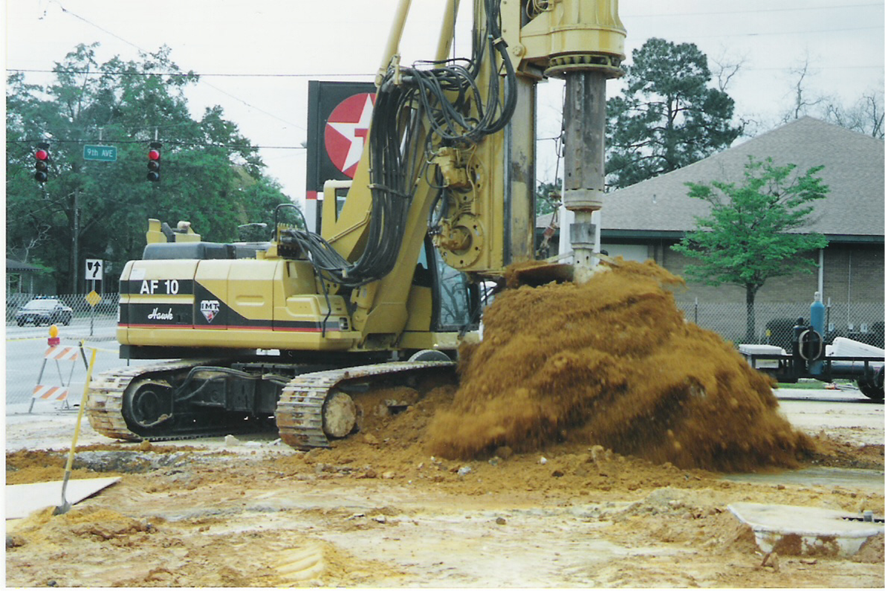
Large Diameter Auger

Slide 87
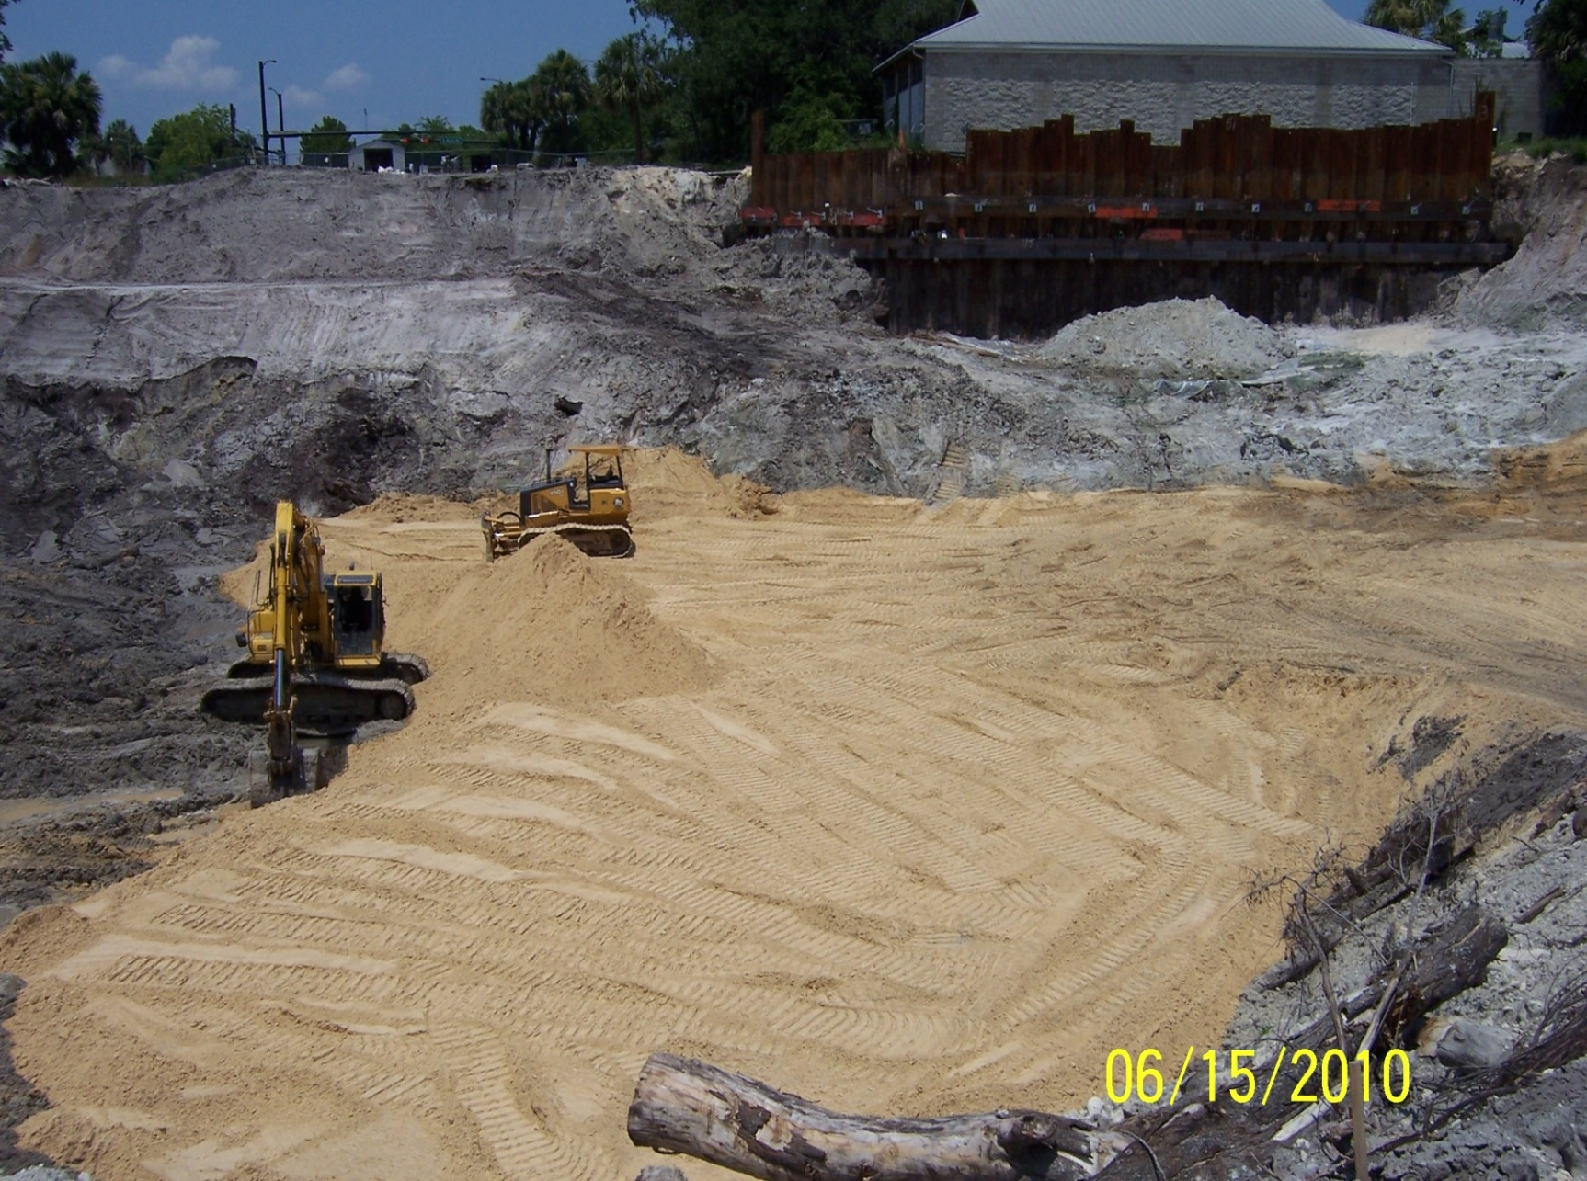
Filling in Excavation

Slide 88
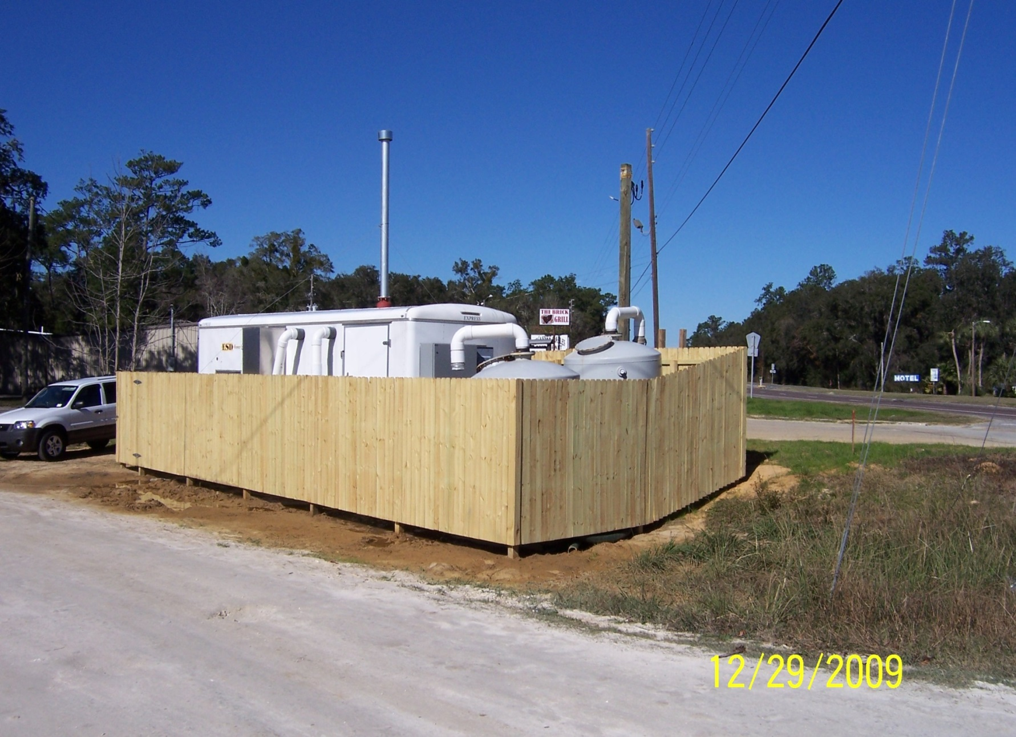
Remediation System Compound

Slide 89
Proposals For RMO II Should Address Ground Water:
Evaluation Should Show That the Plume Is On-Site, Stable or Shrinking Based On One Year of Data and Modeling, If Applicable
  Identify Area Of Ground Water Use Restriction
  (Usually Entire Property For Small Sites)
Identify Engineering Control To Prevent Plume Migration, If Applicable

Slide 90
Engineering Controls For
Ground Water
Permanent Containment That Prevents Ground Water Migration
  Barrier Wall
  Slurry Wall
One Year Of Monitoring Data Is Required To Demonstrate Effectiveness
Periodic Monitoring To Ensure Effectiveness

Slide 91
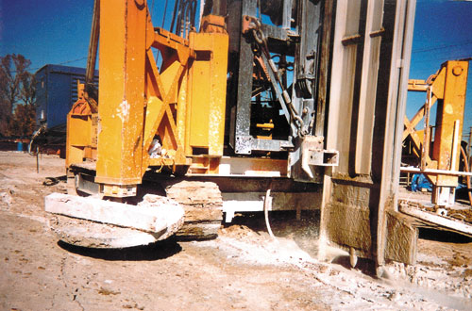
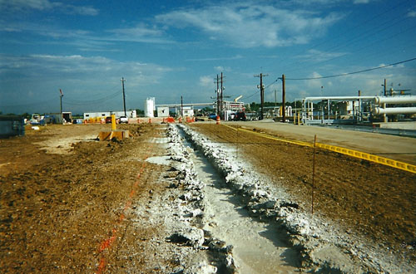
Slurry Walls

Slide 92
Proposals For RMO II Should Address All Contaminated Soil
Identify Contaminated Soil That Exceeds Direct Exposure and Leachability Criteria
Propose An Engineering Control:
  A Solid Cap or a Minimum of Two Feet or Clean Soil If Soil Exceeds Direct Exposure
  An Impervious Cap To Prevent Infiltration If Soil exceeds Leachability
  Engineering Controls Must By Certified By A Professional Engineer

Slide 93
Proposals For RMO II Should Address All Contaminated Soil
A Land Use Restriction May Be Used
  When Soil Exceeds Residential Levels But Is Below Commercial/Industrial Levels.
If Soil Exceeds Commercial/Industrial Levels
  An Engineering Control Is Required To Protect Workers From Exposure To Soil

Slide 94
Engineering Controls For Soil
Soil Cap With A Minimum Two Feet Clean Fill
Impermeable Cap
        Asphalt
        Concrete
        Plastic
Sheet Piling
Seawall

Slide 95
An Engineering Control Maintenance Plan Is Required
The Plan Should Include:
  Maintenance Requirements
  Inspection Frequency
  Criteria For Determining When The Engineering Control Has Failed, e.g.,
    Large Cracks
    Areas of Erosion
    Increase in Ground Water Concentrations

Slide 96
Engineering Control Maintenance Plans
Reporting of Routine Inspection Results Is Not Required
Any Failure of The Engineering Control Must Be Repaired Immediately
Failure of an Engineering Control Designed To Prevent Migration of Ground Water Must Be Reported and Repaired Immediately

Slide 97
Engineering Control Maintenance Plans
Will Be Summarized In The Site Rehabilitation Completion Order (SRCO)
Included As An Attachment To the Restrictive Covenant

Slide 98
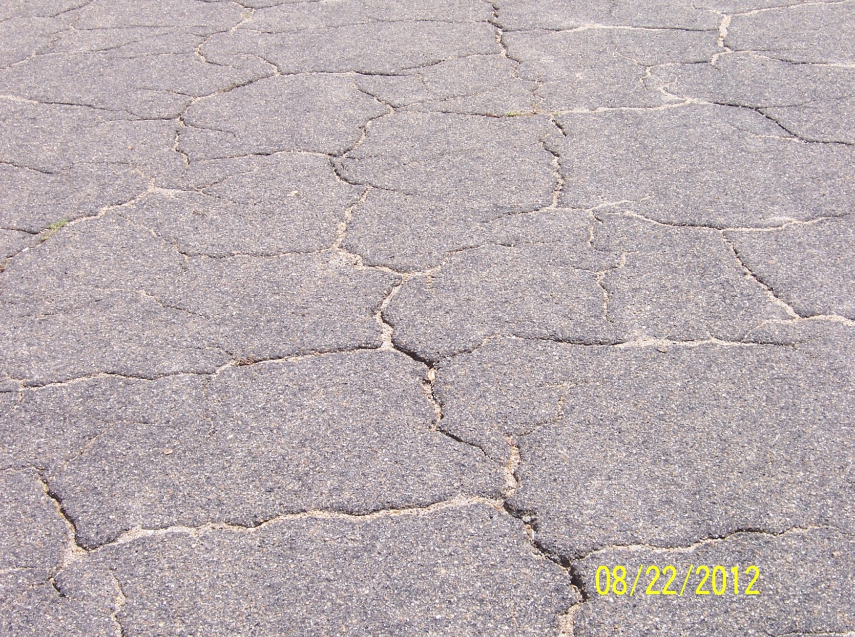
Impervious Surface?

Slide 99
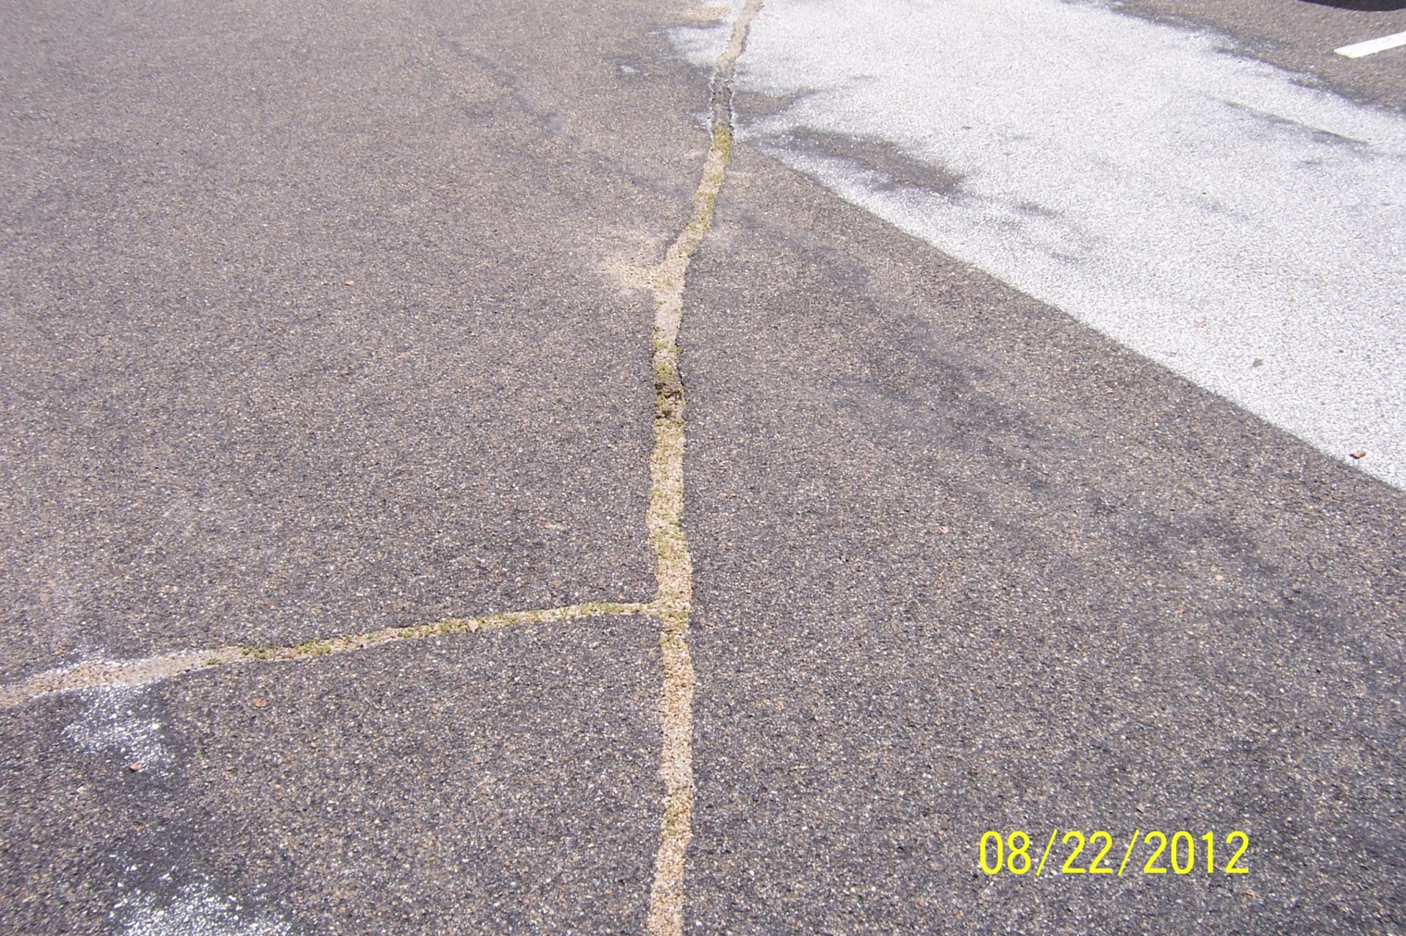
Impervious Surface?

Slide 100
Things To Remember
Proposal For Closures Must Address Both Soil and Ground Water
Use All Risk Based Tools Available For Soil
Engineering Controls Are Required To:
  Be Identified on a Professional Land Survey (PLS)
  Be Certified By A Professional Engineer
  Have an Engineering Control Maintenance Plan

Slide 101
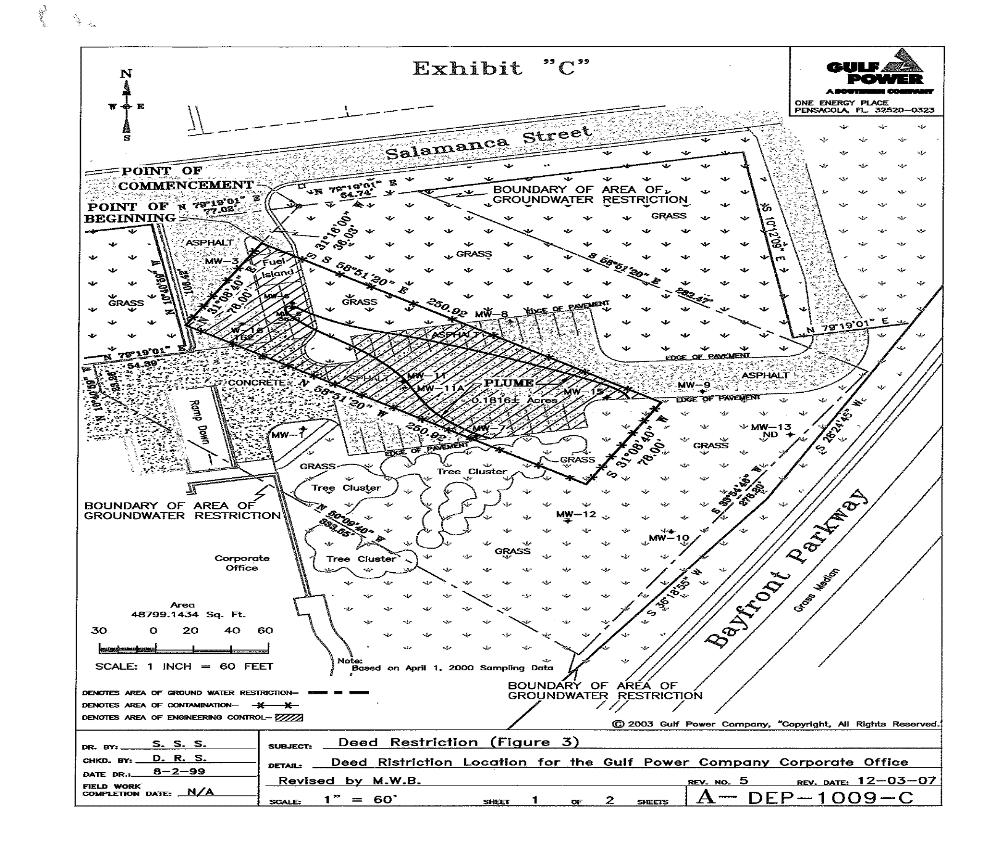
Deed Restrictions

Slide 102

Questions?

Slide 103
Low-Scored Site Initiative (LSSI)
    What is the LSSI?
Legislation created to assess low-scored sites:
  Provided a new closure option (LSSI NFA)
  Voluntary Program
  For Sites scored <29 (up from 10 originally)
  $10M per year funding limit
    Capped at $30,000 per site
    No more than 10 sites per year per owner/RP
What’s in it for the FDEP?
  Advanced closure
  Identify imminent threat sites
  Very low cost per site
  Estimate Future Funding Liability to IPTF

Slide 104
LSSI REQUIREMENTS
Score 29 or less
No “excessively contaminated” soil
Plume is shrinking or stable
No adverse effects on surface water
GW plume less than ¼ acre
Plume confined to source property
Top 2’ soil below SCTLs or have controls
  If controls not put in place (DEP does not pay), then does not qualify for LSSI NFAC

Slide 105
What’s New with LSSI?
Competitive Procurement
  Property owners and RPs may designate:
    An Agency Term Contractor
    Selection via competitive procurement
    A qualified contractor of their choice
      Best value to state
Property owners & RPs must be willing to accept LSSI NFA as a closure option in order to receive funding

Slide 106
LSSI OUTCOMES
SRCO
  If “clean”
LSSI NFA
  If “minimally contaminated” below 2’
LSSI NFAC
  If “minimally contaminated” in top 2’
Parked
  Back in line
  But extent/cost & cleanup technology estimated & documented

Slide 107
LSSI Status (Completed Assessments)
184 SRCOs (25%)
    Ave. Cost = $22,000
15 LSSI NFAs (2%)
    Ave. Cost = $28,000
525 sites returned to priority order (73%)
    Ave. Cost = $14,000

Slide 108
Questions
Diane Pickett, P.G.
850-245-8893
diane.pickett@dep.state.fl.us

Slide 109
Institutional Control Approval Process
IC Process
and
FDOT/FDEP MOU Update
John F. Wright, P.E.
Petroleum Restoration Program
Cleanup Team 1

Slide 110
Institutional Control Procedures Guidance
Latest Version November 2013
Routing/Review Procedures
Sample Restrictive Covenants:
  Form A – When IC Applies to Entire Property
  Form B – When IC Applies To A Portion of Property
Restrictive Covenant Checklist

Slide 111
When Is An Institutional Control Needed?
To Make Sure An Engineering Control Is Identified and Maintained
Any Time a Ground Water Use Restriction Is Needed
Any Time a Land Use Restriction Is Needed

Slide 112
Institutional Control Package
Ground Water Plume
  Stable or Shrinking ?
  Contained Within Property?
  Less Than ¼ Acre?
  Low Yield/Poor Quality Aquifer?
  Is there an IC for GW
  Are there SW Swales

Slide 113
Institutional Control Package
Does Soil Exceed Direct Exposure?
  Residential or Industrial /Commercial
  Is An Engineering Control proposed?
  Was TRPH Fractionation or Used
  Was the 95% UCL Average Used
Does Soil Exceed Leachability
  Was SPLP or TCLP or Site Specific Soil Properties Used to Determine Alternative Target Levels?
  Is an EC that prevents infiltration Proposed
  Has the Soil been Exposed to the Elements and it has been Demonstrated that there is No Leaching?

Slide 114
Institutional Control Package
Does the Restriction Cover A portion of The Property or the Entire Property?
Is a Copy of Deed Provided?
Is a Legal Description Provided for the Restricted Area?
If A Portion of the Property Is restricted has a Survey been Provided”
Is A Title Search Included?

Slide 115
Institutional Control Process
Recommendation From Contractor For NFAC
FDEP/LP Technical Review
  Review of Soil and Ground Water Data
  Recommended Site Restrictions
IC Package Is Submitted With Draft RC
Property Owner Publishes Notice of FDEPs Intent Use of Institutional Control or Engineering Control
OGC Review/Comments/Response
RC Signed By Property Owner and DEP
RC Recorded and Proof Provided
SRCO Issued

Slide 116
Chapter 376, F.S.
  From Chapter 376, F.S. “Site rehabilitation programs may include the use of institutional or engineering controls to eliminate the potential exposure to petroleum products’ chemicals of concern to humans or the environment. Use of such controls must be preapproved by the Department, and institutional controls shall not be acquired with funds from the Inland Protection Trust Fund.”

Slide 117
What Can We Pay For?
Technical Evaluation of Closure Options:
  Evaluation of Restrictions Required
  Evaluating An Existing Engineering Control
Professional Land Survey
Design and Installation of An Engineering Control
Professional Engineering Certification of Sufficiency of an Engineer Control
Engineering Control Maintenance Plan

Slide 118
What Can We Not We Pay For?
  Legal Fees
  Title Work
  Notices

Slide 119
Most Common Problems
Engineering Control Not Surveyed or Not Certified
Engineering Control Maintenance Plan Not Prepared
No Proof of Notice of FDEPs Intent To Use Institutional Engineering Control
Title Search Missing or Out of Date

Slide 120
Engineering Control Maintenance Plan
Should Include Maintenance and Inspection Requirements
Describes Conditions That Constitute a Failure of the Engineering Control

Slide 121
Engineering Control Maintenance Plan
Reporting of Routine Inspection Results Is Not Required
Any Failure of The Engineering Control Must Be Repaired Immediately
Failure of an Engineering Control Designed To Prevent Migration of Ground Water Must Be Reported and Repaired Immediately

Slide 122
Institutional Control Registry
GIS Data-Base/On-Line Tracking
  Facility, Date, and Location
  Engineering/Engineering Control Type
  Describes the Contamination
Instructions and Data Dictionary Are On-line

Slide 123
FDOT/FDEP MOU – The Latest
Meeting In November 2013 to Discuss FDEPs Initial Draft MOU
Mid-November Received Revised Draft Prepared By FDOT
Mid-December Discussed Technical Issues With Northeast District, Northwest District, and Waste Cleanup Program Staff
Late January A Revised Draft Was Sent to FDOT
Tele-Conference Planned Mid February To Finalize Draft

Slide 124
MOU Summary
Sets Up a Process to Allow Risk Based Closures For Discharges With Contamination in The FDOT’s Right of Way (ROW)
Takes Advantage of the inherent “Barriers To Exposure” Provided by the FDOT’s Management of the ROW
  Physical Barriers, i.e., road pavement, clean fill
  Administrative Barriers, i.e., FDOT’s permitting process that is designed to control all activities in the ROW

Slide 125
Process In Draft MOU
FDEP determines That Site Conditions Allow a RMO II or RMO III Closure For the Discharge
FDEP Presents A Proposal For a Alternative Institutional Control Which Includes:
  Summary of Ground Water and/or Soil Data
  Legal Description and Survey of the Extent Of Contamination
  A ROW Map Showing the Contamination
  Draft Property Transfer Agreement Language Listing any Restrictions, i.e. ground water use or ECs

Slide 126
Other Issues
What Happens If FDOT Transfers the Property?
  FDOT ROW Are Typically Only Transferred To Local Government
  Restrictions Will Go With the Property
What Happens If Additional Cleanup Is Required?
  FDEP Agrees to Provide Funding for Additional Work
The MOU Is Still Draft and Subject To Change

Slide 127

QUESTIONS

Slide 128
Petroleum Restoration Program
Closure Sampling
Division of Waste Management
PETROLEUM RESTORATION PROGRAM
Closure Sampling
Diane Pickett, Chief Geologist
February 12, 2014

Slide 129
Closure Sampling
Do all MWs need to be sampled to obtain closure?
Set up a “monitoring network” with representative sampling locations
NAM/PARM Plan for funded sites:
  Can be formal NAM/PARM Plan or simply documented in a deliverable review letter.
  List network MWs that must be part of monitoring
    Plus list any additional MWs that must be sampled to obtain a closure order.

Slide 130
Closure Sampling
How many sampling events?
If site had Active RA (other than Interim Soil SR)
If site had Interim Soil SR
If site did not have RA, only assessment
If site did not have lab-verified contamination (EDI?)

Slide 131
Closure Sampling
How many sampling events?
If site had Active RA (other than Interim Soil SR per 62-780.500)
  Need a minimum of 4 qtrs monitoring
  Last 2 must be clean (have achieved CTLs)
    If CTLs not achieved, stop PARM unless:
      Rebound? Reconsider system startup, or
      Closure expected after 1 more quarter
    Otherwise, move site to NAM
      With longer sampling frequency
  For Chem or Bio RA applications
    Start 4 qtrs after amendments inactive

Slide 132
Closure Sampling
How many sampling events?
If site had Interim Soil SR per 62-780.500 or short-term GW recovery
  Need a minimum of 2 qtrs monitoring if GW contamination was present before SR, or
  One sampling event if GW contamination was not present before SR

Slide 133
Closure Sampling
How many sampling events?
If site did not have RA (or no active RA for 2 yrs), only assessment:
  Need 2 consecutive clean monitoring events
  If site did not have lab-verified contamination (EDI?)
    Only need one sampling event
    Unless site-specific conditions….
  Additional sampling at professional discretion of DEP

Slide 134
Closure Sampling
What do I sample for?
Table C- Petroleum COCs
  No more unless site-specific reason
    e.g.- oxygenates as part of a forensic investigation of eligibility…
  Can do less than Table C
    if anticipated to be NFA
      Can limit to BTEX, PAH (TRPH if KAG suspected)
    If Active RA not needed
      Evaluate need for VOHs
Remove individual analyticals from future sampling once demonstrated to not be present
  If in NAM/PARM
    maintain for year, then eliminate after 2 consecutive <CTL events

Slide 135
Questions?
Diane Pickett, P.G.
850-245-8893
diane.pickett@dep.state.fl.us

Slide 136
Cost Share Cleanup Programs
PACs – Pre-approved Advanced Cleanup Program
PCPPs – Petroleum Cleanup Participation Program
SRFAs – Site Rehabilitation Funding Allocation

Slide 137
PACs
The PAC is a cleanup program to provide an opportunity for Owners/Responsible Parties to conduct site rehabilitation activities on a limited basis at contaminated sites, in advance of a site’s priority ranking, to facilitate property transactions or public works projects.
Site Owners/RPs must pay a minimum cost share of 25%
PAC programs must be planned thru site cleanup (NFAs w/conditions or SRCOs)
Maximum State Funding - $5,000,000
PACs have up to two (2) application periods per year.
November 1 thru December 31
May 1 thru June 30.

Slide 138
PACs (cont.)
A PAC Application Requires the following:
A completed PAC application form
A nonrefundable review fee of $250
A Limited Contamination Assessment Report (LCAR); and
A proposed course of action with estimated costs and schedule thru cleanup.
Section 376.30713, F.S.

Slide 139
PACs (cont.)
December 31, 2013 PAC Applications
13 Applicants
Score Ranges - 10 to 36
Cost Share Percentages – 25.1% to 55%
Estimated Cleanup Amount - $3,437,329
State’s cost share - $1,874,518.18

Slide 140
Next PAC Application Period
May 1st to June 30th, 2014
Available Funding – at least $5,000,000

Slide 141
PCPPs
PCPP is a cost-sharing clean-up program that provides rehabilitation funding assistance to owners/RPs for property currently contaminated by a petroleum discharge from a storage system occurring before January 1, 1995.
Sites are Ranked based on human health and safety risks.
When funds are available, the DEP notifies owner.

Slide 142
PCPPs (cont.)
The PCPP Program Agreement requires:
Owner/RP will provide a 25% copayment (unless financial inability to pay can be established).
Owner must pay for the LCAR which must be reviewed and approved by the Department.
Owners/RPs of sites in the EDI, ATRP, or PLRIP programs, who have not already completed site cleanup may participate.

Slide 143
SRFA
A SRFA is a legal agreement between the Department and the SRFA Applicant (RP for a non-program discharge) which establishes specific cleanup responsibilities for the discharges in the SRFA, including concurrent cleanup, to an endpoint which is generally an issuance of an SRCO.
A SRFA requires:
A state funded program eligible discharge or a non-program discharge that occurred after 12/31/1998.
Completed SRFA application.
LCAR submitted by the SRFA applicant.

Slide 144
SRFA
Types of SRFA’s:
Cost Share Agreement.
Milestone Payment Agreement.
Lump Sum Payment.
All SRFA Agreements are unique.
Site Manager must read and understand the SRFA Agreement.

Slide 145
SRFA
SRFA Rejection Letters are issued for:
  Non-Program minimal discharge where there was no significant impacts on the State’s cleanup costs
  Discharges are sufficiently separate and distinct.

Slide 146
SRFA Agreements
Legal agreement between the Department, and the SRFA Applicant and possible other parties (property owner).
Establishes the cleanup responsibility.
Combines discharges for cleanup activities.
Endpoint is generally an SRCO.

Slide 147
Questions Regarding SRFAs
SRFA REVIEW STAFF
  Lewis J. Cornman, Jr., SRFA Administrator
    850/245-8846
    email - Lewis.Cornman@dep.state.fl.us
  Bill Newmyer, SRFA PG Reviewer
    850/877-1133 extension 3718
    email – wnewmyer@ene.com
  Blake Miller, SRFA Reviewer
    850/877-1133 extension 3715
    email – bmiller@ene.com

Slide 148
QUESTONS

Slide 149
Assessing With Purpose
Question 1 – Is there any petroleum Contamination?
What are the potential sources –
Tanks?
Piping?
Dispensers?
Fill Ports?
Question 2 – What is the type and quantity of the contamination?
Free product?
Soil source?
Groundwater Dissolved Component?
Gasoline, Diesel, Waste Oil, Mixed?
Question 3 – What are the concentrations of the contamination?
Very elevated concentrations?
Below natural attenuation levels?
Question 4 – How deep does the contamination go?
Just in soil?
Surficial or water table aquifer?
Deeper aquifer?
Question 5 – Does the contamination go offsite?
IF yes, procure offsite access

Slide 150
Field Inspection Manual
Appendix A
DEP SOP FS 3000 Soil Sample Collection
BPSS SOP PCS-004; October 1,2001 Soil Assessment and Sampling Methods for Petroleum Storage System Sites.
SPLP Procedures for Petroleum-Contaminated Sites Memo, March 8, 2010
Appendix B
BPSS SOP PCS-006; May 2, 2005 Design, Installation and Placement of Monitoring Wells
Appendix C
DEP SOP FS 2200 Groundwater Sampling
BPSS SOP PCS-005; May 2, 2005 Groundwater Sampling SOPs, Variances and Clarifications for BPSS Sites.

Slide 151
Field Inspection
Office Preparation
Current site map
Soil and Groundwater Tables
Soil and Groundwater Plume Maps
Groundwater Elevation Tables
Groundwater Contour Map
General Monitoring Well Construction Details

Slide 152
Field Inspection
Surface Covering
Walk about the site.
Note: surface covering (concrete, asphalt, grass or gravel)
Power poles, buildings, Canopies/Overhangs
Note: Photographs are very important, particularly areas of broken or subsiding pavement, damaged structures, etc.

Slide 153
Field Inspection
Underground Utilities (water, sewer, gas, telephone, fiber optics, electric, storm drains, etc.)
Call Sunshine 811, 48 hrs before drilling.
Above Ground Utilities and other Overhead Obstructions (power lines, telephone, cable lines, tree limbs, canopies,etc.)
Can affect where drilling can take place.

Slide 154
Field Inspection
Petroleum Storage Tanks, Piping, and Electric Lines
As built drawings
Visual surface indications
Talk to Facility Manager

Slide 155
Field Inspection
What is around the site?
Other Gasoline Stations
Dry Cleaning Operations
RCRA Small Quantity Generators
Basements
FDOH Potable Well Survey
Other Potable Wells

Slide 156
Field Inspection
Soil Assessment
Purpose and Goal of the Soil Assessment
All Potential Source Areas Assessed
Lithology
Depth to Vadose Zone and Water Table
Travel Pathways
Is Contamination going Off-site

Slide 157
Field Inspection
Groundwater Assessment
Purpose and Goal of the GW Assessment
Delineate Free Product and Dissolved Phase areas
Vertical Extent of Contaminant Plume
Travel Pathways
GW Elevation and Flow Direction
Is Contamination going Off-site

Slide 158
COMMUNICATION
Pre-Discussion before Site Inspection with Site Manager.
Friendly but informative discussions with Contractor Field Supervisor
Communications between Inspector, Site Manager and Field Supervisor if problems or issues arise.
Will Result in better Management Control and Informative Field Inspection Report

Slide 159
QUESTIONS

Slide 160
Remediation
Purpose, Strategy and Role
of the
Site & RA Systems Inspector

Slide 161
PURPOSE
The Purpose for the Site & RA Inspections is to ensure the systems are running at optimum efficiency levels as presented in the approved RAP, LSRAP or RAPMOD.

Slide 162
COMMUNICATION
Meetings between:
  Contractor
  Site Manager
  PE
  Inspector
To determine:
  What changes need to be made to system
  Is a RAP modification necessary
  Is the system is ineffective and another course of action entirely is encouraged to achieve closure at the site.

Slide 163
STRATEGY
Inspect the Site and RA Systems
Provide real time feedback on site conditions to Site Managers and Contractors
Take appropriate actions at their sites.

Slide 164
THE INSPECTION PROGRAM WILL
Document and report systems that are off-line or not operating properly which facilitates faster problem resolution and higher system run times.
Confirm that corrective actions are being implemented in a timely manner by contractors.
Reporting of health and safety related issues to contractors and site managers which minimizes program risk.
Maintains a presence in the field to observe contractor performance to confirm compliance with SOP guidance.
Teams would then provide justification to the Program Administrator:
  For continued operation of these systems along with anticipated cost projections to do so
  Recommend discontinuing operation taking into consideration PARM or Long Term NAM procedures.

Slide 165
Remediation
Systems & Equipment

Slide 166
SYSTEMS INSPECTIONS
Document everything!
Have a Site Plan & AS-builts!
Is there a Site Health & Safety Plan?
Is the compound secure or damaged?
Is there good housekeeping?
Is the equipment operating?
Are wells easily located, is the site map correct?
Any innovative Engineering repairs?
Any bare / burnt / exposed wiring?
Any strange noises, or odors?
Check control panel for anything out of the ordinary.
Are wells secure, are well caps secured?

Slide 167
What Makes Up a “System”
Major Components
  Pumps, Blowers, Treatment Equipment, AWS, OWS
Minor Components
  Controllers, Switches, Meters

Slide 168
What Type of Systems Require Remedial Equipment
Pump and Treat
Soil Vapor Extraction
Air Sparge
Others – only require minimal components
  Biological Injections
  Chemical Injection
  Gas Injection

Slide 169
Systems
Ground Water
Pump and Treat
Traditional
Vacuum enhanced
Multiphase/Dual phase

Slide 170
Systems
Extraction Pumps for
Ground Water Recovery
Electric Submersible
Pneumatic
Centrifugal
Jet
Liquid Sealed

Slide 171
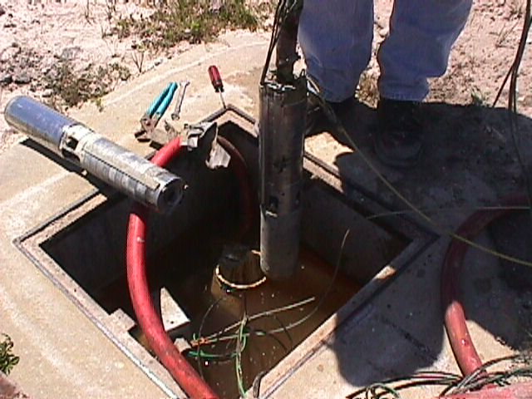
Electric Submersible Extraction Pump

Slide 172

Electric Submersible

Slide 173
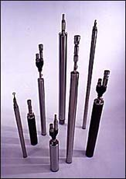
Pneumatic – Submersible
Photo Courtesy Clean Environment Equipment

Slide 174
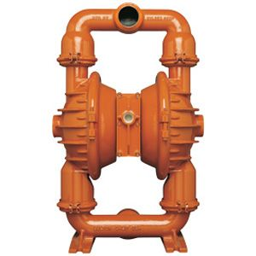
Pneumatic –Double Diaphragm

Slide 175
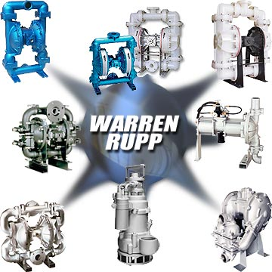
Diaphragm Pumps

Slide 176
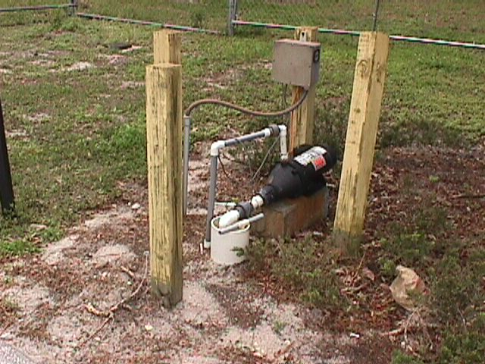
Surface Centrifugal Pumps

Slide 177
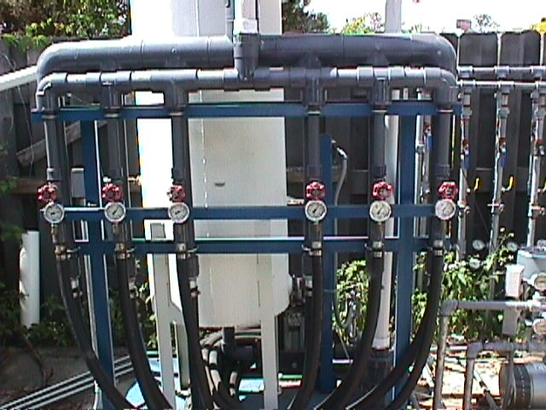
Jet Pump

Slide 178
Systems
Multiphase/Dual Phase
Single Pump Extracting: Product,
Ground Water, and Soil Vapors

Slide 179
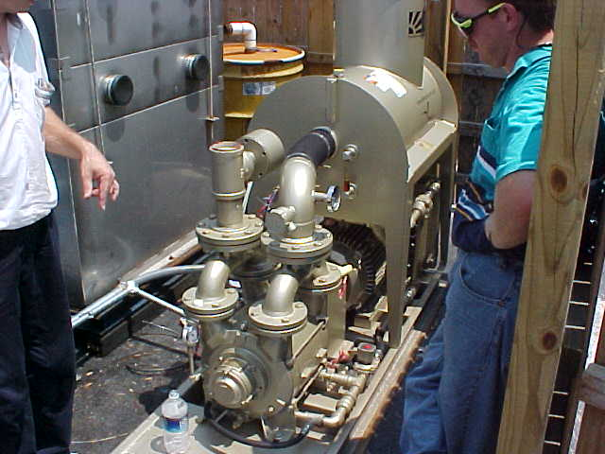
Systems
Oil Sealed

Slide 180
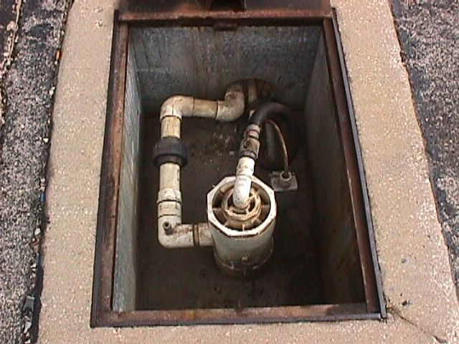
Systems
Electric Submersible Pumps with Vapor Extraction at the Well Head
(aka Dual Phase)

Slide 181
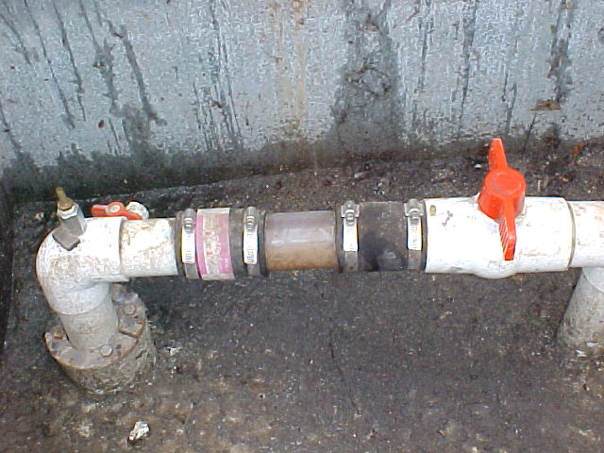
Systems
Typical MPX Well Head

Slide 182
Ground Water Treatment - Air Strippers
Air Stripping Tower
Tray Stripper
Diffused Aerator

Slide 183
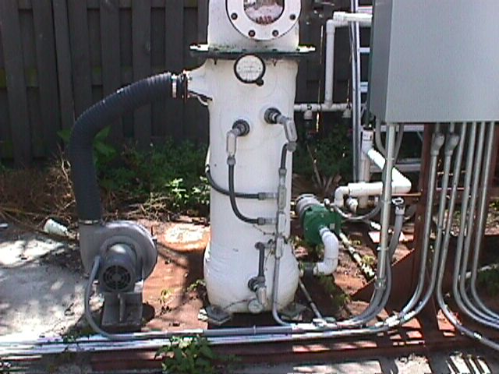
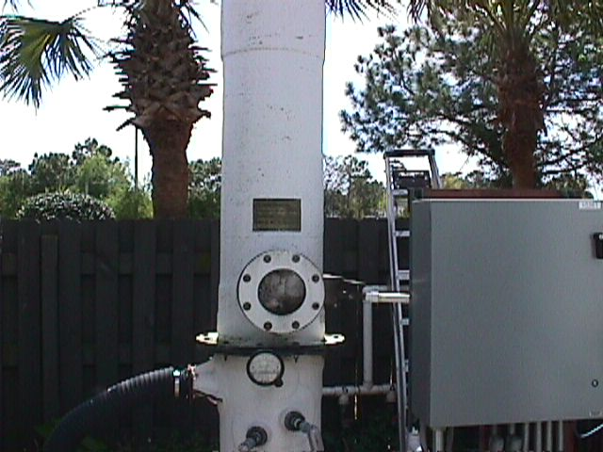
Air Stripping Tower

Slide 184
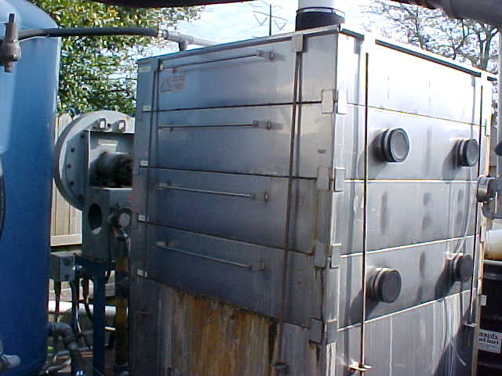
Stacked Tray

Slide 185
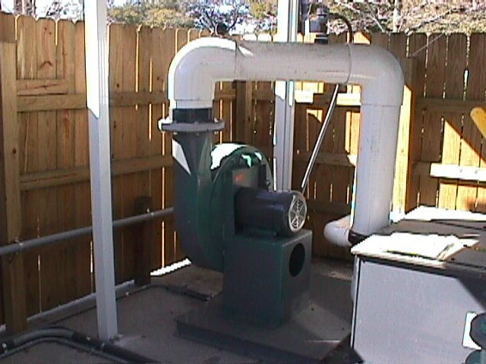
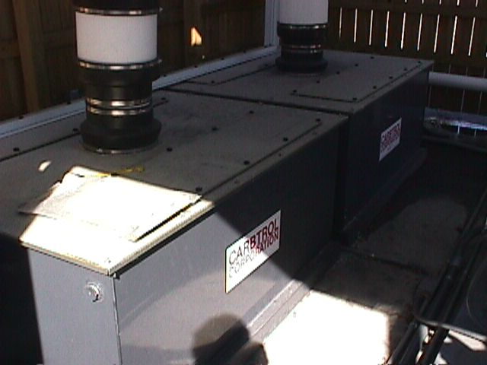
Diffused

Slide 186
Minor Components
Flow Meters
Level Switches
OWS
Transfer Pumps
Disposal Monitoring
  Flow
  NPDES

Slide 187
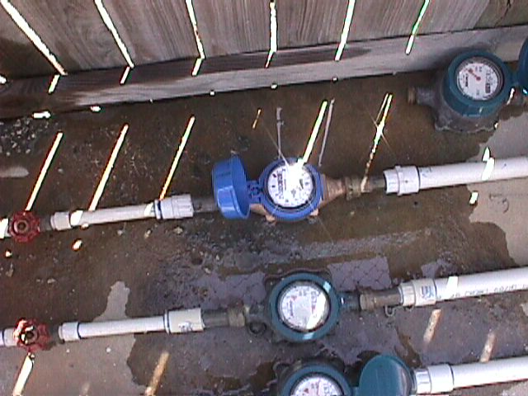
Flow Meters

Slide 188
Transfer Pumps
Progressive Cavity
Centrifugal

Slide 189
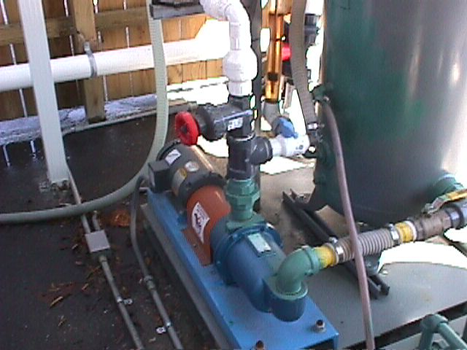
Progressive Cavity

Slide 190
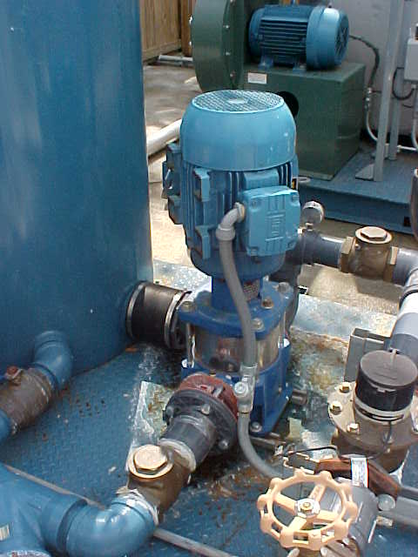
Multi Stage

Slide 191
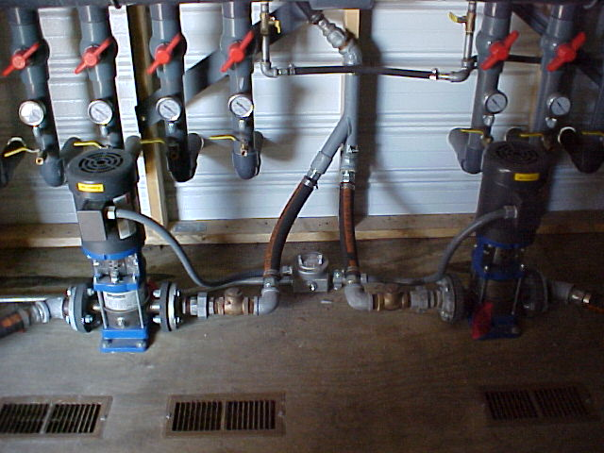
Multi Stage

Slide 192

Level Controls

Slide 193

Level Controls

Slide 194

Another Configuration

Slide 195

OWS

Slide 196
Soil Vapor Extraction
  Major Components
    Vacuum Blower
    Air treatment
      Carbon
      Oxidizer
        Thermal
        Catalytic

Slide 197
Blowers
Regenerative
  Low Vacuum
  High Flow
Positive Displacement
  Medium Vacuum
  Medium Flow
Centrifugal

Slide 198

Typical Regenerative Blower

Slide 199

Dual System

Slide 200

Typical PD Blower
PD- Positive Displacement

Slide 201

Another View

Slide 202

Once more

Slide 203

Centrifugal

Slide 204
Off-gas Treatment
Carbon
    Efficient for Low Hydrocarbon Loading
Oxidizer
  Catalytic
    High Electric Cost
  Thermal
    High Fuel Cost

Slide 205

Carbon Canisters

Slide 206

Carbon comes in all sizes
Photo Courtesy of Carbtrol Corp.

Slide 207

Catalytic Oxidizer
Photo Courtesy of HiTemp

Slide 208

Thermal Oxidizer
Photo Courtesy of HiTemp

Slide 209
Minor Components
Flow Meters
Inlet Filters
Silencers
AWS
  Level Controls
  Transfer Pumps

Slide 210
Flow Meters
Direct Read
Differential Pressure

Slide 211

Direct Read

Slide 212

Rotometer Style

Slide 213

Differential Pressure

Slide 214

Differential Pressure

Slide 215
Inlet Filter, Silencer

Slide 216
Air Sparging
Major Components
  Compressor
Minor Components
  Flow Meters
  Pressure Regulators
  Moisture Separator
  Particulate Filter/Oil Filter
  Pressure Relief Valve

Slide 217
Air Sparge Compressors
Rotary Vane
Rotary Lobe
Rotary Screw
Rotary Claw
Reciprocating

Slide 218

Air Sparge System

Slide 219

Small AS Compressor

Slide 220

Larger AS Compressor

Slide 221

Very Large AS Compressor

Slide 222

Air sparge manifold

Slide 223

Rotometer Style

Slide 224
Others
Bio/Chem injection
  Microbes Injected
  Nutrients Injected
  Oxidizing Agents Injected

Slide 225
Biological
Biological remediation consists of one form or another that enhances the microbial degradation of the petroleum contaminants by either:
Bio-augmentation
  Adds microbes to the environment
    Increase populations
    Increase species
Bio-stimulation
  Stimulates the existing microbes
    Reduce limiting factors
      Nutrients
      Contaminant contact

Slide 226

Biological Injections

Slide 227
Chemical
Chemical remediation consists of one form or another that introduces chemicals into the subsurface to chemically degrade the contaminants, such as:
Peroxide
Permanganate
Fenton's (iron & peroxide)

Slide 228

Chemical Injection

Slide 229
Remedial Systems
Can’t Find Information About A Piece of Equipment or Process
Check the Web.
Most Manufacturers Have A Web Site

Slide 230
Questions???

Slide 231
PROFESSIONAL ENGINEER
ROUND TABLE DISCUSSION
REMEDIATION

