Slide 1
PRP Purchase Order
Request For Change (RFC)
Forms and Change Orders
Contractor Training
August 6, 2014

Slide 2

Change Orders
Use them judiciously, as we have limited staff resources and are simultaneously preparing new Purchase Requisitions on a weekly basis…….

Slide 3
Is Your RFC
-REASONABLE-
Would the Site Manager normally allow a change order for this type of request?
-NECESSARY-
Will the request aid the Department in its site goals (HINT: is it required to complete the work)?
-ALLOWABLE-
Does it meet current DEP ATC terms?

Slide 4
RFC vs Change Order
The Contractor/Site Manager submits a RFC form and all appropriate documentation (e.g., revised SOW, SPI)
Approved RFCs are sent by the Team AA to PRP.ChangeOrder@dep.state.fl.us
RFC is entered in MyFloridaMarketPlace (MFMP) as a version of the original Purchase Requisition (PR)
Goes through the regular PR approval process
Becomes an approved Change Order (CO) when the Revised Purchase Order is issued
  RFC PR-V2 CO/PO

Slide 5
What Is Allowable?
Cost item included in the specific ATC contract
Contractors may have different rates in each contract region (North, Central, South)
The Contractor CANNOT exceed his/her contracted rates, although lower rates are acceptable, based upon negotiation
The ATC Contract number is the first three digits of the task assignment (for example: 999-001A = GC999) this Contract establishes the rate schedule ceiling amounts
Be aware that DEP may amend the original ATC contract—you can find the most recent version in FACTS (web address provided at the end of this presentation)

Slide 6

You’re ready to submit a RFC form for your Purchase Order. Here’s a list of what you’ll need:
RFC Form, initiated by the Contractor or Site Manager
All required quote documentation
Contractor rates for all types of line items (refer to the original SPI-Rates unit tab or FACTS)
Revised documents (SOW and/or SPI)
Future proposed change - Original Purchase Requisition Number (PR) to be included, because all change orders are associated with this number: PRXXXXXXX-V2, etc.

Slide 7
Quotes
Sometimes, you may need miscellaneous items not included in the SPI-----you will need quotes for items such as carbon filters, etc.
  X > $2,500, you’ll need to attach a minimum of 3 written quotes - please combine all quotes into one pdf attachment
  X ≤ $2,500, you will need 1 written quote
  Quoted items cannot be divided to avoid the quote requirements of the ATC
  If quote involves item of proprietary nature, only 1 quote is needed (plus justification for the basis for the claim of proprietary and the need for the proprietary cost item)

Slide 8
RFC Numbering and Attachment Revisions
V represents version number
PRXXXXXXX-V2 is the first RFC
PRXXXXXXX-V3 is the second RFC, and so on
  Note: DEP may initiate a change where a formal RFC is not processed that will cause the V# to change without an attached RFC (for example, change in Site Manager in MFMP – a comment with phone/email should be included on the PR for the Contractor to see)
If the SOW is updated for technical reasons, you must attach a revised version of it (e.g., Attachment A - Revision 1)
If the rate sheet/SPI is updated, you must attach a revised version of it (e.g., Attachment B – Revision 1)
PRP Contracts will make visible only the most recent versions of these attachments to the PR

Slide 9
Example Situations Requiring Change Orders
Scope of Work changes
Additional quantity/cost items not included in the PO
Due date extensions
Administrative needs
Change in site manager

Slide 10
Where Do I Find The PR Number?
Open up your original Purchase Order
You will find the PR Number immediately above it, listed as ReqID
Example: ReqID: PR8114945
It will appear as a hotlink, meaning you can open it up to access/view the original PR

Slide 11
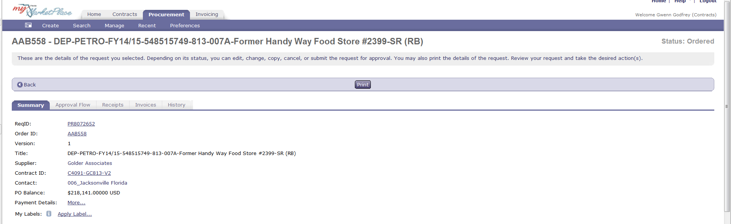
Example PR

Slide 12
Where Do I Find The New RFC Form?
http://www.floridadep.gov/waste/petroleum-restoration/content/templates-forms-tools-and-guidance
Located On the Templates Webpage, under the heading “Agency Term Contract Forms”

Slide 13
WHERE DO I SEND THE RFC FORM?
    A Contractor should send it to the Site Manager, who will then forward it for approval. When approved, the Team AAs will send all RFCs to:
PRP.ChangeOrder@dep.state.fl.us
This is a new email address!!! Please do not send other correspondence to this address, such as invoices or discussion threads.

Slide 14
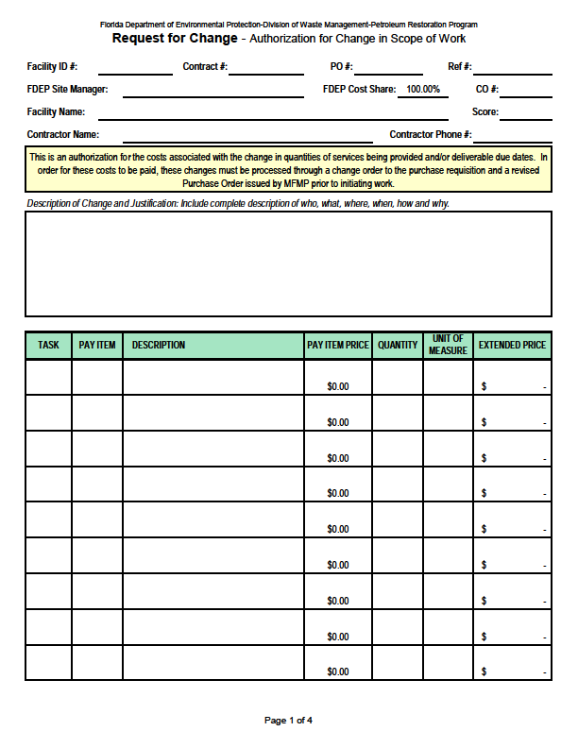
Your New & Improved RFC Form

Slide 15
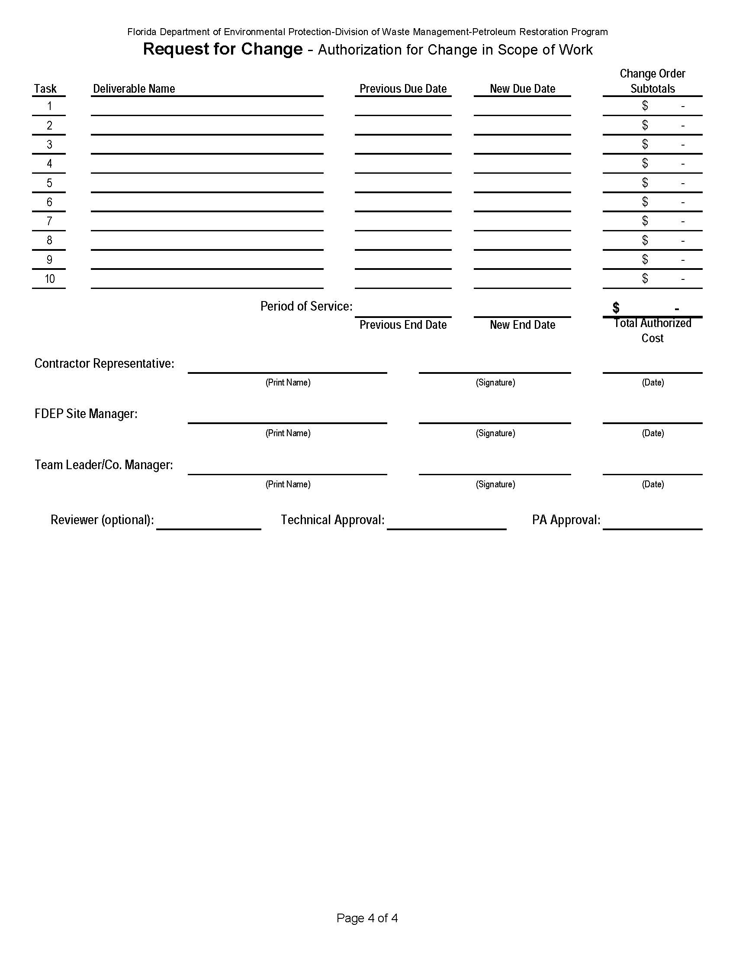
Example 2nd Half of RFC Form

Slide 16
New Version of RFC Form!
Additional column added for Task number
Drop-down menus for Task and Unit of Measure columns
Additional rows added to facilitate larger change orders with multiple items
Requested task due date and subtotal changes added to show total changes per task
You can also alter due dates and end of period of service dates, as needed-cannot alter beginning of service date
A “Hide Rows” macro will hide any unused rows or tasks

Slide 17
Attachments to Your Change Order
Attachment B (Revision 2) - Schedule of Pay Items & Other Related Documents – 2685XXXXX.xls
PO A9DXXX - CO #1, Tk 1 - Old County Store.pdf

Slide 18
Example Change Order Language In the PR-V2, etc.
Found in the comments section of the PR:
“Change Order #2 is attached hereto and made a part of this Purchase Order to add groundwater lab analysis. The total increase to this Purchase order for this change order is $230.00 (new Purchase Order total is $8,866.96)
Attachment B (Revision 2) is attached hereto and made a part of this Purchase Order to replace Attachment B (Revision 1).
All other terms and conditions of the PO remain unchanged.”

Slide 19
Reminders
Are the following correct:
Contractor’s rates? (see 2nd tab of SPI or FACTS for a complete list of rates)
Unit rate/quantity/unit measure/extended price?
Increases/Reductions to SPI appropriately addressed?
PRP Reference Number?
FAC ID and name? (should match PO info)
PO #?
Task #?
RFC #? (some sites have multiple RFCs)
Rate sheet line #?
Description complete and accurate?

Slide 20

Date Extension/No-Cost RFC Forms
RFC forms for date extensions or other no-cost changes to the Purchase Order DO NOT need to be approved by the Program Administrator
We are developing an expedited process for handling them

Slide 21
Confidential Business Information
All DEP contracts and associated documents for procurement of services under the PRP both under its Agency Term Contracts and otherwise, are public records.
If a Contractor believes that it cannot provide the information requested without divulging information which it asserts is and desires to remain as confidential – it should NOT RESPOND, and should immediately notify the Department that it cannot comply with the request.
The DEP has not requested, and will not accept materials which are marked or claimed to be exempt from the public records laws under its Task/Work Orders, Change Orders, or otherwise. The DEP will not review information claimed to be confidential or exempt from the public records law, and will not issue any contracts, purchase order or tasks assignments, based on them.

Slide 22
Confidentiality
BE ADVISED, submitting documents to the Department may waive any claim of confidentiality in such records. If the Department receives such unsolicited information, and a request is made for its disclosure, the burden will be on the submitting entity to obtain a court order prohibiting its disclosure, prior to the time in which the Department is otherwise obligated to disclose it. The Department cannot provide any assurance that you will be notified of receipt of such a request, or of an opportunity to obtain judicial relief prior to its disclosure.

Slide 23

An Important Note
At this time, we are not utilizing electronic signatures on the RFC. However, the Program may consider electronic signatures in the future, once a system is put in place to support their use.

Slide 24

Multiple Requests of Same RFC
Please refrain from sending the RFC form multiple times (unless you’re sending in a revision, then note it in your email and include “previously submitted on Mm/DD/YYYY”)

Slide 25
Common RFC Errors
  Incomplete and/or unclear forms and descriptions
  Incorrect PRP Reference Number (either task assignment XXX-XXXA or work order last five digits (XXXXA))
  Incorrect Contractor Number for that region
  Costs not adding up correctly (automated in new form)
  Missing documentation for reimbursable items
  Illegible handwriting and/or blurred printing
  Use of highlighter
  Our Goal: Clear, Accurate and Justifiable Request

Slide 26
Communication Is Essential
If the RFC has been altered in any way (e.g., costs, due dates) since originally signed by the Contractor, the Site Manager must have the Contractor
a) initial and date all changes, OR
b) attach an email with the RFC in which the Contractor clearly acknowledges and agrees with the specific changes made

Slide 27

A Few Housekeeping Notes..
If your Change Order included new deliverable due dates, the Site Manager should update the corresponding dates in STCM
The Site Manager should contact the Contractor regarding changes to the Purchase Order and verify that he/she received the Ariba notification.

Slide 28

SUCCESS!
When the change order is issued, the Site Manager will receive a notification from MFMP that “PRXXXXXXX-VX has been ordered”. The Contractor should also receive an email notification, if the Contractor has selected the email option in his/her registration, from Ariba (MFMP) at that time. The email notification will provide a hyperlink for the Contractor to sign into the system to view the revised PO and attachments.

Slide 29
Problem: I Never Received My PO/CO
There are several possible explanations:
  Chosen method of communication was via fax – transmission failure
  Designated email address was for a person no longer with the company
  Incorrect email address in MFMP Vendor
  Email notification delivered to Spam folder
  Email notification inadvertently deleted by user
  Suggestion: create an email address accessible by multiple people within the company. If your desired new email address differs from what is listed in your contract, then email our Contract Manager Martin.Ehlen@dep.state.fl.us with your request to amend it in the contract.

Slide 30
Useful Links
MFMP Vendor Website
http://www.dms.myflorida.com/business_operations/state_purchasing/myfloridamarketplace/mfmp_vendors
MFMP Vendor Bid System (VBS)
http://www.myflorida.com/apps/vbs/vbs_www.main_menu
MFMP Vendor Information Portal
https://vendor.myfloridamarketplace.com/vms-web/spring/login?execution=e1s1
MFMP Sourcing (for reviewing E-Quotes)
https://sourcing.myfloridamarketplace.com/Sourcing/Main/
MFMP Customer Service Desk Email:
VendorHelp@myfloridamarketplace.com or (866) 352-3776
FLORIDA Accountability Contract Tracking System (FACTS)
http://www.myfloridacfo.com/division/AA/FACTSReporting/

Slide 31

In Appreciation
Thank you for your patience and understanding as we navigate through a new system!!

Slide 32


Contact Information
  Please refer to your new PRP Contracts Group Point Of Contact Form for individual contact information

