Slide 1
PRP Purchase Order Invoice Processing
Sharon Lee - PRP Accounting
Lauren Mackey - PRP Accounting (York)
August 6, 2014

Slide 2
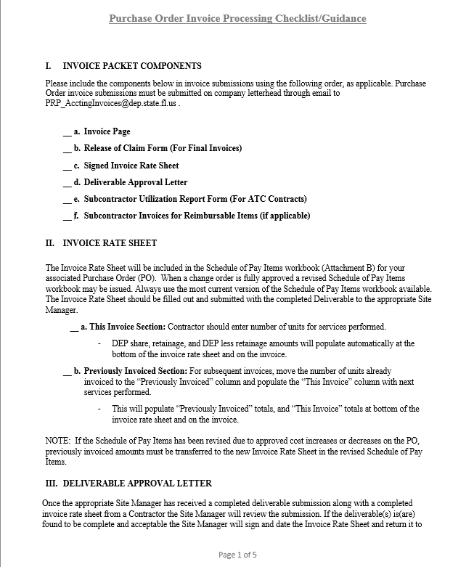

Purchase Order Invoice Processing Checklist/Guidance

Slide 3

Invoice Packet Components
Invoice Page
Release of Claim Form (For Final Invoices)
Signed Invoice Rate Sheet
Deliverable Approval Letter
Subcontractor Utilization Report Form (For ATC Contracts)
Subcontractor Invoices for Reimbursable Items (if applicable)

Slide 4
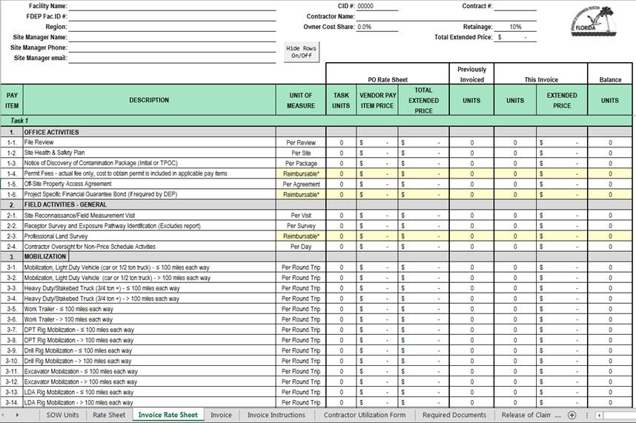
Schedule Of Pay Items – Invoice Rate Sheet Display
Rounding Display Screenshots

Slide 5
How To Complete An Invoice Rate Sheet
The Invoice Rate Sheet is filled out by the Contractor and submitted with the completed Deliverable to the appropriate Site Manager.
This Invoice Section: Contractor should enter number of units for services performed.
Previously Invoiced Section: For subsequent invoices, move the number of units already invoiced to the “Previously Invoiced” column.
Invoice Rate Sheet

Slide 6
Deliverable Approval Letter Components
Task(s)/Pay Items: Must name all tasks and/or pay items that are approved on the signed Invoice Rate Sheet (pay item(s) only needed if select item(s) from task are being billed rather than a complete task). Typos are not acceptable.
Approved Costs: Must state amount approved including retainage. Approved Costs must match the “DEP Cost Share” amount from the signed Invoice Rate Sheet or a corrected Invoice Rate Sheet is needed.
Deliverable Received Date: Must include dates on which deliverables were received by FDEP. Deliverable received date must be on or before the applicable deliverable due dates otherwise the deliverable approval letter should reference that the deliverable was late and what the appropriate financial consequence will be (i.e. forfeiting retainage, etc.).
Purchase Order #: 6 digit/character ID (i.e. AXXXXX). Typos are not acceptable.

Slide 7

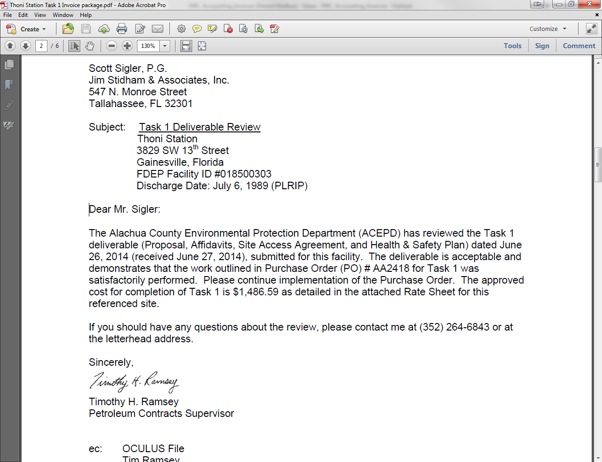
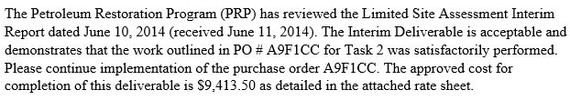
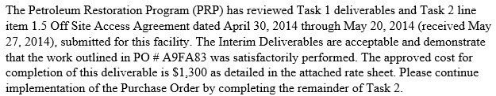
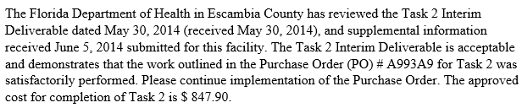
Deliverable Approval Letter Examples
If the deliverables are found to be complete and acceptable the Site Manager will sign and date the Invoice Rate Sheet and return it to the Contractor along with a Deliverable Approval Letter.

Slide 8
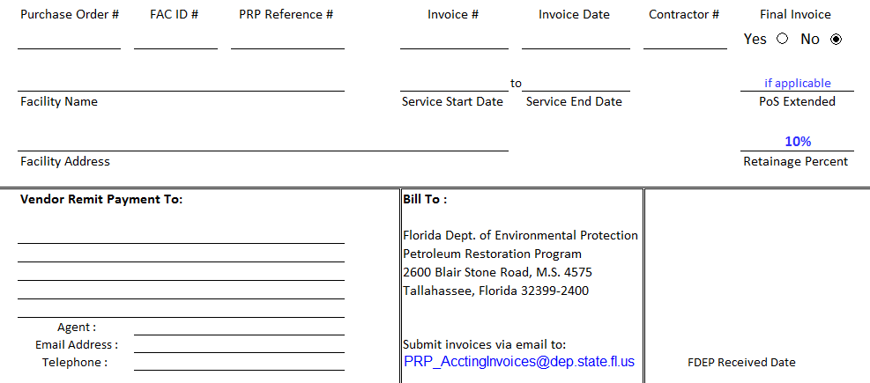
Completing The Invoice Page
The Invoice Page is included in the most current Schedule of Pay Items workbook (Attachment B).
Invoice Page

Slide 9
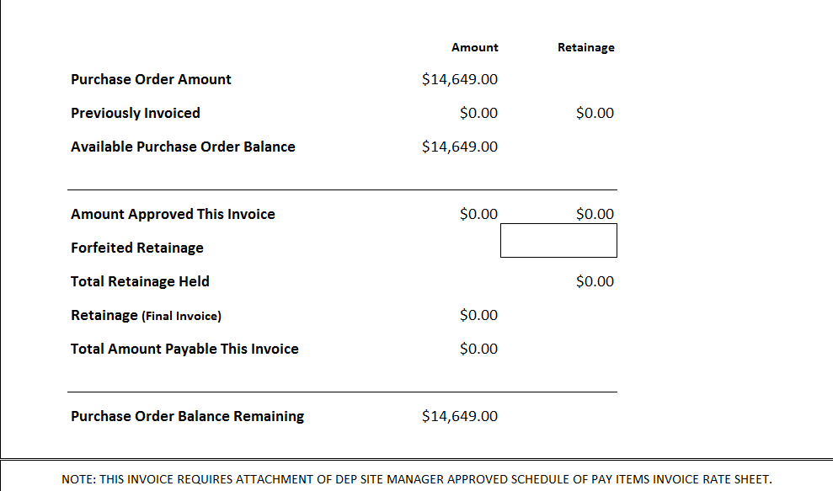

Invoice Page Amounts – What do they all mean ?
Invoice Page

Slide 10
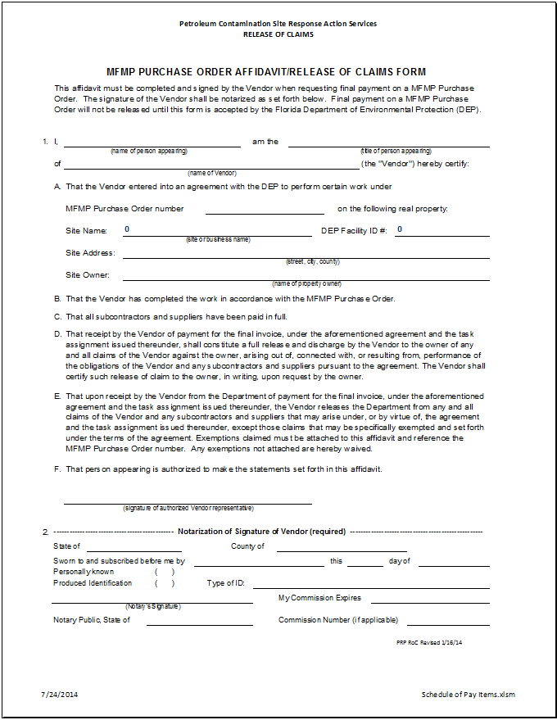
Release Of Claims Form
Final Invoice ?
Final Invoice ?
Final Invoice ?
Final Invoice ?
Release of Claims

Slide 11
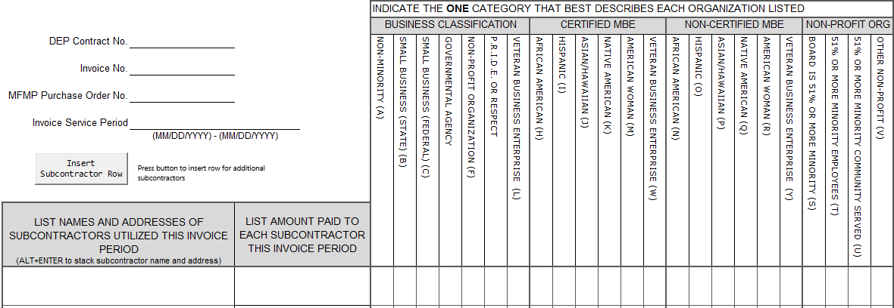
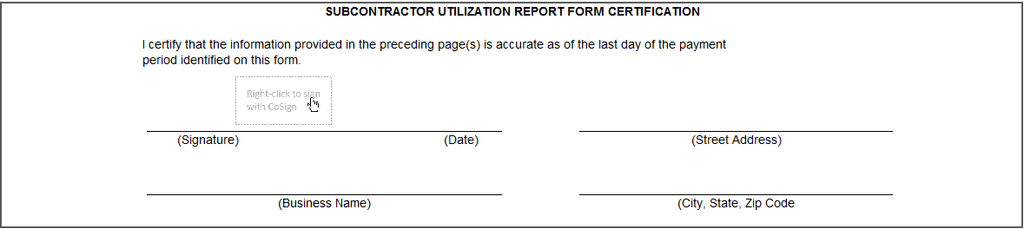
Subcontractor Utilization Report Form
The Subcontractor Utilization Form is included in the most current Schedule of Pay Items workbook or in the Contractor’s ATC contract. The form must be included with every invoice even if subcontractors were not utilized.
Subcontractor Utilization Form

Slide 12
Subcontractor Invoices For Reimbursable Items
Submit only subcontractor invoices for reimbursable costs included in the task(s) being invoiced.
Subcontractor service dates: Subcontractor invoice service dates should fall within the service period indicated on the invoice page. If the date of the subcontractor invoice does not fall within the established service period, and actual services rendered dates are not reflected on the original subcontractor invoice, then the Contractor or subcontractor should hand-write the actual services rendered dates on the subcontractor invoice and initial.
Utility Payments
Permits
Professional Land Survey
Etc.

Slide 13

Common Invoice Errors
  Not on Company letterhead
  Rate sheet filled out incorrectly or not at all
  Missing information in Deliverable Approval Letter
  Incorrect PRP Reference Number
  Incorrect Contractor #
  Incorrect Invoice Service Start and End Dates
  Missing Subcontractor’s Utilization Report form

Slide 14
Helpful Links
  My Florida Market Place Vendor Information Portal:
  https://vendor.myfloridamarketplace.com/vms-web/spring/login;jsessionid=7FB2237B200EEA17218615779705D226.jvm2?execution=e1s1
  Contractor Detail Status Report (Status of invoices within PRP):
  http://appprod.dep.state.fl.us/www_stcm/reports/contractor_wo_ta_invoice_p.asp
  DFS Vendor Payment History:
  http://flair.dbf.state.fl.us/dispub2/cvnhphst.htm
  MFMP Buyer Portal (For Site Managers Only):
  https://buyer.myfloridamarketplace.com/Buyer/Main
  Sample PO

Slide 15


Contact Information
  PRP Accounting:
  - Sharon Lee 850-245-8844 Sharon.A.Lee@dep.state.fl.us
  - Lauren Mackey 850-245-7635 Lauren.Mackey@dep.state.fl.us
  Debbie Harbison 850-245-8820 Deborah.Harbison@dep.state.fl.us
  Derrick Woodard 850-245-8818 Derrick.Woodward@dep.state.fl.us

