Slide 1

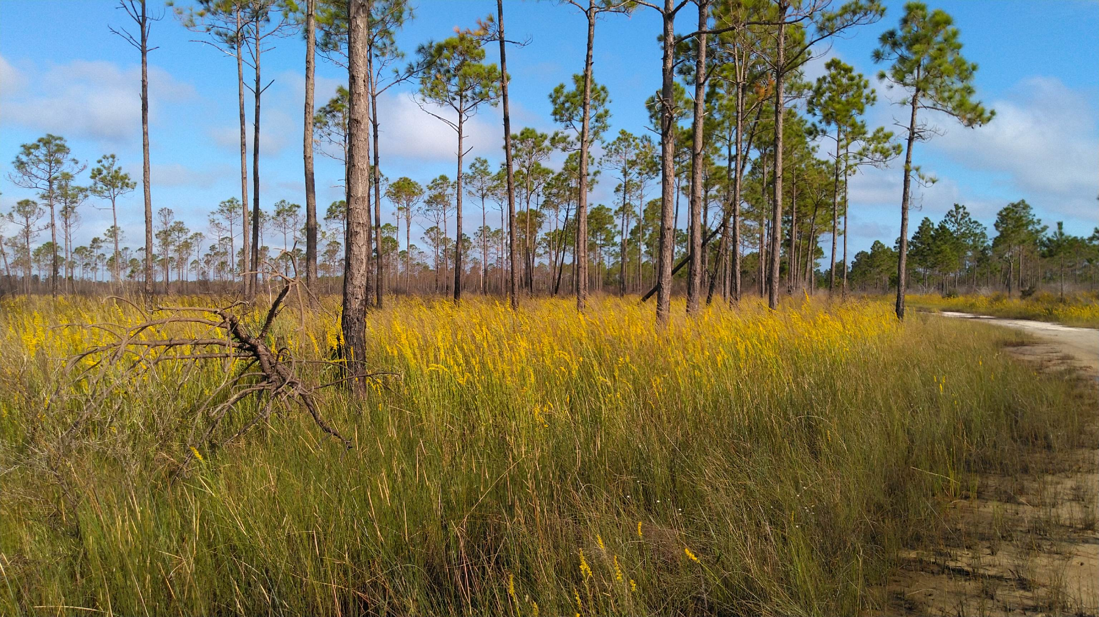
RGP SAJ-114 & Ecosystem Management Agreement 3
2021 Annual Report

Slide 2
Contents
Summary……………………………………………………….. 3
2021 Project Ledger……………………………………………. 4
2021 Sub-basin Ledger………………………………………… 5
2021 Conservation Easements…………………………………. 6
Conservation Unit Ledger……………………………………… 7
Conservation Easement GIS Map……………………………… 8
Conservation Unit Land Management Summary……………… 9

Slide 3
RGP SAJ-114 & Ecosystem Management Agreement 3
2021 Annual Report
SUMMARY
On July 7, 2021, the Florida Department of Environmental Protection executed a third Ecosystem Management Agreement with The St. Joe Company for 28,327 acres within St. Joe ownership. Subsequently, the Army Corps of Engineers issued SAJ-114 on August 21, 2020, for 41,585 acres including St. Joe lands as well as other ownership located in the West Bay and Choctawhatchee watersheds within Bay and Walton Counties of Florida.
This is the second annual report for SAJ 114 and EMA 3 since issuance in August 2020. All projects approved under the SAJ-114 EMA 3 criteria area will be included in the project ledger. No projects have been authorized by this permit at this time and no projects are currently under review by regulatory agencies.

Slide 4
2021 Project Ledger
Number | Type | Permitting Basin | Sub-basin | Project | TOTAL | HQ | HQ IMP | Alt | Alt Imp | WTL | UPL | Onsite CE | Offsite CE | CU Mit CE | CU CE | CR MIT | Rd Remove | Status
1 |  |  |  | * None to Date
2
3
4
5
6
7
8
Tot Prj Ac | Total Project Acres Within Sub-basin
HQ | High Quality Wetlands
HQ IMP | High Quality Wetland Impacts
LQ | Low Quality Wetlands
LQ IMP | Low Quality Wetland Impacts
UPL | Uplands
Onsite CE | Onsite Conservation Easements
Offsite CE | Offsite Conservation Easements
CU MIT CE | Conservation Unit Mitigation Conservation Easement
CU CE | Conservation Unit Conservation Easement
CR MIT | Mitigation Credits
WTL | Wetland
Impacts have not occurred as of 2021
CE’s to be recorded
Regional General Permit SAJ-114
Individual Permit
LQ Impact Allowance Drawdown

Slide 5
2021 Sub-basin Ledger
2021 Sub-basin
Sub-basin | Tot_Area | Tot_Alt | Tot_HQ | Tot_Alt_IMP | %** | Tot_HQ_IMP | %** | Tot_Alt_Remain | Tot_HQ_Remain
Crooked Creek-West Bay | 1,349.22 | 276.22 | 310.18
East River Choctawhatchee River | 7,807.87 | 1,386.91 | 1,779.61
Intercoastal Waterway – West Bay | 9,907.21 | 2,684.89 | 1,912.85
Mitchell River Choctawhatchee River | 4,733.33 | 501.44 | 1,072.25
Peach Creek | 3,339.08 | 644.92 | 635.55
Pine Log Creek | 2,939.97 | 613.63 | 426.67
* Cumulative through December 31, 2021 |  |  |  |  |  |  | Total

Slide 6
2021 Conservation Easements
SUMMARY
No conservation easements required or recorded during 2021.

Slide 7
2021 Conservation Unit Ledger
 |  |  |  | Conservation Easements
 |  |  | Total CU | Recorded | Required | In Process
Conservation Unit | Subbasin | Ownership | Acres | Acres | Acres | Acres
Barrett Branch | ERCR | St. Joe | 458
Boutwell Branch | MRCR | St. Joe | 617
Bunker Cove | MRCR | St. Joe | 92
Mitchell River | MRCR | St. Joe | 679
Doe Head Swamp | Peach Creek | St. Joe | 455
Kelly Pond | ICW-WB | St. Joe | 1,614
Otter Creek | ERCR | St. Joe | 1,170
Pigeon Creek | ERCR | St. Joe | 266
Sisters River | MRCR | St. Joe | 561
State Forest | CC-WB | St. Joe | 503
Three Mile Branch | Pine Log | St. Joe | 398
Tiller Branch | IWC-WB | St. Joe | 799
Total |  |  | 7,612

Slide 8
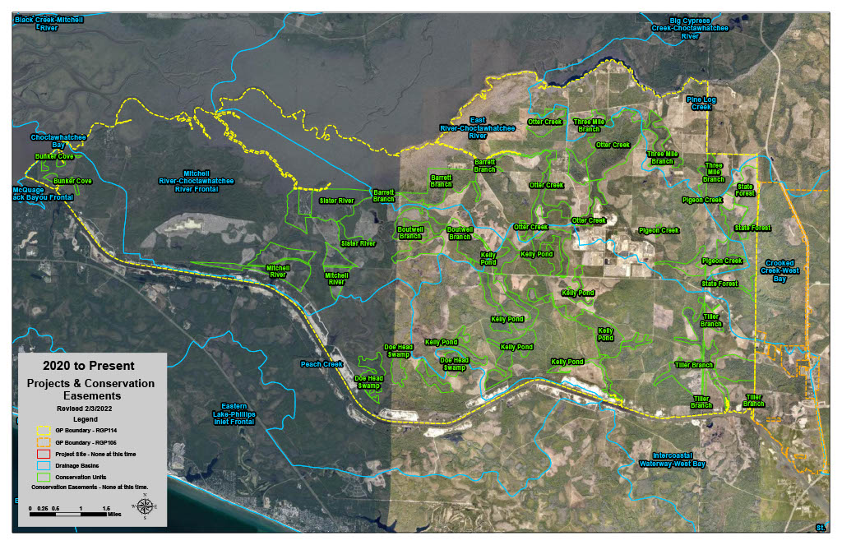
GIS Projects & Conservation Easement Map

Slide 9
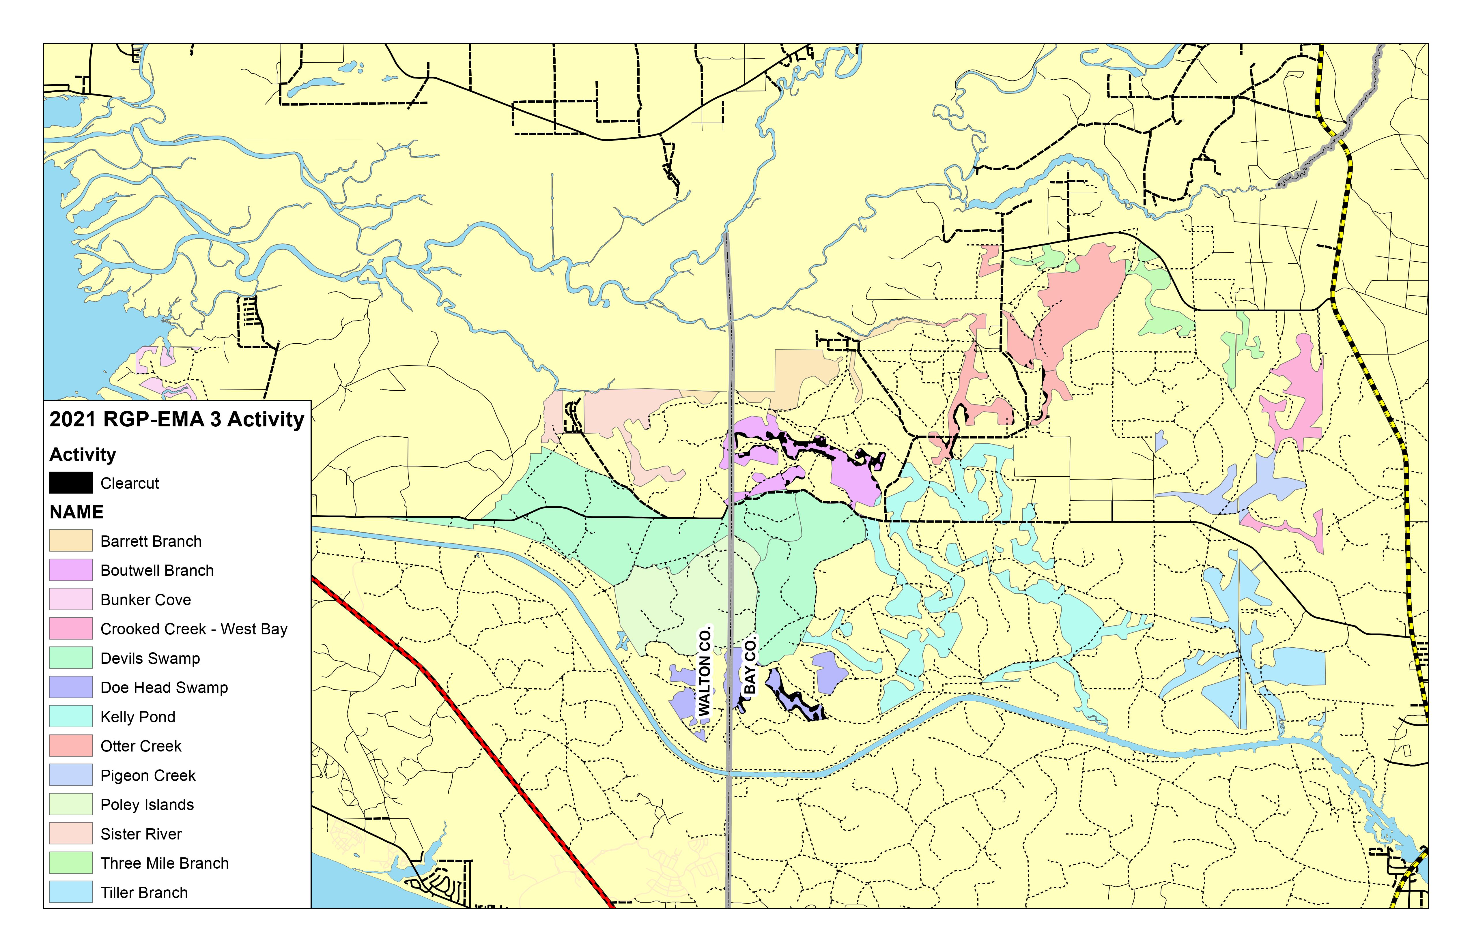
Conservation Unit Land Management Summary

