Slide 1
Florida Communities Trust
Stan Mayfield Working Waterfronts
2018 Application Training Webinar

Slide 2
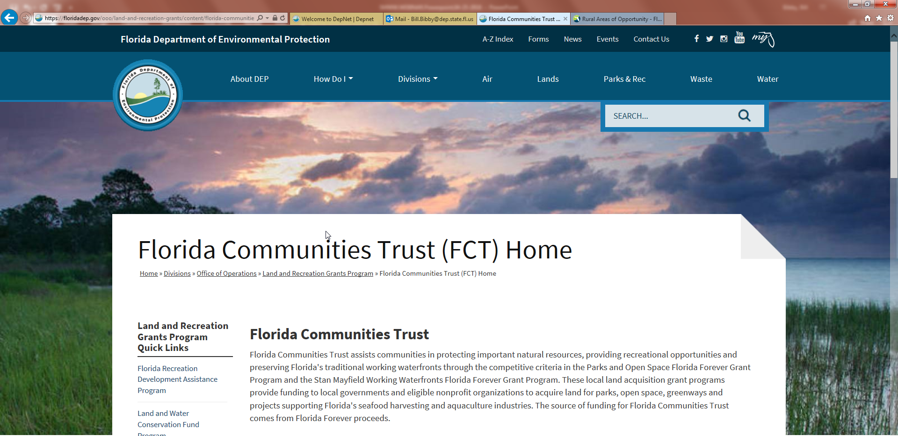
Application
Download Application Form SMWW-2 and the Application Instructions Guide from:
https://floridadep.gov/ooo/land-and-recreation-grants/content/florida-communities-trust-fct-home
Notes:
In order to follow along, please download or print the Application Form SMWW-2 and the Application Instructions Guide from the above reference web-site.

Slide 3
Agenda
Stan Mayfield Working Waterfronts Program Overview
Application Review
Post Completion Responsibilities
Wrap Up
Notes:
Our agenda includes:
The Program overview
Preparing the Application Form and Business Summary
Project Evaluation Criteria
Application Review
Acquisition Process
Post Completion Responsibilities
Wrap Up
Please Open packets with Application Form SMWW-2 and the Application Instruction Guide

Slide 4
Program Overview
Created by the 2008 Legislature
$4.2 million will be available for the 2019 cycle
Match not required, but encouraged
Pre-Acquired sites are NOT ELIGIBLE for SMWW Funding
Notes:
PROGRAM OVERVIEW:
The program was created by the 2008 Legislature- for the purposes of the promoting commercial harvest of marine organisms or saltwater products by state-licensed commercial fishermen, aquaculturists, or business entities. Also to provide opportunities that promotes and educate the public about economic, cultural, and historic heritage of Florida’s traditional working waterfronts, including the marketing of the seafood and aquaculture industries.
This year $4.2 million will be available for this cycle.
Match not required, but encouraged
Pre-Acquired sites are NOT ELIGIBLE for SMWW Funding

Slide 5
Eligible Applicants
  Local Governments
  Non-profit Working Waterfronts Organizations
  Partnership between Local Government and Non-profit Working Waterfronts Organization
Notes:
Eligible Applicants include:
Local Governments of the State of Florida.
Non-profit Working Waterfronts Organizations that are tax exempt under Section 501(c) of the United States Internal Revenue Code.
A partnership between a Local Government and a Nonprofit Working Waterfronts Organization.

Slide 6
Application Cycle 2018-19
Applications will be accepted
June 1 – June 29, 2018.
The application MUST be received by:
5 p.m. Friday June 29, 2018 (EST)
The acquisition of land used for recreational waterfront activities will not be considered for the SMWW program.
Notes:
Applications will be accepted
June 1 – June 29, 2018.
The application MUST be received by:
5 p.m. Friday June 29, 2018 (EST)

Slide 7
Preparing Application
Form SMWW-2
Your Application Packet MUST Include:
Cover Letter
One original & 3 copies
Application Form SMWW-2
All requested exhibits and backup documents
  Tabbed and labeled as per the Application Guide
Notes:
As a part of the application packet you must include
A Cover Letter on official letterhead with
a statement binding applicant to fulfill commitments made in application.
The letter must have the ORIGINAL Signature of City/County Manager or Assistant Manager, or Executive Director of the Non-profit.
The letter must also:
Contain FEID # Federal employer identification number of the applicant or applicants
Enclosed the Physical address and driving directions to the Project Site.
Mailing address that matches address the active Applicant’s in My Florida Market Place account.
To submit the complete packet please include:
One original & 3 copies
Please use the Application Form SMWW-2
All requested exhibits and backup documents must be Tabbed and labeled as per the
Application and instruction Guide

Slide 8
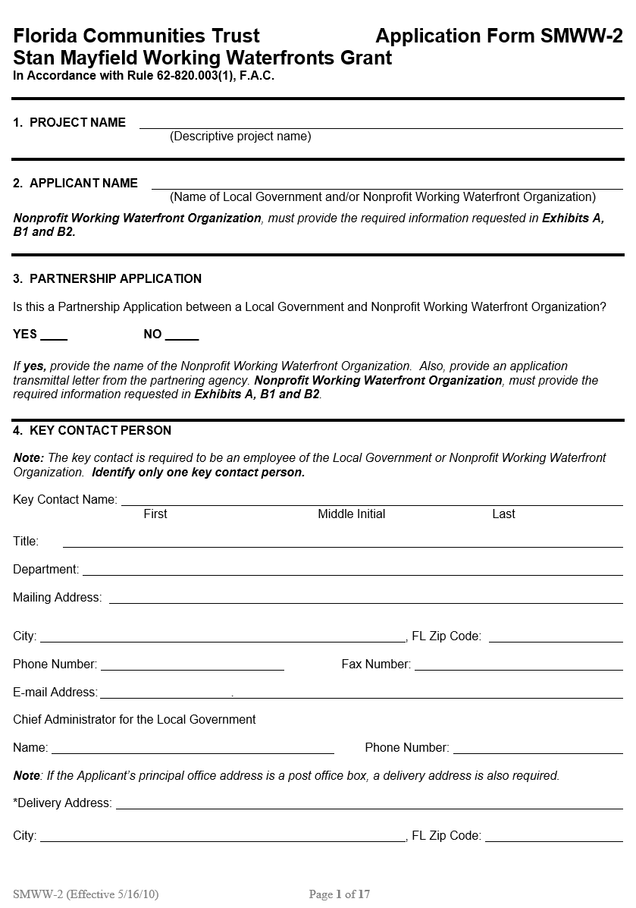
Application Form SMWW-2
General Information
Open your Application form SMWW-2 and Application Instructions Guide
Notes:
If you have not download the application, please download or print now.
This portion of webinar will include Page 1-5
Please turn to the page 1 of the Program application for the General information and criteria
Beginning with the:
Project Name
Use descriptive Project Name.
Applicant Name
Name of Local Government or Non-profit Working Waterfronts Organization. If Non-profit Working Waterfronts Organization, provide information requested in Exhibits A, B1, and B2.
3. Partnership Application
If the application is a partnership application between a Local Government and a Non-profit Working Waterfronts Organization provide transmittal letter from partner.
The Nonprofit Working Waterfronts Organization needs to provide the required information on Exhibits A, B1, and B2.
4. Key Contact Person
Required to be an employee of the Local Government or Representative of Non-profit Organization.
Identify only one key contact.
Please turn to page #2
5. Project Site Location
Provide the County, Section, Township and Range to indicate where the Project acreage is located.
Include all directional designations (north, south, east or west).
Total Project Acreage
Indicate the approximate acreage of the Project Site

Slide 9

Post Ranking & Selection
Grant Agreement
Management Plan
Project Plan
Notes:
For each Project selected, the Recipient will be required to enter into a Grant Agreement that obligates the recipient to certain terms and conditions, which must be met prior to receiving funding.
Once the Grant Agreement is executed by both parties, Trust staff begins the Acquisition process.
The Grant Agreement expires one year after execution. All terms and conditions must be met prior to closing.
Concurrently, the Recipient will begin drafting the Management Plan for review and approval. FCT Staff will provide guidance for drafting the Management Plan, if the Project is funded.
The Project Plan is drafted after the Management Plan is approved and the Option Contract to Purchase is fully executed.

Slide 10

Acquisition
Rule Chapter 62-821, F.A.C.
Joint Acquisition
FCT staff will coordinate with grant recipient during the acquisition process
Notes:
Chapter 62-821, Florida Administrative Code, provides FCT staff guidance on the acquisition procedures for the Stan Mayfield Working Waterfronts grant program.
The grant project site will be acquired via a Joint Acquisition with Trust staff taking the lead on acquisition, handling all transaction activities, including:
ordering due diligence products, as well as
negotiating, contracting and closing
And trust staff will coordinate with the grant recipient during the acquisition process.

Slide 11

Acquisition Guidance
    Voluntarily Negotiated Transactions
    Subject to terms and conditions imposed by the use of Florida Forever Funds
    Designate a key contact
    No pending criminal, civil or regulatory violations
    Reasonable Assurance
Notes:
The disbursement of Florida Forever funds is subject to certain terms and conditions. Since FCT’s Stan Mayfield Working Waterfront Program is a Florida Forever-funded program, funds to purchase the property may only be used to pay for costs associated with voluntarily negotiated transactions. The use or threat of condemnation is not considered a voluntarily-negotiated acquisition.
Additionally, there are certain terms and conditions imposed by the use of Florida Forever funds to avoid a violation of bond covenants that may result in penalties against the State of Florida. (we monitor any private revenue on bond-funded lands and keep it to a minimum so that we don’t risk bonds from being taxable)
The Recipient shall designate an employee or officer who shall serve as the key contact for the exchange of information regarding the acquisition activities.
The Recipient shall also submit a signed statement that the Recipient is not aware of any pending criminal, civil or regulatory violations imposed on the project site.
Lastly, the Recipient shall provide Reasonable Assurance that the Recipient will be able to fulfill its obligations under the Grant Contract, the Declaration of Restrictive Covenants, and Chapter 62-820, Florida Administrative Code.

Slide 12
Acquisition Due Diligence/Process
    Title Commitment and Policy
    Appraisal(s)
      https://floridadep.gov/lands/bureau-appraisal
    Certified Survey
    Phase I ESA
      ASTM Practice E1527
Notes:
If your project is funded, the following due diligence products will be ordered:
A Title commitment and policy
One or two appraisals, depending on the value of the property. Only one appraisal is needed if the value is less than one million dollars; two appraisals if the value is over one million dollars,
In addition, we will order a third-party appraisal review of the appraisals if the value is over $500 thousand dollars.
We will also order a certified survey, and
A Phase I Environmental Site Assessment
A brief overview of how the acquisition process will work is:
We order a title commitment and appraisal mapping of the project sight.
Once title and mapping are complete, these products are forwarded to our Bureau of Appraisal who then order the appraisal products.

Slide 13

Acquisition Process
Negotiations are based on approved appraisals
Option Contracts
120 days to close
Notes:
Our negotiations are based upon the approved appraisals
Once we reach an agreed-upon purchase price with the seller, the Division of State Lands will draft an option contract for the seller’s review and execution. Our option contracts typically allow for 120 days to close. During this 120-day closing period we order additional title work (which is the title policy), certified survey, and a Phase I ESA.
Lastly, The Division of State Lands will work closely with FCT staff, as well as the grant recipient, to ensure everyone is in the loop and deadlines are met.

Slide 14
Project Summary
Solely for public use projects
  Maritime Museum
  Educational Venue
  Civic Event Area
Educate the public about the heritage of Florida’s Working Waterfronts
  Purpose
  Existing & Future Uses
  Physical Improvements and Buildings
  Concessions or leases
REQUIRED
For Education Projects
Notes:
Page 5 of the application
The Project Summary is required if you have an educational component of the project which would include public use such as a maritime museum, educational venue or civic event area to educate the public about the economic, cultural and historic heritage of Florida's traditional working waterfronts.
The Project Summary shall include a discussion of the purpose of the project, existing and future uses, existing and proposed physical improve­ments and historic resources. Include the size of any existing or proposed buildings. Indicate if any easements, concessions, or leases exist or are proposed. The recommended size for a Project Summary is one page.
The Project Summary is required when a Local Government proposes to acquire fee simple interest in the Project Site solely.
Please tab as (Exhibit E)

Slide 15
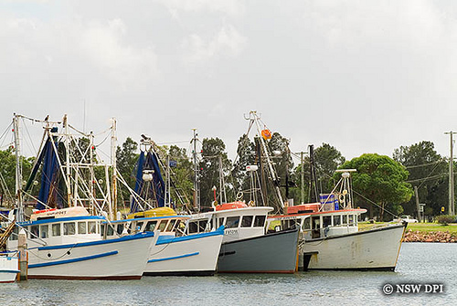
Business Summary
Existing and/or proposed activities
  Further the protection & continuation of a Working Waterfront
  Economic benefit
  Ownership and management
  Four Sections:
    Introduction
    Business
    Management
    Appendix
REQUIRED
For all Projects
Notes:
The Business Summary is required for all project and if not included in the packet the project will be determined ineligible.
The Business Summary must include four sections:
Introduction
Provide a brief description of the existing and/or proposed activities on the Project Site.
Discuss how the Project Site would further the protection and continuation of a Working Waterfront.
Note: The proposed activities on the Project Site must conform to purposes of the Working Waterfronts Program as defined in Sections 380.503(18)(a) and (b) F.S.
Discuss how the development and management of the Project Site will provide an economic benefit to the community.
Ownership Type.
2. Business prospective:
Describe existing or proposed business activities on the Project Site.
Explain the services, benefits and support to the commercial seafood industry.
Describe educational activities to be conducted that highlight the historical or current commercial fishing or aquaculture industry.
Explain any activities indirectly supporting the commercial seafood industry.
Describe the current and future demand for the facilities and activities to be provided.
3. Management
Description of facilities. Identify existing and all proposed improvements.
Identify existing and/or proposed easements, concessions, or leases.
Identify any existing or proposed third party leases including the lessee and purpose of the lease.
Identify all short term and long term maintenance requirements.
Discuss current and proposed staffing needs.
Identify the approximate cost for development and operation of the site including proposed improvements, maintenance, staffing, etc.
Identify funding sources for the development and maintenance of the Project Site.
4. Appendix
Attach and label backup documentation to provide verification of above items as needed.

Slide 16

Project Evaluation Criteria
Location
Location,
Location,
Location
Starting on page 7 – Questions 1(a) through 1(f)
Notes:
Tell us about your Project:
1(a) The Project Site is located within the boundary of a locally designated Community Redevelopment Area and furthers the adopted community redevelopment plan (10 points).
Provide a map showing the boundaries of the CRA.
Provide a copy of the adopted community redevelopment plan.
Contact the local government planning department to obtain the required documentation.
1(b) The Project Site is adjacent to or within 2,000 feet of and tidally connected to state-owned submerged lands designated as an aquatic preserve identified (10 points).
Contact the Department of Environmental Protection’s Florida Coastal Office (formerly known as CAMA) for documentation
Map & Letter
Contact information can be found on the FCT webpage under Application Development Resources for SMWW program
1(c) The Project Site is located within a municipality with a population less than 30,000 or in an unincorporated area of the county with a population less than 40,000 (10 points).
Visit the FCT web page for a link to the most recent population numbers; see Application Development Resources for SMWW program
1(d) The Project Site is within an area designated as an active “Waterfronts Florida Partnership Community” (9 points).
Provide:
Map & Letter
Go to the FCT web page for the list of areas designated as a “Waterfronts Florida Partnership Community”
1(e) The Project Site provides services and is located within 15 miles of a state designated aquaculture “High Density Lease Area” (5 points).
Map & Letter
Contact information for the Department of Agriculture and Consumer Services can be found online under Application Development Resources for SMWW program
1(f) The Project Site is within an area designated as a “Rural Area of Critical Economic Concern” or “Area of Critical State Concern” (4 points).
Go to the FCT web page for the link to “Rural Area of Critical Economic Concern” or “Area of Critical State Concern”

Slide 17

2. Economic Consideration
Starting on page 8 – Questions 2(a) through 2(d)
Notes:
2(a) The proposed project provides an economic benefit to the community (10 points).
Discuss how the acquisition, development and management of the Project Site will provide an economic benefit to the community
Make sure that the discussion is consistent with the Business Summary
2(b) The Project Site is located in a municipality or in the unincorporated county with a growth rate that exceeds the average growth rate for the state, as shown by population increase since the last census (10 points).
Go to the Application Development Resources page for links to census data for growth rates in your area.
2(c) The Project Site has sustained hurricane damage in the past 5 years such that operating capacity was reduced or normal operations were interrupted for a period of not less than two weeks (5 points).
Identify the hurricane and year
Provide a state or federal document verifying that the project site sustained significant hurricane damage
Example: A copy of the Department of Environmental Protection’s Emergency Authorization for the repair of the docking facility
Document that operation capacity was reduced or normal operations were interrupted for a period of not less than two weeks
2(d) The grant award amount requested is within the following thresholds (Points will be awarded on only one of the following criteria):
The Applicant is requesting a grant award amount that does not exceed $1,500,000.00 (8 points);
The Applicant is requesting a grant award amount that does not exceed $2,500,000.00 (4 points);
The Applicant is requesting a grant award amount that does not exceed $3,500,000.00 (2 points).
Note: FCT will not participate in project costs that exceed the grant award amount or the appraisal amount.

Slide 18
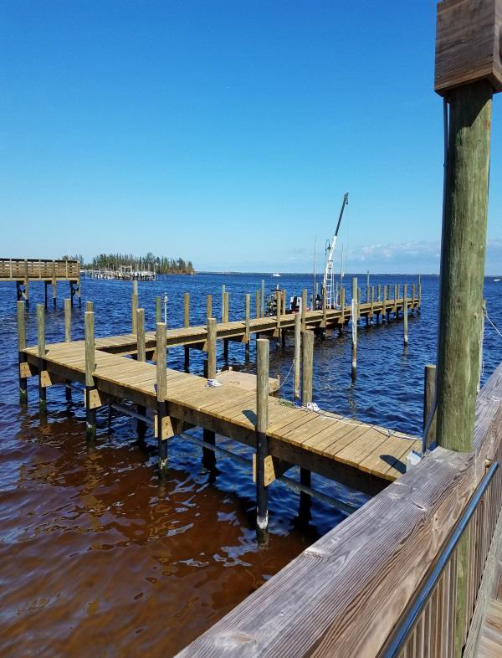
3. Site Suitability / Readiness:
Starting on page 9 – Questions 3(a) through 3(e)
Notes:
3(a) The Project Site will provide a docking facility for commercial fishing vessels (Points will be awarded on only one of the following criteria):
The Project Site contains an existing docking facility that can be presently utilized for commercial saltwater fisheries or aquaculture operations (17 points);
The Project Site contains an existing docking facility that requires major restoration to be utilized for commercial saltwater fisheries or aquaculture operations and the applicant has committed to rebuild the docking facility (12 points);
The Applicant has committed to construct a new docking facility on the Project Site for commercial fishing vessels or aquaculture operations (6 points).
Documentation should include description of existing or proposed facilities, condition of existing facilities and any repairs to be completed, and photographs of existing facilities and the area of the proposed facility. Proposed and existing facilities should be shown of the Site Plan (Exhibit Y). Photographs should be labeled and included under Exhibit O.
3(b) The Project Site will provide a Seafood House or other building to be used for Working Waterfront Business (Points will be awarded on only one of the following criteria):
The Project Site contains an existing Seafood House or other building that can be presently utilized for Working Waterfront Business (10 points);
The Project Site contains an existing Seafood House or other building that requires major restoration and the applicant has committed to rebuild the building to be utilized as a Working Waterfront Business (8 points);
The Applicant has committed to construct a new Seafood House or other buildings of at least 1,000 square feet on the Project Site to be used for Working Waterfronts Business (4 points).
Documentation should include description of existing or proposed facilities, condition of existing facilities and any repairs to be completed, and photographs of existing facilities and the area of the proposed facility. Proposed and existing facilities should be shown of the Site Plan (Exhibit Y). Photographs should be labeled and included under Exhibit O.
3(c) The Project Site will provide a structure for launching commercial fishing vessels, including but not limited to a boat ramp, boat lift or boat rail system (Points will only be awarded on one of the following criteria):
The Project Site contains an existing structure for launching commercial fishing vessels, which can be presently utilized without major restoration (6 points);
The Project Site contains an existing structure for launching commercial fishing vessels, that requires major restoration and the Applicant has committed to rebuild the existing boat launch facility (4 points).
The Applicant has committed to construct a new boat launching facility on the Project Site that will be used for commercial fishing vessels (2 points).
Documentation should include description of existing or proposed facilities, condition of existing facilities and any repairs to be completed, and photographs of existing facilities and the area of any proposed facility. Proposed and existing facilities should be shown of the Site Plan (Exhibit Y) to include a scaled drawing of the proposed boat launching facility. Photographs should be labeled and included under Exhibit O.
Documentation from a surveyor, engineer or environmental consultant, showing that the boat launching facility located in at least 3 feet of water at Mean Low Water and that there no grass beds in the area is required.
3(d) The Project Site contains an open area of at least 1/4 acre to be used for the storage of traps, nets, and other gear needed for commercial fishing or aquaculture operations (4 points);
Provide the required discussion and photographs
3(e) The proposed project will be acquired using a less-than-fee Working Waterfront Covenant for all of the land to be acquired (5 points).
Provide the required documentation / affidavit from the owner.

Slide 19

4. Financial Contribution
Although Match is not required, Applicants who provide matching funds at given levels will receive points
Starting on page 12 – Question 4(a)
Notes:
Next, we have #4 Financial Contribution
A couple of things you need to know for this section are:
A Match is not required for this program, but if you are providing a match you can receive points under question # 4.
You also need to know if you fall into the Small Local Government category as defined in Rule 62-820.002 subsection (22). A small local government is “County Governments with populations of 75,000 or fewer and municipal governments with populations of 10,000 or fewer”
You can visit the FCT web page for the most recent population numbers to determine you fall into the Small Local Government category
If you look at the bottom of page 12 of your application
4(a) Providing a share of the eligible Match. The Applicant is committed to: (You will only receive pts for 1 of the following criteria)
1) Providing a Match between 25 percent to 34 percent of the Project Costs, or, for Small Local Governments and Nonprofit Working Waterfront Organizations, a Match between 10 percent and 19 percent of the Project Costs; or
2) Providing a Match of 35 percent or more of the Project Costs, or for Small Local Governments and Nonprofit Working Waterfront Organizations, a Match of 20 percent or more of the Project Costs
If you have checked yes to one of these items, you will need to provide a letter from your Chief Financial Officer (CFO) confirming amount.
Tab as Exhibit Q

Slide 20
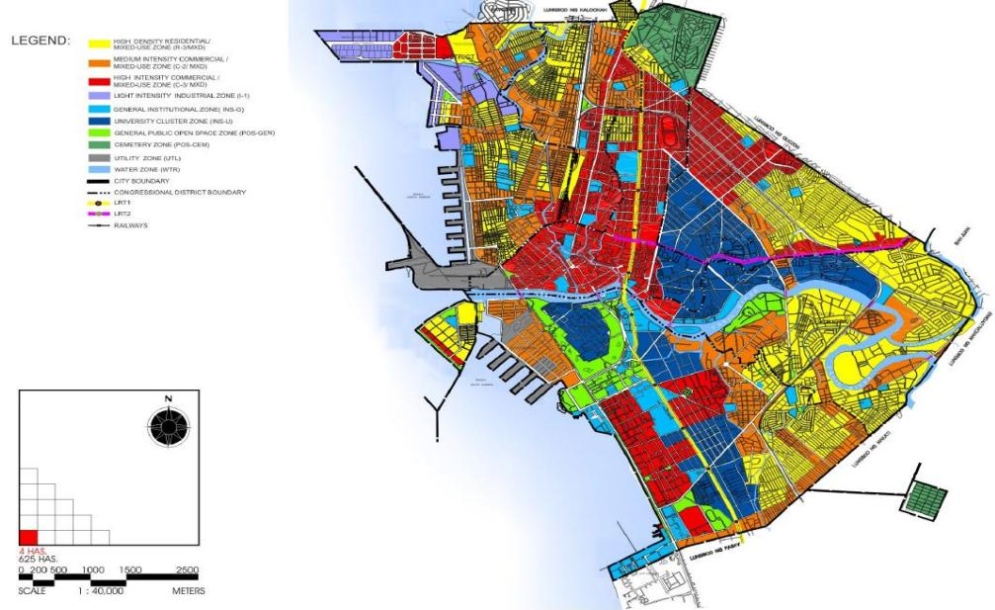

5. Community Planning
Starting on page 13 – Questions 5(a) through 5(b)
Notes:
On Page 13 you will find the Community Planning Section
5(a) The project is located in a Future Land Use category, zoning district, or overlay district that has been identified for the protection and preservation of Working Waterfront;
Map showing that the site is located within one of these areas that has been identified for the protection and preservation of Working Waterfronts.
Also, describe the purpose of the area and how it furthers the protection and preservation of Working Waterfronts.
Contact the local government planning department to obtain the required documentation.
Tab the map and description as Exhibit R, if both are not submitted you will not receive points.
5(b) The project furthers local government comprehensive plan objectives and policies that ensure the protection and preservation of Working Waterfronts for use by commercial fishermen, aquaculturists, or business entities that support these industries;
Identify and summarize the policy or objective.
Describe how the comprehensive plan’s objectives and policies further the protection and preservation of Working Waterfronts
Provide a copy of the local government’s comprehensive plan’s objectives and policies. We do not want your whole comp plan, only a copy of the objectives and policies in which this project will help meet. Please limit this to no more than 3 objectives and policies.
Contact the local government planning department to obtain the required documentation.
Tab the as Exhibit S

Slide 21
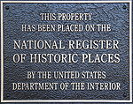
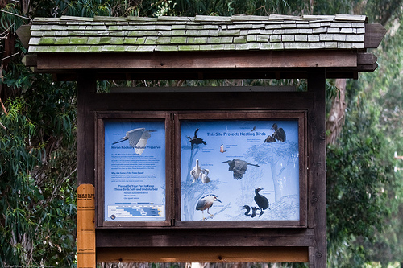
6. Public Education
Starting on page 13 – Questions 6(a) through 6(c)
Notes:
Next you will find the Public Education Section. If you are doing educational projects, please remember that you are required to fill out the Project Summary along with the Business Summary.
6(a) The Project Site provides a permanent structure containing displays of artifacts and other items open to the public that provide information about the economic, cultural or historic heritage of Florida’s traditional Working Waterfronts.
Describe:
Proposed permanent structure,
Types of artifacts & other items to be displayed that will provide information to the public pertaining to this question
How public access to the structure will be provided
The approximate location of the structure
Show the location on the Site Plan Tabbed as Exhibit Y
6(b) The Project Site contains a structure(s) that is listed on the National Register of Historic Places administered by the National Park Service (3 points).
Provide a map & letter from the Division of Historical Resources & Tab as Exhibit T
Contact Division of Historic Resources well in advance of the application deadline. Because if we do not receive the letter and map by the application deadline, you will not receive these points. There contact information will be located on the FCT web site.
6(c) Interpretive kiosk or signs will be provided that educate the public about the economic, cultural, or historic heritage of Florida’s traditional Working Waterfronts (2 points).
Describe:
How the proposed kiosk or signs will educate the public
The approximate location of the kiosk or sign
How public access to the kiosk or sign will be provided.
Show the location on the Site Plan Tabbed as Exhibit Y

Slide 22
Application Checklist
Required Exhibits and Supporting Documentation
Pages 15 – 17
Application Development Resources
https://floridadep.gov/ooo/land-and-recreation-grants/content/fct-parks-and-open-space-program-application-resources
Notes:
Once you have gone through your application and answered the questions….. on pages 15-17 you will find the Required Exhibits and Supporting Documentation. Let me reiterate how important these are to you because if you do not submit the required supporting documentation, you will not receive the points for that question even if you checked yes.
Some things to remember here are:
Use this as a checklist and make sure each one is submitted if you answered yes to that question it pertains to
All the exhibits are to be placed at the end of the application (not behind the question it supports or in-between the application pages)
Make sure you tab the Exhibits and tab them as identified on Pages 15-17. If the Exhibits are not tabbed this makes it very confusing when staff is scoring your application and it may cause the documents to be overlooked which would cause you not to receive those points
If an exhibit does not pertain to your application, please still label it and state N/A
Also remember that if a question asks for multiple supporting documentation, you will not receive the points unless all documentation is submitted.
2 exhibits I want to address specifically are:
Exhibit O – Photographs – Several questions ask you to provide photographs as required documentation. When doing this please make sure you label each photograph with a name and the question number you are providing it for. When scoring the applications sometimes it is difficult to figure out which photographs are meant for which questions.
Exhibit Y – Conceptual Site Plan – Make sure your site plan clearly delineates the Project Boundaries and shows the approximate location of all proposed site improvements. Make sure you address all existing facilities, renovation of existing facilities and any new facilities. Also make sure you label everything as existing, renovation and new.

Slide 23
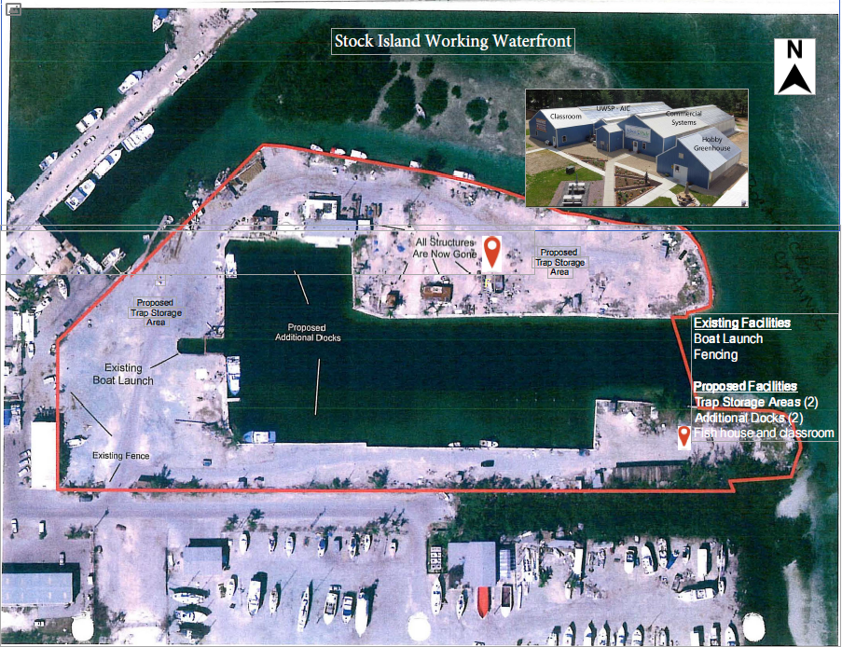
Example Site Plan
Notes:
Exhibit Y – Conceptual Site Plan – Make sure your site plan clearly delineates the Project Boundaries and shows the approximate location of all proposed site improvements. Make sure you address all existing facilities, renovation of existing facilities and any new facilities. Also make sure you label everything as existing, renovation and new.
Also include:
Official park/site name and physical address.
North arrow.
Up to 11 inch x 17 inch format highly preferred for future administrative use such as copying and scanning. Avoid use of color as the only means to delineate areas.

Slide 24


Application Review Process
Per Rule Chapter 62-820, F.A.C.
Notes:
Chapter 62-820, of the Florida Administrative Code, lays out the application submittal and review process. We have gone through submitting the application and the Project Evaluation Criteria, so now let me go through the actual review process:
Once an application is received, no additional information can be provided to receive points after application deadline
The only additional information which may be submitted, would be if FCT staff requested clarification but this is only allowed on eligibility criteria; not for deficient information for the Project Evaluation Criteria
Next, FCT staff and other agencies will review and score the applications & determine sufficiency of the business summary
Once scoring is complete, Staff will then conduct site visits as needed to verify the conditions represented in the application
FCT staff will then provide applicants with an evaluation report addressing points given for their project and a business summary sufficiency determination report.
Once the applicant receives the evaluation report, they are given an opportunity to submit written objections to the staff’s recommended scores. These written objections must be submitted in writing to the Trust staff at least 48 hours prior to the Board ranking and selection meeting in order to be considered.
The Florida Communities Trust Governing Board meets to review rankings and provide applicants the opportunity to voice objections about the application review. The applicants are not required to attend this meeting, however, if they wish to object to their score they can attend and speak to these objections.
The FCT Governing Board will adjust scores as necessary and create the final ranking list for submission to the Board of Trustees (Governor and Cabinet).
Applicants with business summaries deemed insufficient will not be included on the ranking list considered by the Board of Trustees.

Slide 25

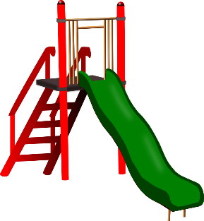


Post Completion
“In Perpetuity”
Open to the Public (Education Component)
Developed per Management Plan
Stewardship Reporting
Revenue Reporting
Notes:
Listed is a brief overview of the Post Completion responsibility of the project applicant:
The project site must be dedicated in “Perpetuity” and recorded with the Deed of
Restricted Covenant
If the project site has an (Education Component) for the applicant must provide public access to the general public
Prior to the closing the applicant develop and have an Management Plan- if there any change to the project site the FCT staff must approve any modification in advance.
An annual Stewardship Report detailing the process of the project is required
An Revenue Reporting- An annual revenue report is also required after the project open to ensure that any fund is properly handle.

Slide 26

Wrap Up
$4.2 million will be available for the 2019 cycle
Applications Accepted June 1- June 29, 2018
Completing the Application -- Project Evaluation Criteria
Application Review Process
Acquisition Process
Post Completion Responsibilities
APPLICATIONS MUST BE RECEIVED BY
5:00 PM EST June 29, 2018
Notes:
$4.2 million will be available for the 2018-19 cycle
Applications Accepted June 1- June 29, 2018
Completing the Application
Project Evaluation Criteria
Application Review Process
Acquisition Process
Post Completion Responsibilities
Once again a reminder of the deadline
APPLICATIONS MUST BE RECEIVED BY
5:00 PM EST June 29, 2018

Slide 27
Save the Date
Upcoming Grant Application Cycles
2019 FCT Parks & Open Space 7/2 – 9/17/2018
2019 FRDAP Playground 8/1 – 8/15/2018
2020 FRDAP 10/1 – 10/15/2018
2019 RTP 11/12 – 11/30/2018
2019 LWCF 1/14 – 1/28/2019
For upcoming Grant Application Cycles at:
https://floridadep.gov/ooo/land-and-recreation-grants
Notes:
Listed are more recreational resource grant opportunities:
Upcoming Grant Application Cycles
2019 FCT Parks & Open Space 7/2 – 9/17/2018
2019 FRDAP Playground 8/1 – 8/15/2018
2020 FRDAP 10/1 – 10/15/2018
2019 RTP 11/12 – 11/30/2018
2019 LWCF 1/14 – 1/28/2019
For upcoming Grant Application Cycles and program information please our website at:
https://floridadep.gov/ooo/land-and-recreation-grants

Slide 28

For Questions -- FCT Contacts
FCT Email: FloridaCommunitiesTrust@floridadep.gov
FCT Phone: (850) 245-2501
Linda Reeves, OMC Manager Linda.Reeves@floridadep.gov
FCT Planners:
  Rita Ventry Rita.Ventry@floridadep.gov
  Pamela Lister Pamela.Lister@floridadep.gov
  Bill Bibby Bill.Bibby@floridadep.gov
Acquisition:
Marjorie Karter Marjorie.Karter@floridadep.gov
Closing and Legal Matters:
Lois La Seur Lois.LaSeur@floridadep.gov
Notes:
For additional information please contact our staff as listed via email to phone.

Slide 29
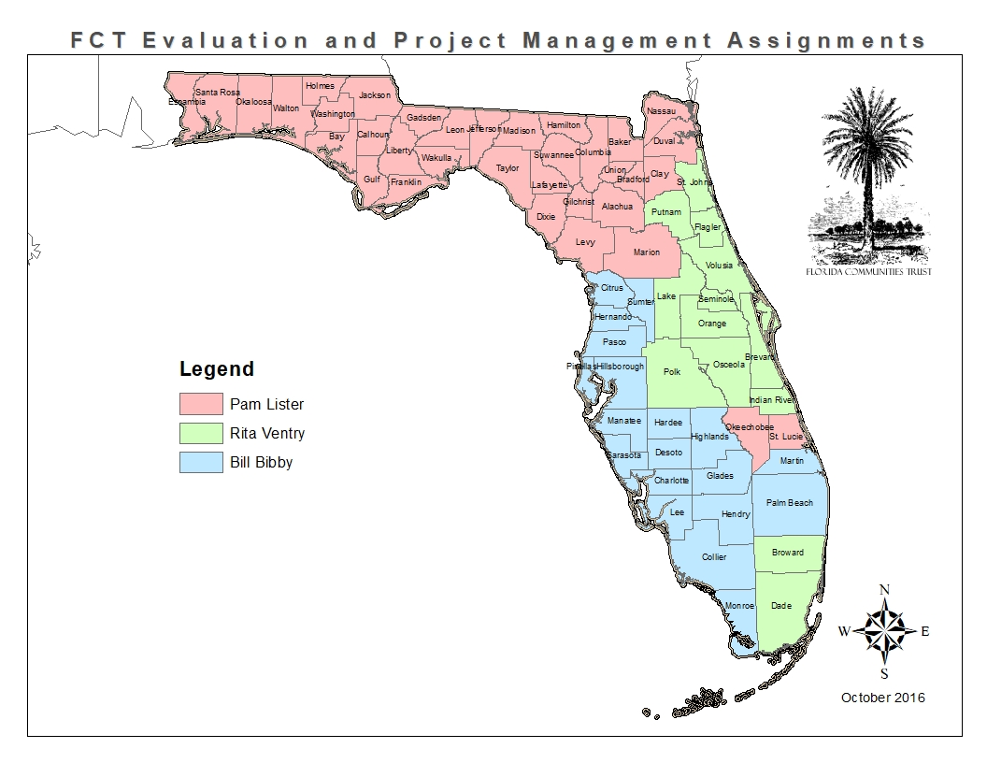
Staff Assignments
Notes:
Our staff is divided by regions, please refer to the map for your planner and region

Slide 30

More Information
For more information, please visit
the Florida Communities Trust website at https://floridadep.gov/ooo/land-and-recreation-grants/content/florida-communities-trust-fct-home
Notes:
For more information, please visit
the Florida Communities Trust website listed above

