Slide 1
Source Removal Info
Source Removal Quote Form
Graham Witt
Kristy Trueblood
Source Removal Work Orders
Kristin Bailey
Tamara Blyden
Invoices & VCOs
Jeff Ray

Slide 2
Source Removal Quote Form (SRQF)
Source Removal Quote Form (SRQF)
EFFECTIVE 12/15/2011
Proposals received on or after December 15th, must use the new SRQF.
Proposals received prior to December 15th, may use either the previous SRQF or new version.

Slide 3
What’s New?
What’s New?
Exclusion of in-house costs
Mobilization costs broken out of unit rates
Minor line item revisions
BPSS is no longer tracking SRQF data

Slide 4
SRQF In-house Exclusion
SRQF In-house Exclusion
In-house SRs should be built up on backup spreadsheet similar to RAC work orders
Subcontractor quotes for non-in-house work/resources procured per SOP
Any activity requiring in-house resources should not be presented on the SRQF
SRQF is required to be used if SR is 3-bid to “turnkey” subs or if SR is subcontracted through multiple subs/vendors

Slide 5
Mobilization
Mobilization
Mobilization costs broken out from unit rate to reduce repetitive payment for mobilizations through VCO process
Mobilization costs may not be applicable to the activity

Slide 6
Line Item Changes
Line Item Changes
#3: Asphalt/Concrete removal now specifies that loading is included in the unit rate
#4: Added Clean Concrete T&D

Slide 7
Line Item Changes (continued…)
#5: Added Mixed Debris T&D
#6/#7: Flexibility incorporated into conversion factor

Slide 8
Line Item Changes (continued…)
Line Item Changes (continued…)
#8: Sheet piling now bid by day/week/month
#31/#32: Dewatering system installation and operation separated

Slide 9
1st Tier Sub ID Summary
1st Tier Sub ID Summary
All 1st tier subs and their associated costs must be listed

Slide 10
2nd Tier Sub ID Summary
2nd Tier Sub ID Summary
Select 2nd tier subs must be specified
2nd tier sub costs are not required to be specified

Slide 11
Reminders
Reminders
Ensure that you are comparing same quantities and same units among bids (apples to apples).
Transport and disposal should be accounted for separately.
Flowable fill should be broken out from LDA costs.
Fuel, equipment and labor need to be built into each unit rate. Effective 12/15/11, mobilizations should be excluded from the unit rate.
“DEP USE ONLY” columns are for Site Manager use

Slide 12
Last Minute Notes
Last Minute Notes
The initial revision to the SRQF posted on the website incorrectly included footnote #5. This footnote indicated that Backfill Project Soil Analysis Form should be submitted to Team 5. The BPSS does not track backfill facilities anymore, therefore all backfill analyses should be negotiated and reported directly with the FDEP/LP site manager for acceptance.

Slide 13
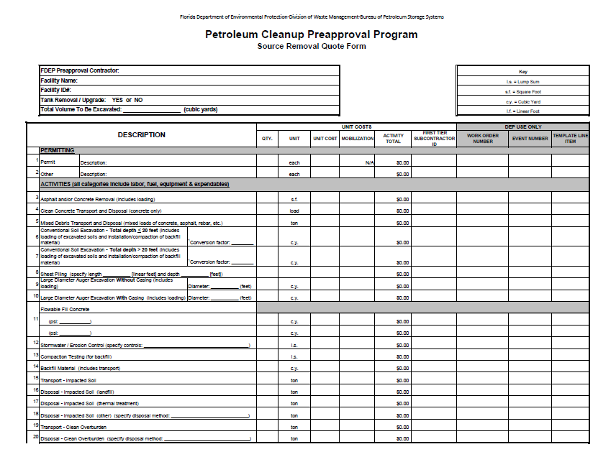
Petroleum Cleanup Preapproval Program Source Removal Quote Form

Slide 14
Proposal Review
Proposal Review
Request a Gantt chart or schedule
Confirm subcontractor quotes are still valid if work order preparation was substantially delayed.
Verify bids are from local and appropriate vendors.
Confirm that proposed site restoration is “like for like”
Comprehensive proposal review comments.

Slide 15
Preparation of Split Work Orders
Preparation of Split Work Orders
$250,000 per work order maximum
Projects >$1,000,000 require approval from the Governor’s Office ( Planning and Budget).
All work orders need to be prepared at the same time
Excavation activities cannot commence until all work orders are encumbered, signed and returned to DEP.
Make sure all appropriate costs are included on the SRQF.

Slide 16
Preparation of Split Work Orders
Preparation of Split Work Orders
Source Removal Report is the final deliverable for all work orders and retainage (non-PPA) will not be paid on any work order until the Source Removal Report has been received and approved.
Utilize the RAC and CO worksheets when preparing work orders (Summary of Consultant Mobilizations and Oversight/Costs and Summary of Subcontractor Changes)

Slide 17
Segregate Costs
Segregate Costs
Segregate Costs
 | Example Breakdown of LDA Source Removal
Work Order No. | Description | 1st Event | 2nd Event | 3rd Event | 4th Event | Project Total
1 | Well Aband, permits, sampling | $50,000 |  |  |  | $50,000
1 | LDA oversight - 3 week increments |  | $40,000 | $40,000 | $40,000 | $120,000
2 | LDA & Flowable fill - 750 CY increments | $120,000 | $120,000 |  |  | $240,000
3 | LDA & Flowable fill - 750 CY increments | $120,000 | $120,000 |  |  | $240,000
4 | T & D of Cont. Soil - 1400 ton increments | $70,000 | $70,000 | $70,000 |  | $210,000
4 | Site Restoration, Sampling, Reporting |  |  |  | $35,000 | $35,000
 | Total Cost |  |  |  |  | $895,000
Place preliminary activities in initial event(s) or a separate work order
Professional Oversight can be invoiced independent from subcontractor costs
Work orders contain estimated quantities (tons or CY) that can be invoiced independently
Site Restoration and other tasks occurring at the end of project are placed in last work order

Slide 18
Permits
Permits
NPDES Permits:
Verify the point of discharge
Storm drain
City/County/State owned
Short-term vs. Long-term
Sampling requirements may vary between districts/counties/cities/state.
General Permits
Construction & Dewatering
Requirements may vary between districts/counties/cities/state.

Slide 19
Compensation Agreements *with or without monetary compensation
Compensation Agreements
*with or without monetary payment
All compensation agreements must be reviewed and signed by OGC prior to submission to the property owner.
See 10-03-08 SOP Section 5.11 and Appendix H.11 for further explanation and examples of how to create an agreement. This is also in the COMMON: drive under the Compensation Agreement folder.
Usually required when removing canopies and buildings. In rare occasions may be used for UST replacement. It is most beneficial to determine whether an agreement is needed in the RAP stage of the project.
MUST be finalized prior to issuance of work orders.

Slide 20
Oversight
Oversight
Per Diem
Allowable if activities exceed one whole day.
Pro-rate based on actual hours worked in 1/10 day increments.
P.E. Oversight
If excavation is performed in phases (LDA and conventional) or is very complicated an additional visit may be warranted.
SOP states a 1 time ½ day oversight and mobilization is allowed for excavations.

Slide 21
Kits
Kits
In-house
One person oversight
Kits are given to the in-house crew.
Subcontractor
Oversight person should be given costs for PPE and a vehicle when warranted.
Two person oversight
Oversight kit (C-24) is given per SOP (maximum of 12 per month)

Slide 22
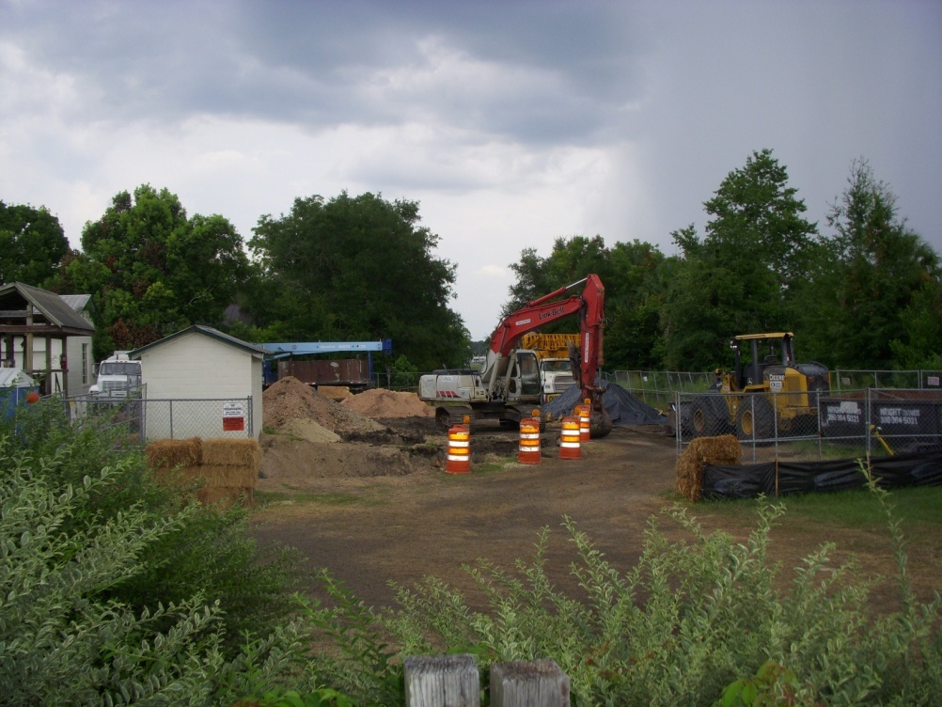
Logistics
Logistics
MOT issues
Utilities
Night Work
Stockpile
* It may be helpful to request before and after site photos.

Slide 23
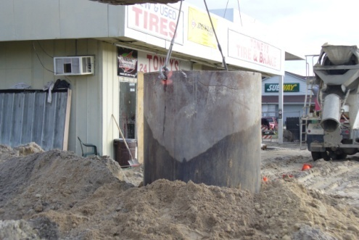
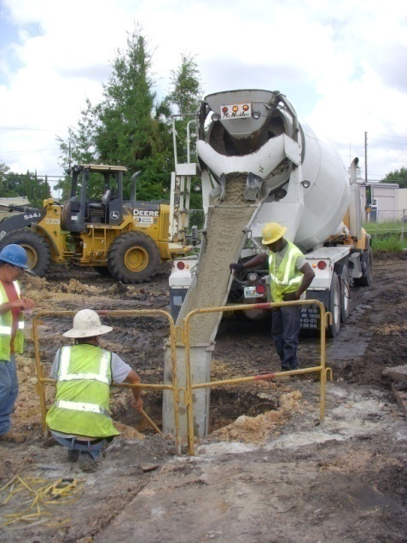
L D A
L
D
A
When drilling under the water table or in existing backfill material the need for casing must be evaluated.
Flowable Fill
Contingency factor
Should be discussed in the RAP and account for wobble and overlap.
Stability Wall vs. Sheetpiling
Cost Comparison
Safety Concerns
Composition of flowable fill
How will LDA affect future remediation?

Slide 24
Confirmation Soil Samples
Confirmation Soil Samples
LDA
Not recommended to collect from the auger flight.
Conventional
Bottom samples under the water table are not recommended.
Sufficient assessment up front is critical to avoid rush fees of lab analytical samples.
Occasionally bottom samples may be useful if the area will be inaccessible after the excavation (tank pit, dispenser/canopy location, etc.).

Slide 25
Invoicing
Invoicing
Segregate work order costs in a manner that facilitates invoicing and reduces need to move costs around via VCOs.
Consider requesting a letter from the site owner stating that site restoration is acceptable prior to final invoicing.
Request a table or spreadsheet with the invoice summarizing daily labor for oversight or in-house crew costs being invoiced.

Slide 26
Invoicing
Invoicing
Request a tabulated summary of weight tickets/manifests for soil disposal with each invoice.
Specify field notes per SOP 3.8.
Consider requesting draft invoices to minimize stop clocks and voids.

Slide 27
VCOs
VCOs
Remind contractors to consider all impacts of a change in scope before submitting VCOs. (avoid piece meal approach to VCOs)
In the event of multiple split work orders, double check that the VCO scope of work is applicable to the correct work order.
Make sure if an extension is authorized that the period of service on all split work orders is extended.

Slide 28
VCOs
VCOs
Make sure the rates match or are lower than the original approved bid.
Descriptions need to be detailed and reference any verbal conversations that took place with the site manager.
If a delay in VCO submittal is warranted (waiting for tonnage, etc.) it’s a good idea to follow up verbal conversations with e-mails.

Slide 29
VCOs > $100,000
VCOs > $100,000
Must be signed by the Bureau Chief.
May warrant generation of a new work order.
VCO
New Work Order
Change in scope of work
Minor Changes
Excessive cost increase

Slide 30
Questions???
QUESTIONS???
Graham Witt – (850) 222-6446 x 260 gwitt@wrscompass.com
Kristy Trueblood - (850) 222-6446 x 261 ktrueblood@wrscompass.com
Kristin Bailey – (850) 245-8902 kristin.bailey@dep.state.fl.us
Tamara Blyden – (850) 245-8903 tamara.blyden@dep.state.fl.us
Jeff A. Ray – (850) 245-8913 jeff.a.ray@dep.state.fl.us

