Slide 1
Used Oil Filter
Transporter
62-710, FAC

Slide 2
Used Oil Filters
Used Oil Filters are any devices which are an integral part of an oil flow system, the primary purpose of which is to remove contaminants from the flowing oil contained within the system and which, as a result of use, has become contaminated and unsuitable for its original purpose, is removed from service, and contains entrapped used oil
No person who removes or manages used oil filters shall dispose of such filters, or comingle such filters with other solid waste for disposal, in a landfill in Florida

Slide 3
Used Oil Filter Transporter
A Used Oil Filter Transporter is any person who transports, over public highways, for hire used oil filters to a Used Oil Filter Transfer or Processing Facility
The used oil filters are stored for < 10 days
Note: Generators of used oil filters are exempt for the registration and reporting requirements provided that they transport their own used oil filters in sealed containers of 55 gallons or less which are secured to a vehicle owned by the generator

Slide 4
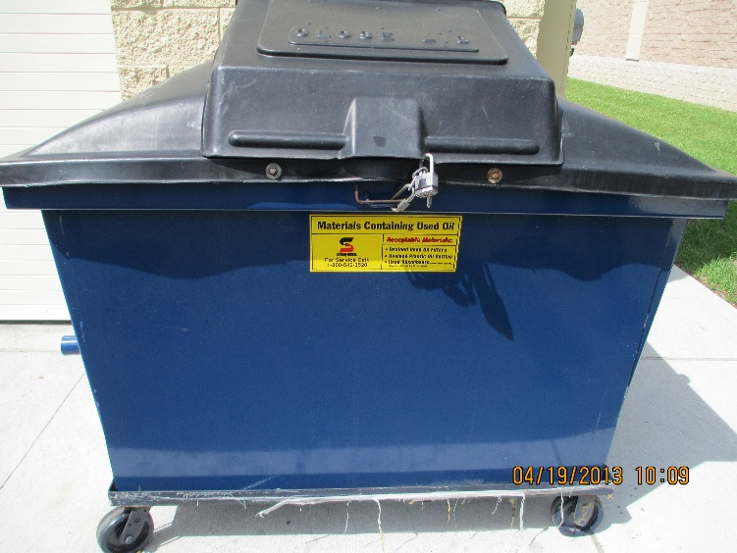
Used Oil Filter Transporter Requirements
Annual registration [62-710.850(3)(a), FAC]
Container Management [62-710.850(5)(a), FAC]:
Store used oil filters in aboveground containers
Label containers “Used Oil Filters”
Containers need to be in good condition
Containers can not have visible oil leaks
Containers need to be closed or covered
Containers need to be stored on an oil-impermeable surface

Slide 5
Used Oil Filter Transporter Requirements
Upon detection of a release of oil from any used oil filter container, the facility shall [62-710.850(5)(b)(1-4), FAC]:
Stop the release
Contain the released oil
Clean up and manage properly the released oil and any subsequently oily waste in accordance with 62-777, FAC, if applicable
Repair or replace any leaking used oil filter storage containers prior to returning them to service

Slide 6
Used Oil Filter
Transfer Facility
62-710.850, FAC

Slide 7
Used Oil Filter Transfer Facility
A Used Oil Filter Transfer Facility is any facility which is used to store, for more than 10 days, used oil filters which were not generated at that facility
Note: A person who stores its own used oil filters generated at its own non-contiguous operations on its own property is not considered a Used Oil Filter Transfer Facility provided the used oil filters are processed by a registered Used Oil Filter Processor

Slide 8
Used Oil Filter Transfer Facility Requirements
Annual registration [62-710.850(3)(b), FAC]
Container Management [62-710.850(5)(a), FAC]:
Store used oil filters in aboveground containers
Label containers “Used Oil Filters”
Containers need to be in good condition
Containers can not have visible oil leaks
Containers need to be closed or covered
Containers need to be stored on an oil-impermeable surface

Slide 9
Used Oil Filter Transfer Facility Requirements
Upon detection of a release of oil from any used oil filter container, the facility shall [62-710.850(5)(b)(1-4), FAC]:
Stop the release
Contain the released oil
Clean up and manage properly the released oil and any subsequently oily waste in accordance with 62-777, FAC, if applicable
Repair or replace any leaking used oil filter storage containers prior to returning them to service

Slide 10
Used Oil Filter
Processor
62-710.850, FAC

Slide 11
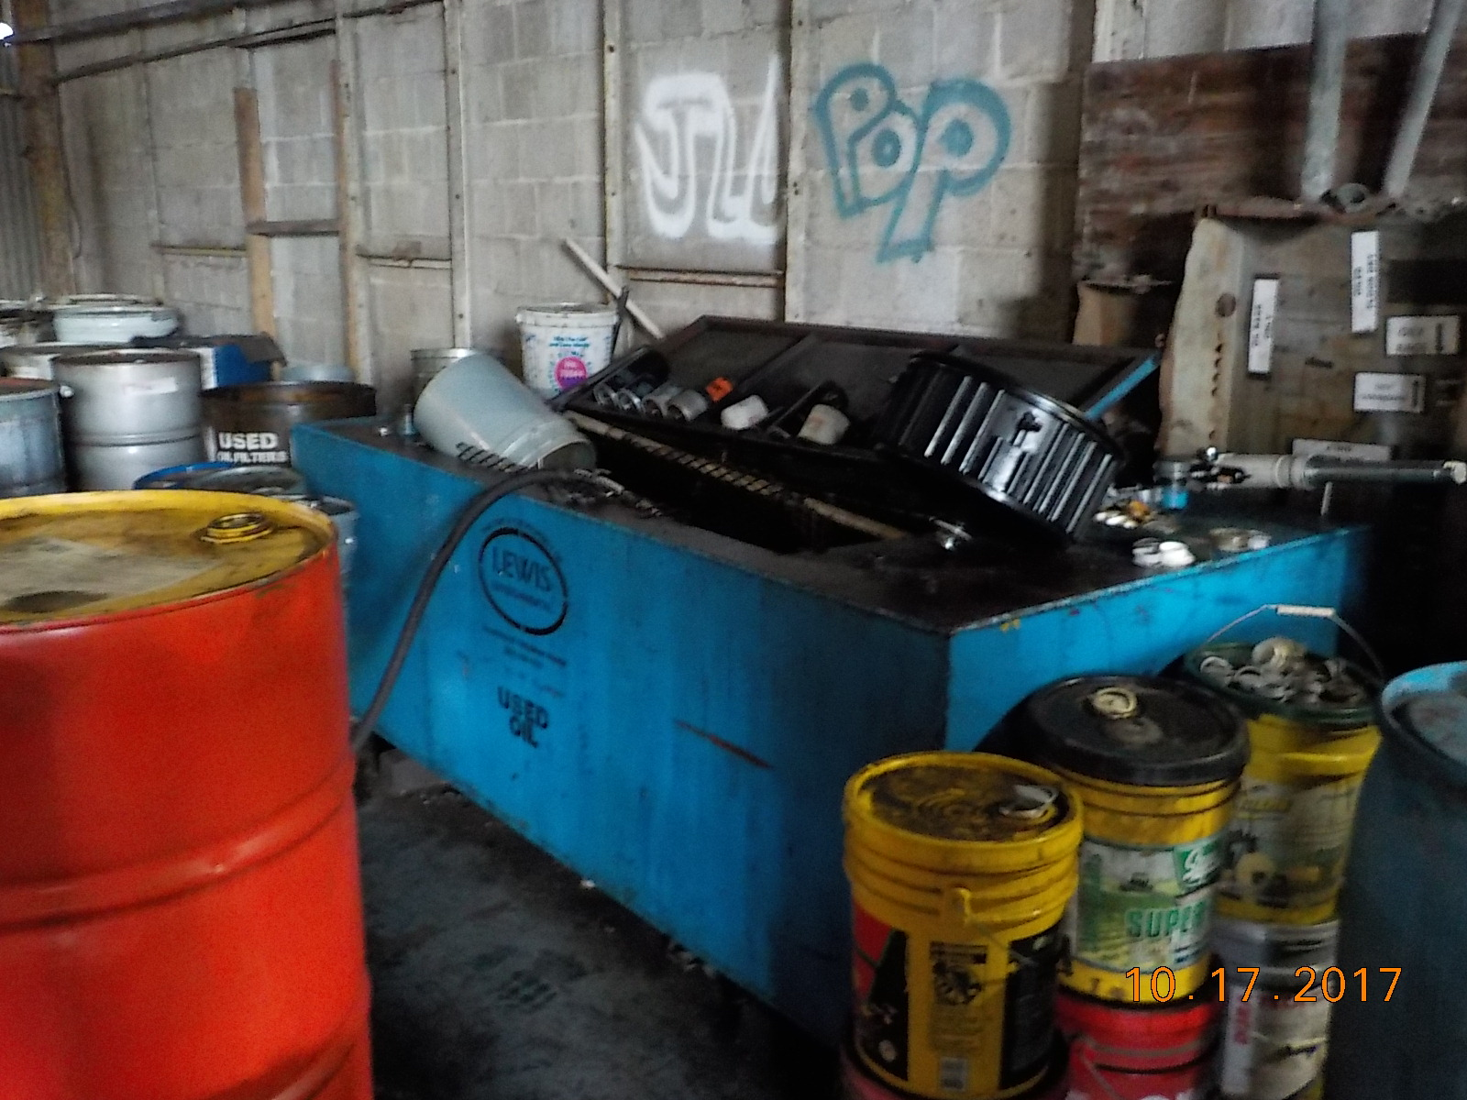
Used Oil Filter Processor
A Used Oil Filter Processor is a person who removes used oil from used oil filters to prepare them for recycling
Note: Generators of used oil filters who consolidate, drain or crush used oil filters for off-site recycling are not Used Oil Filter Processors provided that they comply with 62-710.850(2), FAC

Slide 12
Used Oil Filter Processor Requirements
Annual registration [62-710.850(3)(c), FAC]

Slide 13
Used Oil Filter Processor Requirements
Recordkeeping [62-710.850(4)(a-c), FAC]
Maintain records on Form 62-710.901(2), or substantially equivalent form. Forms shall include the destination or end use of the processed used oil filters and the name and street address of each destination or end user.
Records retained for 3 years, kept at the street address of the registered person and be available for inspection.
No later than March 1st of every year, submit an annual report on Form 62-710.901(3).

Slide 14
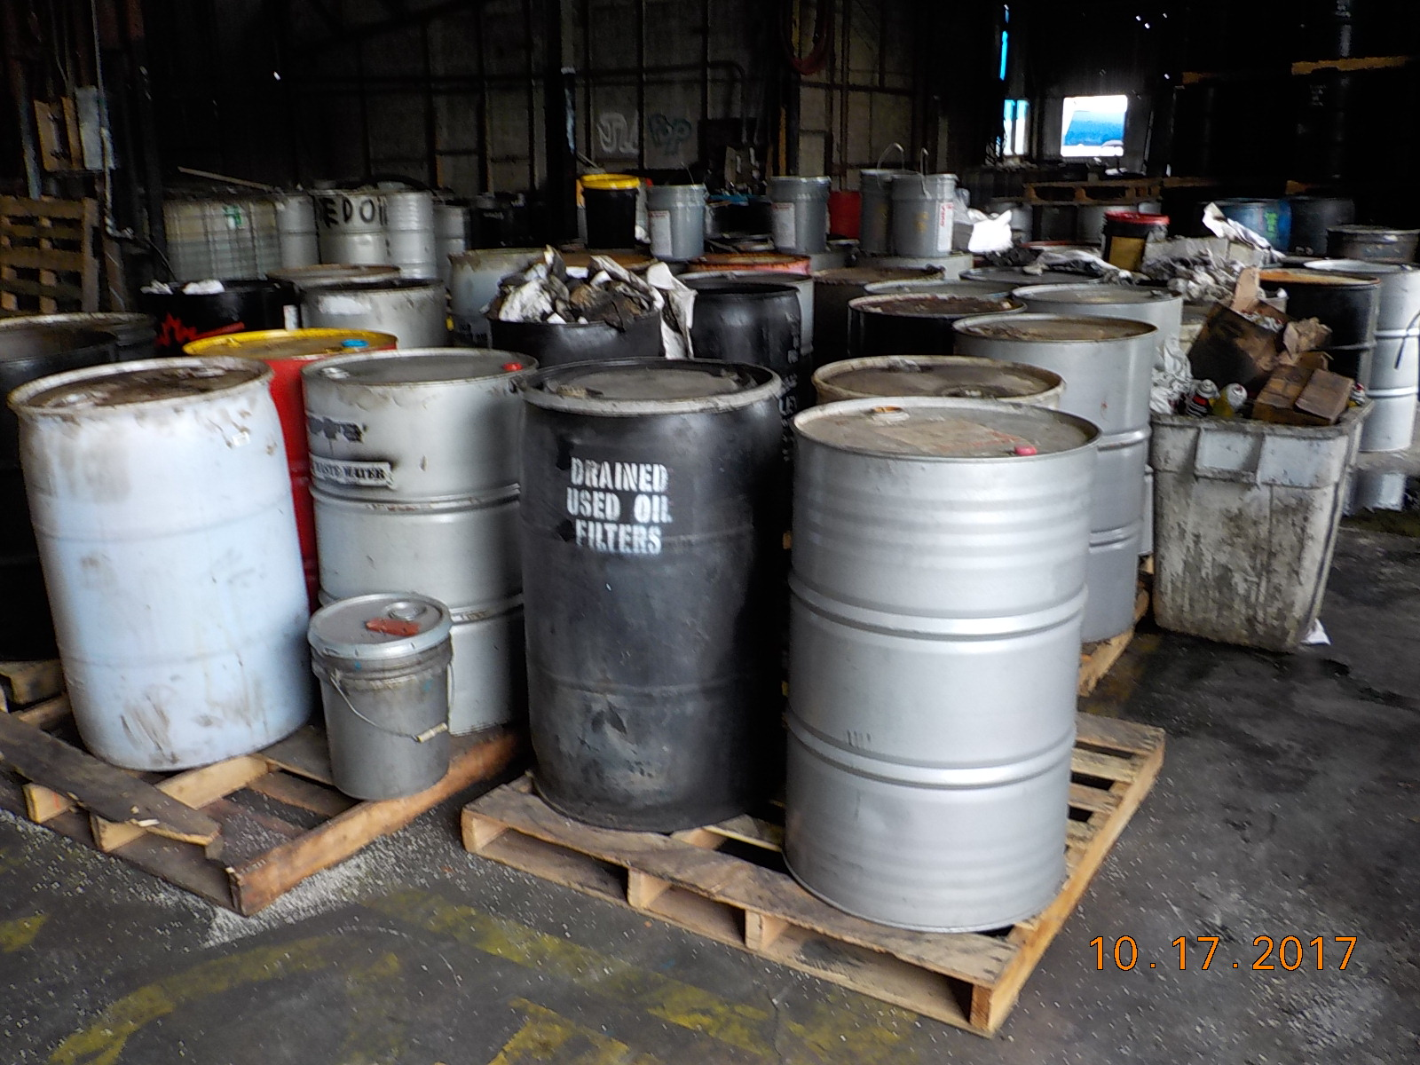
Used Oil Filter Processor Requirements
Container Management [62-710.850(5)(a), FAC]:
Store used oil filters in aboveground containers
Label containers “Used Oil Filters”
Containers need to be in good condition
Containers can not have visible oil leaks
Containers need to be closed or covered
Containers need to be stored on an oil-impermeable surface

Slide 15
Used Oil Filter Processor Requirements
Upon detection of a release of oil from any used oil filter container, the facility shall [62-710.850(5)(b)(1-4), FAC]:
Stop the release
Contain the released oil
Clean up and manage properly the released oil and any subsequently oily waste in accordance with 62-777, FAC, if applicable
Repair or replace any leaking used oil filter storage containers prior to returning them to service

Slide 16
Questions?
Hazardous Waste Program
8800 Baymeadows Way West
Suite 100 Jacksonville, Florida 32256 (904) 256-1700 (904) 256-1588 fax

