Slide 1
Used Oil
Transporters
40 CFR 279 Subpart E; 62-710, FAC
Notes:
Note: The rules in this PowerPoint have been summarized. Please refer to the rule for the complete text.

Slide 2
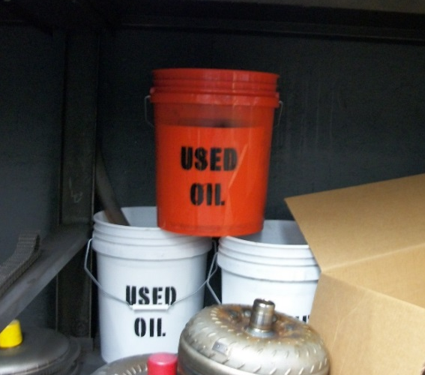
Who is NOT a Used Oil Transporter?
The facility is exempt under the following (40 CFR 279.24):
Self-transportation of small amounts to approved collection centers. Provided that:
Company or employee owns vehicle
No more than 55 gallons at one time
Used oil is taken to an facility that is registered, licensed, permitted or recognized to managed used oil

Slide 3
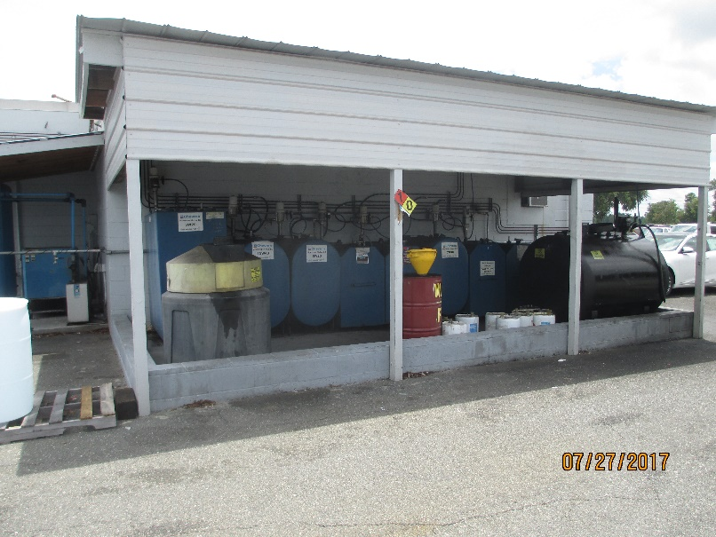
Who is NOT a Used Oil Transporter?
The facility is exempt under the following (40 CFR 279.24):
Self-transportation of small amounts to aggregation points owned by the generator. Provided that:
Company or employee owns vehicle
No more than 55 gallons at one time (and less than 500 gallons annually)
The aggregation point is owned and/or operated by the same generator

Slide 4
Who is NOT a Used Oil Transporter?
Generators of used oil may transport used oil on-site

Slide 5
Who is a Used Oil Transporter?
Used Oil Transporters [40 CFR 279.40] are:
Persons who transport used oil
Persons who collect used oil from more than one generator and transport the collected oil
Owners or operators of used oil transfer facilities
“Used Oil Transporter” [62-710.201(5), FAC] is:
Any person who transports used oil over highways
Any person who collects used oil from more than one generator and transports the collected oil over public highways
Owners and operators of used oil transfer facilities

Slide 6
Who is a Used Oil Transporter?
Used Oil Transporters:
Hold used oil for less than 24 hours
Note: If you hold used oil for >24 hours (and less than 35 days), you are a Transfer Facility
Note: If you hold used oil for >35 days, you are a Used Oil Processor. Used Oil Processor Requirements are not covered in this Presentation.

Slide 7
Used Oil Transporter Requirements
Used Oil Transporters [40 CFR 279.40(b-c)]:
(b) Imports and exports of used oil are regulated while the used oil is in the US
(c) Trucks used to transport hazardous waste should be empty (40 CFR 261.7) or the used oil may be considered to be mixed with the hazardous waste

Slide 8
Used Oil Transporter Requirements
Used Oil Transporters [40 CFR 279.40(d)(1-3)]:
(1) Transporters who generate used oil are also used oil generators and need to comply with 40 CFR 279 Subpart C
(2) Transporters who process or re-refine used oil, except as provided in 40 CFR 279.41, need to comply with 40 CFR 279 Subpart F
(3) Transporters who burn off-spec used oil for energy recovery need to comply with 40 CFR 279 Subpart G

Slide 9
Used Oil Transporter Requirements
Used Oil Transporters [40 CFR 279.40(d)(4 - 5)]:
(4) Transporters who direct shipments of off-spec used oil to a used oil burner or first claim that the used oil that is to be burned meets the used oil fuel specs need to comply with 40 CFR 279 Subpart H
(5) N/A Note: Used oil may not be used as dust suppressant in Florida

Slide 10
Used Oil Transporter Requirements
Used Oil Transporters [40 CFR 279.41(a - c)]:
(a) Transporters may consolidate or aggregate loads of used oil for purposes of transportation, but not process unless they comply with 40 CFR 279 Subpart F.
Transporters may conduct incidental processing operations that occur in the normal course of used oil transportation, but not those that are designed to produce or make more amenable used oil derived products unless they comply with 40 CFR 279 Subpart F
Transporters may remove and filter oil from electrical transformers and turbines and return the oil to its original use

Slide 11
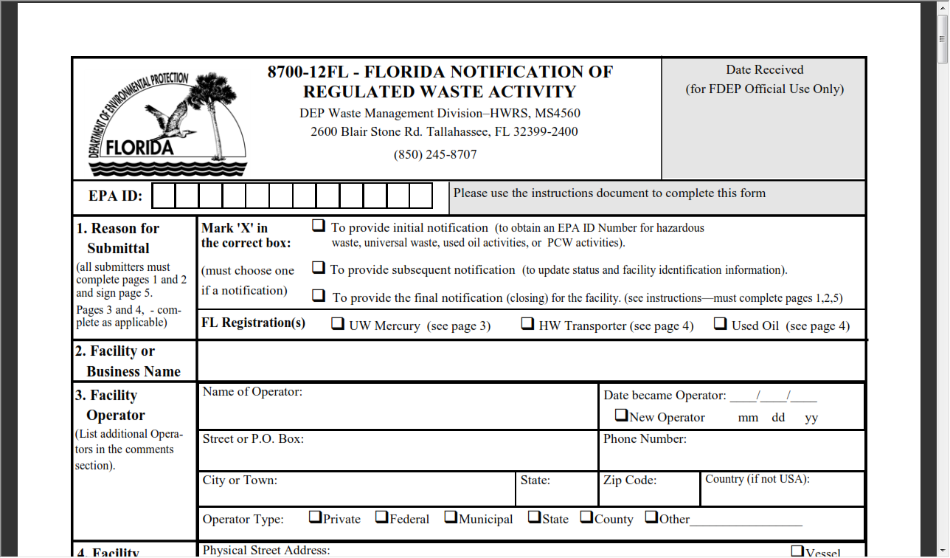
Used Oil Transporter Requirements
Notification [40 CFR 279.42]:
Obtain a DEP/EPA identification number

Slide 12
Florida Used Oil Transporter Registration
Florida Used Oil Transporters [62-710.500, FAC]:
Annually register [62-710.500(1)(a), FAC]
Pay $100.00 per year per facility [62-710.500(2), FAC]
Register and pay fee by March 1 of each year [62-710.500(2), FAC]
Display the valid registration form and identification number in a prominent place at each facility location [62-710.500(4), FAC]

Slide 13
Florida Used Oil Transporter Certification - Exceptions
Any Used Oil Transporter that transports over public highways more than 500 gallons of used oil annually, not including oily waste, shall become certified except for [62-710.600(1), FAC]:
Local governments or a private solid waste hauler under contract to a local government that transports used oil collected from households to a PUOCC
(b) A Used Oil Transporter transporting its own used oil to its own central collection facility for storage, processing or energy recovery. Proof of financial responsibility still required
(c) Any Used Oil Transporter who always transports <55 gallons of used oil in tightly closed containers in a totally enclosed section of the transport vehicle

Slide 14
Florida Used Oil Transporter Certification
Florida Used Oil Transporter Certification [62-710.600(2)(a-c), FAC]:
Annually register and comply with reporting record requirements [62-710.500(1)(a), FAC]
Show evidence of familiarity with laws and rules for Used Oil Transporters by submitting a certification and have an annual and new employees training program
Maintain training records as required

Slide 15
Florida Used Oil Transporter Certification
Does the facility train its employees in the following:
State and federal rules governing used oil
Proper used oil management practices, including spill response
SOP for halogen screening including instrument specs and capabilities, calibration methods and frequency, procedures for loads in excess of 1,000 ppm
Record keeping procedures

Slide 16
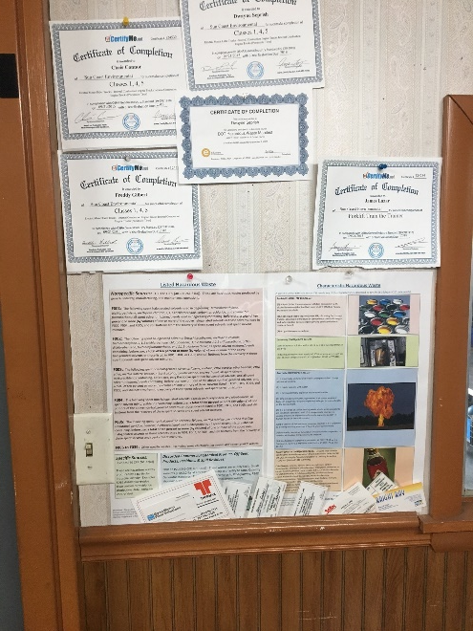
Florida Used Oil Transporter Certification
Do the facility training records include the following [62-710.600(2)(c), FAC]:
Documents in the operating record and the individual personnel file that indicate the type of training
The dated signature of those receiving and providing the training
3 year retention of records

Slide 17
Florida Used Oil Transporter Certification
Florida Used Oil Transporter Annual Certification [62-710.600(2)(d), FAC]:
Submit an annual Certification along with the annual registration.
Statement that the Transporter is familiar with laws and rules
Has an annual and a new employee training program that is annually reviewed to stay current with the rules
Provide any modifications to the training plan

Slide 18
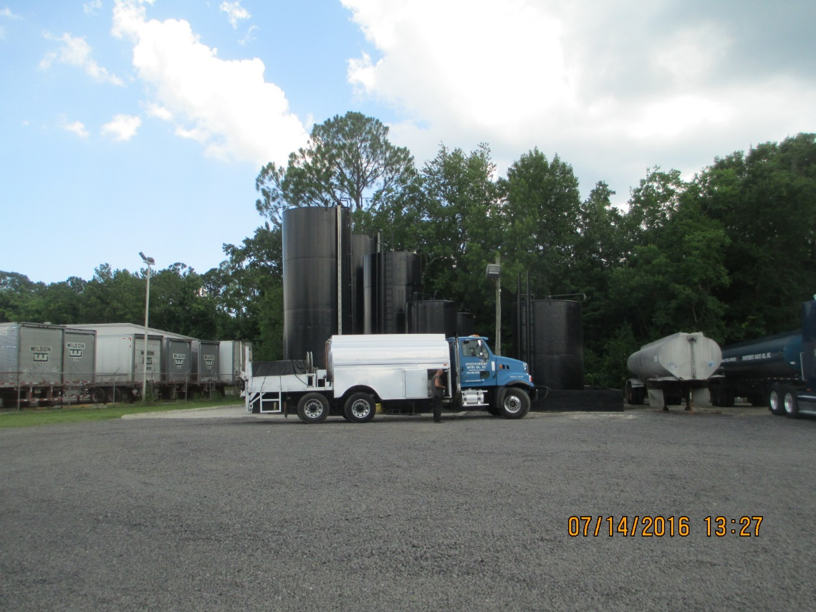
Florida Used Oil Transporter Certification
Does the facility have verify and maintain insurance or financial assurance of $1,000,000 combined single limit? [62-710.600(2)(e), FAC]

Slide 19
Used Oil Transporter Acceptance
To ensure that the used oil is not a hazardous waste under the rebuttable presumption of 40 CFR 279.10(b)(1)(ii), the Used Oil Transporter must determine whether the total halogen content of a used oil being transported or stored at a transfer facility is above or below 1,000 ppm [40 CFR 279.44(a)].

Slide 20
Used Oil Transporter Acceptance
The Used Oil Transporter must make the determination by [40 CFR 279.44(b)(1-2)]:
Testing the used oil – Methods used include, but are not limited to:
Halogen detectors
Chlor-D-Tect kits
Lab analysis
(2) Applying knowledge of the used oil in light of the materials or process used. Note: This is not sufficient in most cases for commercial Used Oil Transporters.

Slide 21
Used Oil Transporter Acceptance
If the used oil contains greater than or equal to 1,000 ppm total halogens, it is presumed to be a hazardous waste. The Transporter may rebut the presumption by following the procedures in 40 CFR 279.44(c)
Also see (c)(1) and (c)(2) for exceptions:
(c)(1) Some metalworking fluids
(c)(2) Some refrigeration oils

Slide 22
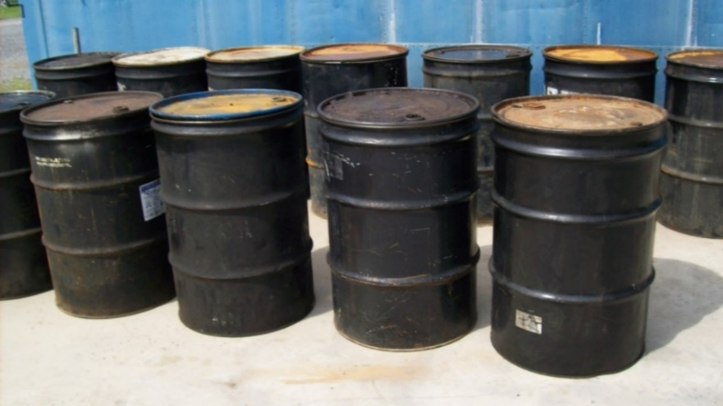
Used Oil Transporter Acceptance
Have any analyses shown exceedances over the 1,000 ppm level?
If so, was the used oil managed as hazardous waste?
If so, was the used oil rejected? See 62-710.510(2), FAC
If not, was the oil exempt?
Every shipment must be screened.
Every screening must be documented.

Slide 23
Florida Used Oil Transporter Records
The Transporter is responsible for keeping track of the following information [62-710.510(1)(a-c), FAC]:
Name, business address, phone number and EPA ID# of the Transporter
Source of the used oil, including the name, and street address of each source and EPA ID # if the generator has one
Total number of gallons received from each source, including any oily wastes

Slide 24
Florida Used Oil Transporter Records
Records (cont.) [62-710.510(1)(d-g), FAC]:
The type of used oil received using the type codes from the instructions
Date of receipt
Destination or end use of used oil and oily wastes, including the name and street address of each destination or end user, the EPA ID # and the end use code from the instructions
Documentation of halogen screening discussed in previous slides

Slide 25
Florida Used Oil Transporter Acceptance/Rejection
Transporters shall maintain documentation of all shipments of used oil, including those accepted for transport as well as those refused due to suspected mixing with hazardous waste. A copy of this record shall be left with the generator [62-710.510(2), FAC]

Slide 26
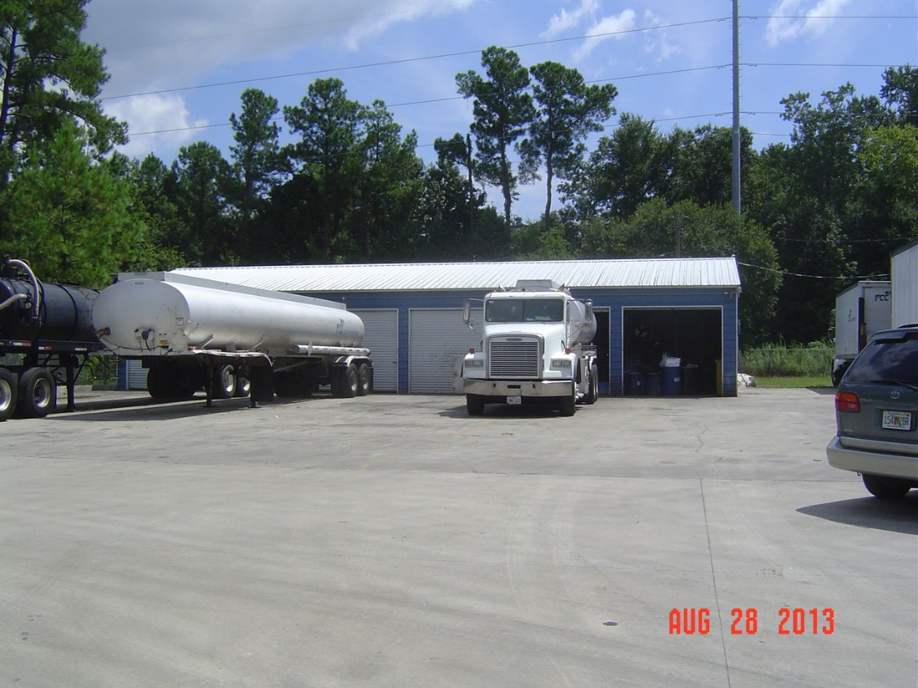
Used Oil Transporter Transportation
UO Transporters need to comply with DOT regulations in 49 CFR 171-180 [40 CFR 279.43(b)]

Slide 27
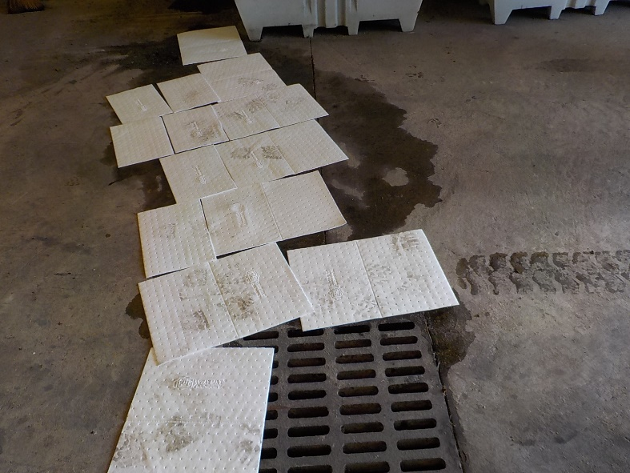
Used Oil Transporter Transportation
In the event of a discharge during transport [40 CFR 279.43(c)(1-2)]:
The Transporter must take immediate action to protect human health and the environment
If discharge occurs during transportation, government officials may authorize removal by other transporters

Slide 28
Used Oil Transporter Transportation
In the event of a discharge during transport [40 CFR 279.43(c)(3-4)]:
Air, rail, highway or water transporters who have discharged used oil must:
Notify the NRC (800) 424-8802 or (202) 426-2675
Report in writing as required by 29 CFR 171.16
A water transporter who has discharged used oil must give notice as required by 33 CFR 153.203

Slide 29
Florida Used Oil Transporter Transportation
In the event of a discharge during transport in Florida, the following reporting requirements in addition to the federal requirements apply:
In all of Florida - Petroleum or petroleum products equal to, or exceeding, 25 gallons discharged onto pervious surfaces or any discharge to surface waters shall be reported to the State Watch Office or FDEP Office of Emergency Response as soon as possible, but no later than 24 hours after occurrence. The SWO number is (800) 320 - 0519 [62-780.210(1)(b), FAC].
In Duval County – The reportable quantity is 10 gallons or more regardless of the media spilled to and any amount discharged to water. Notification is “immediately.” The City of Jacksonville EQD number is (904) 255 – 7171.
In Alachua County – The reportable quantity is greater than 5 gallons regardless of media spilled on, and any amount to water. The number to call is either 911 or the ACEPD at (352) 955 – 1818.

Slide 30
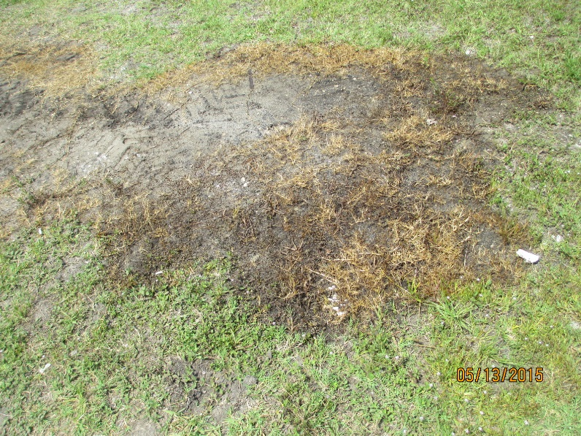
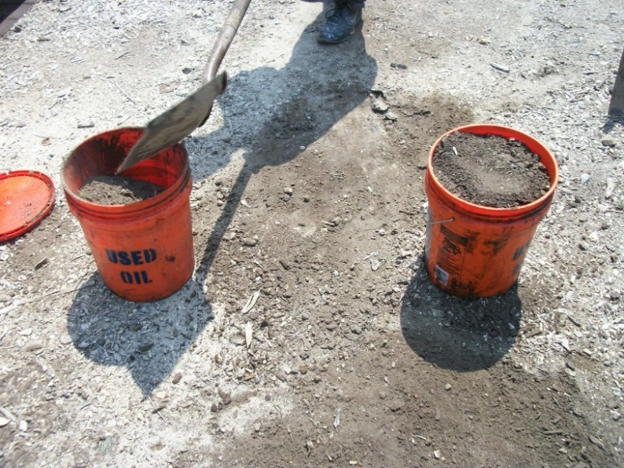
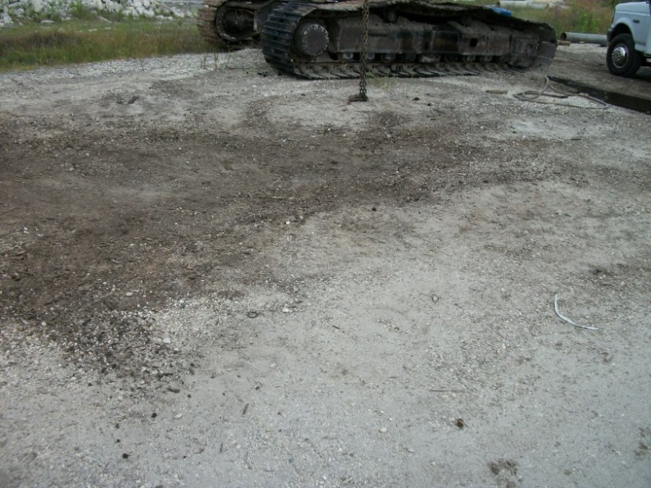
Used Oil Transporter Transportation
In the event of a discharge during transport [40 CFR 279.43(c)(5)]:
(5) Clean up any discharge that occurs or take other action so that the discharge no longer presents a hazard to human health or the environment

Slide 31
Used Oil Transporter Residues
Transporters who generate residue from the storage or transport of used oil must manage the residues as specified in 40 CFR 279.10(e)(1-2) [40 CFR 279.47]:
(e)(1) Materials derived from used oil that are reclaimed and used beneficially and not burned for energy recovery or used in a manner constituting disposal are:
Not used oil subject to 40 CFR 279
Not solid wastes, and as a result could not be hazardous waste
(2) Materials produced from used oil that are burned for energy recovery are regulated under 40 CFR 279
Notes:
Example for (1) – re-refined lubricants
Example for (2) – used oil fuels

Slide 32
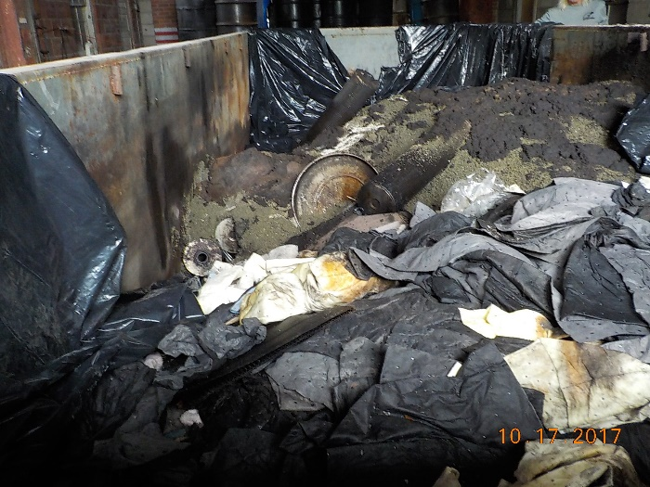
Florida Used Oil Transporter Residues
Transporters who generate residue from the storage or transport of used oil must manage the residues as specified in 40 CFR 279.10(e)(3-4) [40 CFR 279.47]:
(e)(3)Except for #4 below, materials derived from used oil that are disposed of or used in a manner constituting disposal are:
Not used oil subject to 40 CFR 279
Are solid wastes and may be hazardous waste. A hazardous waste determination must be performed pursuant to 40 CFR 262.11.
Notes:
Example for (3) –used oil sludge generated by the Transporter. 262.11 – TCLP is needed

Slide 33
Florida Used Oil Transporter Residues
Transporters who generate residue from the storage or transport of used oil must manage the residues as specified in 40 CFR 279.10(e)(3-4) [40 CFR 279.47]:
(e)(4) Used oil re-refining distillation bottoms that are used as feedstock to manufacture asphalt products are not subject to 40 CFR 279

Slide 34
Used Oil Transporter Deliveries
A Used Oil (UO) Transporter must deliver all used oil to [40 CFR 279.43(a)(1-4)]:
Another UO Transporter, provided that the Transporter has obtained an EPA ID#
A UO Processing/re-fining facility who has obtained an EPA ID#
An off-spec UO burner facility who has obtained an EPA ID#
An on-spec used oil burner facility

Slide 35
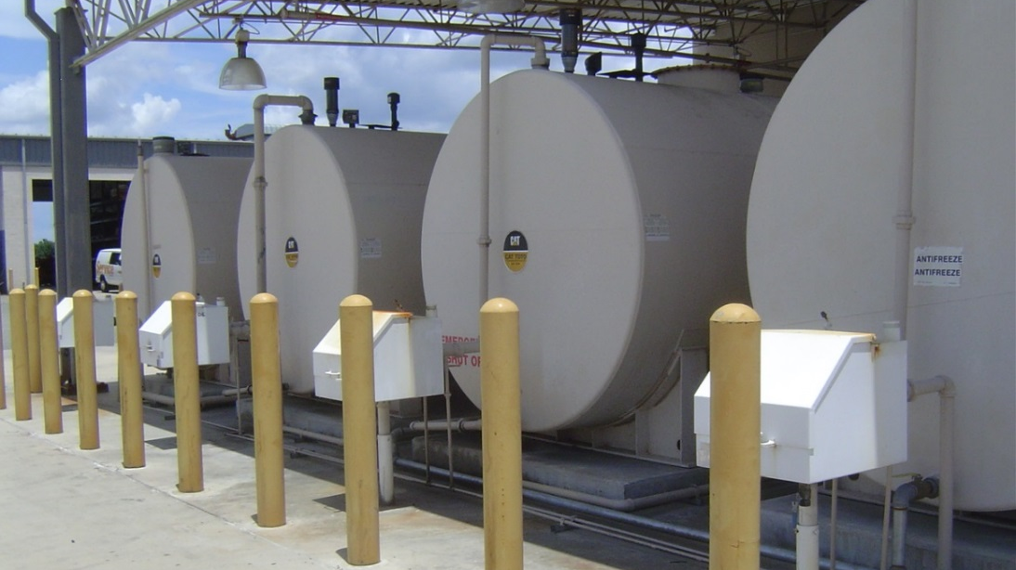
Used Oil Transporter Deliveries
Do used oil delivery records include the following [40 CFR 279.46(b)(1-4)]:
(1) Name and address of receiving facility/Transporter?
(2) EPA ID# of receiving facility/Transporter?
(3) Quantity of used oil delivered?
(4) Date of delivery?

Slide 36
Used Oil Transporter Deliveries
Records (cont.) [40 CFR 279.46(b)(5)]:
(5) Except for intermediate rail Transporters:
Signature of a representative of the receiving facility or Transporter
Signature dated upon receipt
Records for exports of used oil to any foreign country need to contain [40 CFR 279.46(c)]:
Name and address of receiving facility/Transporter?
EPA ID# of receiving facility/Transporter?
Quantity of used oil delivered?
Date of delivery?

Slide 37
Used Oil Transporter Deliveries
Records for used oil acceptance, delivery and exports must be maintained for at least three years [40 CFR 279.46(d)]

Slide 38
Florida Used Oil Transporter Records
DEP Form 62-710.901(2) or a substantially equivalent form must be used. (Page 1)
Notes:
Go over paper form

Slide 39
Florida Used Oil Transporter Records
DEP Form 62-710.901(2) or a substantially equivalent form must be used.
(Page 2)
Notes:
Go over paper form

Slide 40
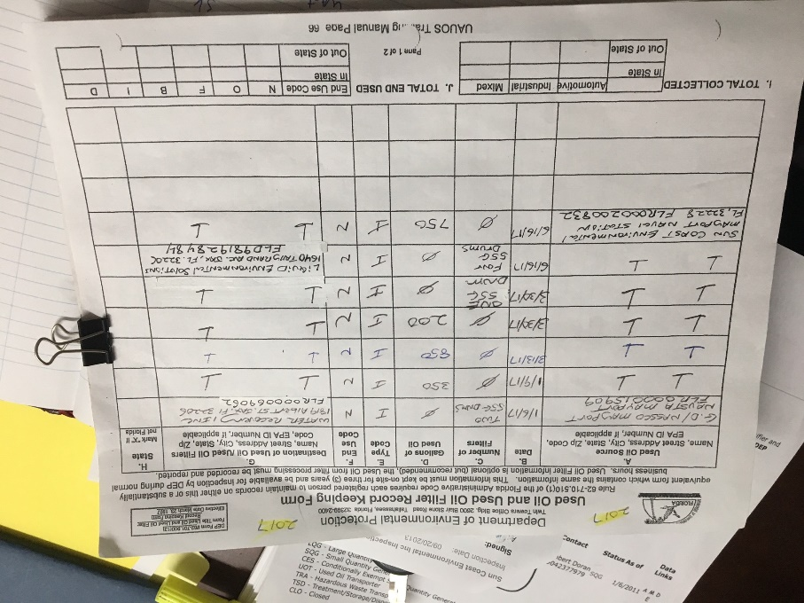
Florida Used Oil Transporter Records
Records shall be retained for a period of three years. The records shall be kept at the street address of the registered person and be available for DEP inspection during normal business hours, unless another location and inspection schedule is specified in the registration packet [62-710.510(4), FAC]

Slide 41
Florida Used Oil Transporter Records
Annual Report:
No later than March 1 of each year submit an annual report for the preceding calendar year [62-710.510(5), FAC].
Use Form 62-710.901(3)
(Page 1)

Slide 42
Florida Used Oil Transporter Records
Annual Report:
No later than March 1 of each year submit an annual report for the preceding calendar year [62-710.510(5), FAC].
Use Form 62-710.901(3)
(Page 2)

Slide 43
Used Oil
Transfer Facilities
40 CFR 279 Subpart E; 62-710, FAC

Slide 44
Used Oil Transfer Facilities
UO Transfer Facilities are transportation related facilities including loading docks, parking areas, storage and other areas where shipments of used oil are held for more than 24 hours during the normal course of transportation [40 CFR 279.45(a) and 62-710.201(11), FAC]
If used oil is held for longer than 35 days, the facility is defined as a Used Oil “Processor” [62-710.201(3), FAC]. The facility is then subject to regulation under 40 CFR 279 Subpart F
How does the facility keep track of how many days the used oil is stored on site?

Slide 45
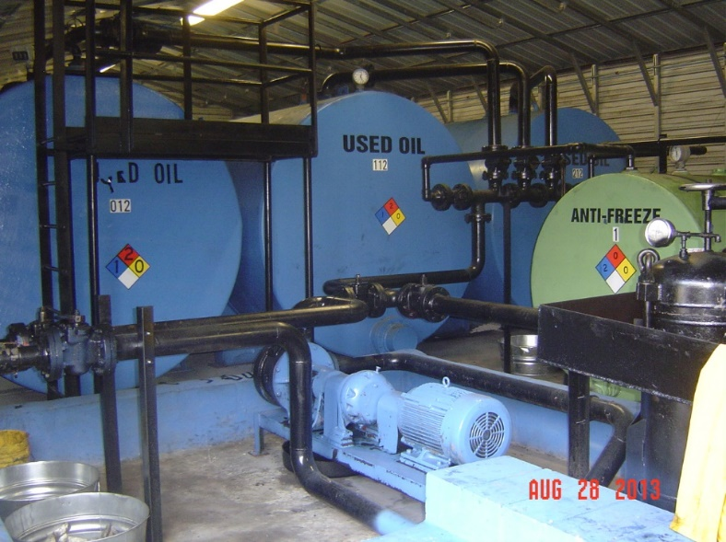
Used Oil Transfer Facility Requirements
Used Oil Transfer Facilities are required to comply with all of the requirements for Used Oil Transporters mentioned in the previous presentation.

Slide 46
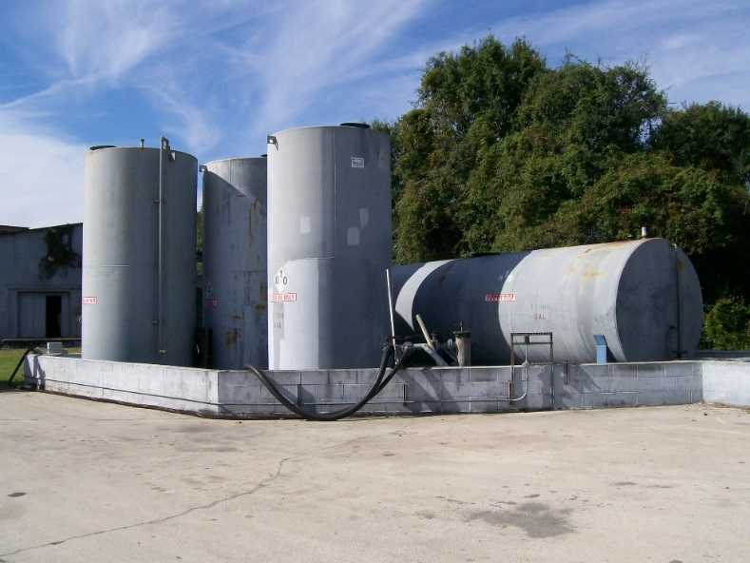
Used Oil Transfer Facility Requirements
Used Oil Transfer Facilities are subject to all applicable Spill Prevention, Control and Countermeasures (40 CFR Part 112) in addition to the applicable requirements of 40 CFR 279 and 62-710, FAC.

Slide 47
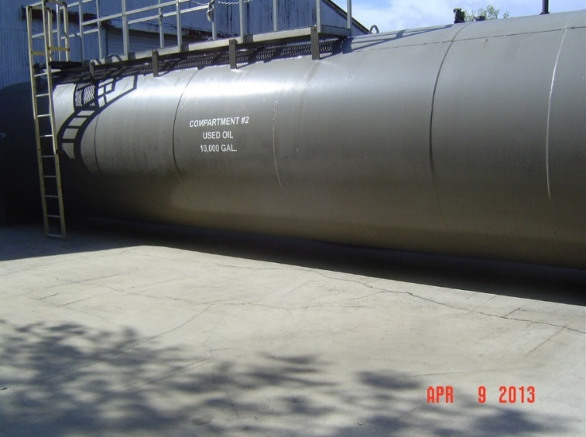
Used Oil Transfer Facility Requirements
Storage units [40 CFR 279.45(b - c)]:
Store used oil only in containers, tanks or units subject to the requirements of 40 CFR 264 and 265
Containers and aboveground tanks must be:
In good condition
Not leaking (no visible leaks)

Slide 48
Used Oil Transfer Facility Requirements
Secondary containment for containers [40 CFR 279.45(d)]:
Secondary containment must be a dike, berm or retaining wall and have a floor that covers the entire area. It may also be an equivalent secondary containment system. It must also be sufficiently impervious to used oil.
State requirements for containers [62-710.401(6), FAC]:
Must be kept closed or covered if not inside of a structure
Must be an oil-impermeable surface such as sealed concrete or asphalt
Must have the capacity to hold 110% of the volume of the largest container or be double walled

Slide 49
Used Oil Transfer Facility Requirements
Secondary Containment for existing aboveground tanks (Note: See definition of “existing” in 40 CFR 279.1) [40 CFR 279.45(e)]:
(e) Secondary containment must be a dike, berm or retaining wall and have a floor that covers the entire area except areas where existing portions of the tank meet the ground. It may also be an equivalent secondary containment system. It must also be sufficiently impervious to used oil.
State requirements for tanks [62-710.401(6), FAC]:
Must be kept closed or covered if not inside of a structure
Must be an oil-impermeable surface such as sealed concrete or asphalt
Must have the capacity to hold 110% of the volume of the largest tank or be double walled

Slide 50
Used Oil Transfer Facility Requirements
Secondary containment for new aboveground tanks (Note: See definition of “new” in 40 CFR 279.1) [40 CFR 279.45(f)]:
(e) Secondary containment must be a dike, berm or retaining wall and have a floor that covers the entire area. It may also be an equivalent secondary containment system. It must also be sufficiently impervious to used oil.
State requirement for tanks [62-710.401(6), FAC]:
Must be kept closed or covered if not inside of a structure
Must be an oil-impermeable surface such as sealed concrete or asphalt
Must have the capacity to hold 110% of the volume of the largest container

Slide 51
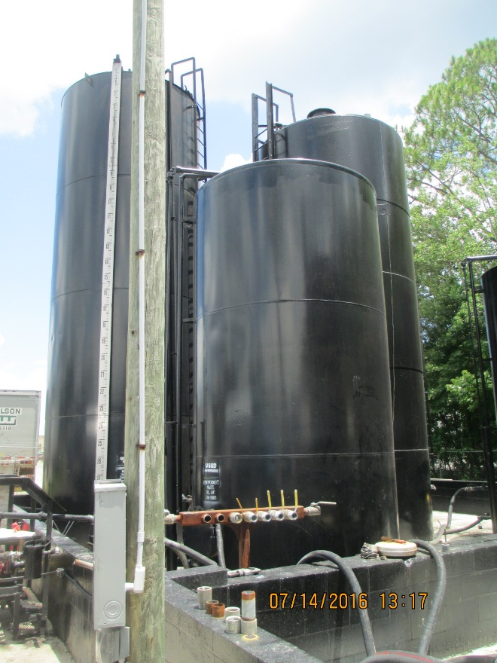
Used Oil Transfer Facility Requirements
Underground used oil tanks with the capacity of greater than 110 gallons or aboveground tanks with a capacity of greater than 550 gallons shall comply with 62-761 and 62-762, FAC

Slide 52
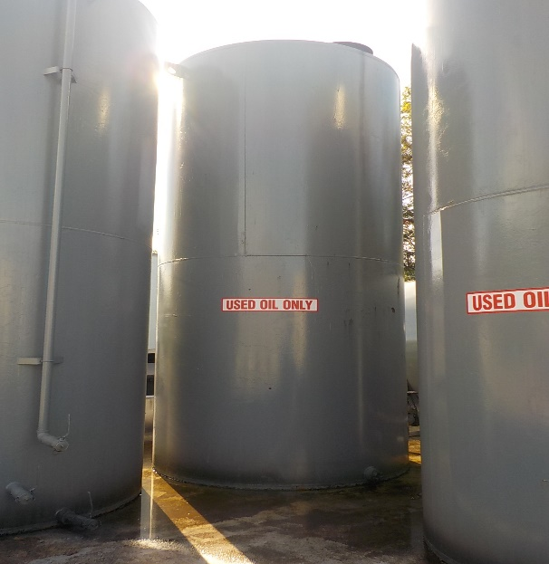
Used Oil Transfer Facility Requirements
All of the following at Used Oil Transfer Facilities should be labeled or clearly marked “Used Oil” [40 CFR 279.45(g) and 62-710.401(6), FAC]:
Containers
Aboveground tanks
Fill pipes used to transfer the used oil into underground storage tanks

Slide 53
Used Oil Transfer Facility Requirements
Upon detection of a release of used oil to the environment, not subject to 40 CFR 280 Subpart F, the owner/operator must perform the following cleanup steps [40 CFR 279.45(h)]:
Stop the release
Contain the released used oil
Clean up and manage properly the released used oil and other materials
If necessary repair or replace any leaking used oil storage container or tanks prior to returning them to service
Note: The facility is also required to report releases as discussed above in the UO Transporter section

Slide 54
Used Oil Fuel Marketer Definitions
Used Oil Fuel Marketer [40 CFR 279.1 and 62-710.201(10), FAC] – Any person who:
Directs a shipment of off-spec used oil from their facility to a used oil burner
First claims that the used oil that is to be burned for energy recovery meets the used oil fuel specs in 40 CFR 279.11

Slide 55
Used Oil Processor Definitions
Processing Used Oil [40 CFR 279.1 and 62-710.201(2), FAC]:
Chemical or physical operations designed to produce form used oil, or to make used oil more amenable for production of, fuel oils, lubricants or other used oil-derived product.
Blending used oil with virgin petroleum products
Blending used oil to meet the fuel specs
Filtration
Simple distillation
Chemical or physical separation
Re-refining
Note: Incidental processing and other examples are not “processing” (See 40 CFR 279.41)

Slide 56
Used Oil Processor Definitions
Used Oil Processor [40 CFR 279.1 and 62-710.201(3), FAC]:
Any person processing used oil
Any Used Oil Transfer Facility that stores used oil for longer than 35 days
Any Used Oil Marketer who receives used oil from Transporters and who has at least 25,000 gallons of used oil storage capacity
Any person who blends used oil with on-spec used oil fuel or with virgin petroleum products for the purpose of producing on-spec used oil fuel

Slide 57
Public Used Oil
Collection Centers
40 CFR 279 Subpart D; 62-710, FAC

Slide 58
Public Used Oil Collection Center
Public Used Oil Collection Center/DIY/Used Oil Collection Centers [40 CFR 279.30, 40 CFR 279.31 and 62-710.201(4), FAC]:
DIY collection centers
Used oil collection center
An automotive service facility which accepts household used oil
Government sponsored collection facility which accepts household used oil
Facility which stores used oil and accepts small quantities from households

Slide 59
Public Used Oil Collection Center Requirements
Storage units [40 CFR 279.22(a-b)]:
Store used oil only in containers, tanks or units subject to the requirements of 40 CFR 264 and 265
Containers and aboveground tanks must be:
In good condition
Not leaking (no visible leaks)
Don’t

Slide 60
Public Used Oil Collection Center Requirements
State requirements for containers and tanks [62-710.401(6), FAC]:
Must be kept closed or covered if not inside of a structure
Must be an oil-impermeable surface such as sealed concrete or asphalt
Must have the capacity to hold 110% of the volume of the largest container/tank or be double walled

Slide 61
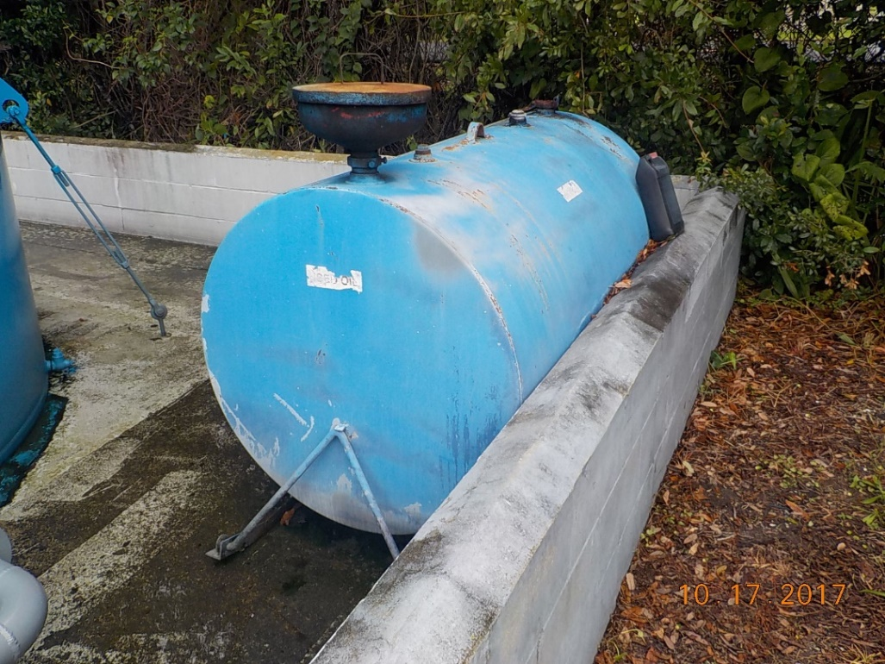
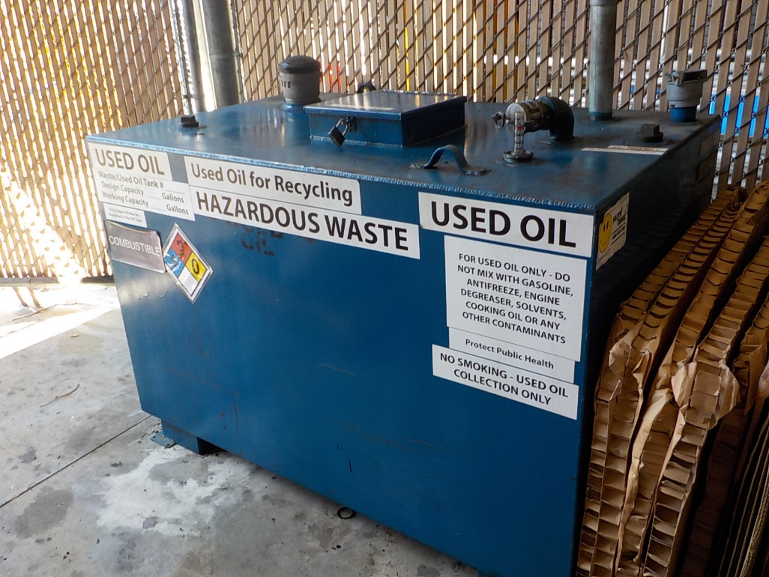
Public Used Oil Collection Center Requirements
Containers and tanks of used oil should be labeled or clearly marked “Used Oil” [40 CFR 279.22(c) and 62-710.401(6), FAC].
Note: Not properly labeled

Slide 62
Public Used Oil Collection Center Requirements
Upon detection of a release of used oil to the environment, not subject to 40 CFR 280 Subpart F, the owner/operator must perform the following cleanup steps [40 CFR 279.22(d)(1-4)]:
Stop the release
Contain the released used oil
Clean up and manage properly the released used oil and other materials
If necessary repair or replace any leaking used oil storage container or tanks prior to returning them to service
Note: The facility is also required to report releases as discussed in the UO Transporter section above

Slide 63
Public Used Oil Collection Center Requirements
State Requirement for Public Used Oil Collection Centers:
Notify the DEP no later than 30 days after first accepting used oil from the public on Form 62-710.901(5) [62-710.500(5), FAC]
Submit an estimate of the quantity of used oil accepted from the public during the previous calendar year to the DEP no later than July 1st of each year [62-710.510(6), FAC]

Slide 64
Questions?
Hazardous Waste Program
8800 Baymeadows Way West
Suite 100 Jacksonville, Florida 32256 (904) 256-1700 (904) 256-1588 fax

