Slide 1
Changes to Chapter 62-761, Florida Administrative Code Underground Storage Tank Systems (USTs)
Effective – 1/11/2017

Slide 2
Rule Organization
The rule sections are reorganized a bit with separate sections now for:
Registration
Notification
Financial responsibility
Incidents
Discharges
The concept of Category A, B and C USTs has been removed since all USTs must have met upgrade requirements by December 31, 2009.

Slide 3
Intent
The facility shall provide a representative to access storage tank system components for inspection purposes and to demonstrate operational functionality of electronic equipment.

Slide 4
Definitions
Terms that are defined in the Florida Statutes, such as “Discharge”, “Facility”, “Petroleum”, and “Owner” will no longer be defined in the rule.
There are 21 new definitions and 34 definitions have been removed (including 12 statutory definitions).

Slide 5
Definitions
“Class A, B, & C operators” have now been defined due to the addition of the Operator Training & Certification requirements to the rule.
“Certified Contractor” is required only if backfill is disturbed.
“Closure Integrity Evaluation” is the assessment by a 3rd party of the integrity of a component in contact with the soil that is being closed.
“In-service” and “Out-of-service” definitions have been revised in an attempt to simplify things. A UST is in-service until registered as out-of-service. And, there is no longer a definition of “Unmaintained”.

Slide 6
Definitions
“Integrity test” is a determination of the liquid tightness of a component:
“Interstitial integrity test” is used to determine if double-walled component is tight.
“Primary integrity test” is used to determine if the primary wall of the component is tight. This concept replaces former “tightness test” concept.
“Containment integrity test” is used to determine if single-walled component (sump or spill containment) is tight.

Slide 7
Reference Guidelines
The rule update allowed the Department to update such reference guidelines as from the American Petroleum Institute (API), Petroleum Equipment Institute (PEI) and the National Fire Protection Agency (NFPA).

Slide 8
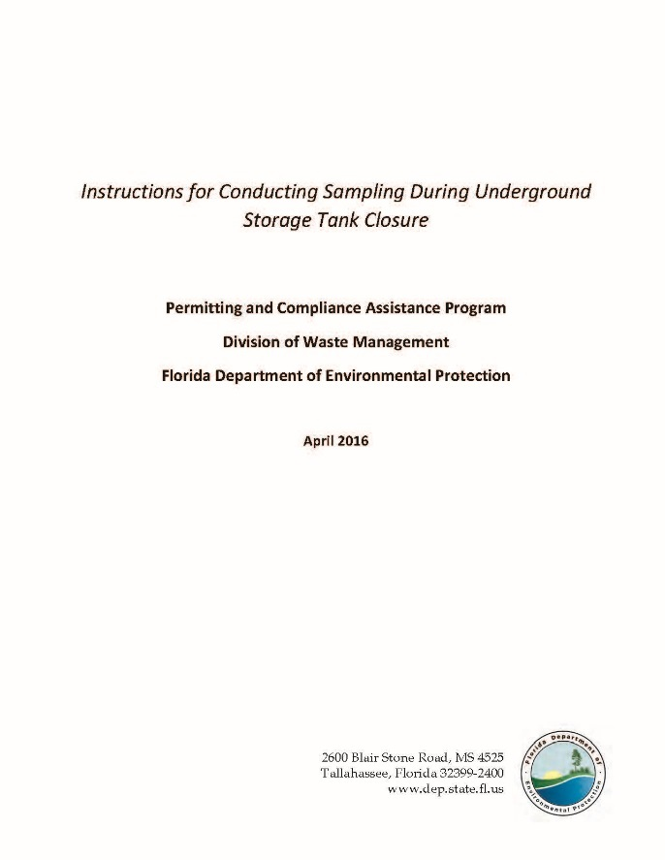
Reference Guidelines
Instructions for Conducting Sampling
Recommended Practices for Testing Secondary Containment

Slide 9
Applicability
The Department removed the term “de minimus” and replaced
it with more specific rule exemptions:
Storage tanks containing pollutants of less than 2% and hazardous substances below the reportable quantities, and
Storage tanks containing biofuels with 5% or less of regulated substances

Slide 10
Operator Training
Each facility, including unmanned facilities, must designate a Class A, B, and C operator by October 13, 2018.
Class A – has primary responsibility for facility, such as owner, and can operate one or more facilities.
Class B – implements day-to-day tank operations, such as operator or independent consultant, and can operate up to 50 facilities. If a contractor, then must also be a Certified Contractor or must be employed by a Certified Contractor.
Class C – controls dispensing of fuel, such as manager/clerk, and must be trained for each facility.
Class A and B operators must be re-trained if the Department issues a Notice of Violation for a significant issue (FR, construction, overfill/spill containment, and release detection).

Slide 11
Operator Training
Class A - C must complete approved training course, except that Class C may receive training from Class B.
Facilities must have a trained employee present during hours of operation, unless facility is unmanned.
Unmanned facilities must have emergency information signage visible from any dispenser.
Certificates of training must be maintained and available for inspection.
Emergency contact numbers must be posted for Class C operators’ use and site specific response procedures must be accessible.

Slide 12
Registration/Notification - Installations
Former Requirements
New Requirements
Notify county at least 30 days prior to install (verbal or written).
Confirm with county at least 48 hours prior to install (verbal or written).
Register no later than 30 days after putting substance into new tank.
Provide a certified contractor form within 30 days after installation.
Notify county 30-45 days prior to install (written).
Confirm with county 48-72 hours prior to install (written).
For new facility – register 30 days prior to install. 7 days prior to adding product for existing facility.
Provide a certified contractor form within 21 days after installation.

Slide 13
Registration/Notification - Closures
Former Requirements
New Requirements
Notify county at least 10 days prior to closure (verbal or written).
Confirm with county at least 48 hours prior to closure (verbal or written).
Register no later than 30 days after closure.
Register no later than 30 days after other changes.
Provide a certified contractor form within 30 days after removal.
Notify county 30-45 days prior to closure (written).
Confirm with county 48-72 hours prior to closure (written).
Register no later than 10 days after closure.
Register no later than 10 days after other changes.
Provide a certified contractor form within 21 days after removal.

Slide 14
Registration/Notification - Delivery Prohibition
Motor fuel may not be placed into regulated tanks unless there is a valid registration placard displayed at the facility.
Motor fuel means petroleum products used for the operation of a motor or engine.

Slide 15
Placard Revocation & Delivery Prohibition
A placard may be revoked for the following non-compliance issues:
Failure to install, operate and maintain release detection equipment
Failure to meet storage tank system requirements (Section .500)
Failure to respond to an ongoing discharge
Failure to maintain financial responsibility

Slide 16
Placard Revocation & Delivery Prohibition
To release a revocation:
Facility owner gives written notice to Department.
Local program reinspects (as necessary) within 2 business days.
Department releases revocation within 3 business days if all deficiencies corrected.

Slide 17
Financial Responsibility
Financial responsibility (FR) is the ability to pay for cleanup of a discharge of petroleum or petroleum product and for third-party liability resulting from the discharge.
FR must be maintained until the regulated tank is closed. If it is not maintained, then the UST must be closed.
FR may be demonstrated by owner or operator. The facility owner is liable in event of noncompliance.
FR must be demonstrated in accordance with EPA’s reference guideline, or in accordance with 62-761.900(3).

Slide 18
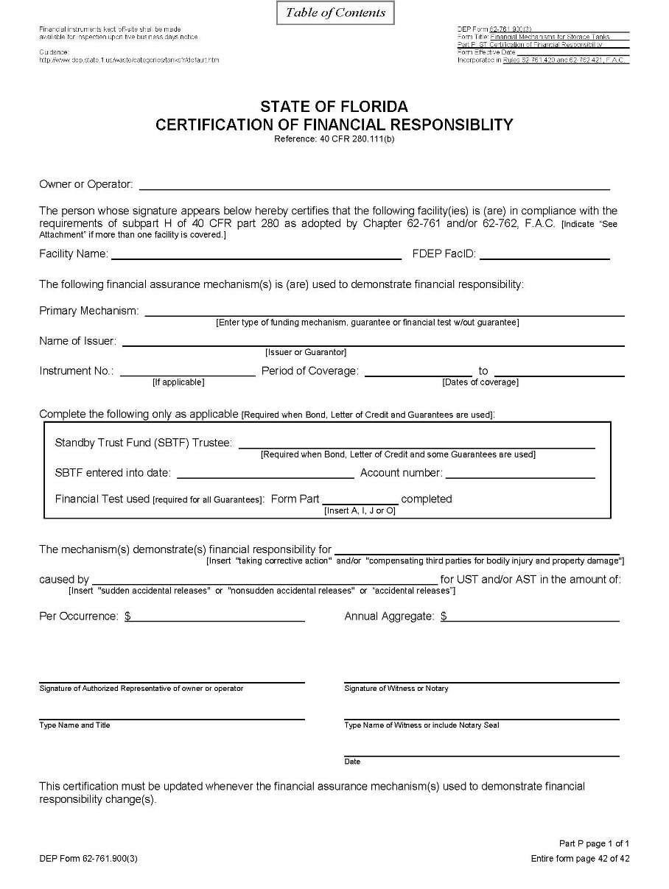
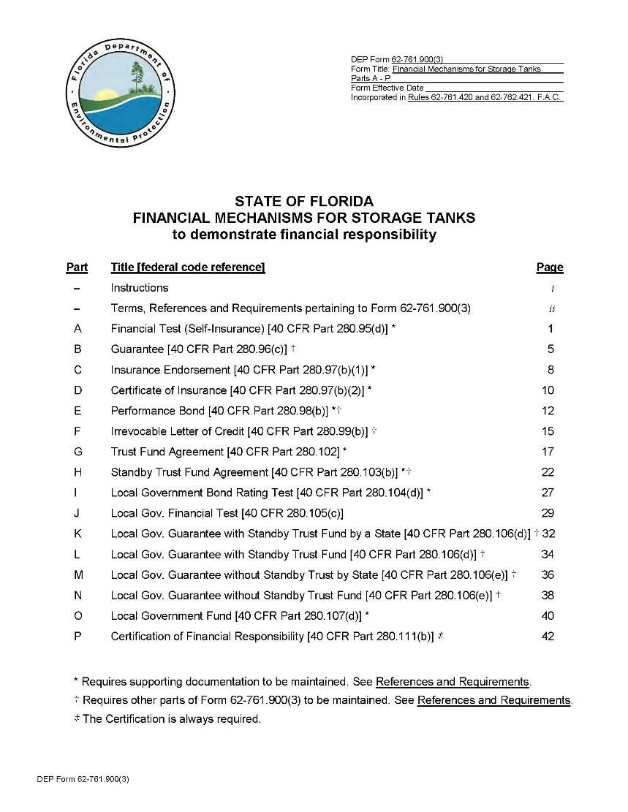
Financial Responsibility
Form 62-761.900(3)
Certificate of Insurance

Slide 19
Incidents
An incident is a situation indicating that a release or discharge may have occurred.
The Incidents section now includes all the possible positive responses of release detection devices.
The facility now has 72 hours to report an incident (former rule – 24 hours). An Incident Notification Form (INF) is not required if during this timeframe it is confirmed that a discharge did not occur.
The facility still has 14 days to investigate, but may be extended, upon approval, to 45 days without having to remove from service.
For every incident that occurs, whether an INF is required or not, there must be documentation maintained of the discovery/investigation/conclusions of the investigation.
This information is very important in instances where closure integrity evaluations are being conducted or repairs are being made due to sump or other secondary containment integrity issues.

Slide 20
Discharges
The owner must report the discovery of a discharge within 24 hours.
However, if it is thought that the discovery is a previously reported discharge, then the owner has 30 days to investigate and submit supporting documentation.

Slide 21
Construction Requirements
For new installations:
A containment integrity test shall be conducted for single-walled spill buckets and sumps.
An interstitial integrity test shall be conducted for USTs, double-walled small diameter piping in contact with the soil or over surface waters of the state, and for double-walled spill buckets and sumps.
In general, the testing must be conducted for one hour, instead of the former three hours in accordance with PEI/RP1200-12.

Slide 22
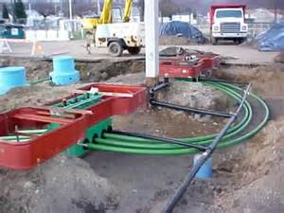
Construction Requirements
For new USTs or piping installed in contact with the soil, a survey drawing signed
and sealed by a professional land surveyor or engineer must be completed
and maintained.

Slide 23
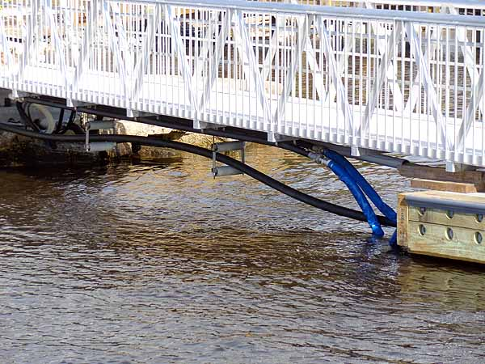
Construction Requirements
Storage tank systems that produce a gravity head on small diameter piping
must be installed with anti-siphon valves.
For existing systems without ASVs, they must be installed by October 13, 2018.

Slide 24
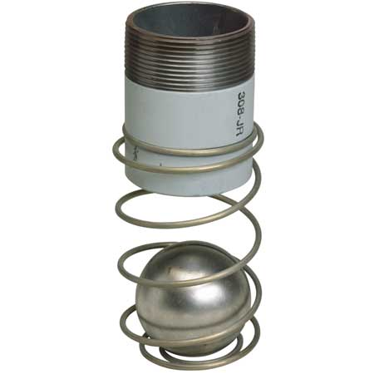
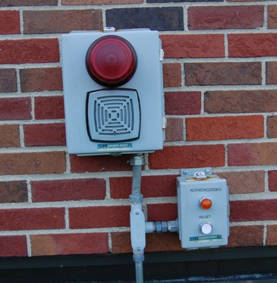
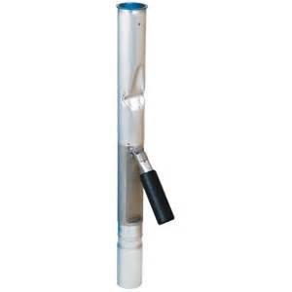
Construction Requirements
Ball Float Valves
High-Level Alarms
Flapper Valves
All overfill protection devices for USTs must be tested for proper operation annually at intervals not exceeding 12 months. The initial testing must be conducted within 12 months of the effective date of the rule (by 1/11/18).

Slide 25
Construction Requirements
Vent restriction devices cannot be used when:
Overfill protection is installed or replaced after the effective date of the rule,
There is a possibility of a pumped delivery into the tank,
The storage tank system is equipped with suction pumps & air eliminators,
The storage tank is equipped with coaxial stage I vapor recovery, unless special fittings are installed, and
Flapper valves have been installed.

Slide 26
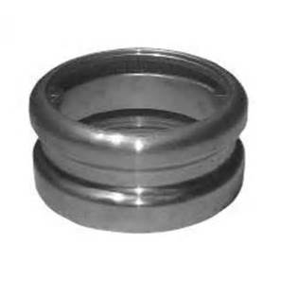
Construction Requirements
USTs with capacities of 2,000 gallons or less that DO NOT receive delivery
by a joined tight fill adaptor connection are exempt from overfill protection
requirements as long as the USTs are never filled beyond 80% capacity.

Slide 27
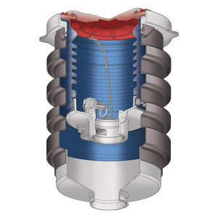
Release Detection Requirements
Double-walled spill buckets, regardless of when installed, must be operated
and maintained as double-walled.

Slide 28
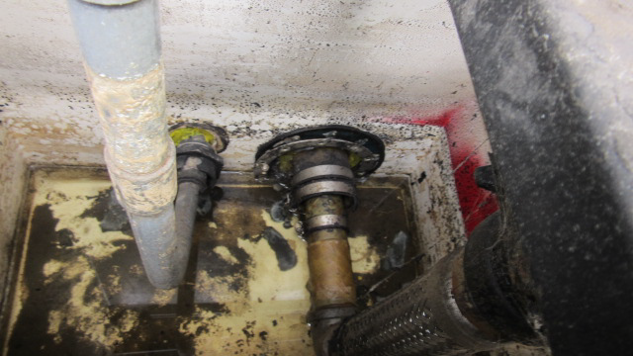
Release Detection Requirements
Piping and dispenser sumps that use electronic release detection must
also be visually inspected every six months.

Slide 29
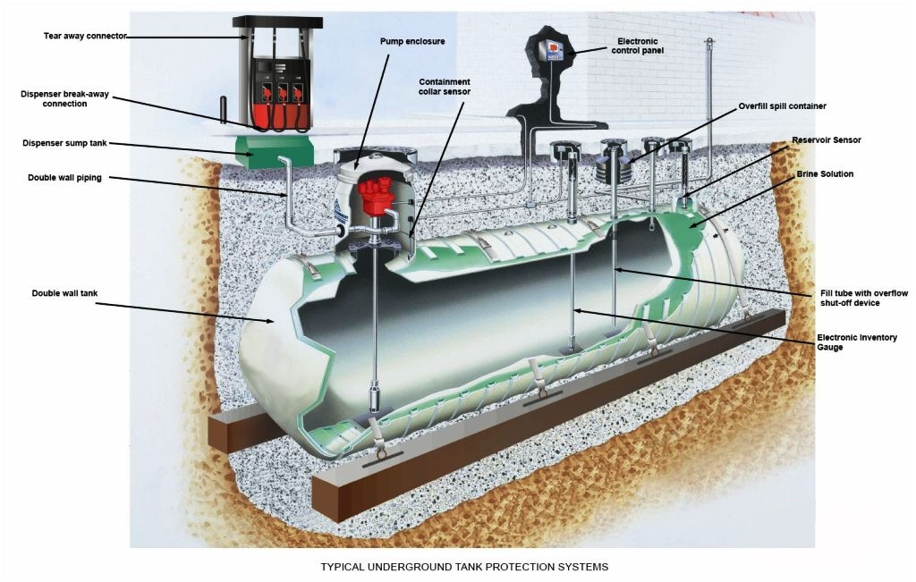
Release Detection Requirements
The rule now specifically requires that facilities maintain a monthly record of alarm history and sensor status for inspection. Each release detection alarm that occurs from a facility’s chosen form(s) of release detection must be investigated as an incident, and findings must be maintained for inspection.

Slide 30
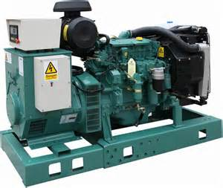
Release Detection Requirements
Existing USTs that store fuel for generators must have release detection by
October 13, 2018. USTs installed after the effective date of the new rule must
have release detection upon installation.

Slide 31
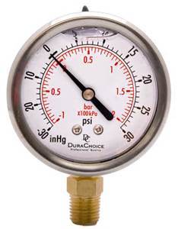
Release Detection Requirements
Pressure readings shall be able to detect a 50% change from month to month or from the initial level. Vacuum systems shall be able to detect any complete loss of vacuum or positive pressure reading.

Slide 32
Repairs, Operation and Maintenance
Periodic integrity testing will be required as follows:
Double-walled tanks and double-walled piping at the time of installation and at the time of any repairs.
Piping/dispenser sumps and double-walled spill containment by October 13, 2018, and every three years after.
Single-walled spill containment systems within one year of the rule effective date (by 1/11/18) and every year thereafter.

Slide 33
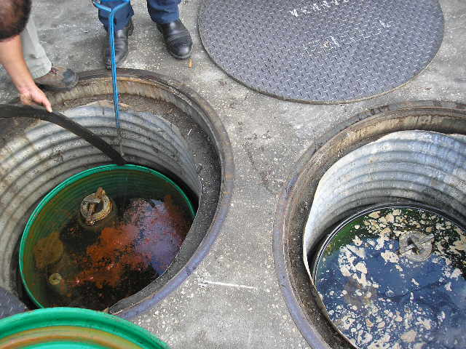
Repairs, Operation and Maintenance
Water in excess of 1”(no longer at the piping penetrations) or any regulated substances must be removed within 72 hours of discovery.

Slide 34
Recordkeeping
Records, unless required to be maintained until UST closure,
must be maintained for three years (except that records generated prior to the effective date of the rule must still be kept for two years).

Slide 35
Recordkeeping
The following changes to the records requirements have been made:
The Release Detection Response Level (RDRL) requirement has been removed from the rule.
Release detection records must include a record of alarm history for electronic release detection devices.
Class A, B, and C training certificates shall be maintained for as long as the operators are designated for the facility, once required.
Survey drawings shall be kept until closure of the component(s) surveyed.

Slide 36
Out-of-Service Requirements
Whether the tank contains petroleum/petroleum products or not, FR must be maintained. If FR is not maintained, then the tank must be closed within 90 days.
For tanks that are “empty” but still contain regulated substances – monitor the interstice and liquid level every 12 months.
For systems out-of-service for more than 2 years – interstitial integrity testing must be conducted before placing back into service.

Slide 37
Closure Requirements
Single-walled USTs and piping in contact with the soil that are discovered must be closed and undergo closure sampling during closure.
Double-walled USTs, double-walled piping, dispenser/piping sumps and spill containment devices in contact with the soil must undergo a closure integrity evaluation no more than 45 days prior to closure to determine if closure sampling is required.
In cases where closure integrity evaluation is required, the closure integrity report must be submitted to the county with closure notification prior to actual closure (30-45 days prior).

Slide 38
Closure Requirements
If a closure integrity evaluation is required but not conducted, then closure sampling is required.
In cases where closure sampling is required, a closure report will be due to the county within 60 days.
In cases where closure sampling is not required, a Limited Closure Report will be due in 60 days using Form 62-761.900(8).

Slide 39
Closure Requirements

Slide 40
Equipment Registration
Currently, storage tank system equipment used in the State of Florida must undergo formal Department equipment approval.
The proposed rule replaces equipment approval process with a registration process.
The registration application must include a third-party evaluation of the equipment.
Registration renewal must occur every five years.

Slide 41
Any Questions?

