Slide 1
Used Oil Transporter 40 CFR 279 Subpart E; 62-710, FAC

Slide 2
What is a Used Oil Transporter?
Used Oil Transporters are:
Persons who transport used oil ;
Persons who collect used oil from more than one Generator and transports the collected oil ;
Owners or operators of used oil transfer facilities;
40 Code of Federal Regulations (CFR) 279.40.
“Used Oil Transporter” means any person who transports used oil over public highways in shipments of greater than 55 gallons at one time
Rule 62-710.201(6), Florida Administrative Code (FAC)

Slide 3
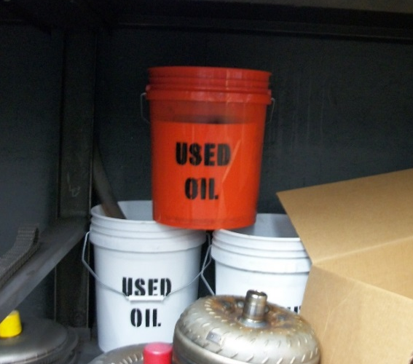
Who is NOT a Used Oil Transporter?
The facility is exempt under the following:
On-site transport only;
Generator who transports shipments of used oil totaling 55 gallons or less from the Generator to a used oil collection facility;
Generator who transports shipments of used oil totaling 55 gallons or less from the Generator to a used oil aggregation point owned or operated by the same Generator as specified in 40 CFR 279.24(b).

Slide 4
Exemption
40 CFR 279.24(b)
Self transportation of small amounts to aggregation points owned by the Generator. Generators may transport without an EPA ID number used oil that is generated at the Generator’s site to an aggregation point provided that:
The Generator transports the used oil in a vehicle owned by the Generator or owned by an employee of the Generator;
The Generator transports no more than 55 gallons at any one time (and less than 500 gallons annually);
The Generator transports the used oil to an aggregation point that is owned and/or operated by the same Generator.

Slide 5
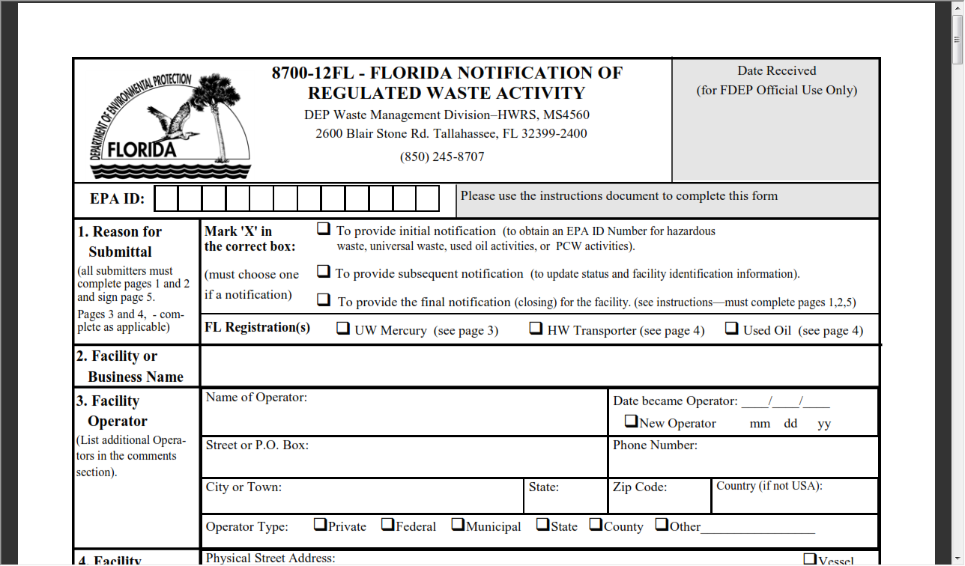
Registration
Has the facility notified and registered its used oil activities using Form 8700-12FL?

Slide 6
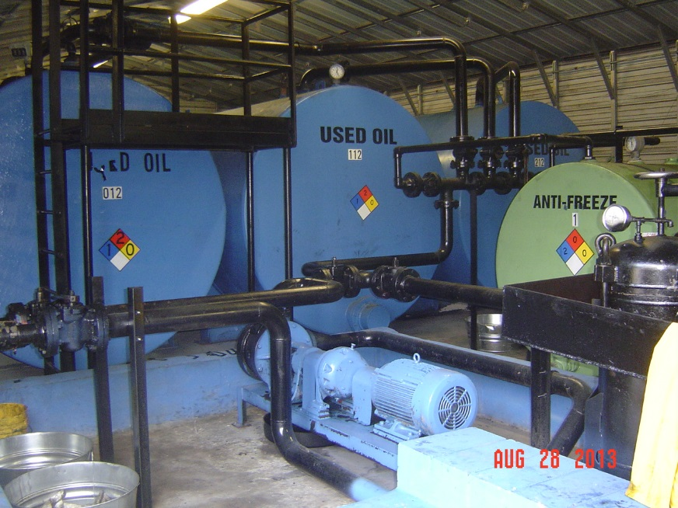
Deliveries - 40 CFR 279.43
A Used Oil (UO) Transporter must deliver all used oil to:
Another UO Transporter, provided that the Transporter has obtained an EPA ID#;
A UO Processing/re-fining facility who has obtained an EPA ID#;
An off-spec UO burner facility who has obtained an EPA ID#;
An on-spec used oil burner facility.

Slide 7
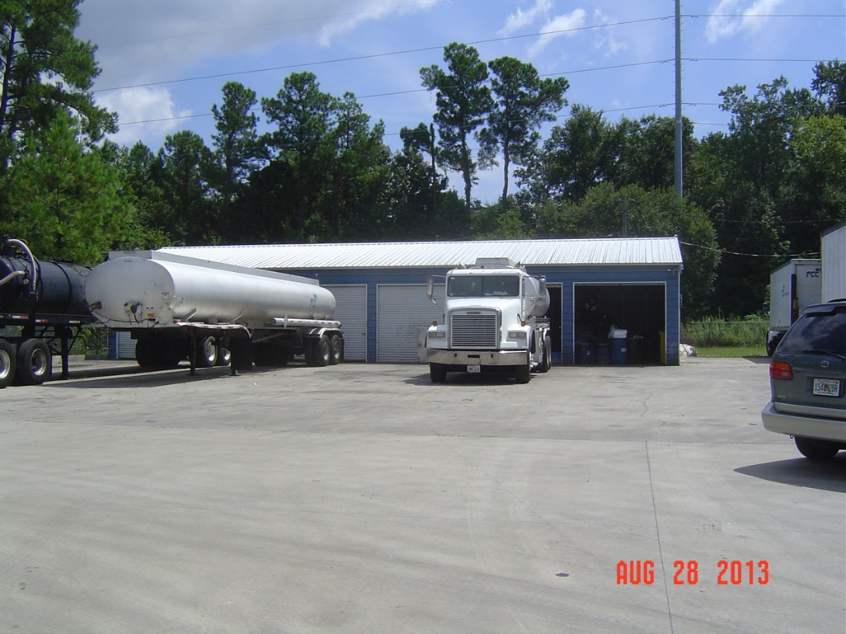
U.S. DOT Requirements - 40 CFR 279.43(b)
UO Transporters must comply with DOT regulations in 49 CFR 171-180.

Slide 8
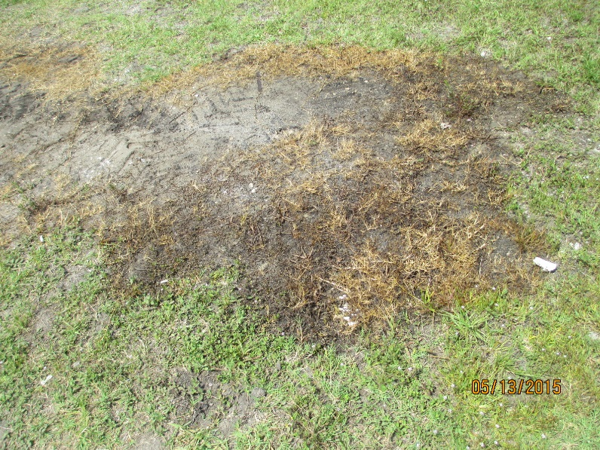
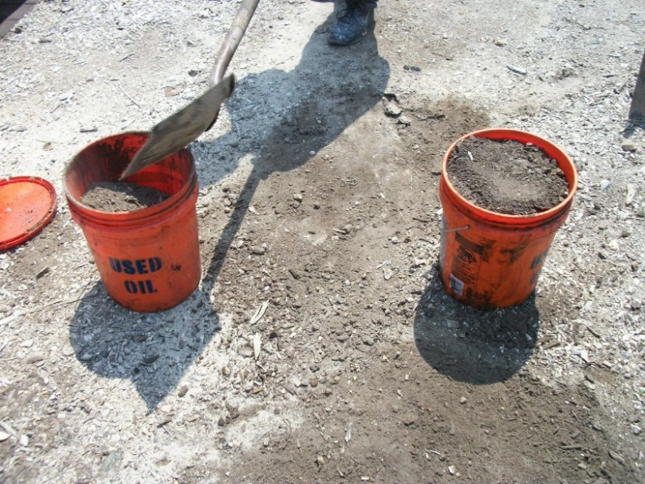
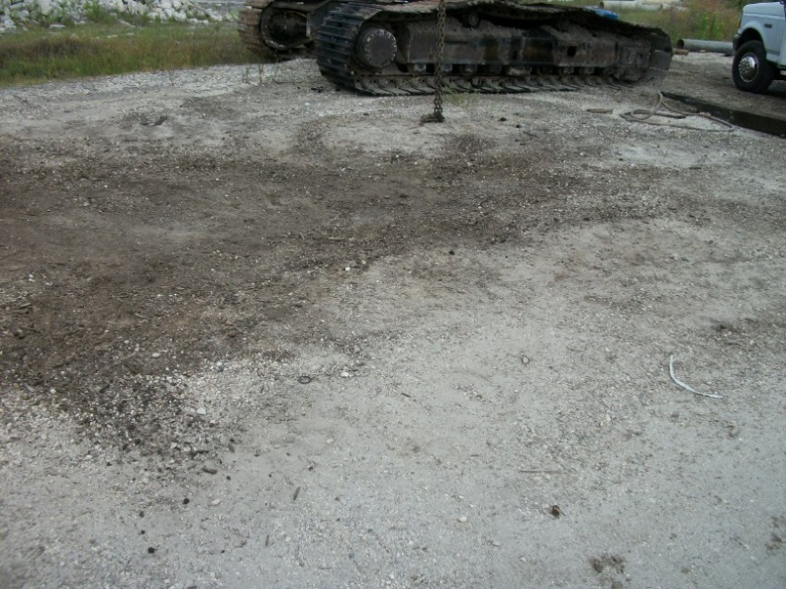
Used Oil Discharges – 40 CFR 279.43(c)
In the event of a discharge during transport:
The Transporter must take immediate action to protect human health and the environment;
Notify the National Response Center 1-800-424-8802 and State Warning Point 1-800-320-0519;
Clean up any discharges until the discharge poses no threat.
Notes:
Do you have the State Warning Point in your cell phone?

Slide 9
Rebuttable Presumption – 40 CFR 279.44
Does the Transporter determine whether used oil has a total halogen content above or below 1,000 parts per million (ppm)?
Is this done by testing or process knowledge?
Are test records that provide a basis for determination kept for 3 years?
Have any analyses shown exceedances over the 1,000 ppm level?
If so, was the used oil managed as hazardous waste?
If not, was the oil exempt?

Slide 10
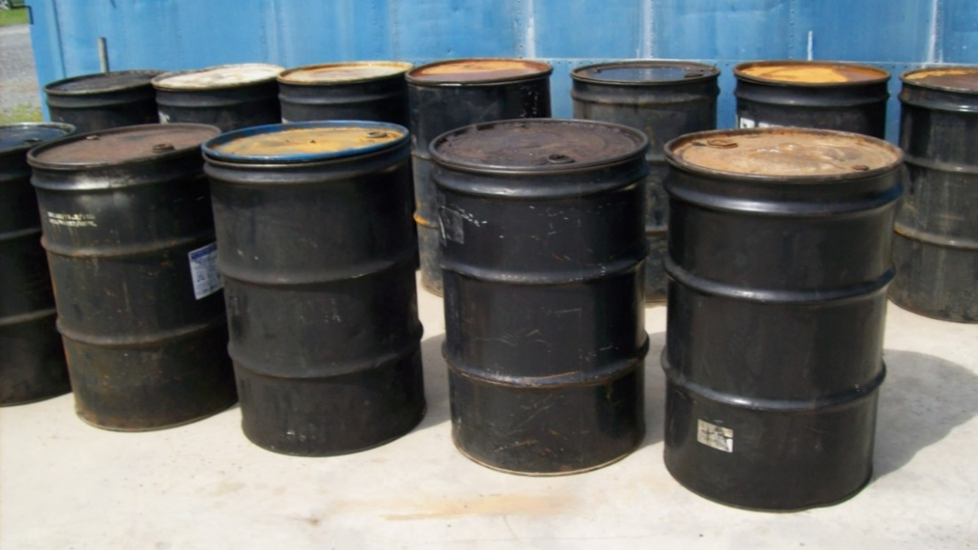
Record Keeping – 40 CFR 279.46
Do used oil acceptance records include the following:
Name and address of oil provider?
EPA ID # of oil provider?
Quantity of oil shipped?
Date of shipment?
Signature of Generator, dated upon receipt?

Slide 11
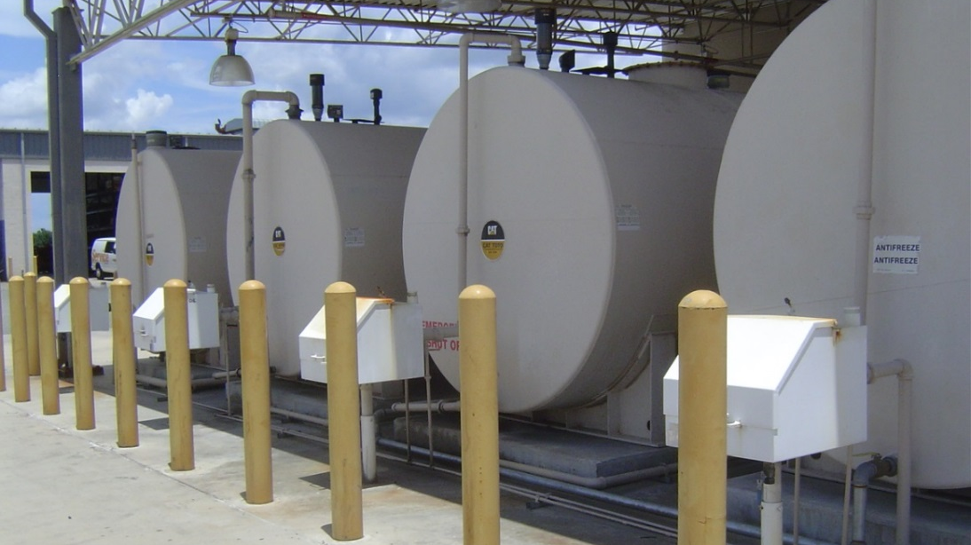
Record Keeping – 40 CFR 279.46 (cont)
Do used oil delivery records include the following:
Name and address of receiving facility / Transporter?
EPA ID# of receiving facility/Transporter?
Quantity of used oil delivered?
Date of delivery?
Signature of receiver, dated upon receipt?

Slide 12
Record Keeping and Reporting
Do the records also include information on type of oil and destination or end use? [Rule 62-710.510(c) and (e), FAC]
Does the facility keep records on Department form 62-710.901(2) or equivalent form? [Rule 62-710.510(1), FAC]
Does the facility submit an annual report by March 1 each year? [Rule 62-710.510(5), FAC]
Does the Transporter keep copies of records and reports for at least 3 years? [40 CFR 279.46(d)]

Slide 13
Employee Training – Rule 62-710.600(2)(b), FAC
Does the facility train its employees in the following:
State and federal rules governing used oil?
Proper used oil management practices, including spill response?
SOP for halogen screening (including instrument specs and capabilities, calibration methods and frequency, procedures for loads in excess of 1,000 ppm?
Record keeping procedures for all loads accepted or rejected?

Slide 14
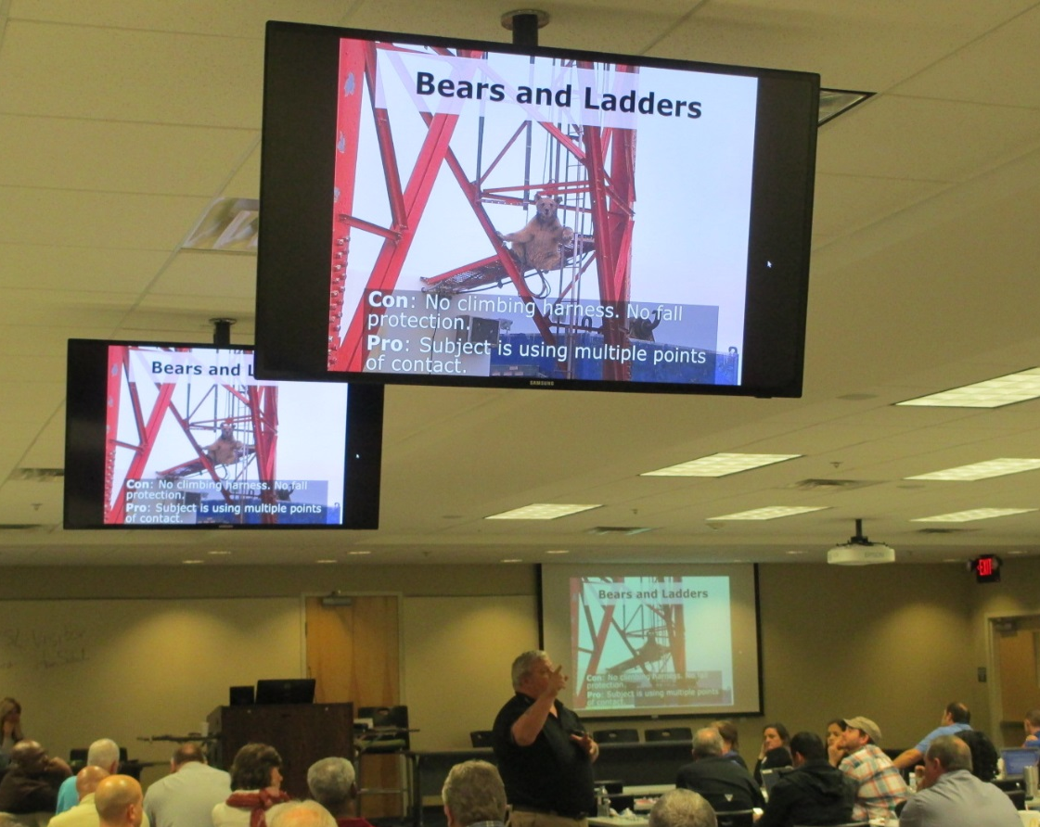
Employee Training – Rule 62-710.600(2)(c), FAC
Are new employees trained prior to unsupervised driving?
Does the facility maintain training records?

Slide 15
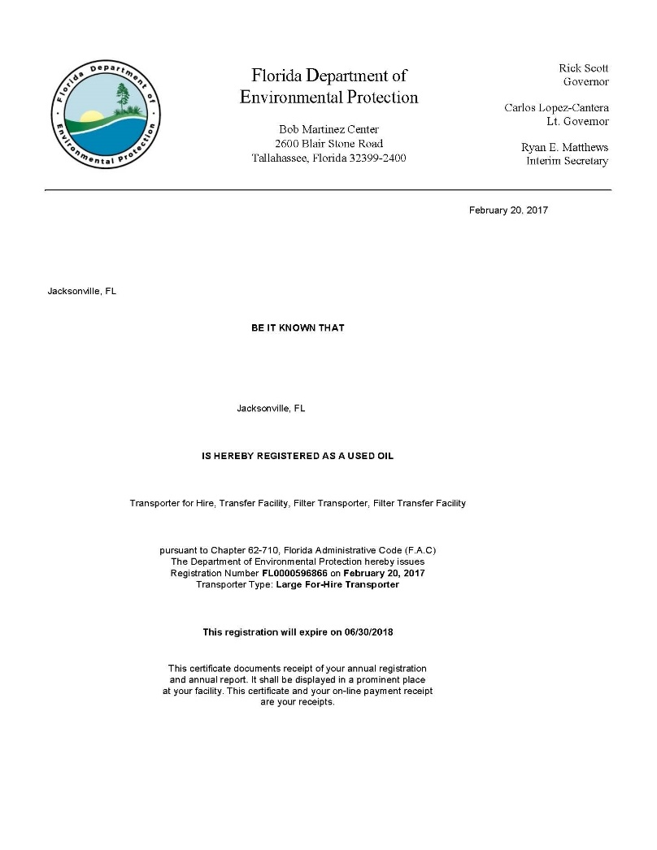
Transporter Certification
Does the facility maintain insurance or financial assurance of $1,000,000 combined single limit? [Rule 62-710.600(2)(e), FAC]
Is the facility’s registration letter from the Department displayed? [Rule 62-710.500(4), FAC]

Slide 16
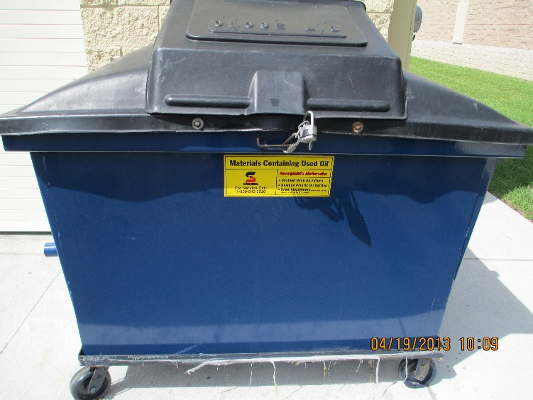
Used Oil Filter Transporter
Is the Transporter registered to transport used oil filters? [Rule 62-710.850(3), FAC]
Are the filters stored in above ground containers which are:
In good condition?
Closed or otherwise protected from the environment?
Labeled “Used Oil Filters?”
Stored on an oil impervious surface?

Slide 17
Questions?
Hazardous Waste Program
8800 Baymeadows Way West
Suite 100 Jacksonville, Florida 32256 (904) 256-1700 (904) 256-1588 fax

