Slide 1
THE PLAN The Goal
Focus on:
Entire system
Level of service (LOS)
Capacity and I/I
Education

Slide 2
THE PLAN The Goal
Maximize short-term capacity increases through in-plant modifications
Establish a Level of Service (LOS) for the entire system
Create long-range (20 year) plan and funding commitment to ensure LOS is met without overflows
Create a well-defined, detailed contingency plan to handle weather events beyond the LOS scenario
Predict the impact of sea level rise on I/I and whether any current facilities need to be protected or relocated
Provide sufficient redundancy to manage one plant completely shut down for two weeks
Operate with no violations of FDEP rules

Slide 3
THE PLAN The priorities
Existing Plant Expansion
Pipe Lining
Manhole Repair

Slide 4
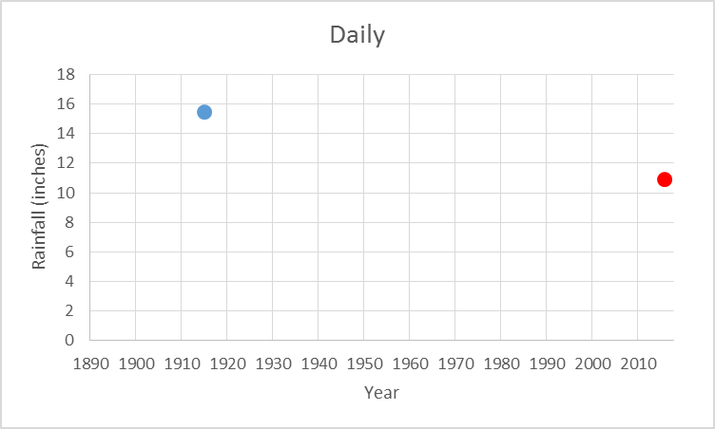
THE PLAN The history
134 years of daily rainfall data for St. Pete
Only one other time has the 24-hour rainfall exceeded Hermine (August 31, 2016)
Hermine Peak 24-Hour Rainfall

Slide 5
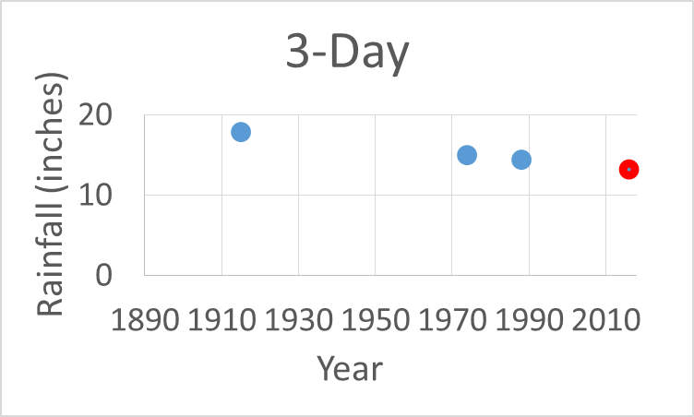
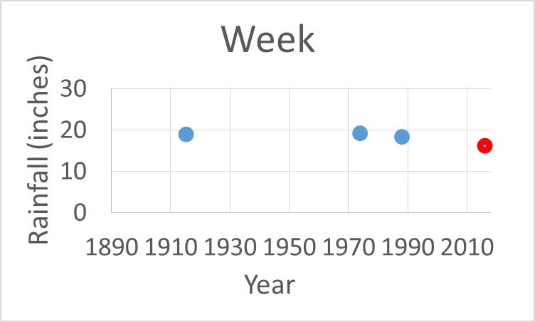
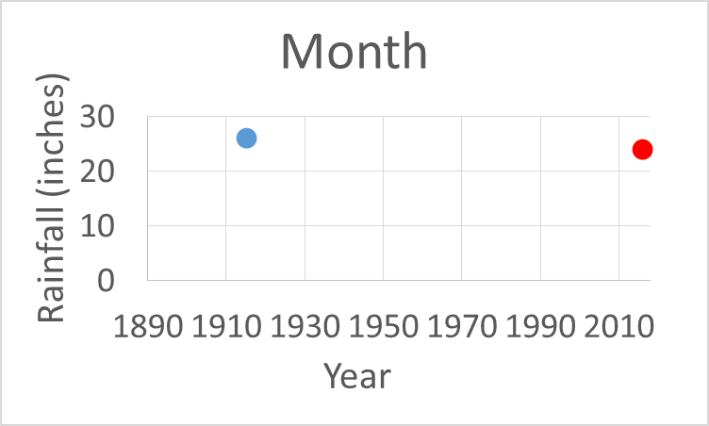
THE PLAN the history
The 3-day and weekly totals for Hermine were only surpassed three times in the last 134 years
August 2016 was second highest month of rainfall on record

Slide 6
THE PLAN level of service (LOS)
What we know:
Peak flows during Hermine:
AW/SW basins: 84 MGD
All basins: 150 MGD
Hermine was a good stress test of our system
Highest 24-hour, 3-day, week and month rainfalls for past 134 years were 25% higher than Hermine
How we will determine LOS:
Calibrate the collection system model using Hermine data (complete August 2017 as part of Phase II project)
Run model simulations for worse-case scenarios (more intense storms, longer rainy seasons, groundwater rise, etc.)
Establish capacity vs cost matrix to inform LOS policy decision

Slide 7
THE PLAN short-term projects
Location | Project | Peak Capacity |  | Target | Estimated Cost (Millions) | Funding Source
 |  | Now | Target
SWWRF | Acute Expansion – Treatment Acute Expansion – Disposal | 40 | 70 | Aug 2017 Sep 2017* | $ 6.0 $ 8.0 | Bond Bond
NWWRF | Acute Expansion – Treatment Acute Expansion – Disposal | 40 | 55 | Sep 2017 Dec 2017* | $10.0 $ 6.0 | Bond Bond
NEWRF | Reliability Improvements | -- | -- | Oct 2017 | $ 1.0 | Bond
Collection | Lining, sealing and point-repairs | -- | -- | Oct 2017 | $10.5 | Bond
Master Plan | Long-term expansion planning for treatment and disposal | -- | -- | Apr 2019 | $ 3.5 | Paygo
Total |  |  |  |  | $45.0
*Complete date reflects when injection well can be used in an emergency. Full testing and completion will take longer.

Slide 8
THE PLAN long-term projects
Location | Project | Complete | Estimated Cost (Millions) | Funding Source
SWWRF | Reliability Improvements | 2021 | $ 17 | TBD
NWWRF | Reliability Improvements | 2021 | $ 42 | TBD
NEWRF | Reliability Improvements | 2021 | $ 26 | TBD
Collection | Lining, sealing and point-repair* | 2021 | $ 74 | TBD
Subtotal |  |  | $159
Capacity Expansion | From Master Plan: additional expansion of SWWRF? Re-open AWWRF/4th WRF? Interconnect WRFs? Target capacity >150 total for all WRFs. | 2021 | $100 | TBD
Total |  |  | $259
*Target 10% I&I reduction in five years (2017-2021) – increase funding to a total of $18.5 M per year (from $10.5 M).

Slide 9
THE PLAN 5-year project summary
Location | Cost (Millions) |  |  | Previously Budgeted | Additional Needed
 | Short-Term | Long-Term | Total
SWWRF | $ 14.0 | $ 17.0 | $ 31.0 | $48.7 | -$17.7
NWWRF | $ 16.0 | $ 42.0 | $ 58.0 | $18.8 | $39.2
NEWRF | $ 1.0 | $ 26.0 | $ 27.0 | $18.8 | $8.2
Collection | $ 10.5 | $ 74.0 | $ 84.5 | $75.1 | $9.4
Master Plan | $ 3.5 | -- | $ 3.5 | $0.0 | $3.5
Subtotal | $ 45.0 | $159.0 | $204.0 | $161.4 | $42.6
Capacity Expand | -- | $100.0 | $100.0 | $0.0 | $100.0
Total | $45.0 | $259.0 | $304.0 | $161.4 | $142.6

Slide 10
THE PLAN The results

